Slide 1
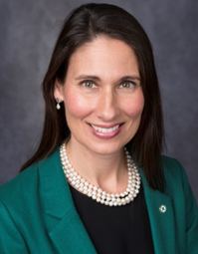
Deborah A.P. Hersman
President & CEO
National Safety Council

Slide 2


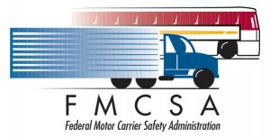


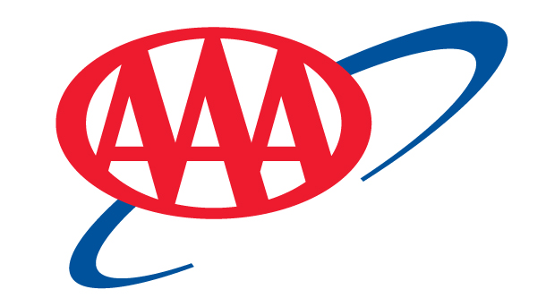
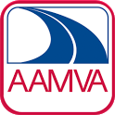














Steering Group Members

Slide 3
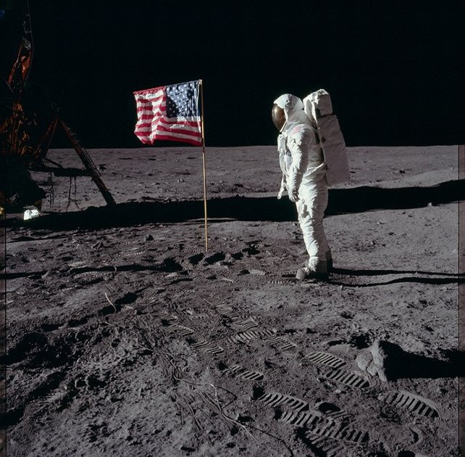

Slide 4
How RTZ is working
Coalition Work
Innovative Grants
Long Term Scenario
Coalition
Grants
Notes:
We are working with Coalition members to identify immediate goals for the group, doing a lot of brainstorming in breakout groups looking at highway safety and innovation, and learning from experts who have devoted their professional careers to supporting safe driving practices.
We are breaking the silos of transportation to bring together groups that don’t normally get a lot of interaction. We have advocates like MADD alongside insurance groups and technology and automation experts all getting to find where their ideas intersect, and where the Coalition can have a stronger voice in getting the private and government agencies to see these possibilities in a new light.
In the long term, we are developing a future-planning scenario with the help of the RAND group.

Slide 5
How We Get to ZERO:
Double Down on What Works
Accelerate Technology
Change Culture

Slide 6
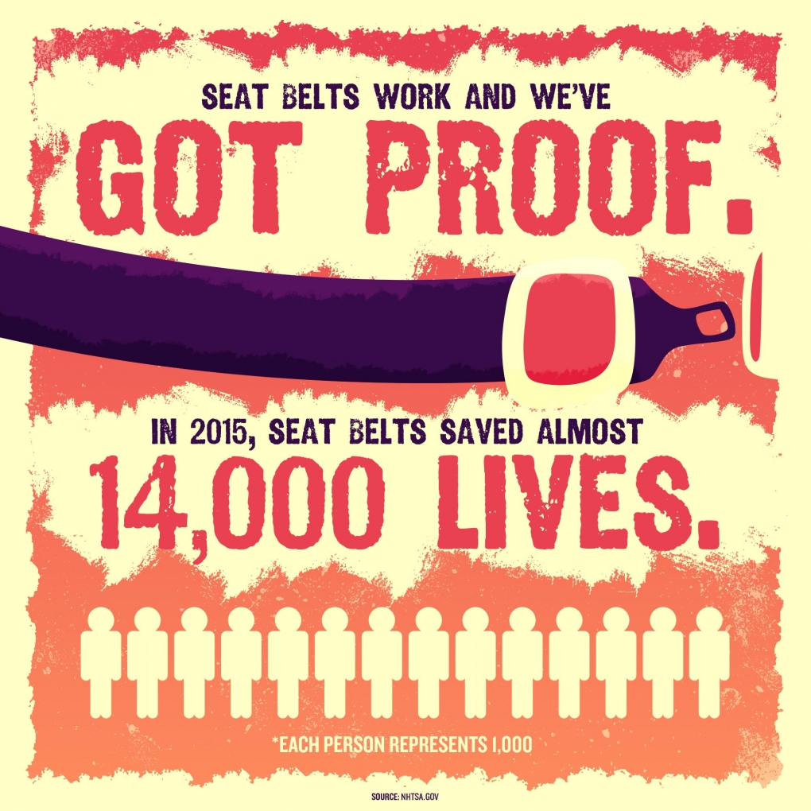

Slide 7
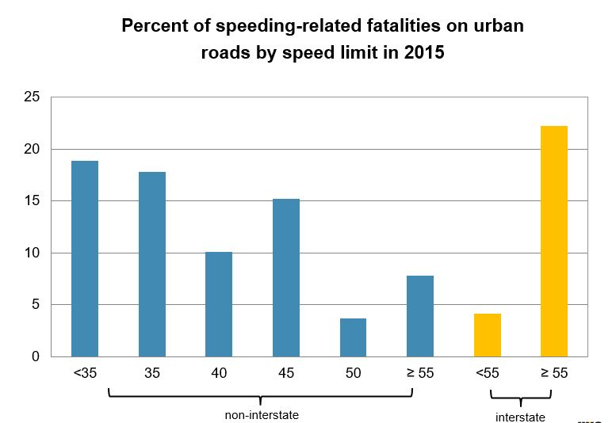
Source: Vision Zero Network

Slide 8

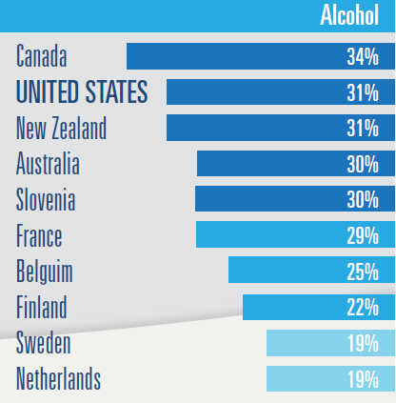
Alcohol was involved in 31% of
U.S. motor vehicle crash deaths in 2013
10,197
Deaths in United States

Slide 9
How We Get to ZERO:
Double Down on What Works
Accelerate Technology
Change Culture

Slide 10
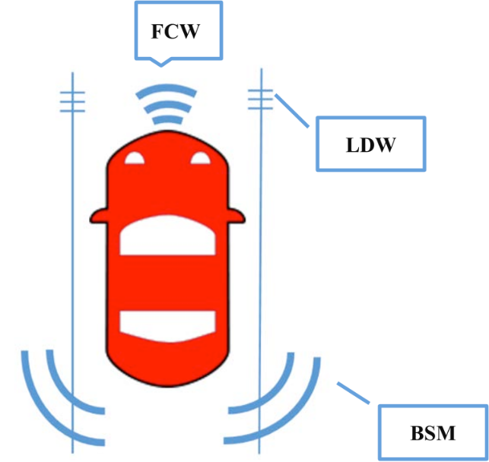
Just 3 Existing Technologies
Can Save 10,000 Lives

Slide 11
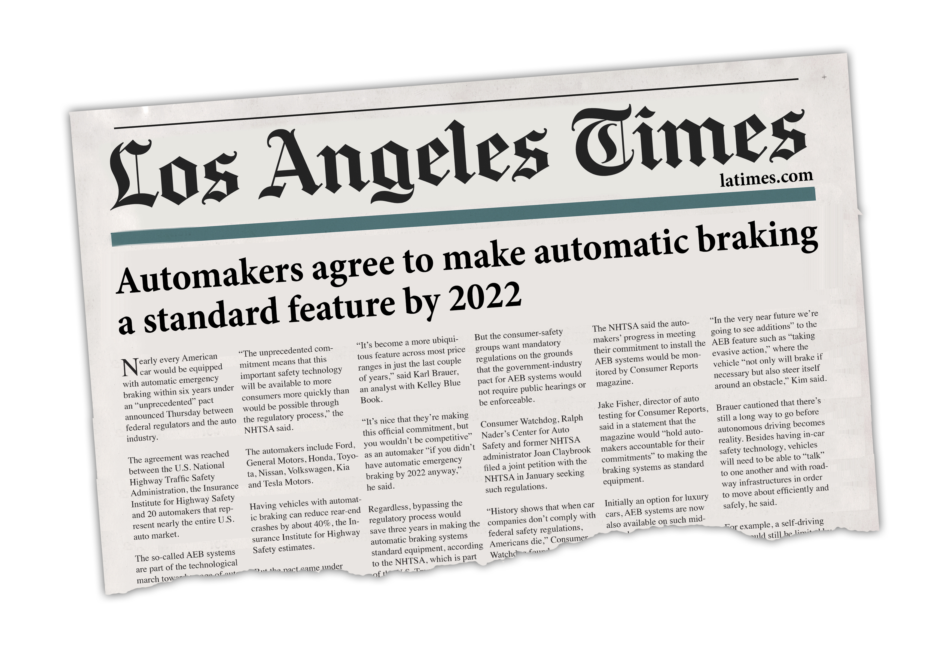

Slide 12
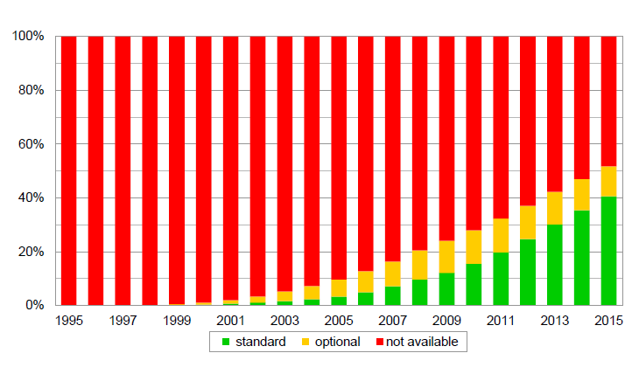
Registered vehicles with electronic stability control
By calendar year
Source: Highway Loss Data Institute

Slide 13
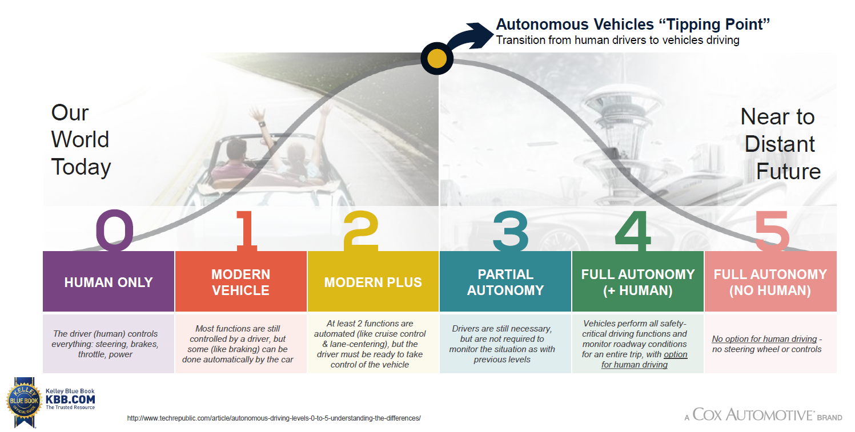
The Levels of Autonomous Vehicles

Slide 14
How We Get to ZERO:
Double Down on What Works
Accelerate Technology
Change Culture –
Safe Systems Approach

Slide 15
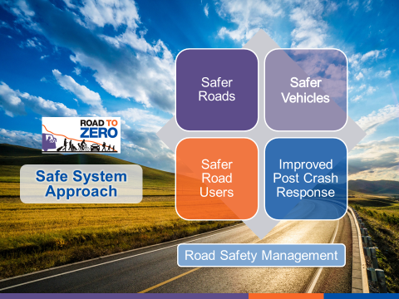

Slide 16
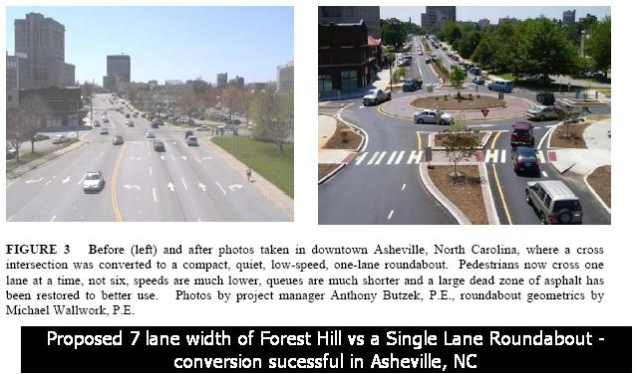
Safer Infrastructure

Slide 17
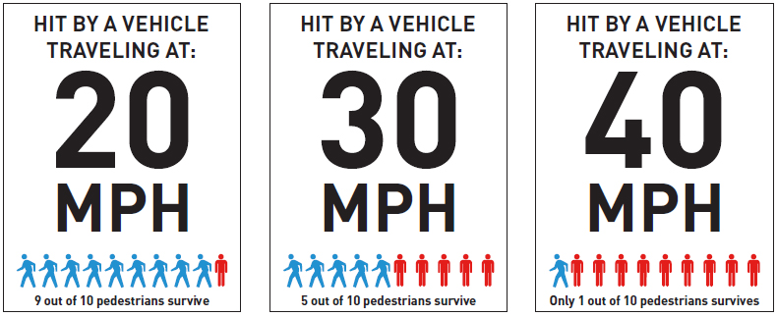
Fatality Risk Goes Up
Over 25 MPH
Image: Seattle Department of Transportation

Slide 18
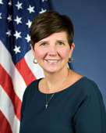
Brandye Hendrickson
Acting Administrator
Federal Highway Administration

