Slide 1




















Proven Safety Countermeasures: A Brief History
Roadside Design Improvement at Curves
Reduced Left-Turn Conflict Intersections
Systemic Application of Multiple Low Cost Countermeasures at Stop-Controlled Intersections
Leading Pedestrian Interval
Local Road Safety Plan
USLIMITS2
Enhanced Delineation and Friction for Horizontal Curves
Longitudinal Rumble Strips and Stripes on Two-Lane Roads
Median Barrier
Safety Edge_{SM}
Backplates with Retroreflective Borders
Corridor Access Management
Dedicated Left- and Right-Turn Lanes at Intersections
Roundabouts
Yellow Change Intervals
Medians and Pedestrian Crossing Islands in Urban and Suburban Areas
Pedestrian Hybrid Beacon
Road Diet
Walkways
Road Safety Audits
Notes:
A Brief History of the PSCi
--Version 1.0 debuted in 2008
First nine “proven safety countermeasures.”
Envisioned as a means to boost systemic implementation.
Began tracking implementation progress.
--Version 2.0 released in 2012
Retained four of original nine.
Added five new countermeasures.
New progress tracking approach anchored to Focus State status and SHSP Emphasis Areas.
Steps to PSCi Version 3.0
--FHWA formed working groups to review the PSCi.
--First group evaluated the overall initiative.
Widely popular and has established a valued brand.
Consensus to continue the PSCi with minor tweaks.
--Second group vetted candidates for the update.
Identified and evaluated 31 candidate countermeasures and strategies.
In selecting the newest group of PSCi’s FHWA’s Office of Safety Reaffirms a Data-Driven approach
FHWA will continue to support States and other safety partners’ efforts to:
Conduct appropriate analysis of quality safety data.
Use evidence-based framework for decision-making.
Use the CMF Clearinghouse to choose appropriate countermeasures.
Consider the proven safety countermeasures as viable options.

Slide 2


Introducing the PSCi 3.0
Intersections: | Cross-Cutting:
Pedestrian: | Roadway Departure:
Systemic Application of Multiple Low Cost Countermeasures at Stop-Controlled Intersections
Local Road Safety Plan
Reduced Left-Turn Conflict Intersections
USLIMITS2
Leading Pedestrian Interval
Roadside Design Improvement at Curves

Slide 3
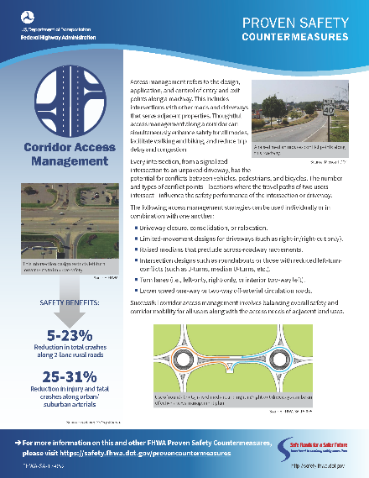
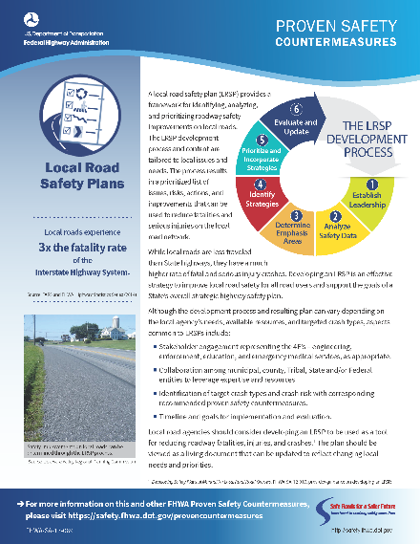
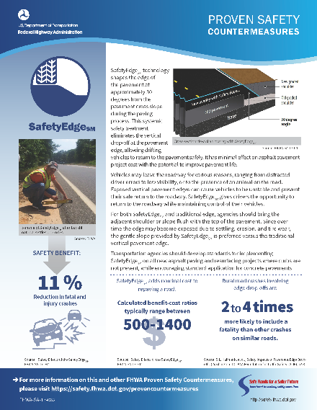
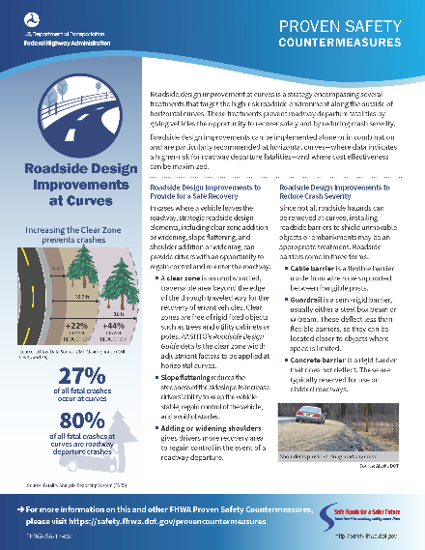

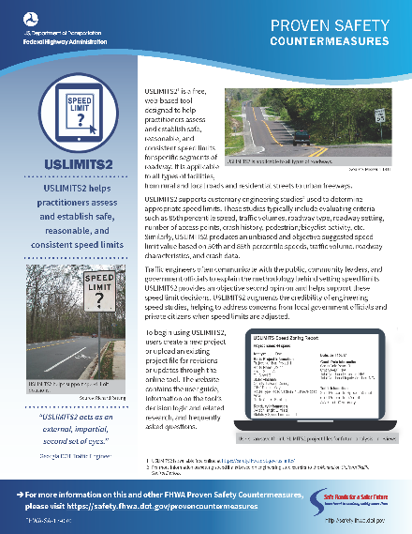
PSCi – Available Resources
http://safety.fhwa.dot.gov/provencountermeasures
1-pager marketing flyers.
Slides from webinar and link to recorded session.
Links to additional FHWA resources for each item.

Slide 4
Contacts for Further Information
Intersection Countermeasures:
Jeffrey Shaw jeffrey.shaw@dot.gov (708) 283-3524
Roadway Departure Countermeasures:
Menna Yassin menna.yassin@dot.gov (202) 366-2833
Cathy Satterfield cathy.satterfield@dot.gov (708) 283-3552
Pedestrian/Bicycle Countermeasures:
Tamara Redmon tamara.redmon@dot.gov (202) 366-4077
Crosscutting:
LRSP – Rosemarie Anderson rosemarie.anderson@dot.gov (202) 366-5007
RSA – Becky Crowe rebecca.crowe@dot.gov (804) 775-3381
USLIMITS2 – Guan Xu guan.xu@dot.gov (202) 366-5892
Notes:
Here are the technical leads from the Office of Safety for each of the program areas now represented in the Proven Safety Countermeasures family.
For Intersections: Jeff Shaw
For Roadway Departure: Menna Yassin and Cathy Satterfield
For Pedestrians and Bicycles: Tamara Redmon
For Local Road Safety Plans: Rosemarie Anderson
For Road Safety Audits: Becky Crowe
For USLIMITS2: Guan Xu

