Slide 1
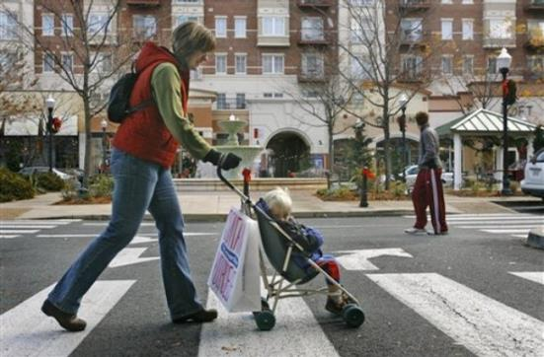
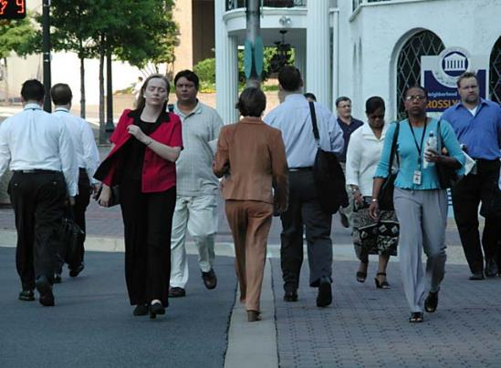
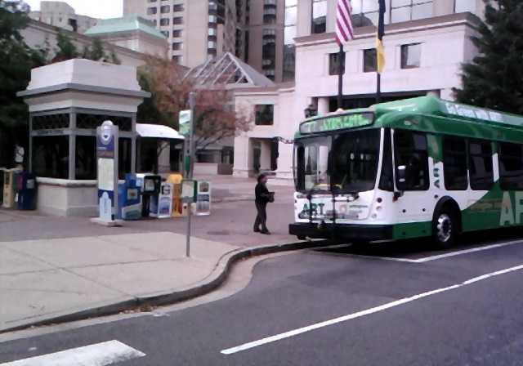
Improving Pedestrian and Bicycle Safety and Accessibility: Short-term and Long-term Strategies
Arlington, Virginia
Road to Zero Coalition Meeting
Dan Nabors, P.E.
December 12, 2017

Slide 2
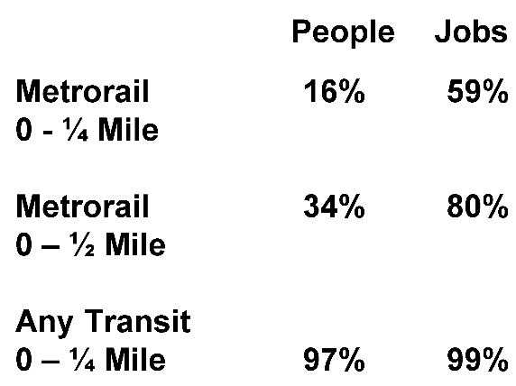
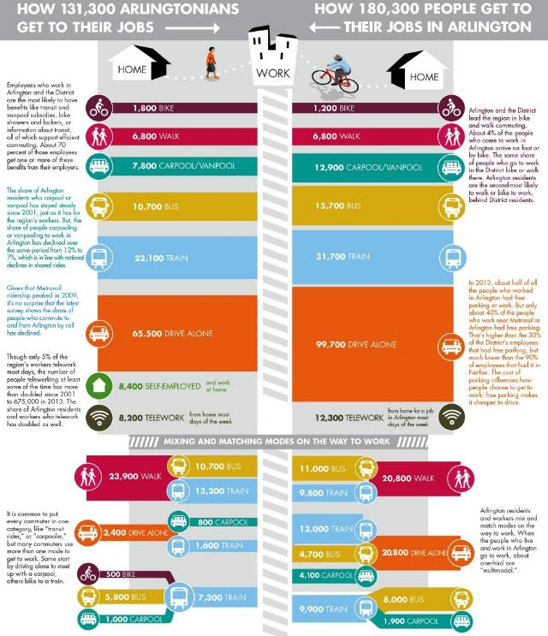
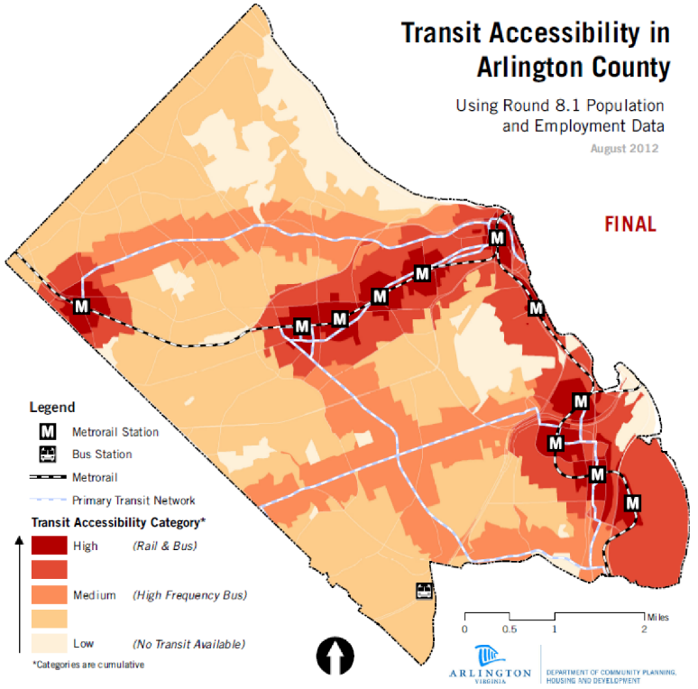
Arlington County Background
Notes:
25.8 sq. miles
11 Metrorail stations
Frequently investigate citizen, Civic Association, and Planning Dept requests to mark crosswalks at unmarked crossings

Slide 3
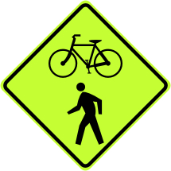
Pedestrian and Bicycle Projects
Capital Projects
Long-Range
Transportation & Redevelopment
Safety Reviews
Corridors
Hot Spots
Community
Input
Engagement
Repaving, Remarking, & Signage Reviews
Maintenance
Short-range
Crossings Overview
2,800 intersections
300 signalized intersections
1,100 transit stops
8 Pedestrian Hybrid Beacons
Bicycle Lanes Overview
Extensive trail network
Over 75 miles of on-street lanes
Time

Slide 4
Pavement Marking Process
Review Data
Review crash data
Review traffic data
Coord. w/ Signals
Confirm traffic control
Notify staff of paving limits (coordinate loop replacement on signals)
Coord. w/ Transit
Obtain bus stop ridership
Analyze location of stops
Coord. w/ Planning
Engineer Review
Coordinate ped/bike master plan/CIP improvements
Obtain data if necessary and analyze location of crossings
Review data and analysis
Approve plans
CADD Standards
Design Standards
Design Process

Slide 5

Increase Effectiveness Of Crosswalks With:
High Visibility Markings
Signing
Curb Extensions
Notes:
Physical treatments such as these listed do the most to improve pedestrian safety at crosswalks. They will be covered in greater detail in the rest of this module.

Slide 6
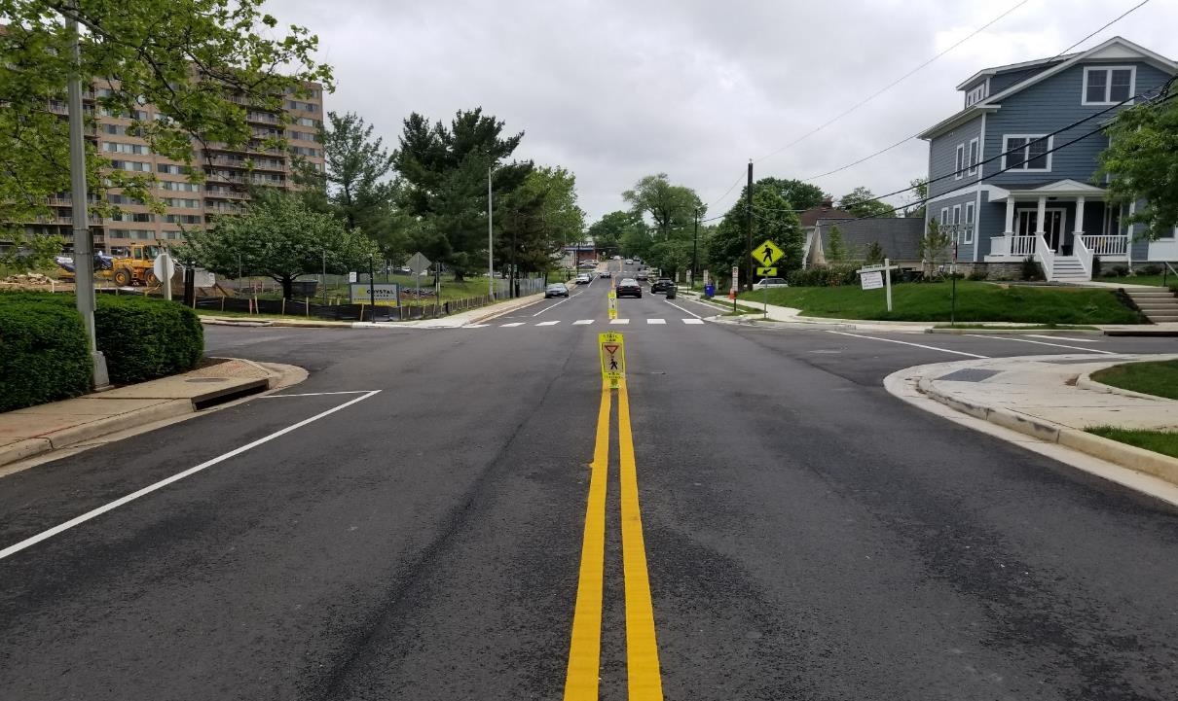
Improve Crosswalk Visibility
2-lane roads- high visibility markings
In-street pedestrian volumes based on volume, speed, and geometry

Slide 7
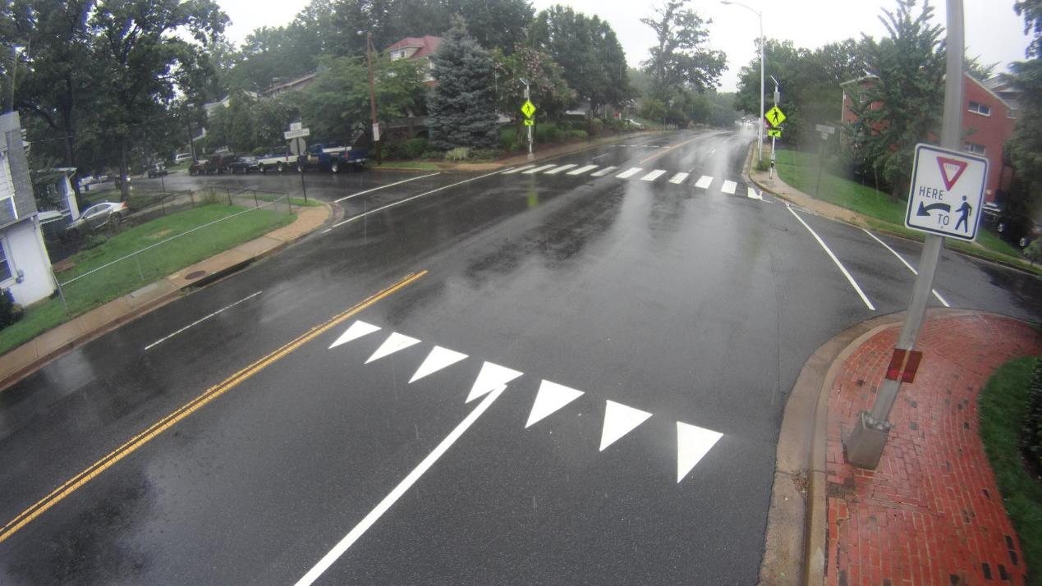
Apply Additional Markings
Use MUTCD as minimum standard
Other markings as needed to standardize lanes
Provide additional guidance to motorists

Slide 8
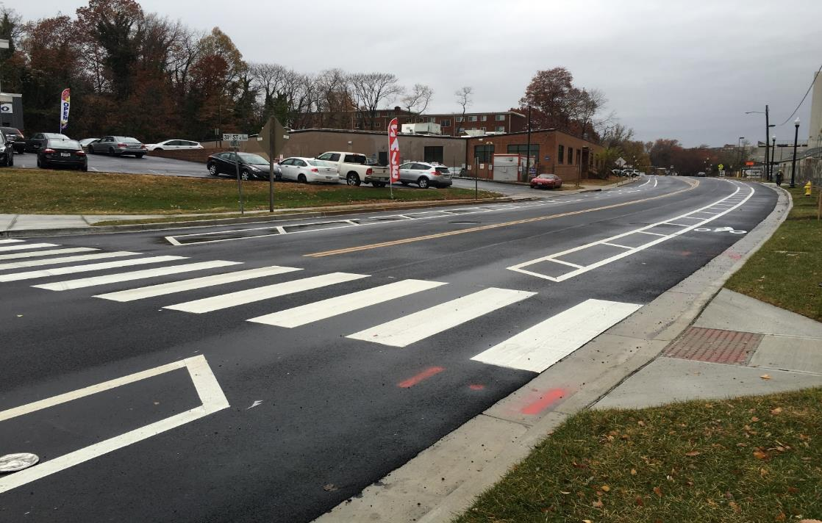
Improve Effectiveness of Bike Lanes with:
Buffered bike lanes
Standardize cross section with application of buffered bike lanes
2-lane roads- high visibility crosswalk markings

Slide 9
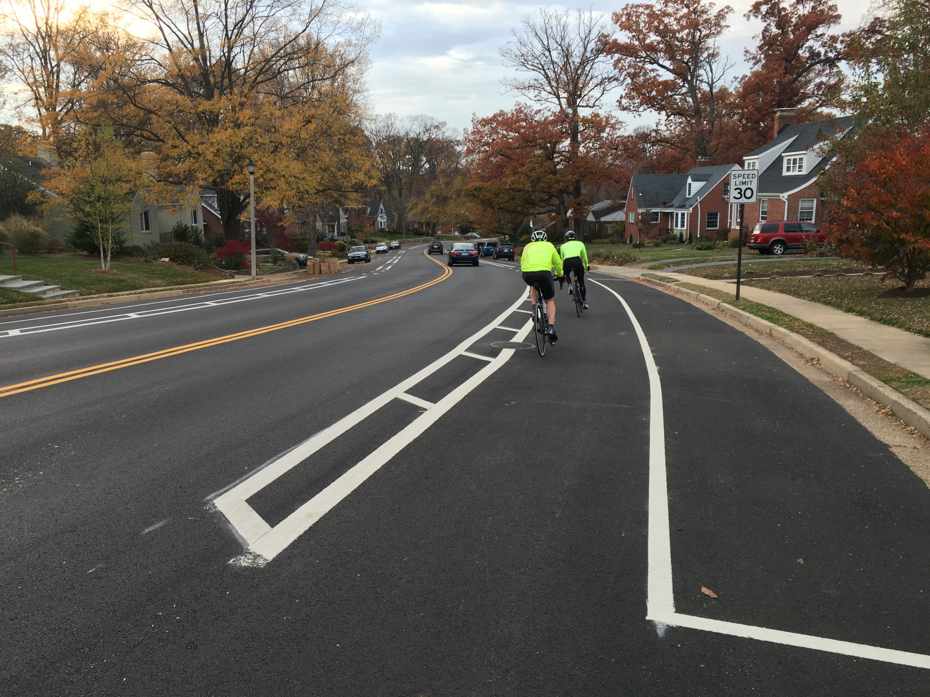
Improve Effectiveness of Bike Lanes with:
Buffered bike lanes
Standardize cross section with application of buffered bike lanes
2-lane roads- high visibility crosswalk markings

Slide 10
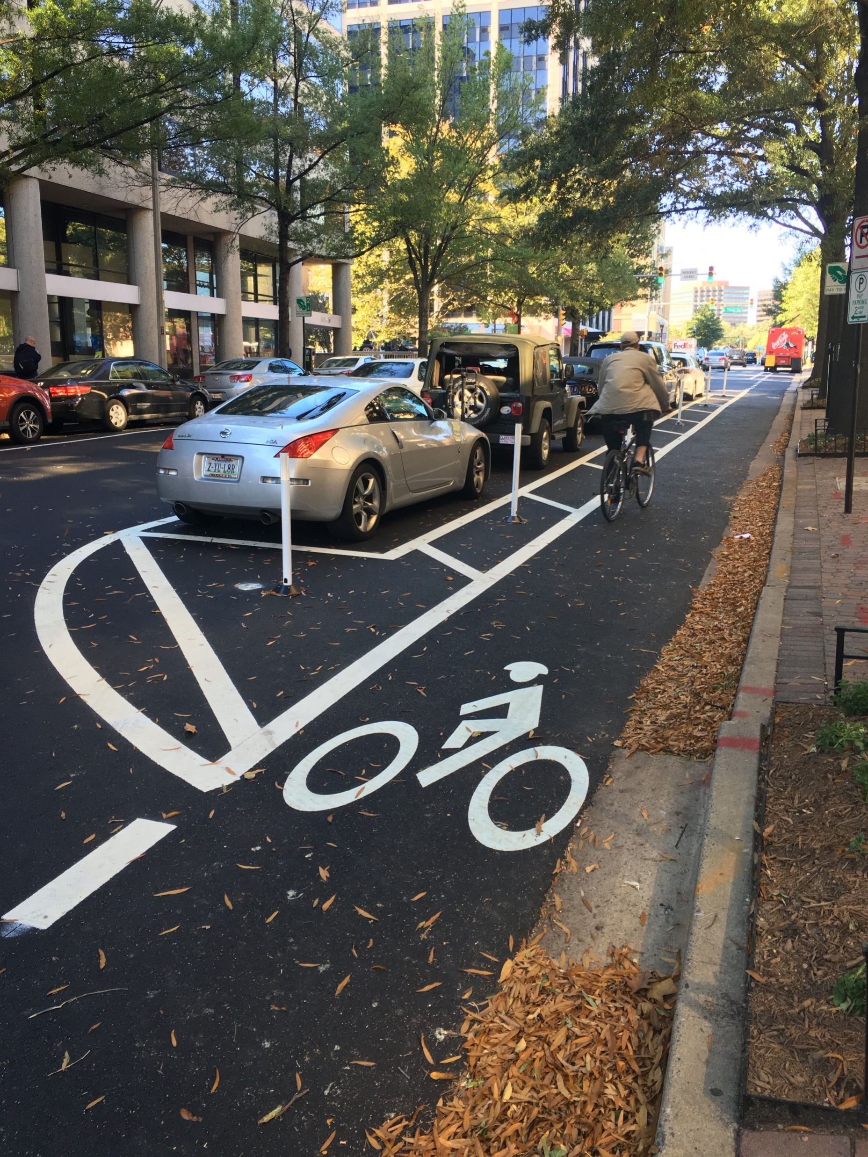
Improve Effectiveness of Bike Lanes with:
Protected bike lanes
Standardize cross section with application of protected bike lanes
Look at maintenance impacts

Slide 11
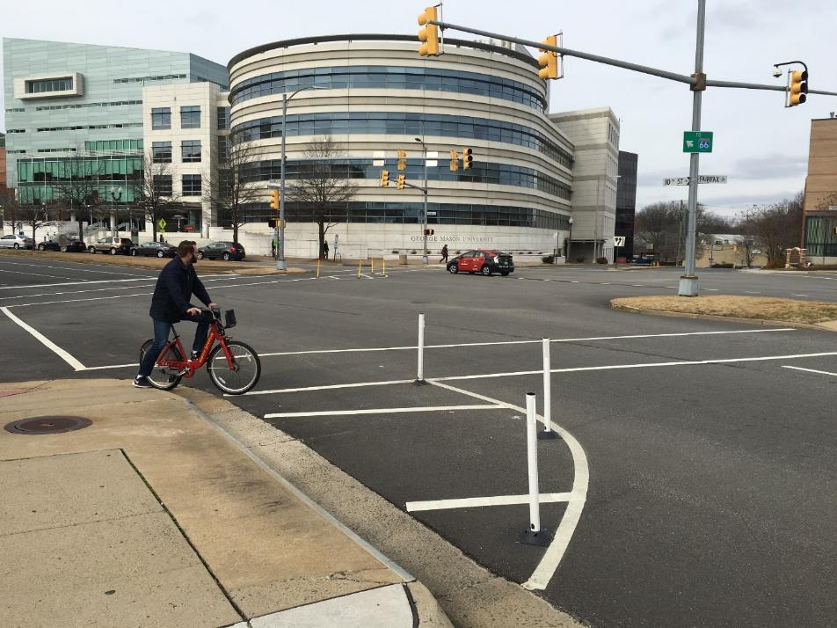
Additional Measures
Other markings as needed to standardize lanes
Reallocate space

Slide 12
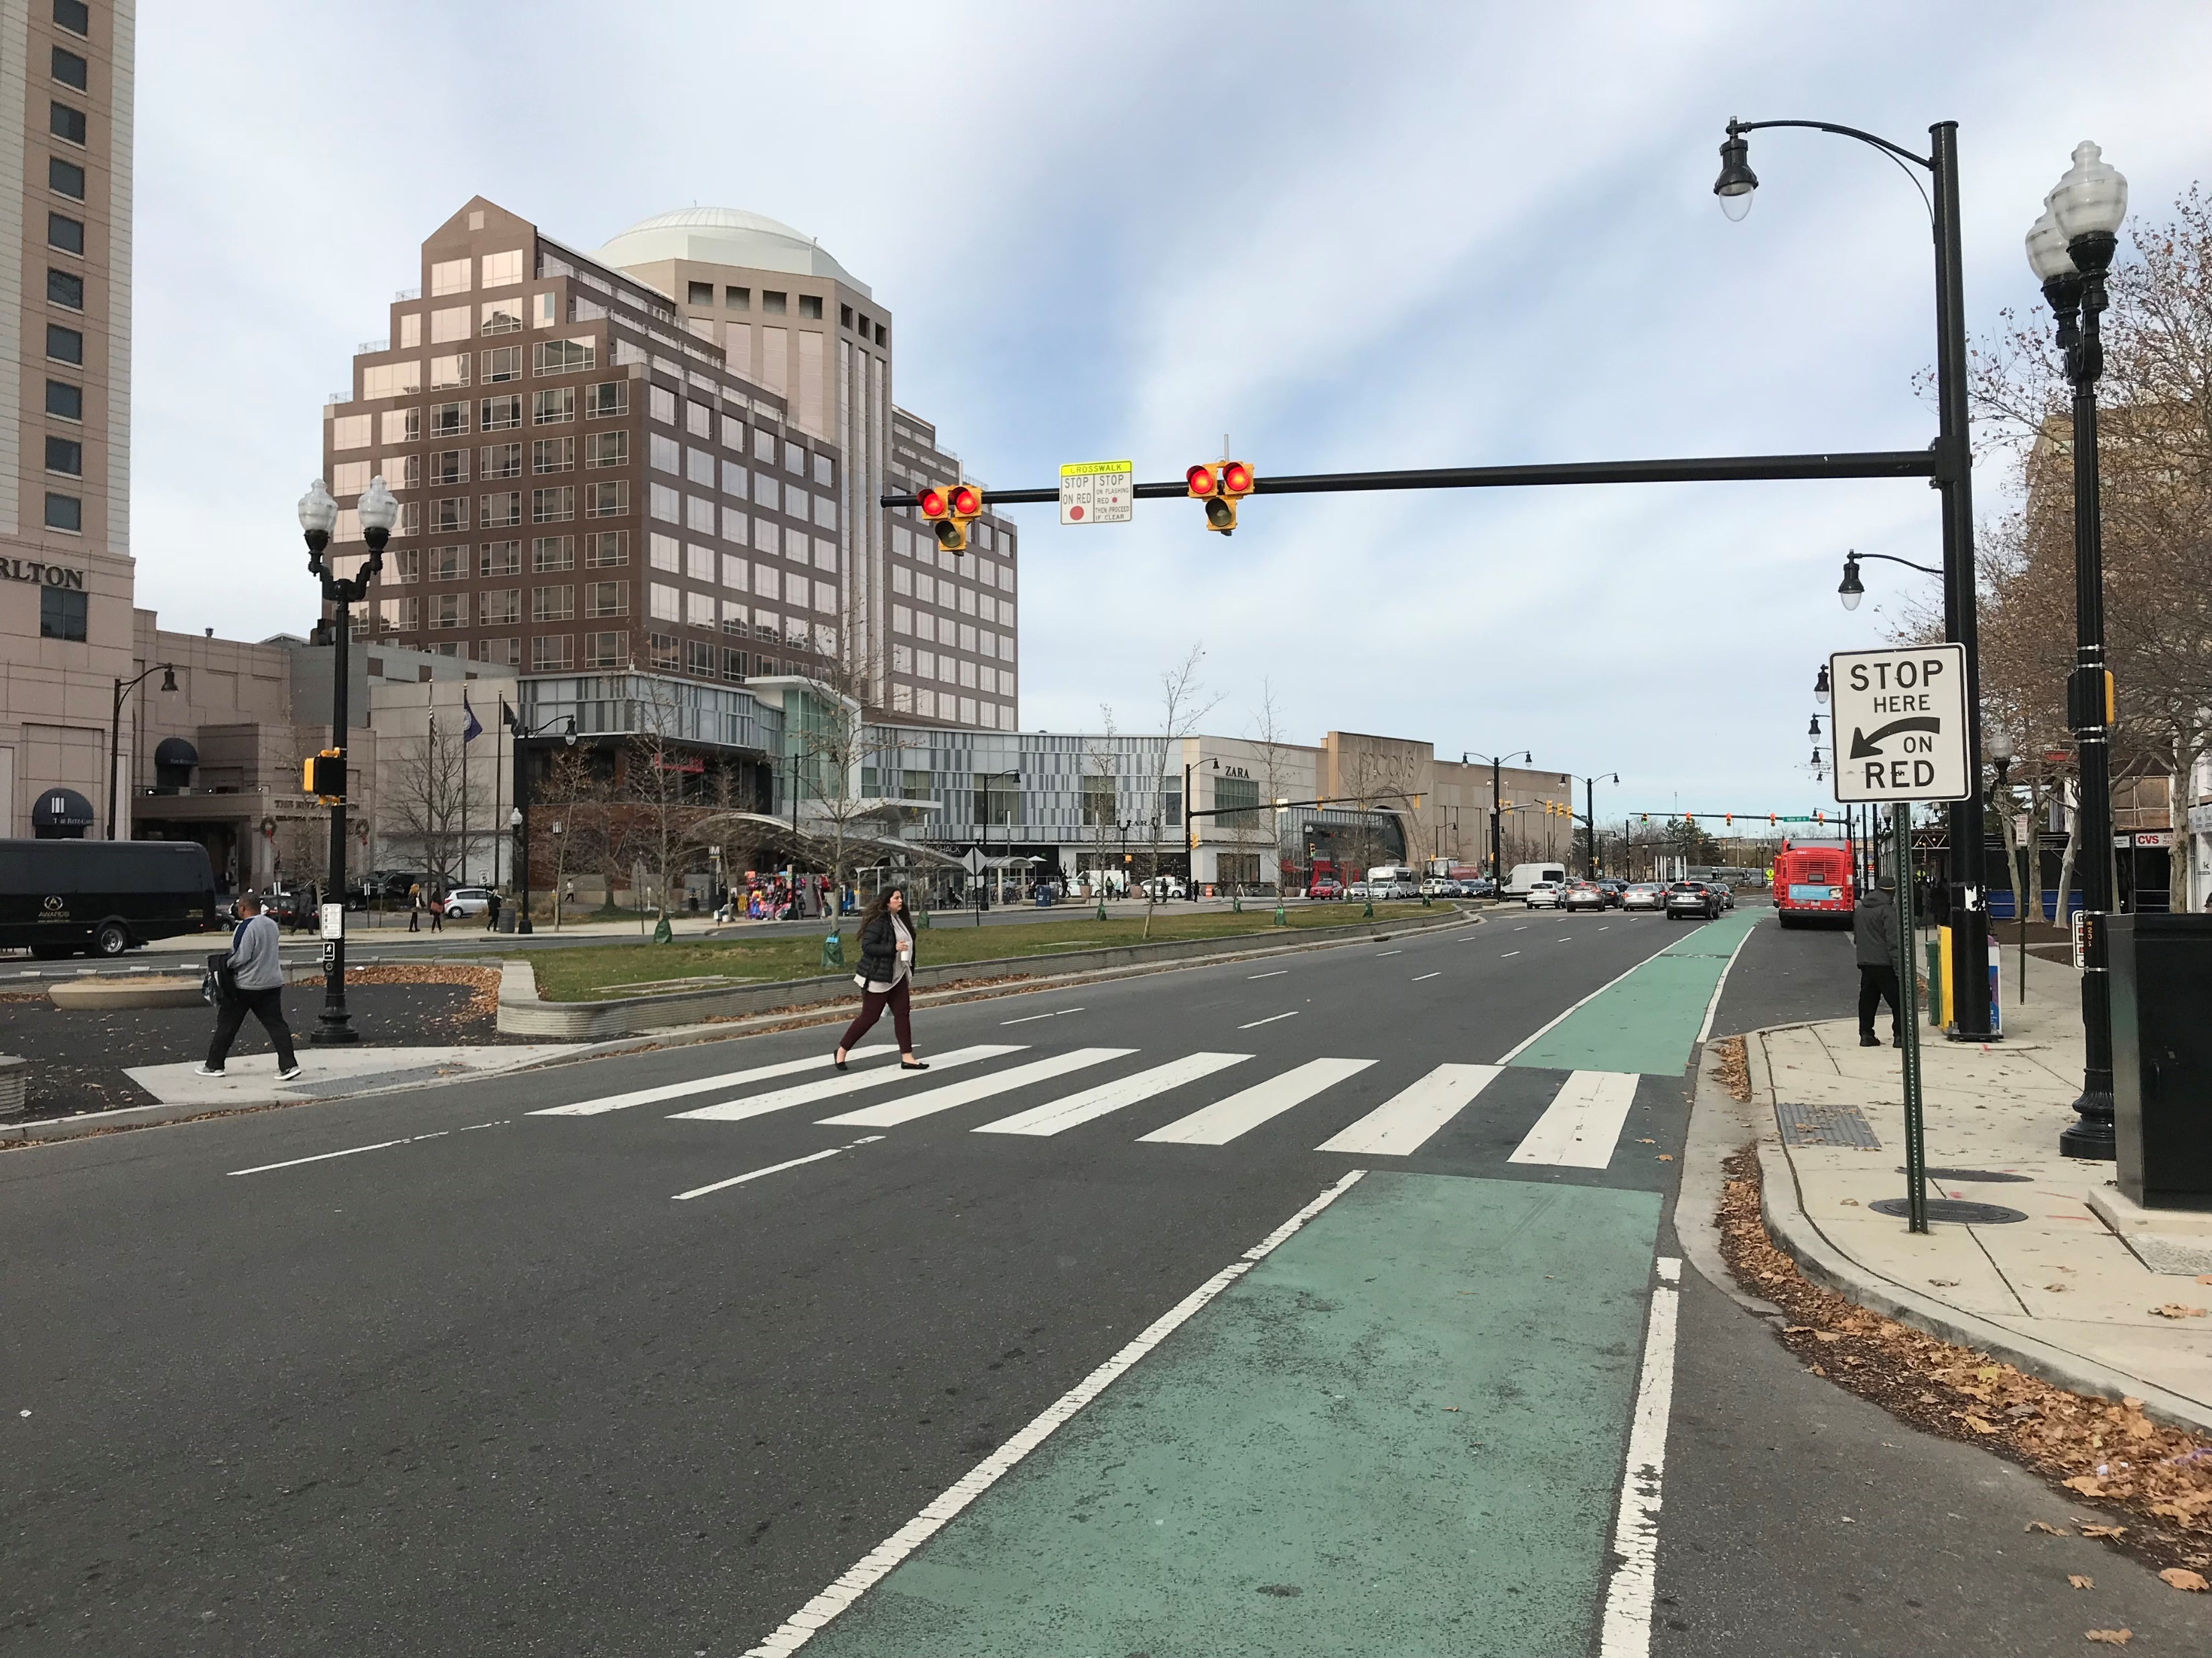
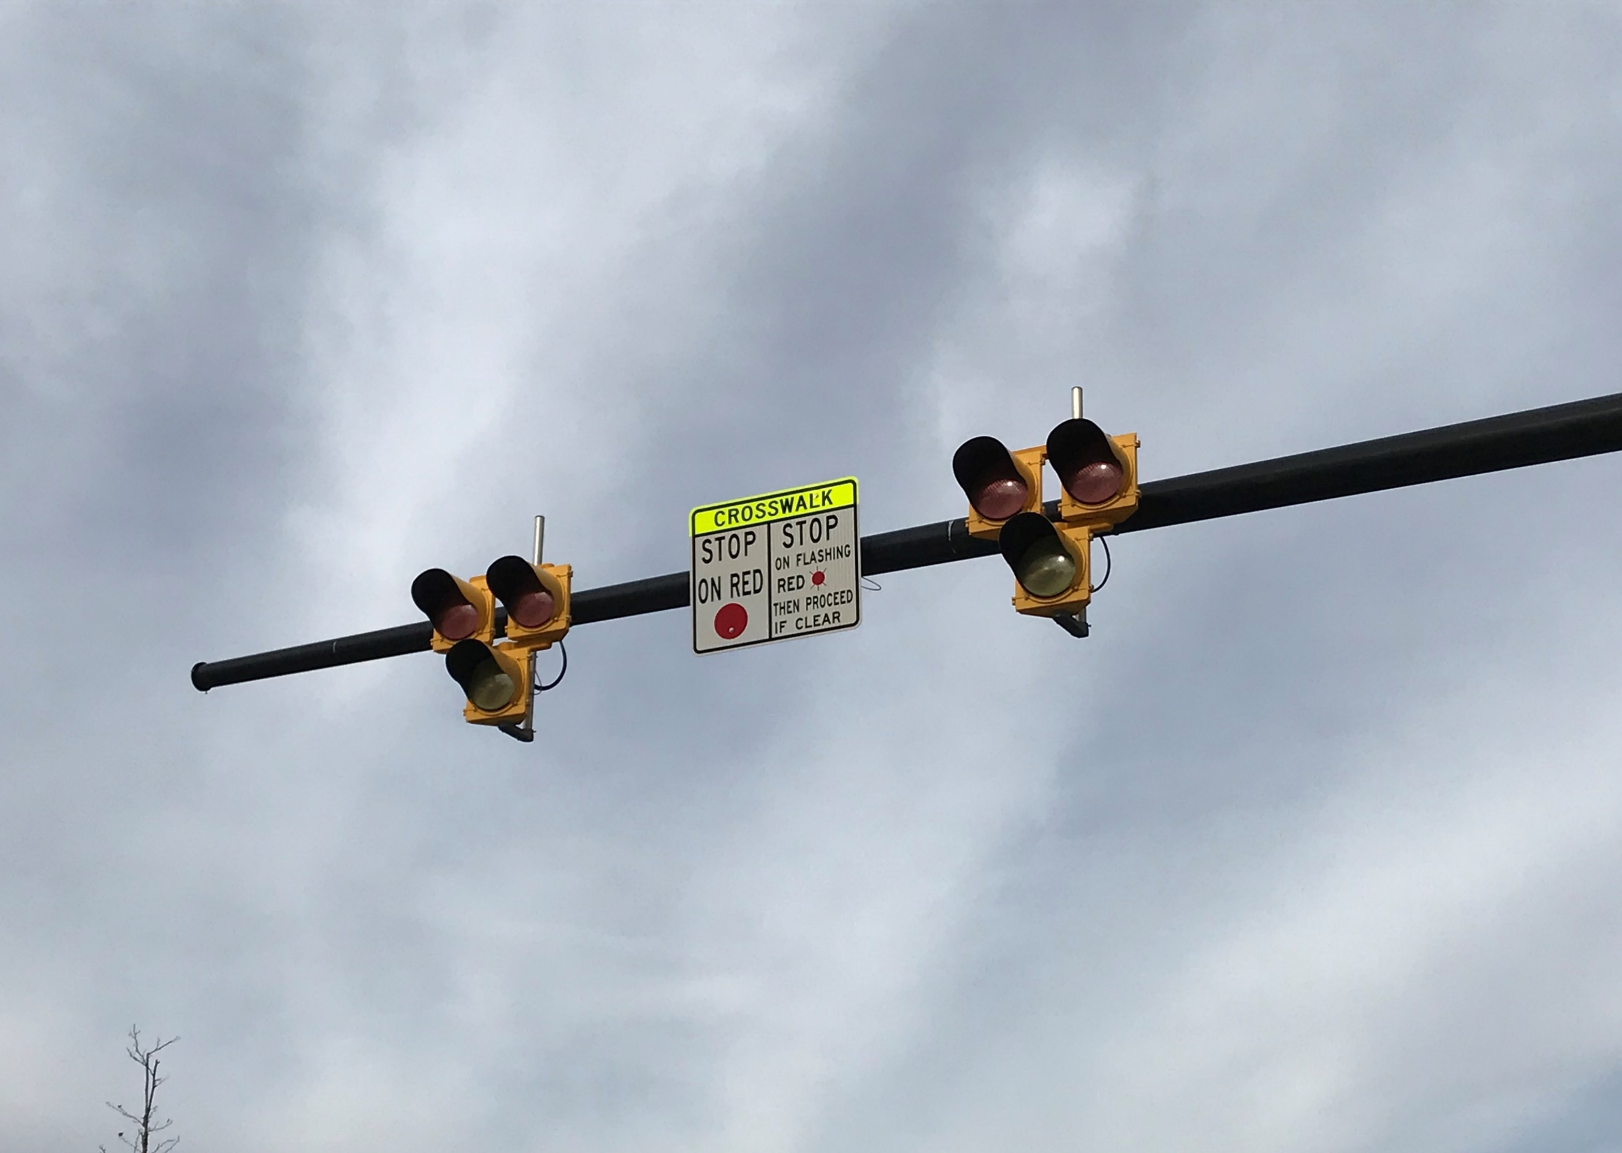
Improve Signage
Pedestrian Hybrid Beacon

Slide 13
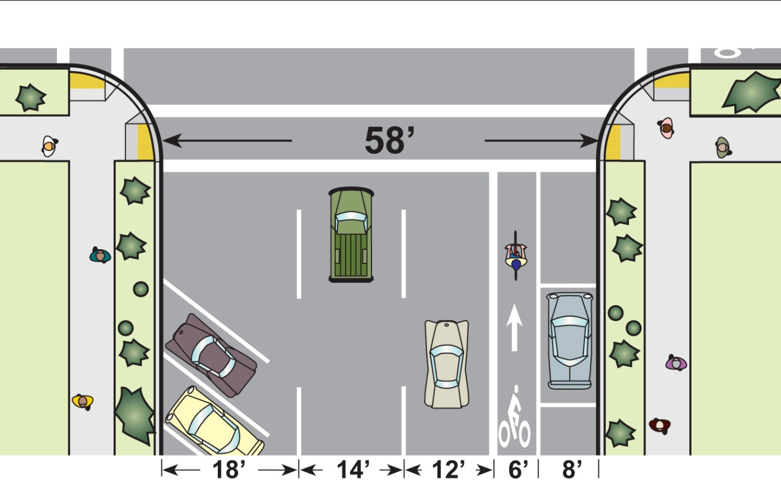
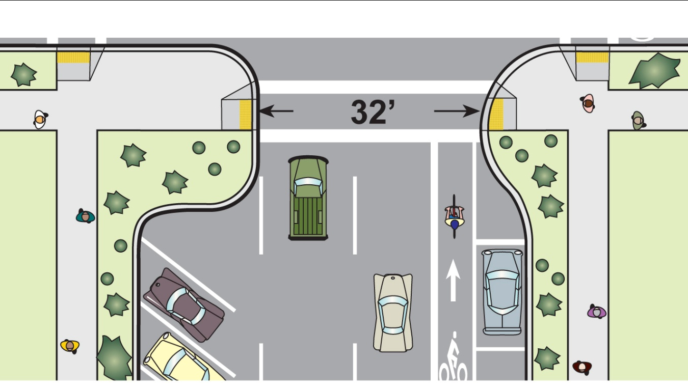
Curb extensions
Reduce crossing distance
Other advantages
Better visibility
Traffic calming
Room for pedestrians
Notes:
Animated. Self-explanatory except last point: once the curb extension is in place, parking can be moved closer to the crosswalk.

Slide 14
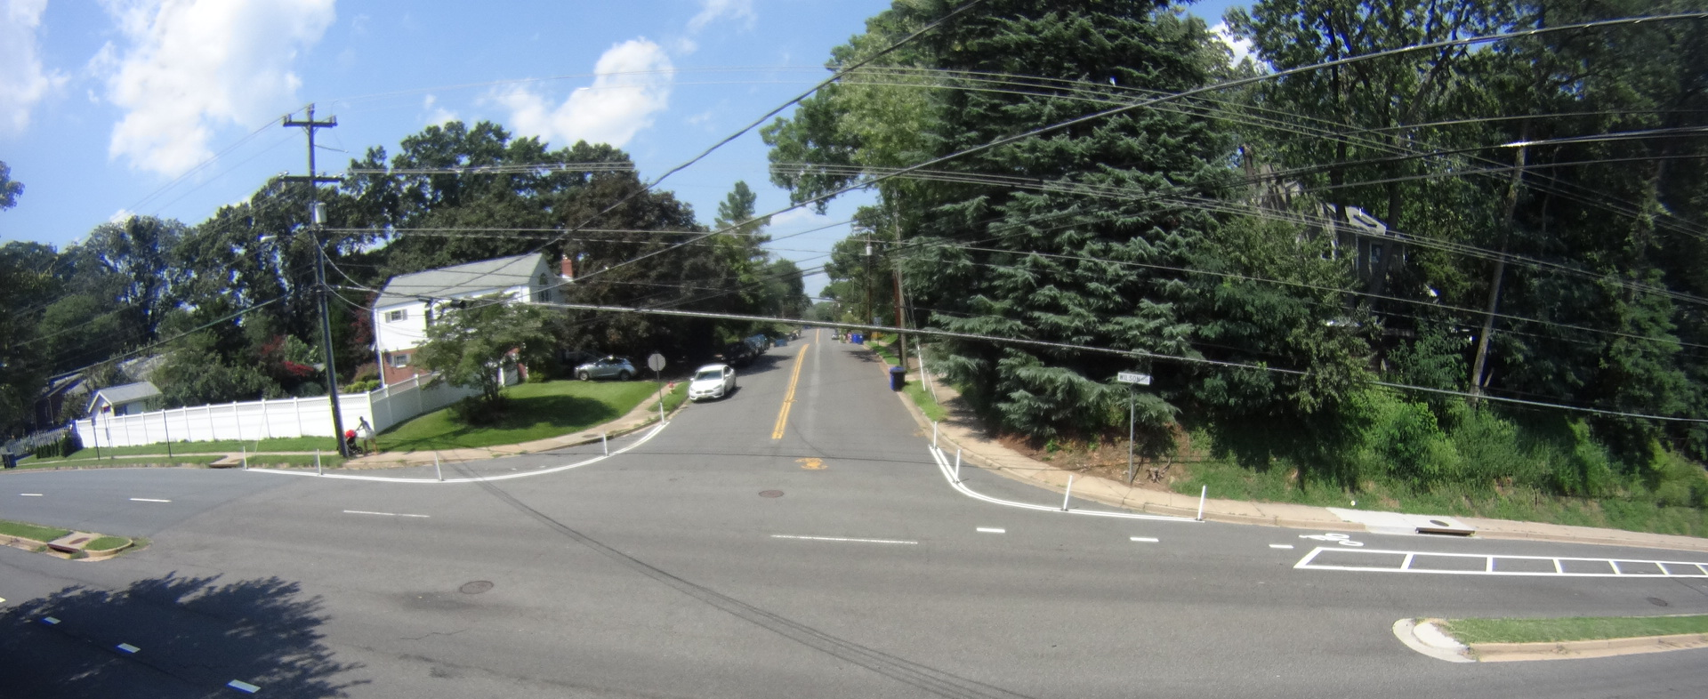
Curb extensions
Reduce crossing distance
Other advantages
Better visibility
Traffic calming
Room for pedestrians
Notes:
Animated. Self-explanatory except last point: once the curb extension is in place, parking can be moved closer to the crosswalk.

Slide 15
Corridor Projects
Medians do not provide refuge
Wide intersection
Skewed crossing

Slide 16
Corridor Projects
Median refuge
Shorter crossing
Smaller intersection footprint
Bioretention facilities

Slide 17
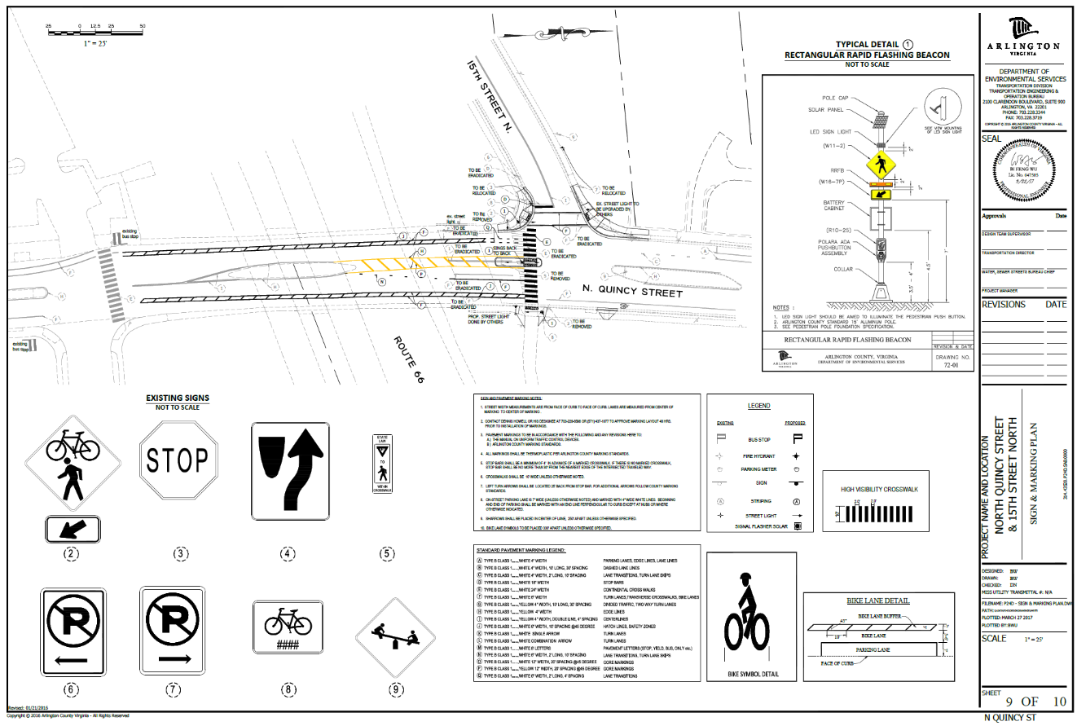
Median Refuge- Spot Location
Median refuge
Small island
RRFB
Bulb outs
High visibility markings

Slide 18
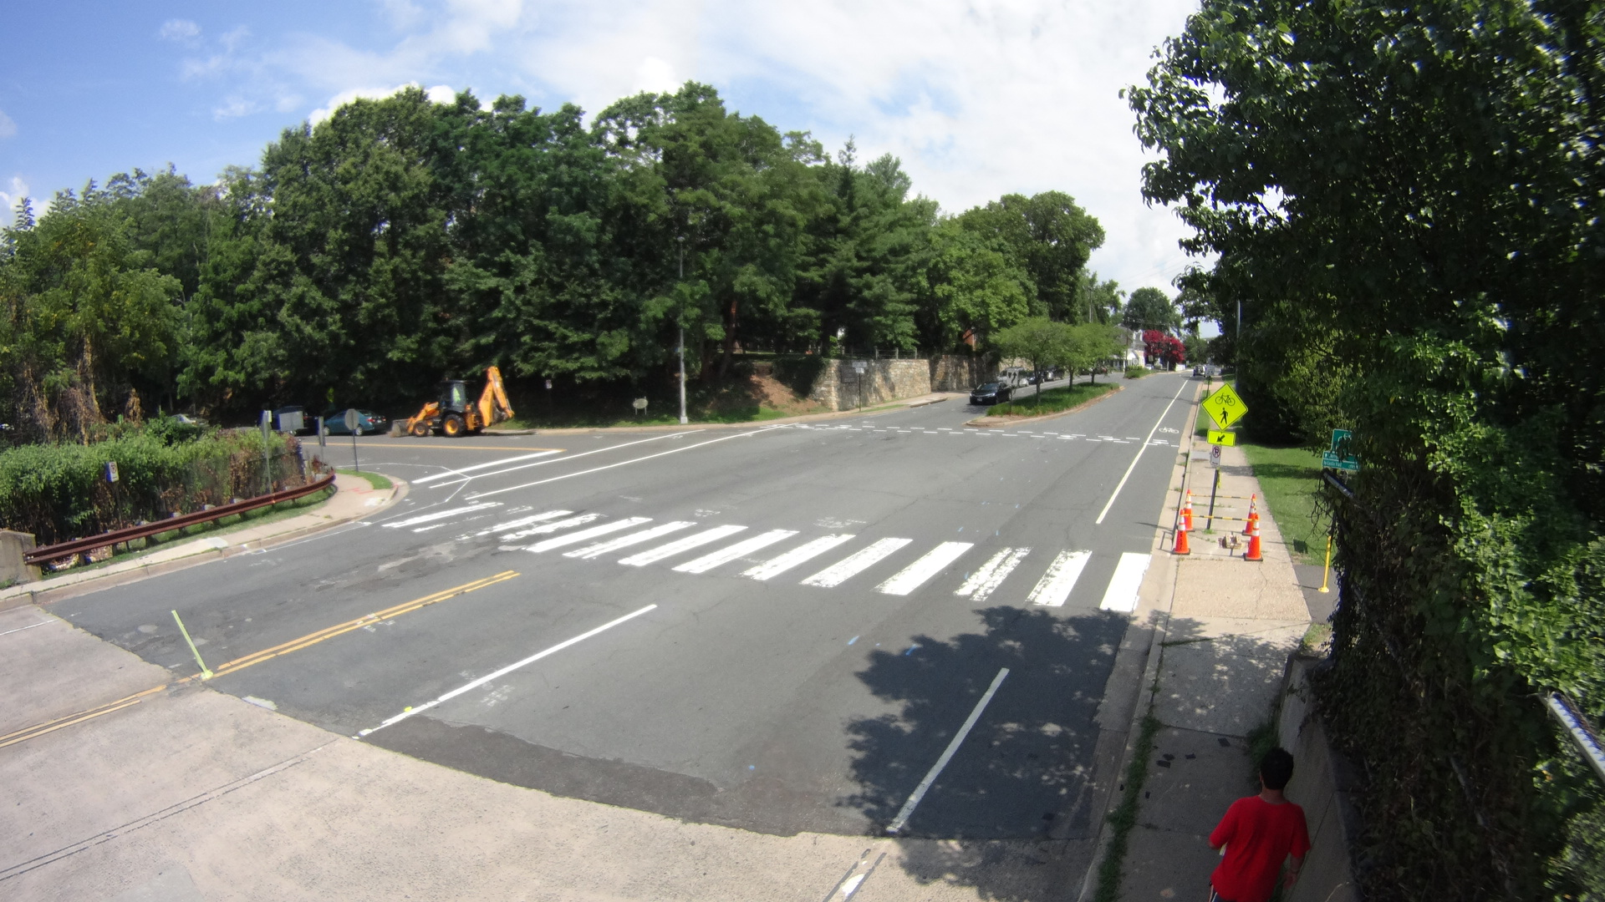
Median Refuge- Spot Location
Median refuge
Small island
RRFB
Bulb outs
High visibility markings

Slide 19
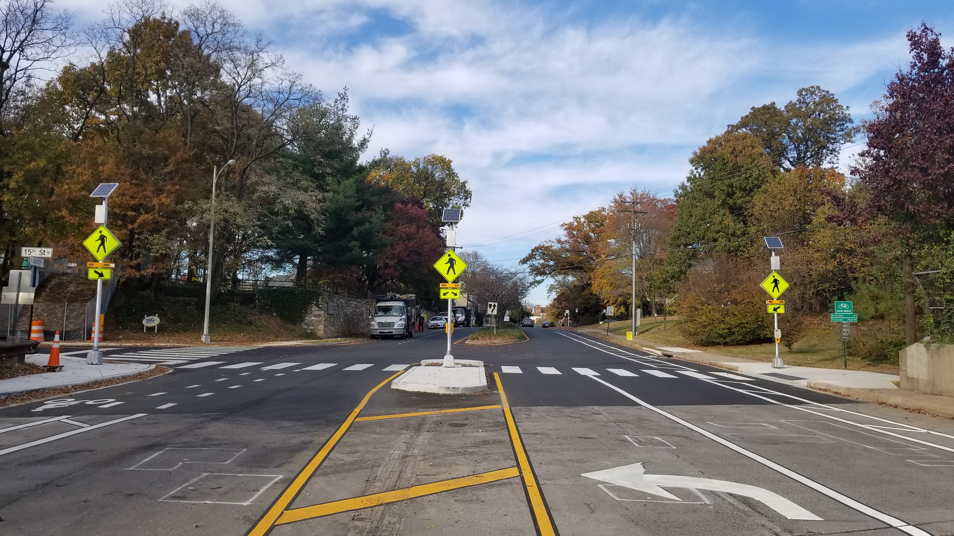
Median Refuge- Spot Location
Median refuge
Small island
RRFB
Bulb outs
High visibility markings

Slide 20
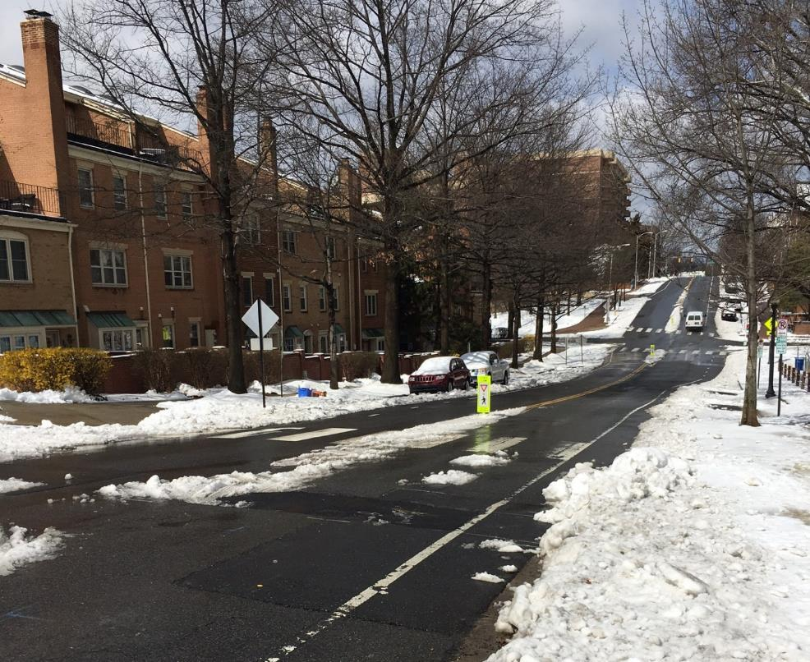
Short-Range Median Improvements
Opportunistic
High traffic areas
Vulnerable users
Wide lanes
With repaving or stand-alone marking projects

Slide 21
Short-Range Median Improvements
Pilot
Collect before and after data
Make adjustments
Update design guidance
Continue implementation

Slide 22
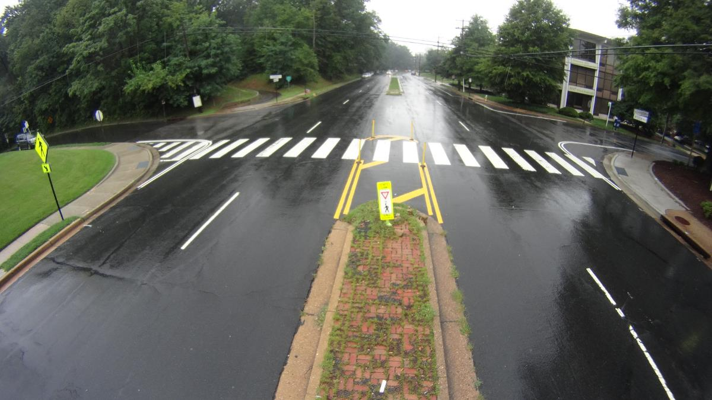
Short-Range Median Improvements

Slide 23
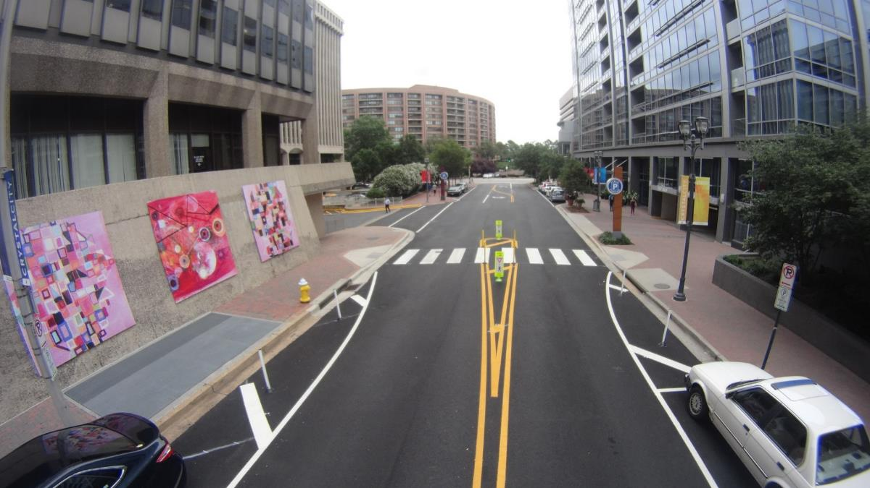
Short-Range Median Improvements

Slide 24
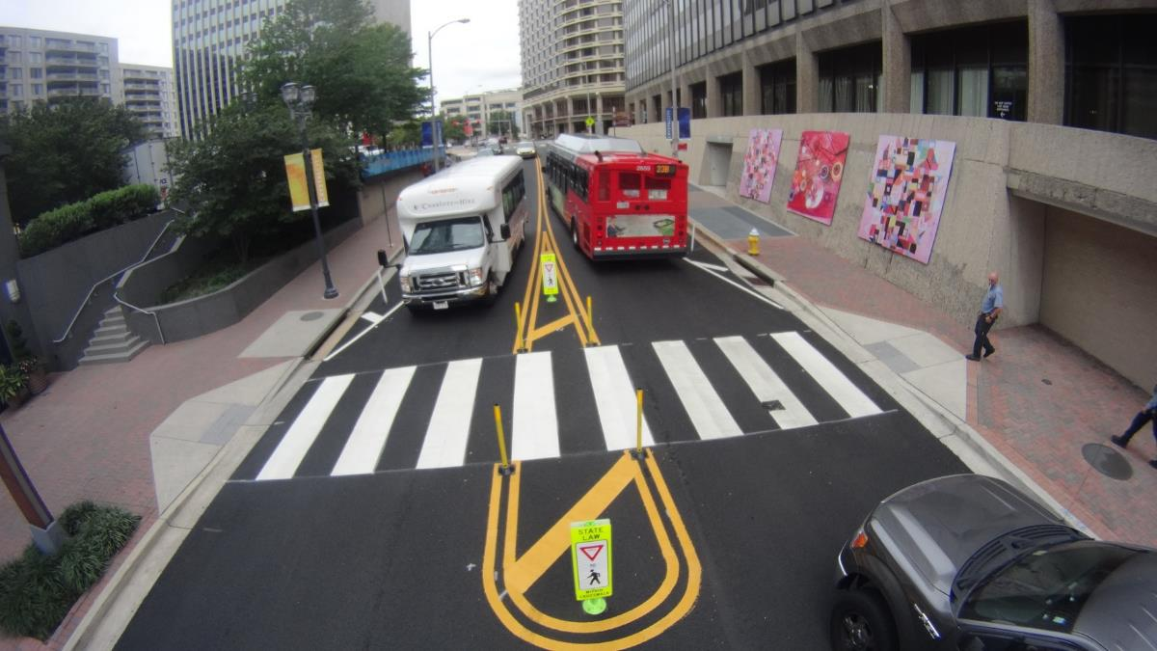
Short-Range Median Improvements

Slide 25
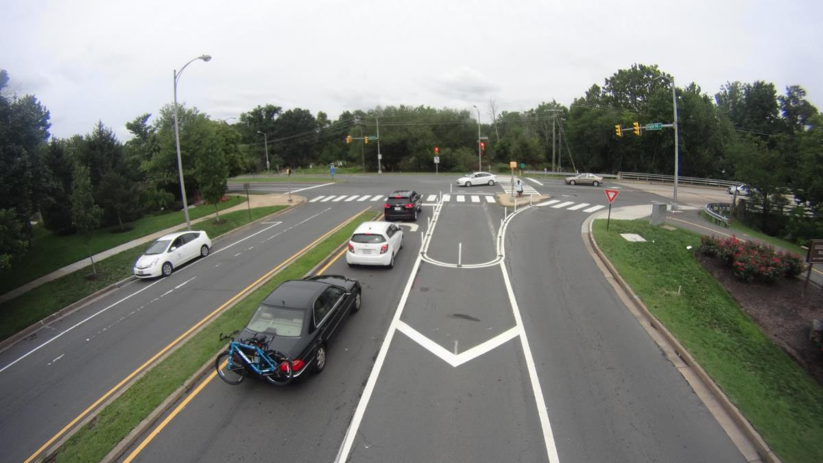
Short-Range Median Improvements
Stage 1
Markings
Signage
Bollards

Slide 26
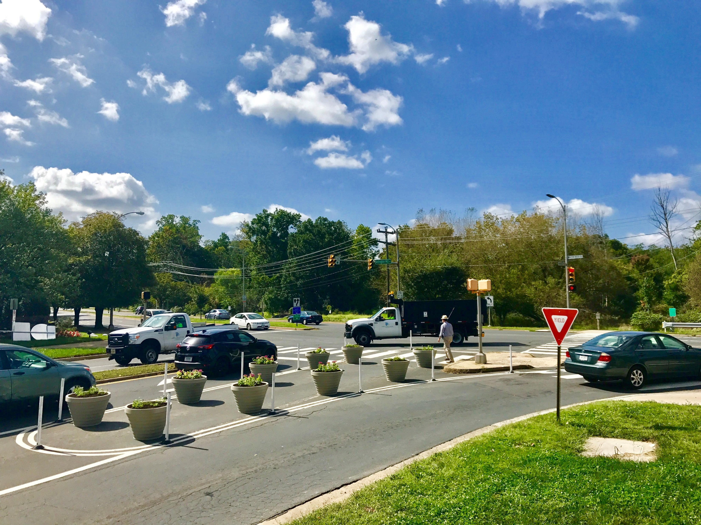
Short-Range Median Improvements
Stage 2
Planters and physical separation added
Final design will include hardscape curb and gutter changes

Slide 27
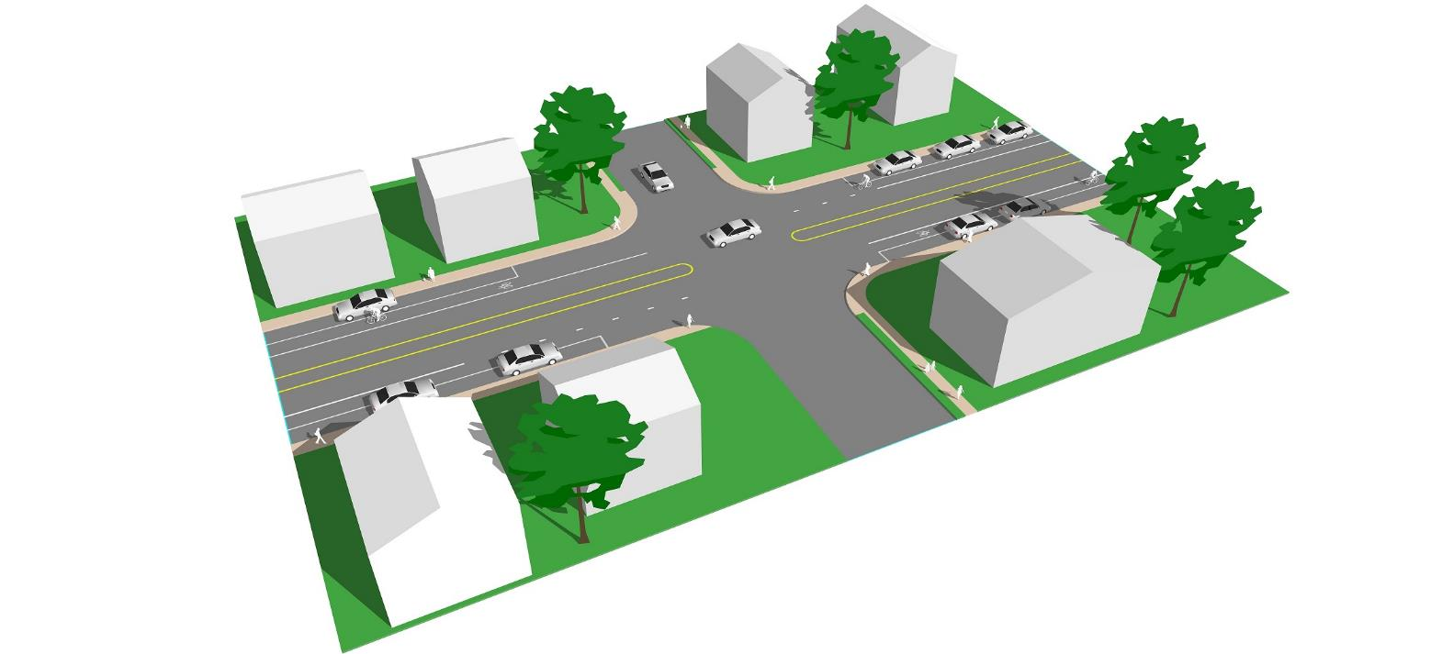
Existing Street

Slide 28
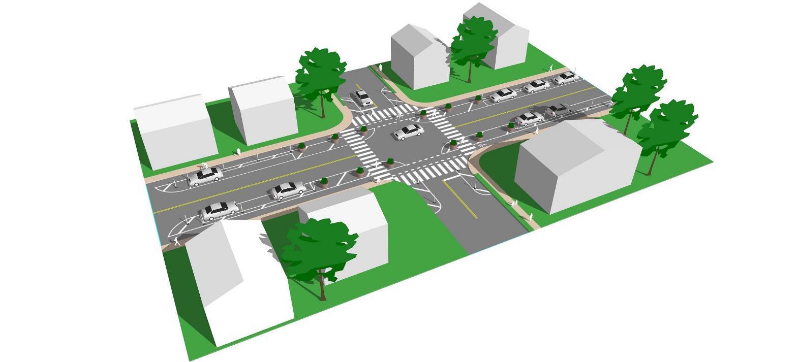
Short-Range Improvements

Slide 29
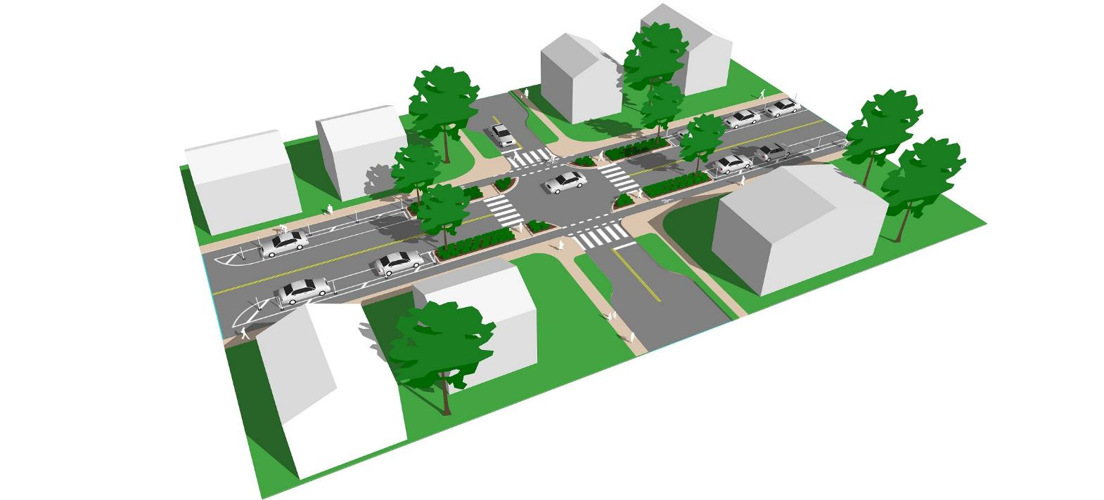
Long-Range Improvements

Slide 30
Road Diet- Wilson Blvd
2015 - Year 1
Repaving and restriping from four lanes to three lanes
Providing a center left turn lane throughout
Addition of bike lanes on both sides
Bus stop consolidation
2016 – Year 2
Began monitoring the reconfiguration and collected data on traffic flow and safety.
2017 – Year 3
Extended road diet one block.
Notes:
of the demonstration project. The goals of the reconfiguration were to improve pedestrian, cyclist, and motorist safety, to better accommodate all road users

Slide 31
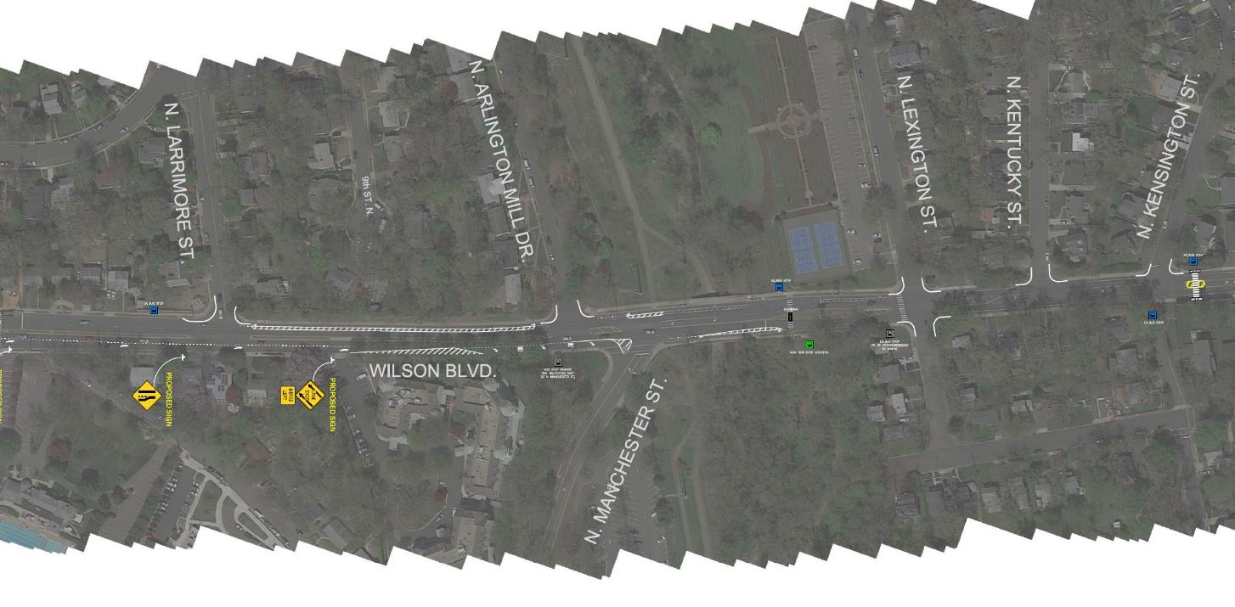
Road Diet- Wilson Blvd
First Phase of Road Diet: 3,600 Ft.
Crossing
Road diet extension
First Phase of Road Diet: 3,600 Ft.
https://projects.arlingtonva.us/projects/wilson-boulevard-improvements/

Slide 32
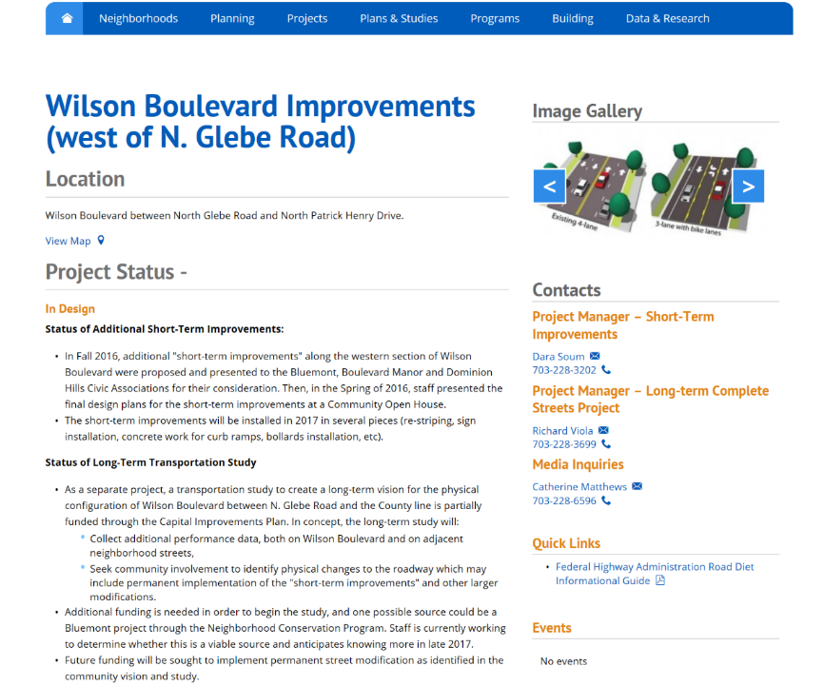
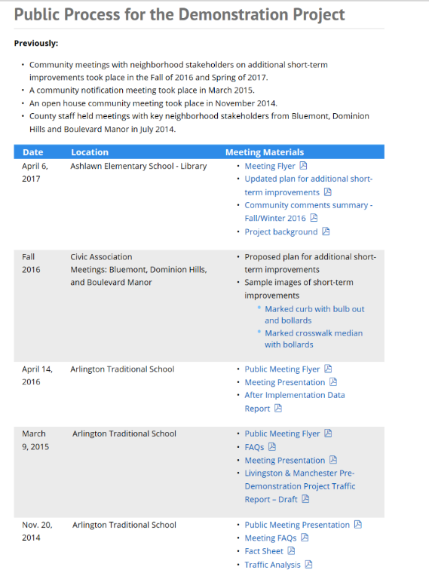
Road Diet- Wilson Blvd
https://projects.arlingtonva.us/projects/wilson-boulevard-improvements/

Slide 33
Dan Nabors, P.E.
Arlington County
DES Transportation Engineering & Operations
O: 703-228-3726 dnabors@arlingtonva.us

