Slide 1

https://www.etsy.com/listing/208458419/white-star-of-david-tree-topper-with?ref=shop_home_active_3
Automation & Enhanced Safety
State Interests and Action
Presentation to Road to Zero Coalition Meeting
December 15, 2016
Sue Gander, Director
Environment, Energy & Transportation Division
NGA Center for Best Practices
National Governors Association

Slide 2


About the National Governors Association
Center for Best Practices
Comparative policy consulting shop
Office of Federal Relations
Collective, bi-partisan, voice of governors in DC
Office of Management Consulting & Training
Internal management consultants
Provides governors and staff technical assistance based on state direction
Builds consensus on Federal issues
Training and advice for governors, chiefs of staff, schedulers, spouses, legal counsels
National Governors Association

Slide 3

Highlights
Automation already providing safety benefits alongside other important measures –more changes coming
Automation plays role in enhanced safety
States see potential benefits and concerns
States face new policy, infrastructure questions
States taking policy actions
National Governors Association

Slide 4
NGA Traffic Safety Project
Working with CDC to help states with strategies to reduce highway and traffic injuries and fatalities
Identifying key state strategies and recommendations for governors
Highlighting innovative cost-effective intervention tools for states
Convening a 2017 learning lab for states to address the increase in traffic fatalities
National Governors Association

Slide 5
NHTSA Safety Technology Vehicle Evolution
Role of Technology in Transportation Public Safety
Many technologies in-place or commonplace that can help address safety concerns.
Other technologies are emerging that hold promise.
Combining technology, behavioral and other approaches provides a robust response to safety concerns.
National Governors Association

Slide 6
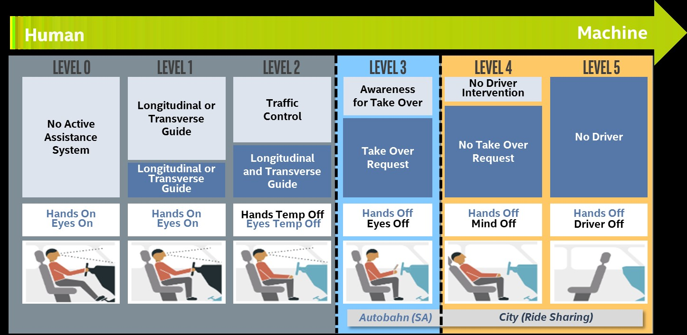
SAE Automation Levels - Vehicles
Driverless Cars Not Here Yet (But Underway)
National Governors Association

Slide 7
States Interested in Safety, Other AV Benefits
Lower accident rates
Improve congestion, reduce emissions, improve public health
Increased personal mobility, e.g. for aging in place
Also, potential for automated service and delivery vehicles, increased ridesharing, reduced need for urban parking lots
National Governors Association

Slide 8
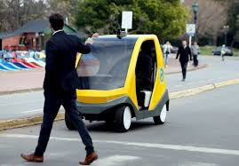
States Also Have Concerns with New Technology
Reliability and Public Safety
  Pilot testing issues
  Private sector collaboration with law enforcement
  Drivers, pedestrians, bicyclists adjustments
Can policy keep pace with technology change?
Liability
Data Privacy
Cyber
National Governors Association

Slide 9

States Face New Infrastructure, Policy Needs
Integrate sensors and telematics
Create new standards
Adapt/update existing transportation standards and regulatory frameworks
Develop cyber security provisions
Update insurance provisions
Address interagency coordination -- transportation, public safety, insurance, economic development
National Governors Association

Slide 10
States Responding by Adapting Policy
50 pieces of legislation concerning HAVs have been introduced in 23 states in past two years
17 laws have been passed since 2011 – in 8 states – to define HAVs and set rules for AV testing/use
  LA, ND, UT – focused on definitions and studies
  CA, FL, MI, NV, TN – issued guidelines for testing and use
    NV first state to enact AV legislation, in 2011, which set operation guidelines, safety standards and insurance rules
    CA, MI, NV permit the use of AVs on roads for testing
    FL and TN expressly permit use of AVs outside of testing
  Other states (e.g., PA) working on guidelines
AZ 2015 executive order supports testing of HAVs on public roads
National Governors Association

Slide 11

Contact
Sue Gander, Division Director
Environment, Energy & Transportation
sgander@nga.org
(202) 624-7740

