Slide 1
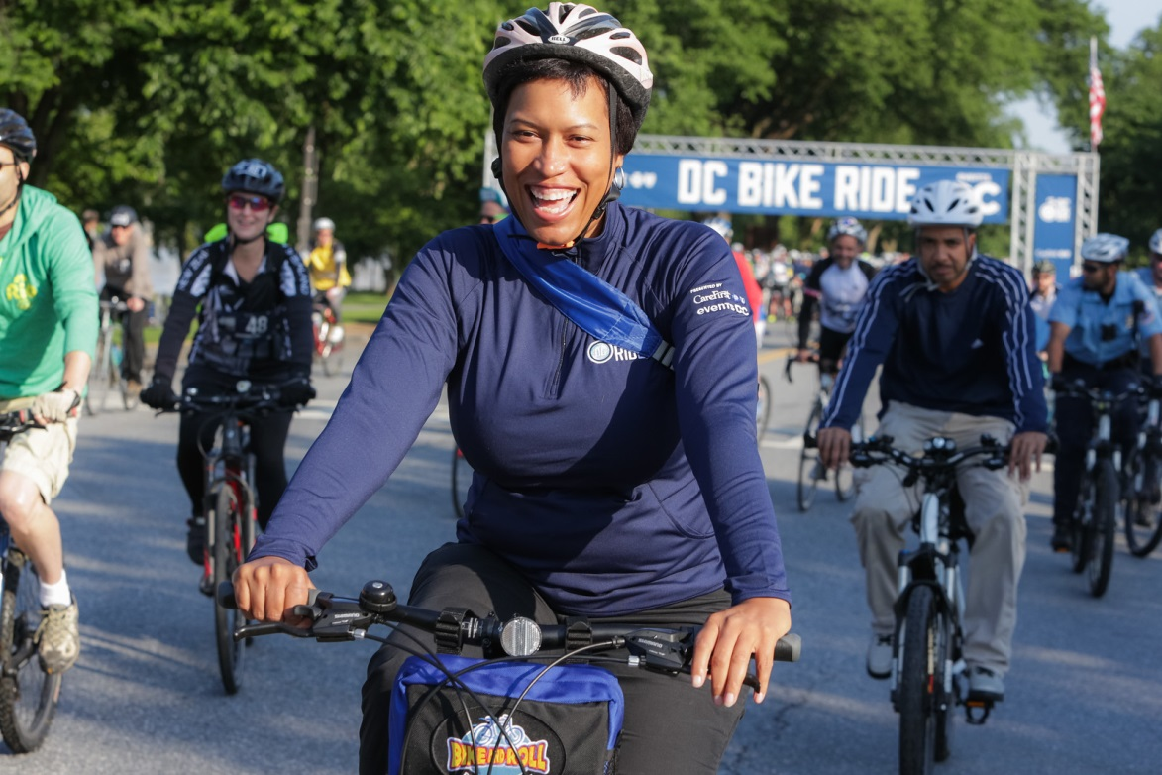


Two Years of
Vision Zero in Washington, D.C.
Jonathan M. Rogers
District Department of Transportation

Slide 2
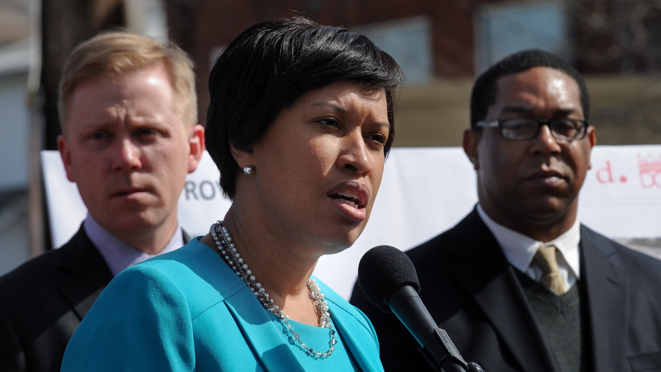

“By the year 2024, we will do everything in our power to eliminate transportation fatalities and serious injuries, because no loss of life is acceptable.”

Slide 3
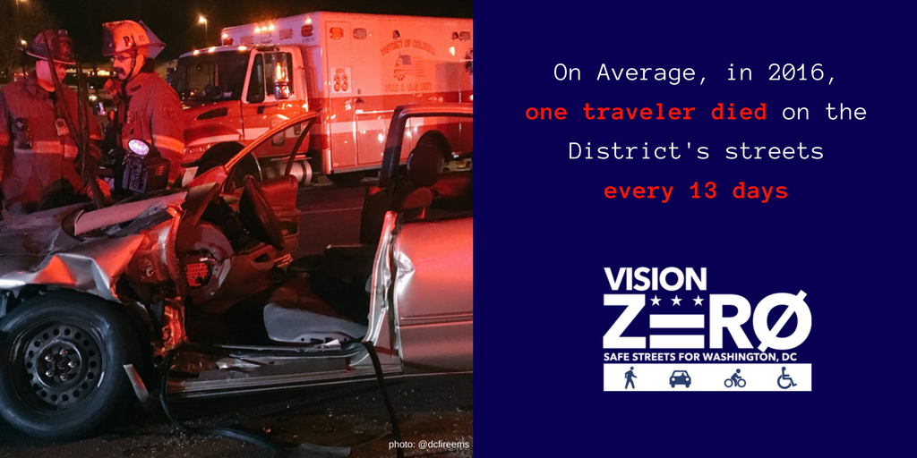

Slide 4
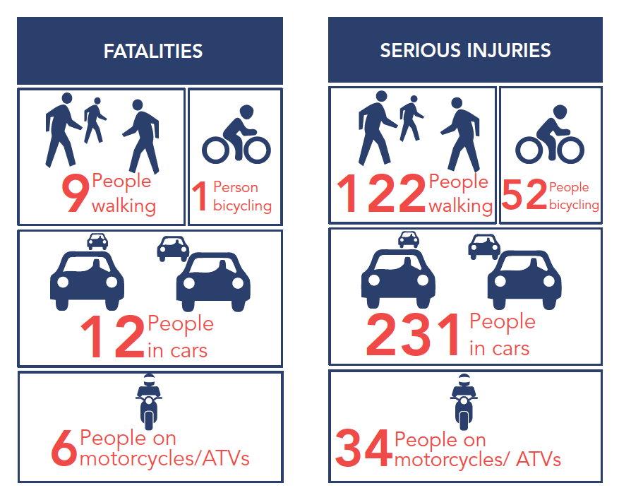
2016

Slide 5
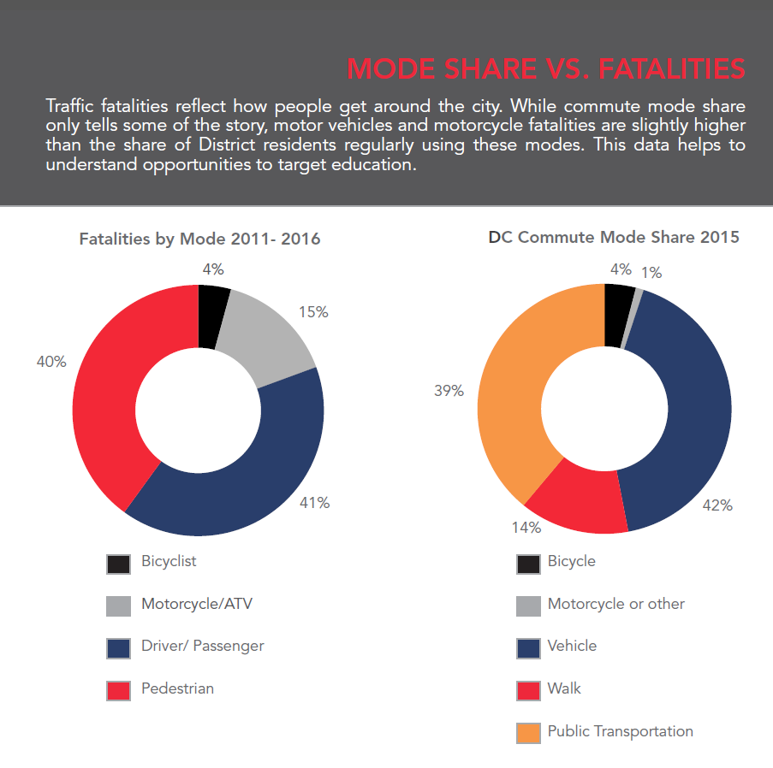

Slide 6
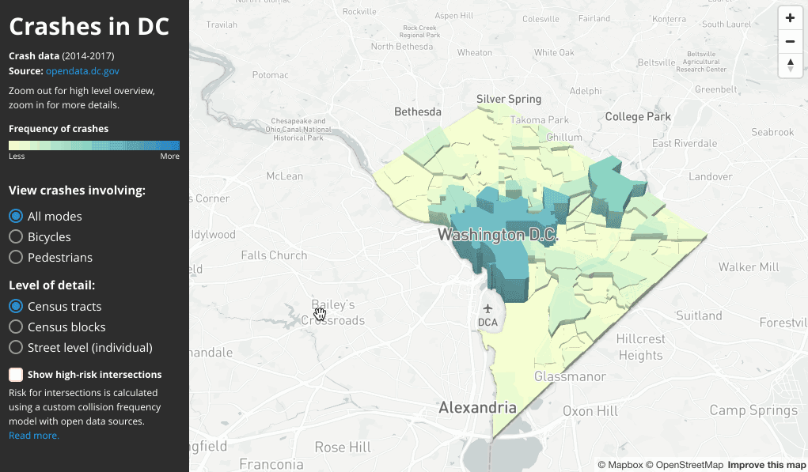

Slide 7
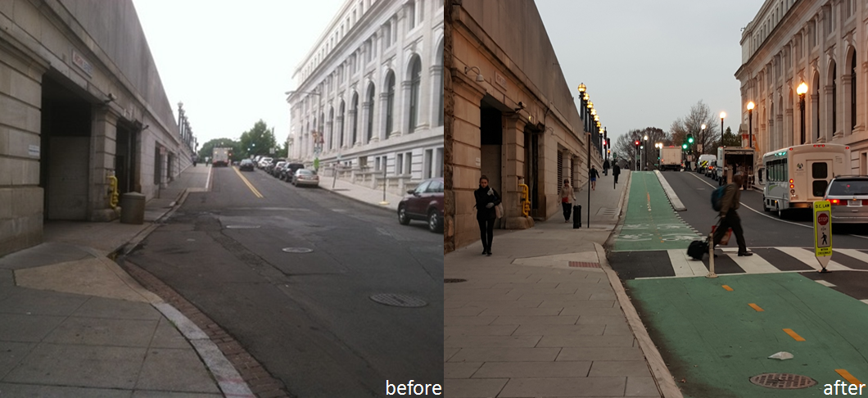

Slide 8
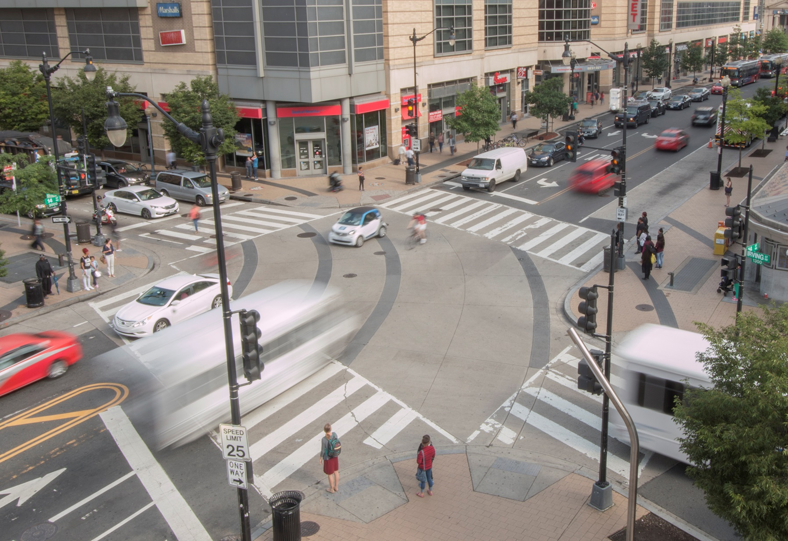
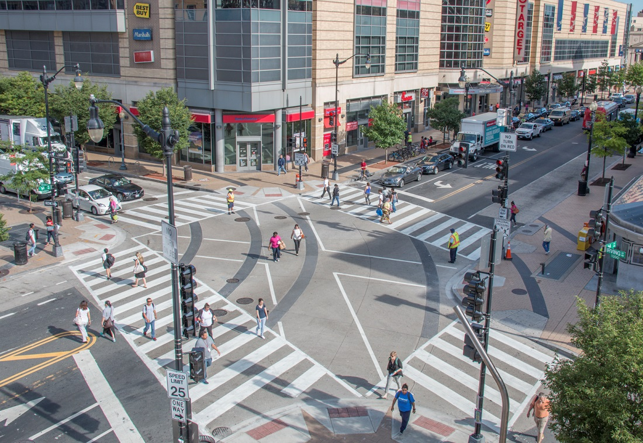

Slide 9
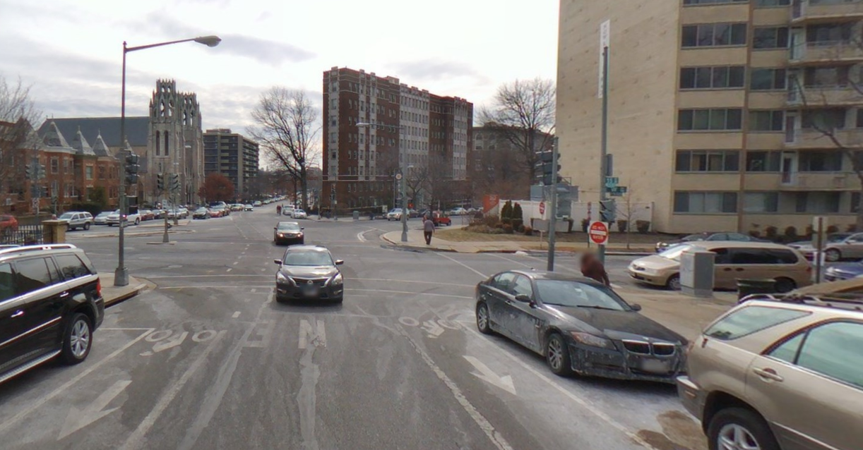
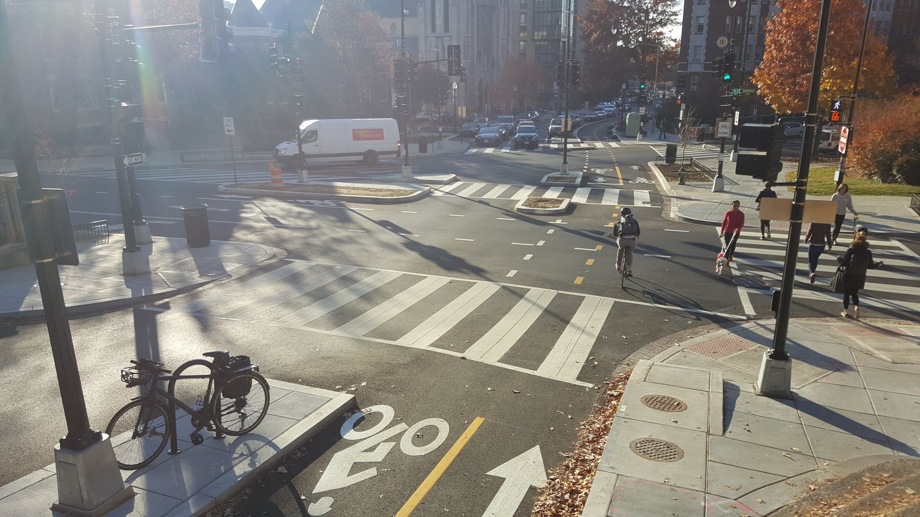

Slide 10
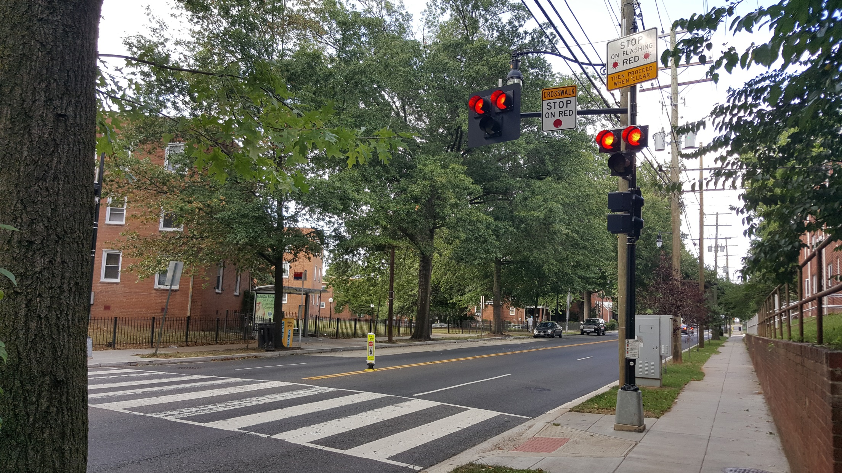

Slide 11
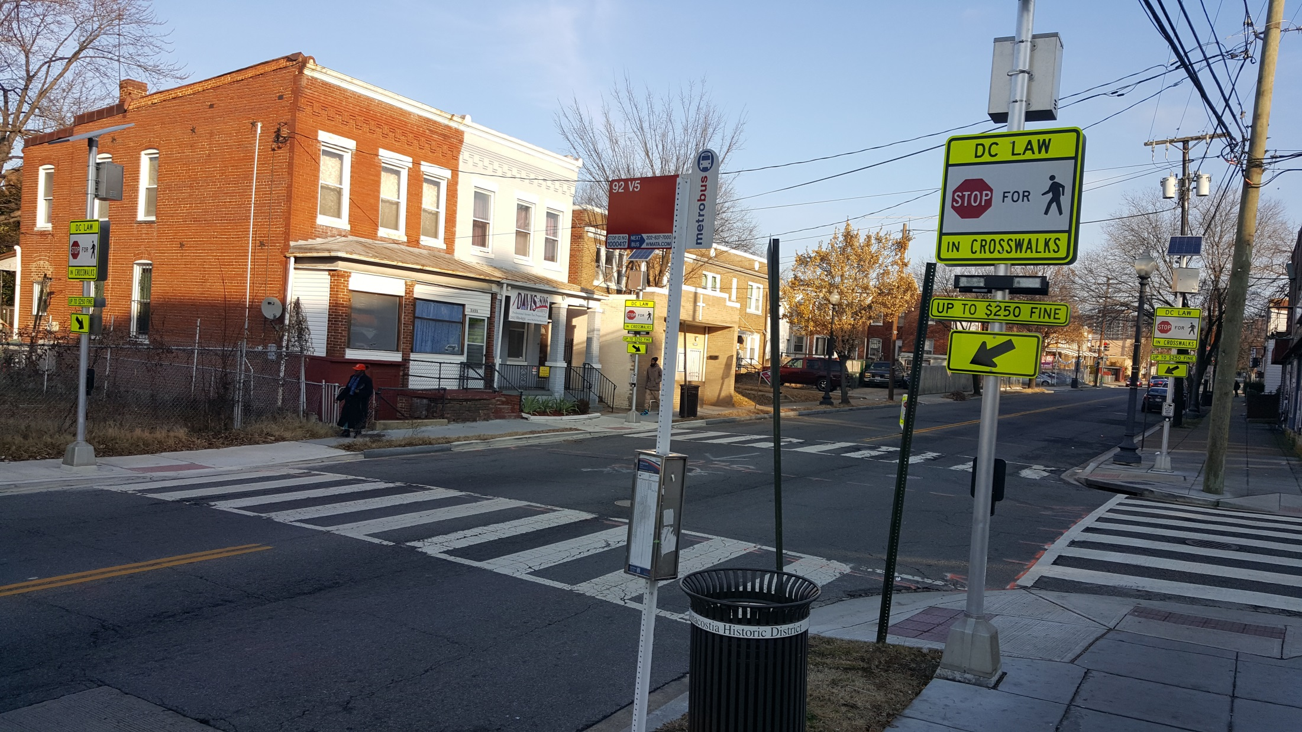

Slide 12
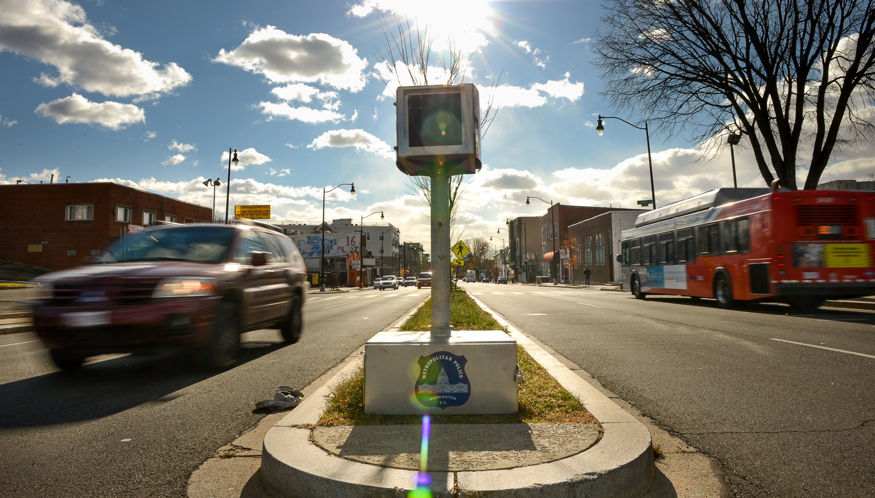



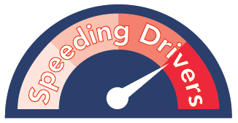
79 Speed Cameras
44 Red Light
6 Oversize
8 Stop Sign

Slide 13
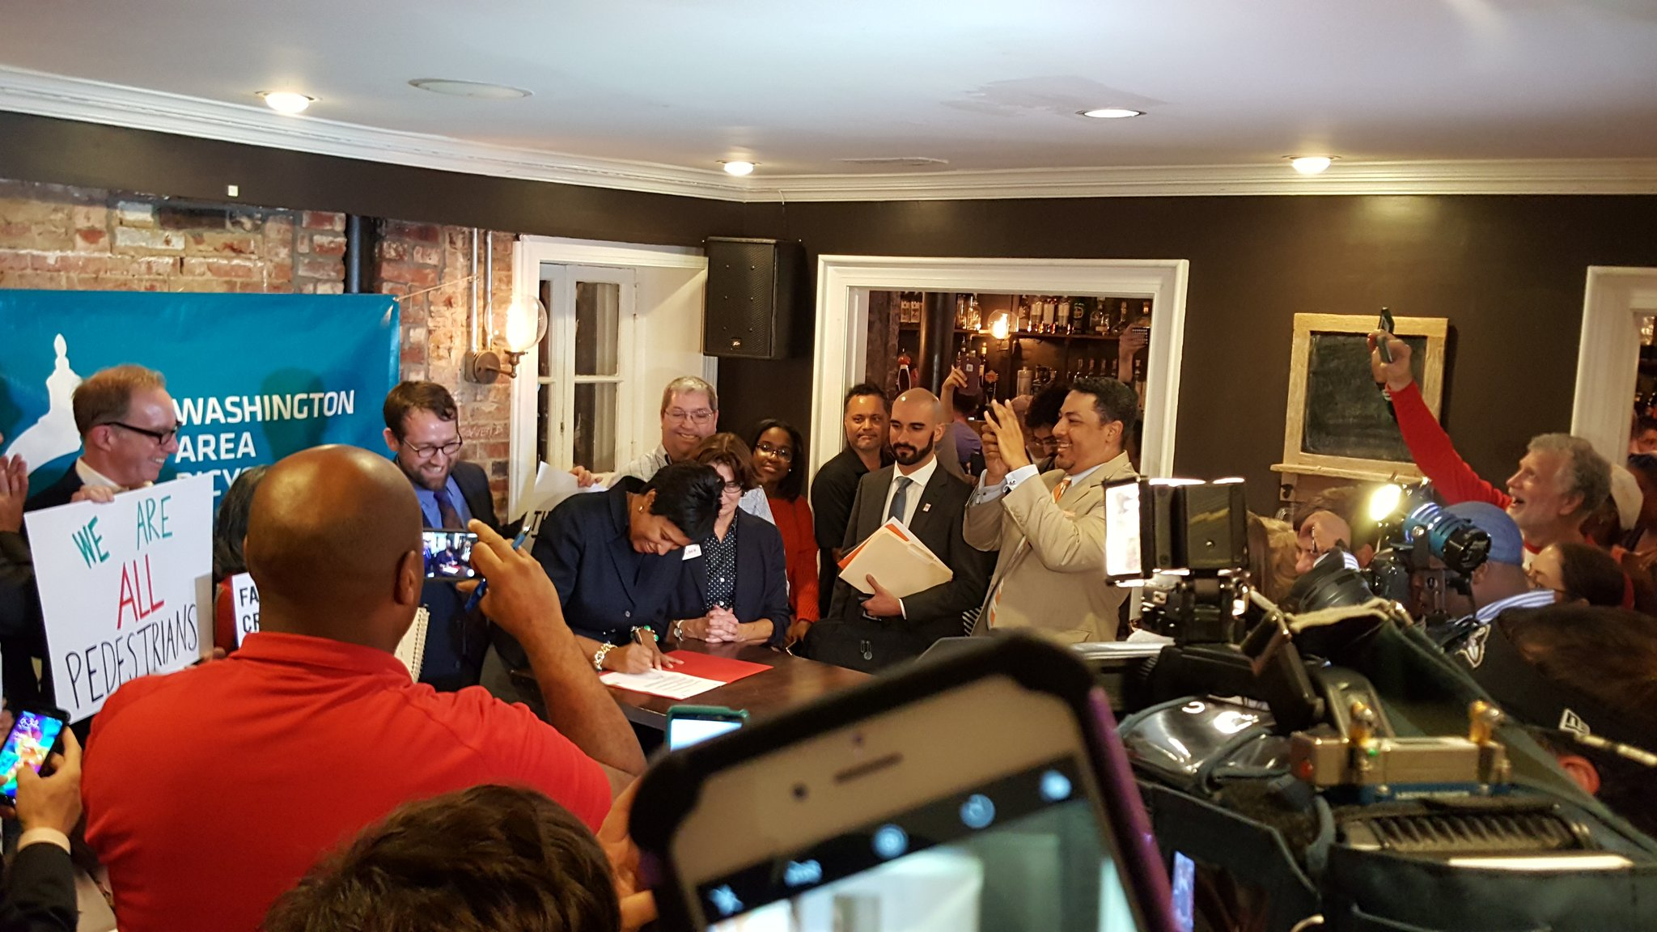
Bicycle and Pedestrian Safety Amendment Act of 2016
  Major Crash Review Task Force
  Complete Streets
  Open Data
Motor Vehicle Collision Recovery Act of 2015
Ignition Interlock
Side-guards
Aggressive Driving

Slide 14
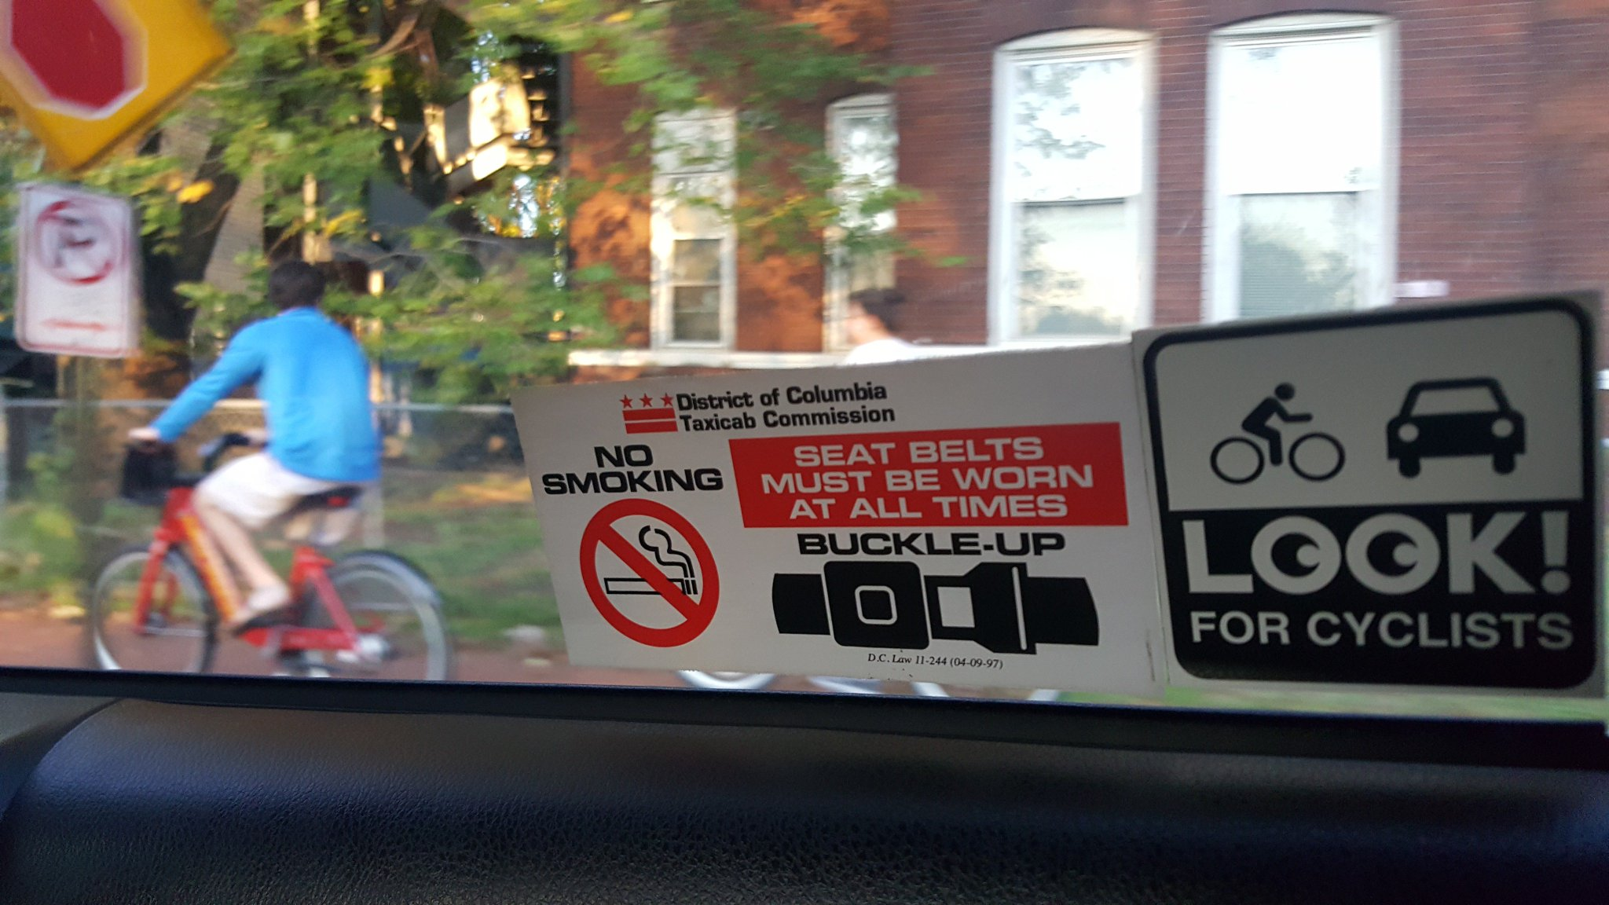

Slide 15
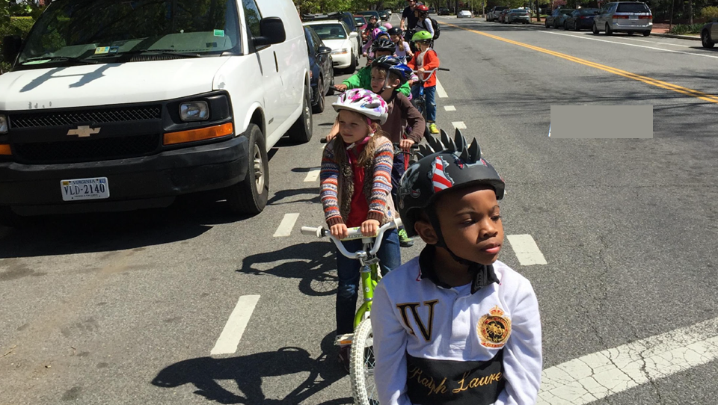
Universal Bicycle Education
in Public Schools

Slide 16
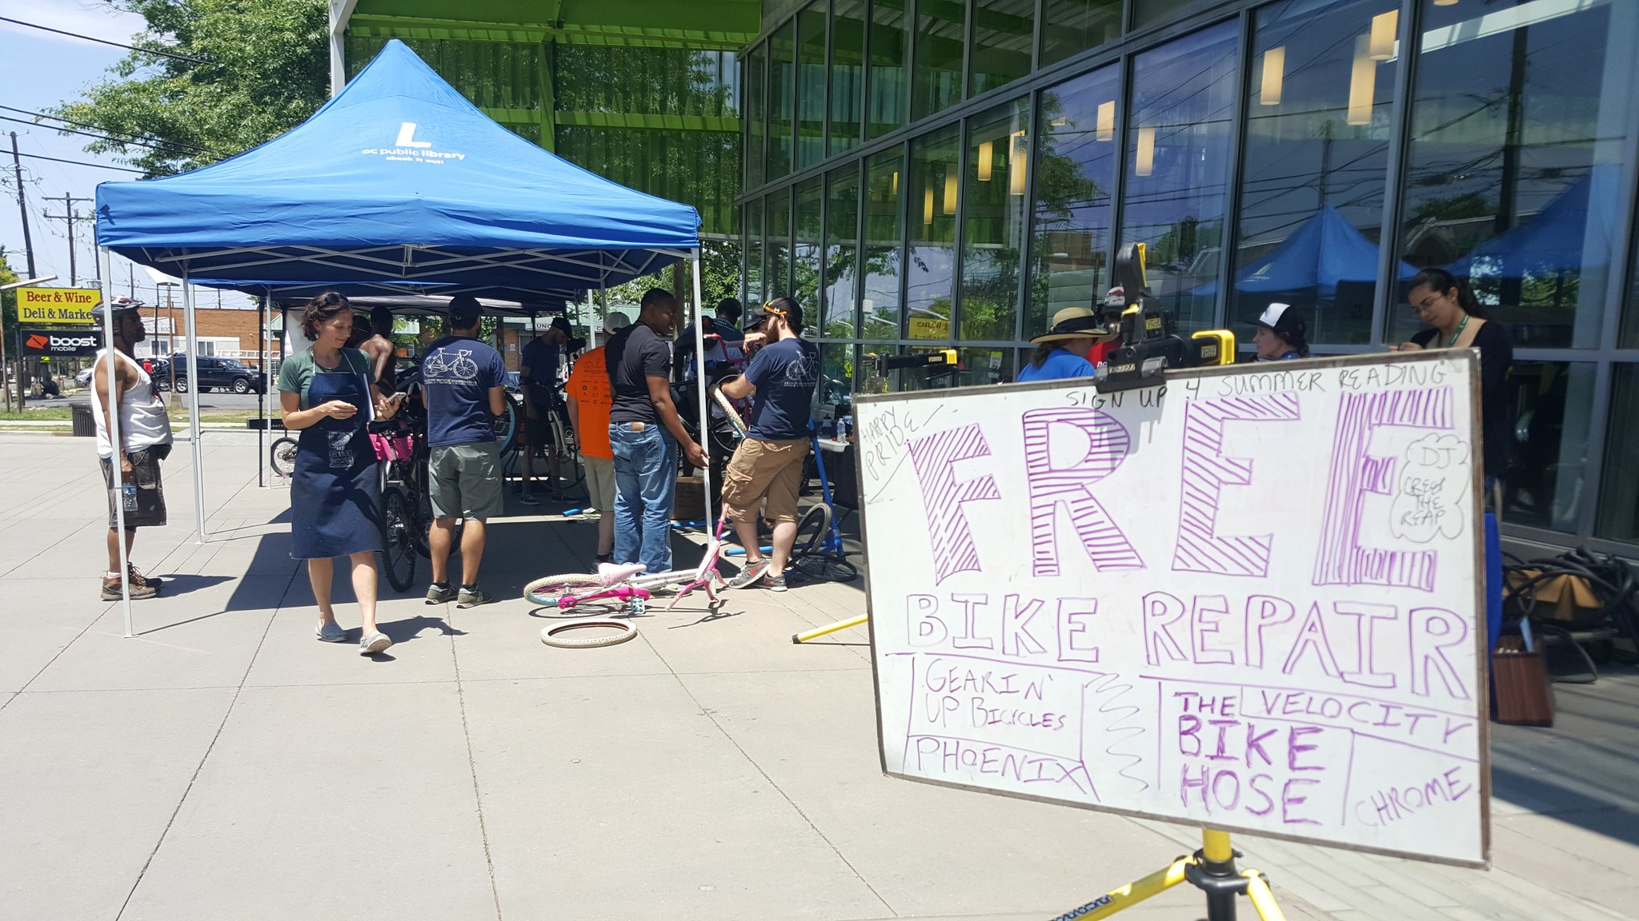

Slide 17
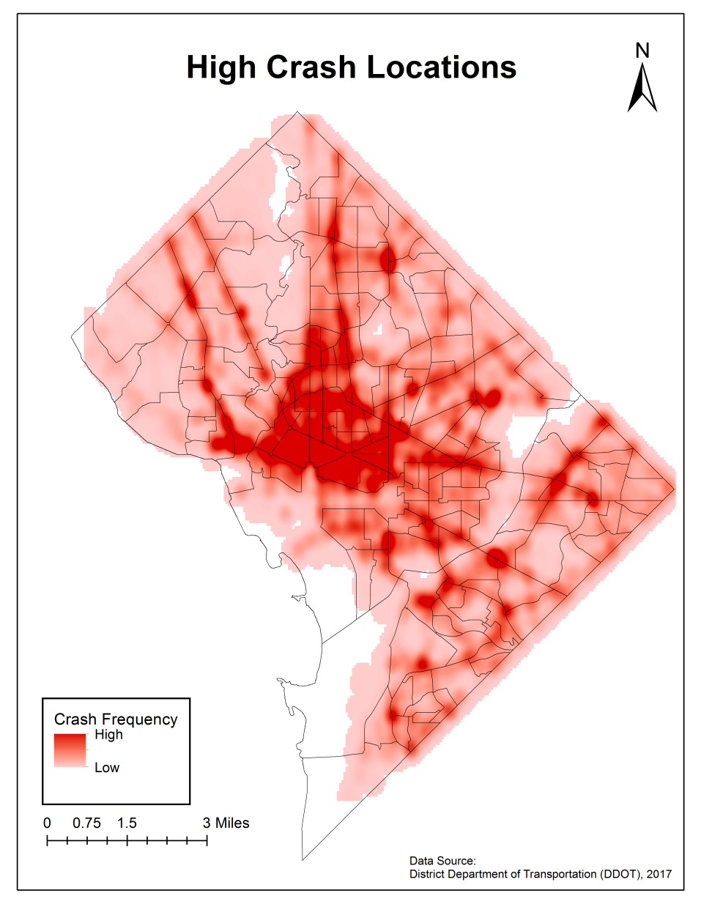
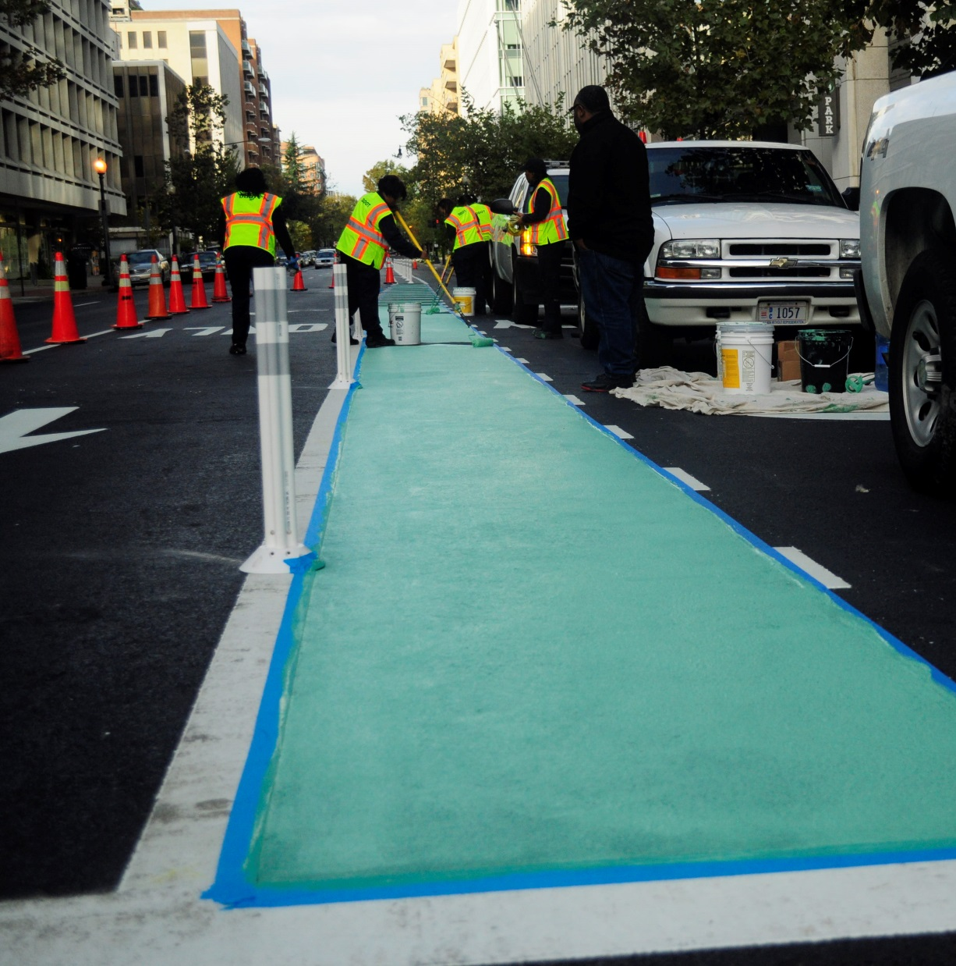

Slide 18
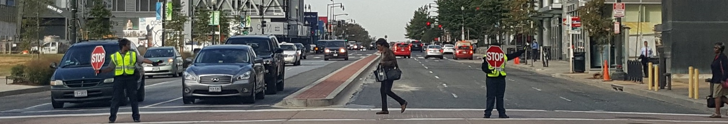
New, More Flexible Funding
Mayor Bowser’s Proposed FY18 Budget:
$4.5 Million for 45 Traffic Control Officers and 26 School Crossing Guards (164 and 51 total)
New ‘Master’ Capital Project: Safety and Mobility
$42 Million over 6 years
Pedestrian and Bicycle Safety Enhancements
Vision Zero Infrastructure Improvements

