Slide 1
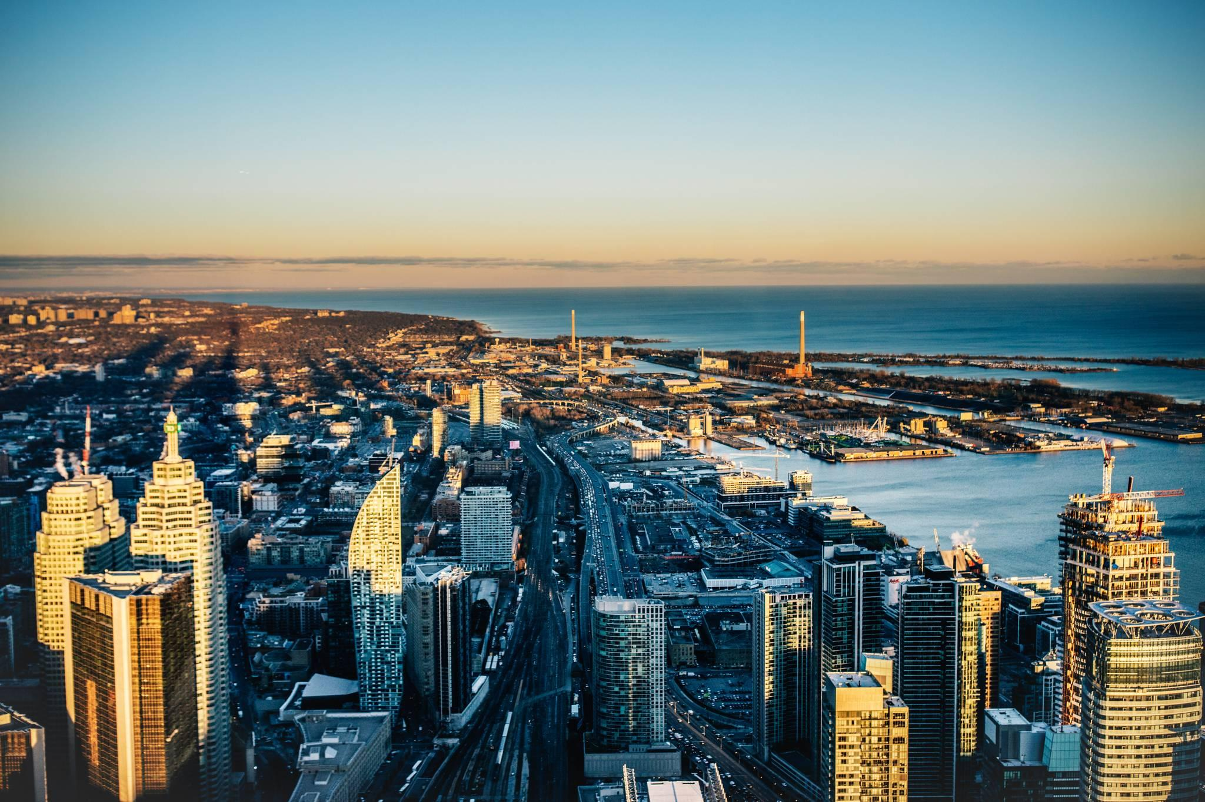
Reimagining the Future of Cities and Road Safety
Nadia Anderson, Ph.D.
Manager, Public Policy, Road and Traffic Safety
Uber Technologies

Slide 2
Agenda
ONE
Uber 101
A global epidemic
What are we trying to do ?
The future of cities and the road ahead
TWO
THREE
FOUR

Slide 3
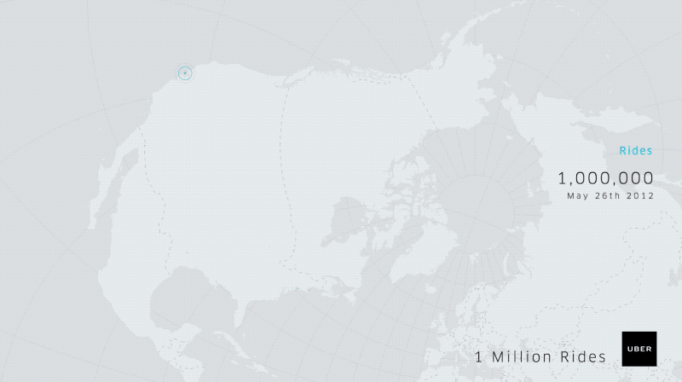

Slide 4
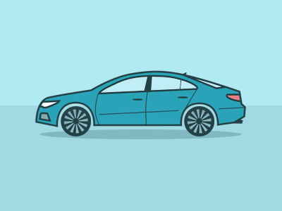

MISSION
Uber's mission is to bring transportation — for everyone, everywhere.

Slide 5
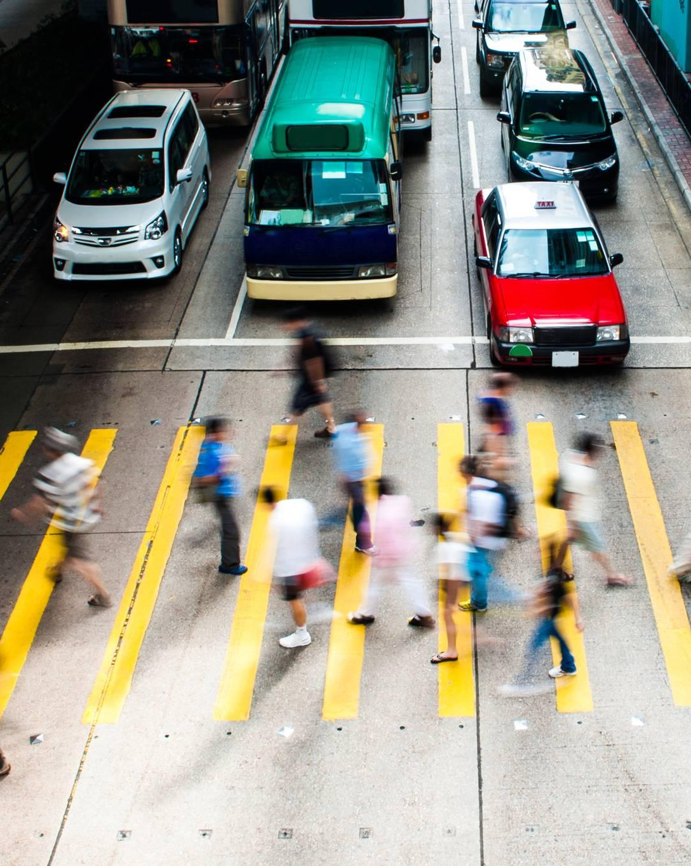
A global epidemic
1.3 million people die each year from crashes
  37,461 fatal crashes in the U.S.
90 percent occur in emerging economies - despite having approx. half of the world’s vehicles
  Established economies are not immune
20-50 million more suffer non-fatal injuries

Slide 6
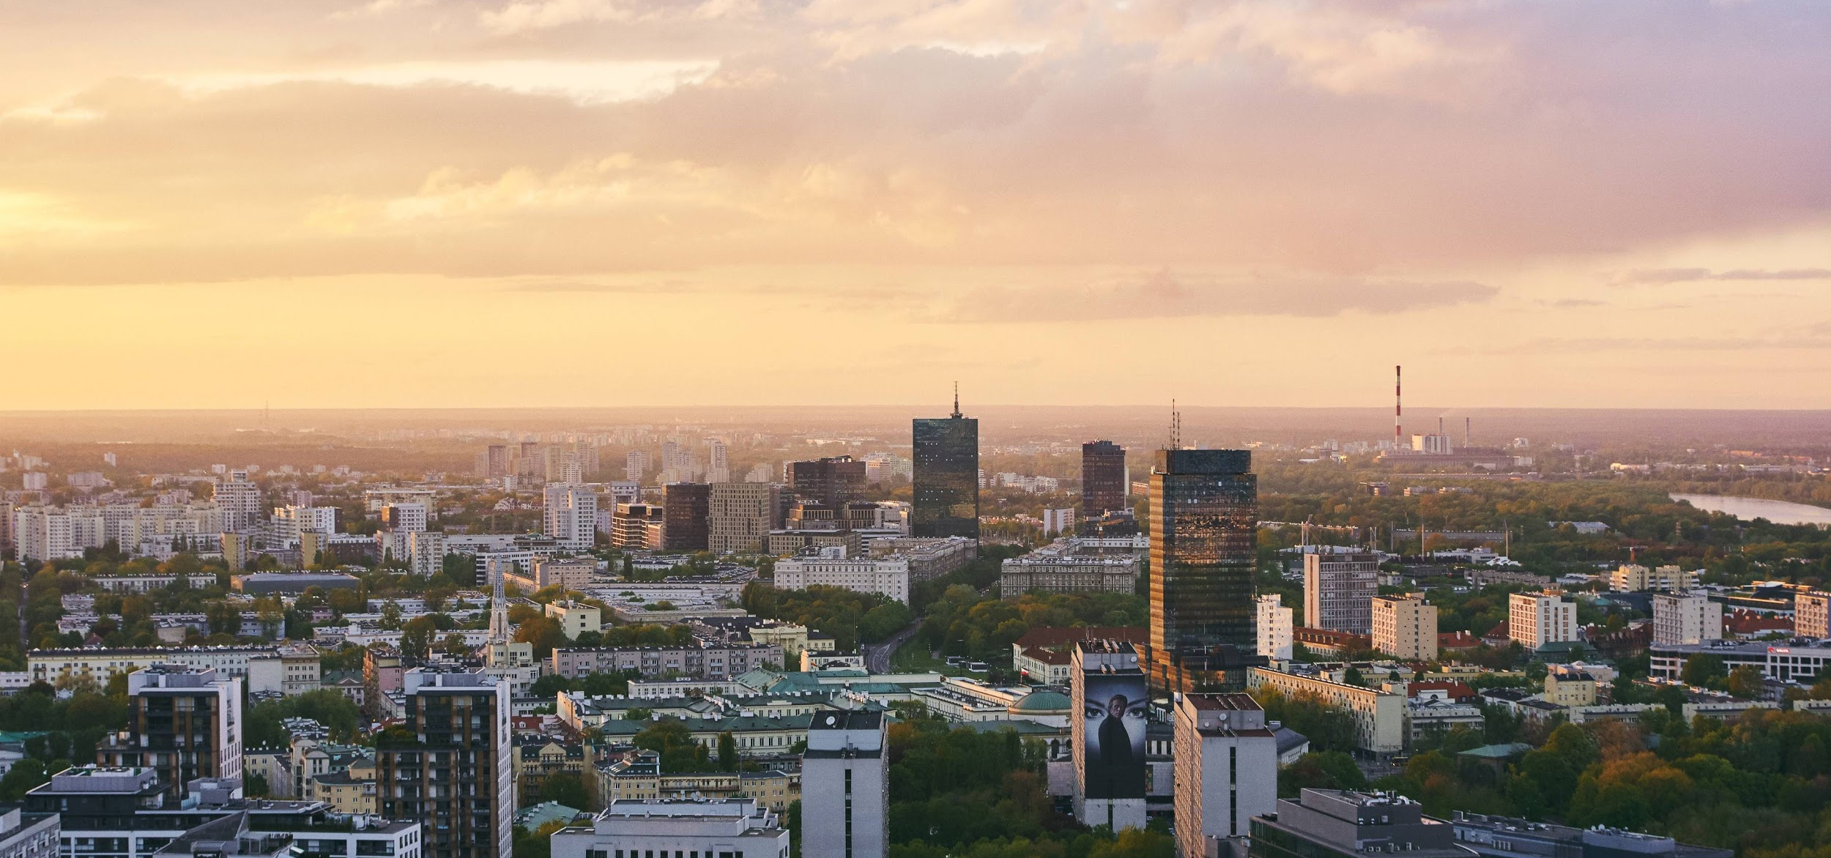
What are we trying to do?
CELEBRATE CITIES
Technology, innovation and transportation.
Working with cities and helping to make roads safer for everyone.

Slide 7
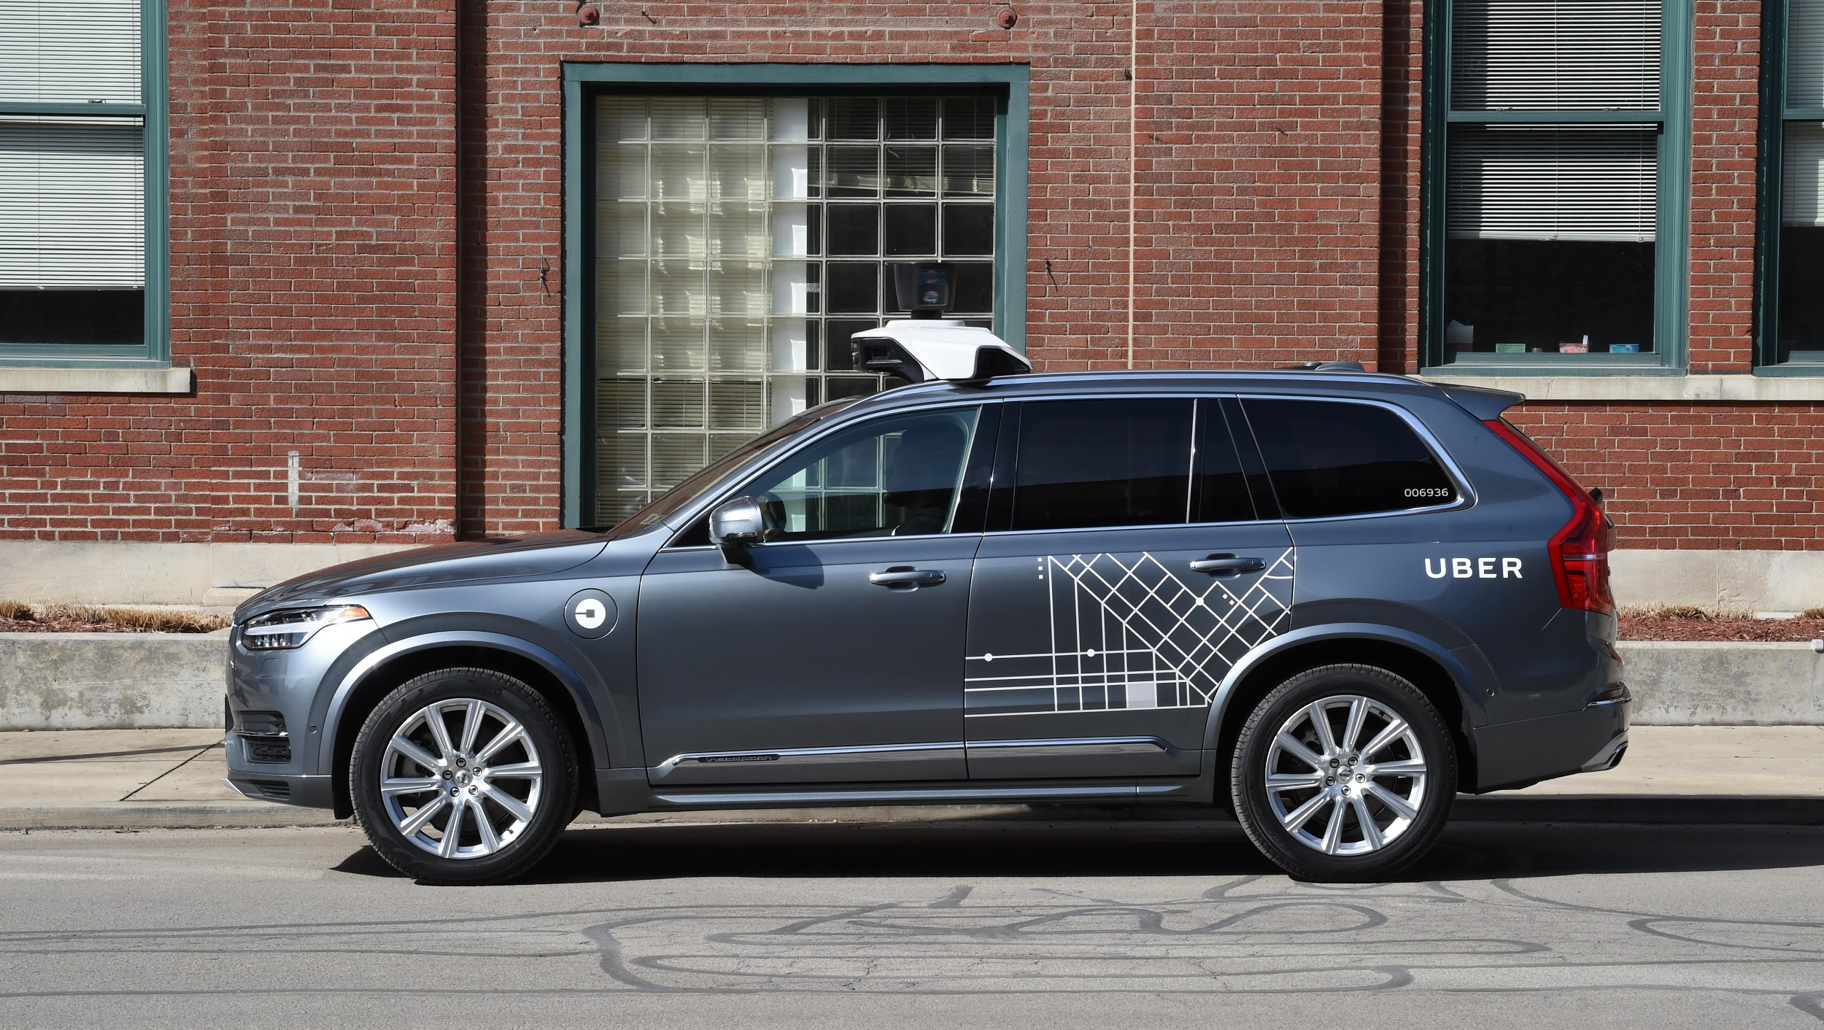

Slide 8
Why is Uber well suited to tackle this challenge?
Strong foundation through Uber network
Transportation technology expertise
The world’s best minds

Slide 9
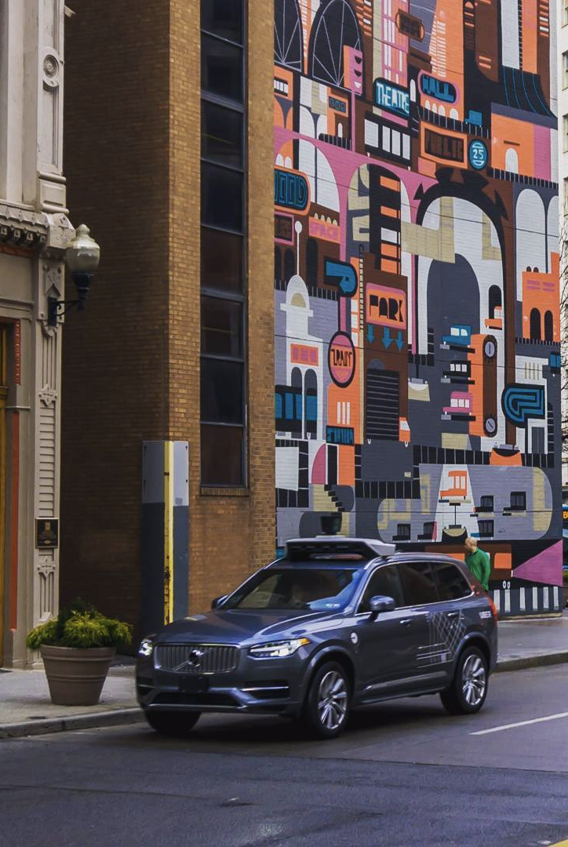
Map
Collect and utilize real-world mapping data via HD maps and Uber Maps
Route
Select specific well-traveled routes based on ridesharing data
Program
Build software that specifically addresses local needs and dynamics along specified routes
Simulate
Simulate routes, and test adjustments on a track near engineering sites
Test & Deploy
Maximize self-driving vehicle utilization and learnings through real-world testing and passenger operations

Slide 10
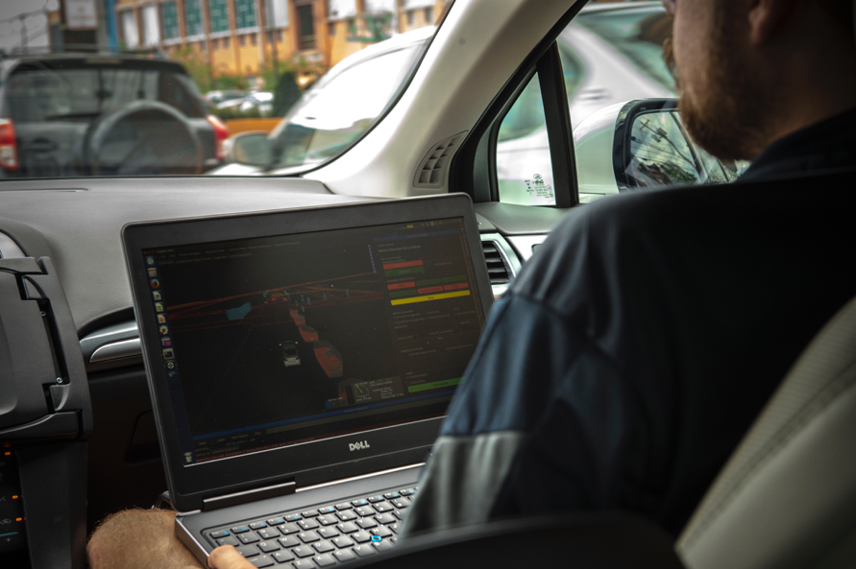
Always learning
Always improving

Slide 11
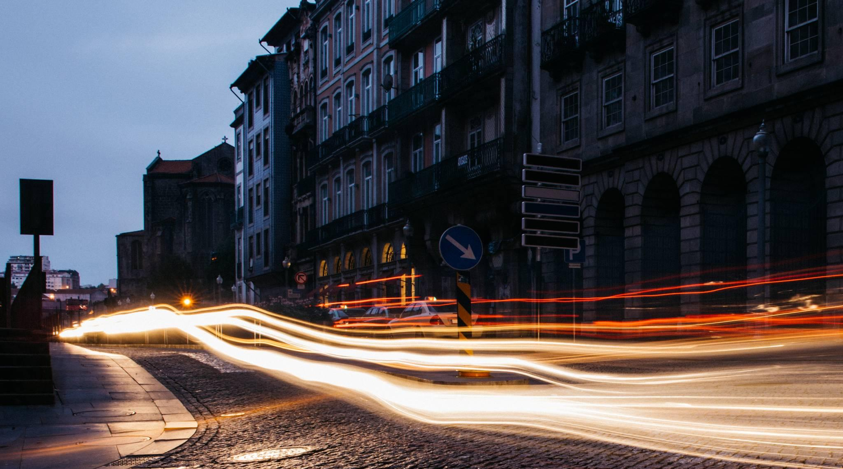

What we set out to do
Smarter ways to move forward
Uber Movement

Slide 12

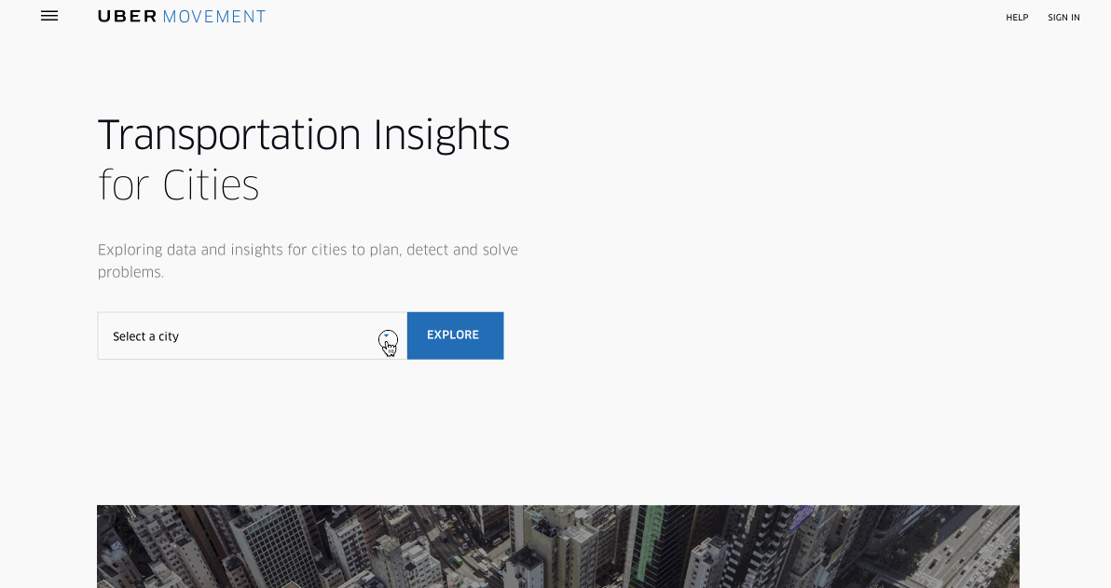
Uber Movement
A free and public website using Uber’s data to help cities

Slide 13

movement.uber.com

Slide 14
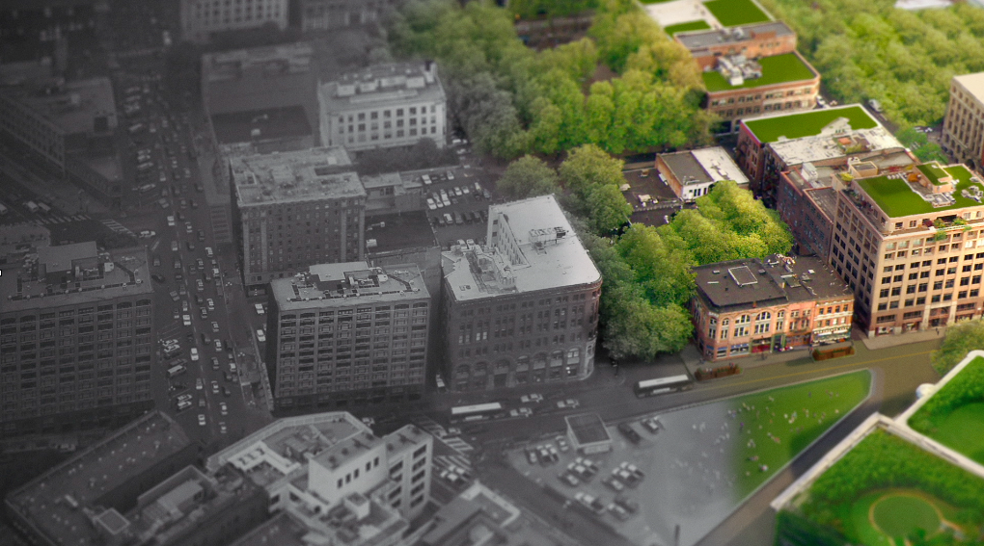
The Future of Cities & the Road Ahead

Slide 15
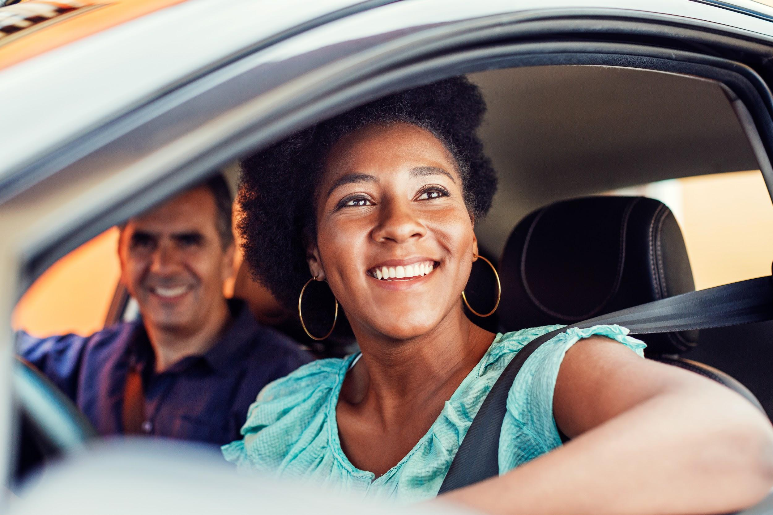
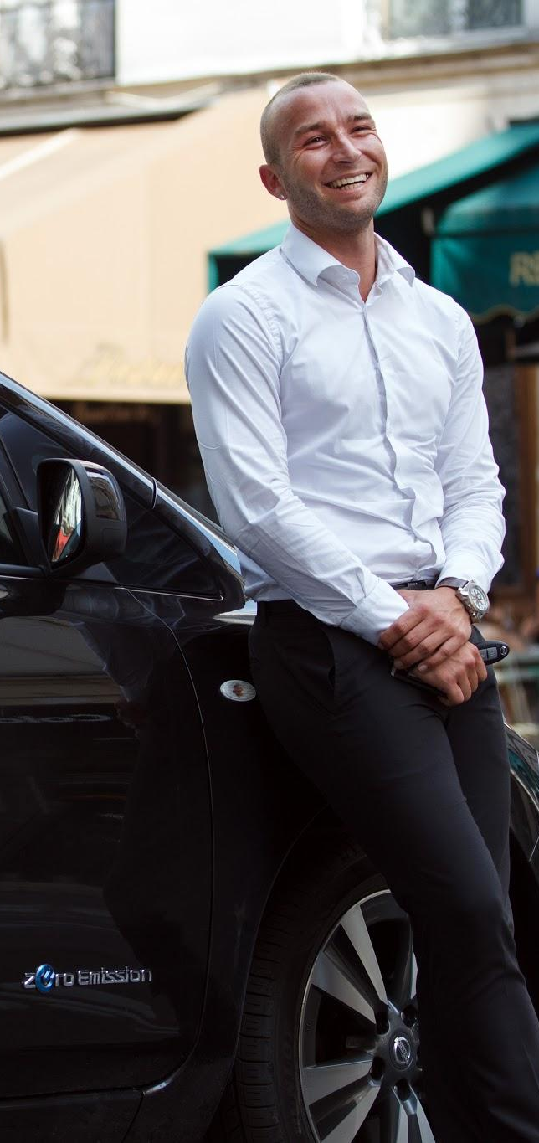
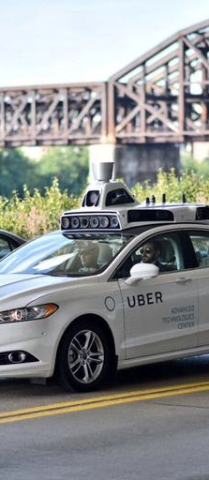
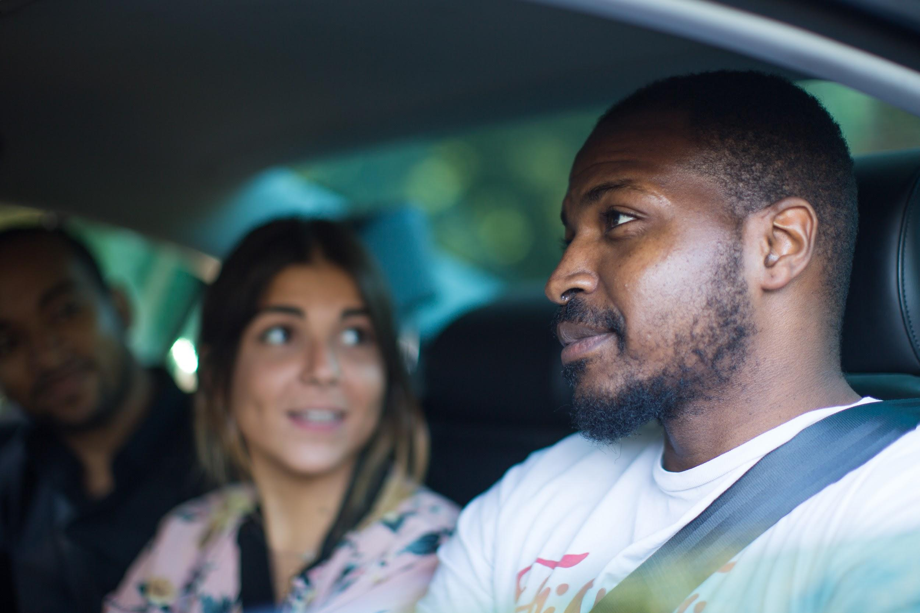
SHARED
ELECTRIC
AUTOMATED

Slide 16

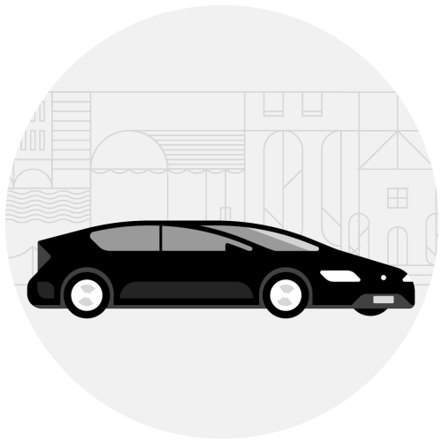





Exploring ways to help cities make data-driven decisions

Slide 17
nadia.a@uber.com

