Slide 1

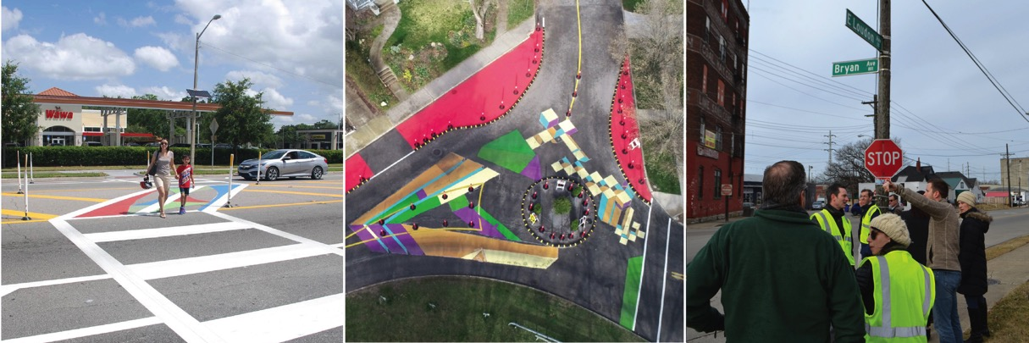
Creating safer streets with demonstration projects
Road to Zero Coalition meeting
June 28, 2018

Slide 2

Safe Streets Academy
Technical assistance program funded by Safe System Innovation Grant from
Road to Zero
Series of three workshops and six distance learning modules
Peer-learning model with interactive exercises
Practical component: plan and implement a safety demonstration project

Slide 3
Demonstration projects
Temporary safety improvements
Fast, flexible, low-cost design interventions
Show the community what’s possible
Introduce new and unfamiliar ideas
Test out whether or not changes work before making them permanent
Build support for safer streets

Slide 4
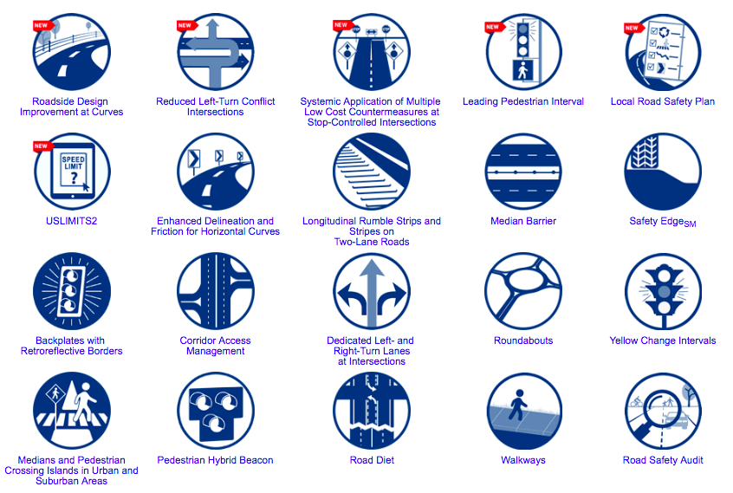
Proven safety countermeasures

Slide 5
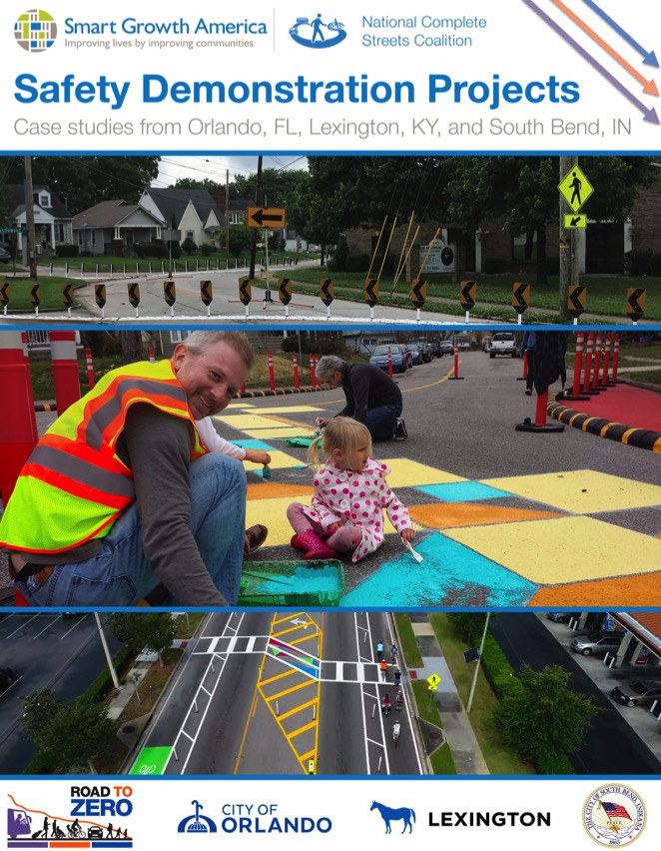
Competitive application process
City of Orlando, FL
Lexington-Fayette Urban County Government, KY
City of South Bend, IN
Read the full stories of these demonstration projects on our website at smartgrowthamerica.org.

Slide 6
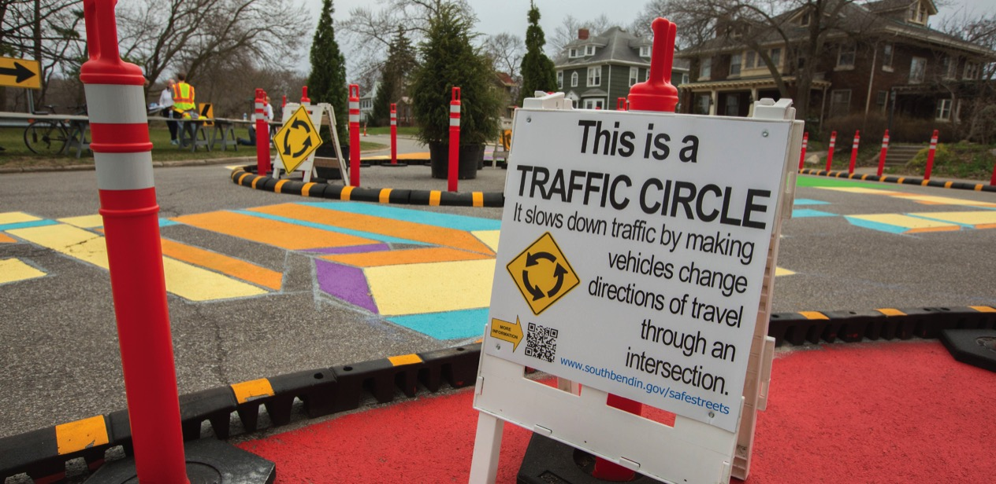
1. Temporary demonstration projects are great opportunities to test out new ideas, teach people about safer streets, and build trust with the community.
Lessons learned

Slide 7
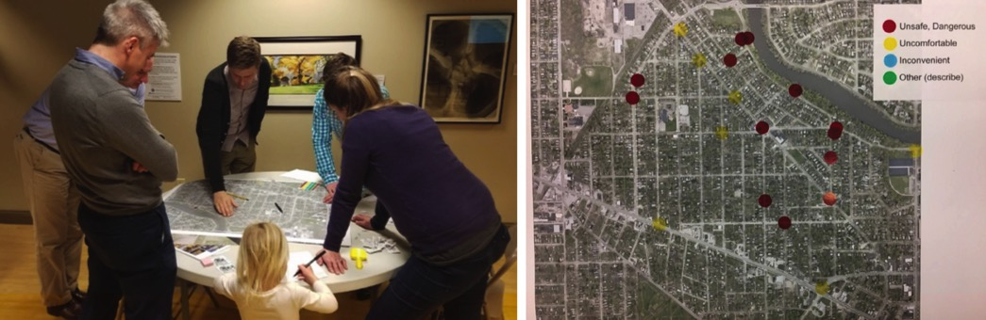
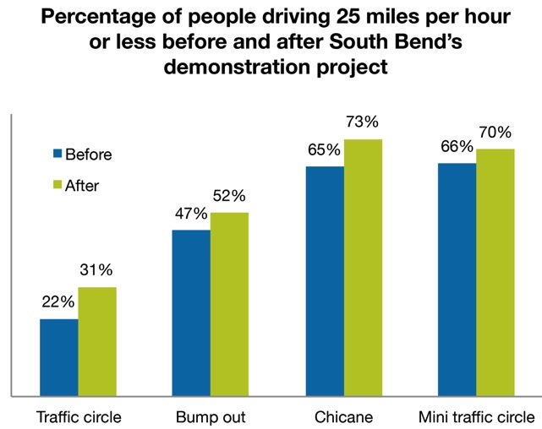
South Bend, IN Neighborhood traffic calming
Tested out traffic circles, bump outs, and chicanes
Community identified sites where they feel unsafe and where drivers speed
Educational signs to teach people about safe speeds
Drivers slowed down

Slide 8
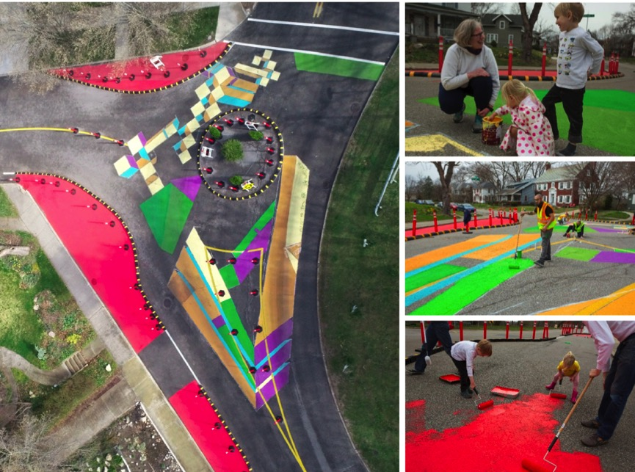
South Bend, IN Neighborhood traffic calming
“People are familiar with speed humps and stop signs, but we’re trying to show them that there’s a whole range of tools available.”
-Jitin Kain, City of South Bend

Slide 9
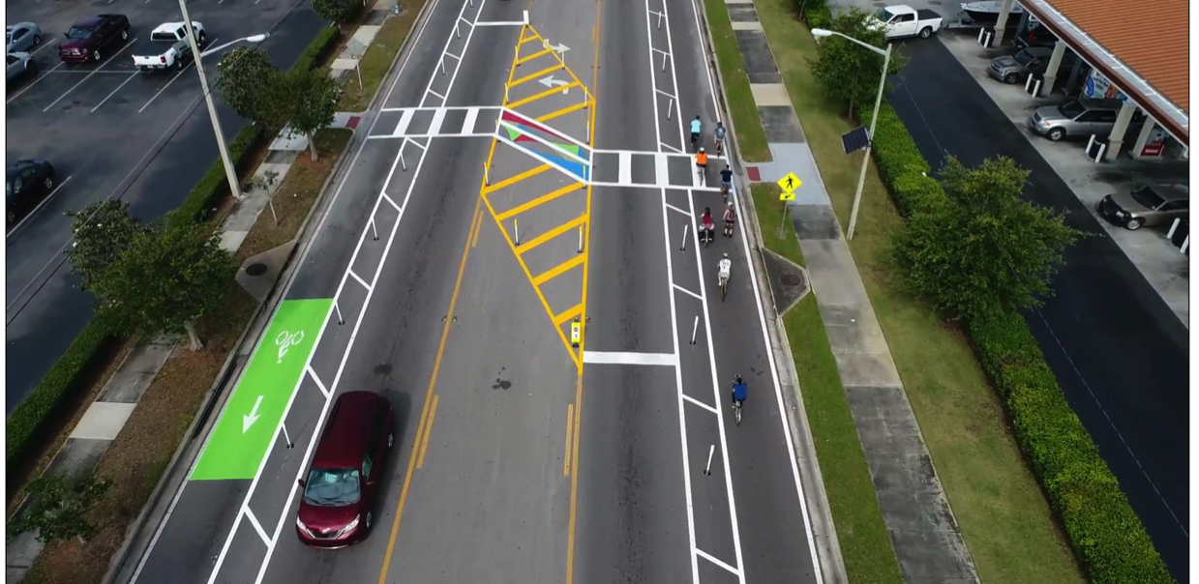
2. You need thorough community engagement to build support for projects that improve safety, especially when these projects come with trade-offs for driving speed.
Lessons learned

Slide 10
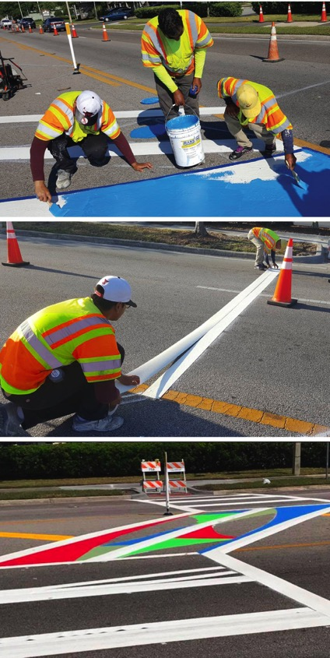
Orlando, FL Curry Ford Road
Before:
  High rate of pedestrian and bicycle crashes
  Frequent speeding
After:
  Slower speeds
  Cars yielding to pedestrians at new mid-block crossing
  People feel safer biking in the protected lanes

Slide 11
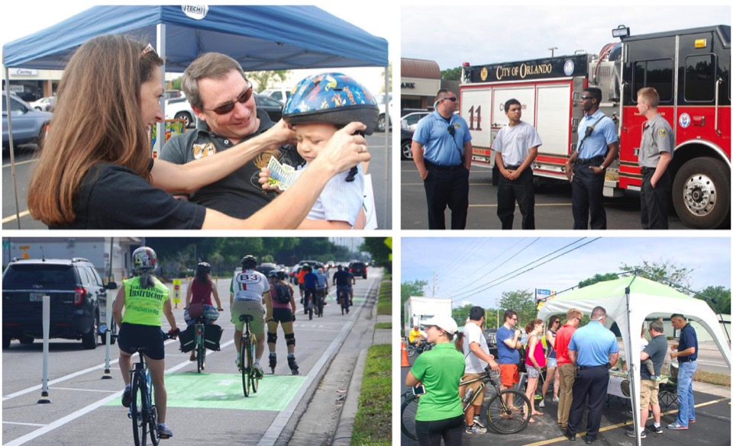
Orlando, FL Curry Ford Road
“Do you want to be a drive to or a drive through community? If you want to be a drive to, there’s going to be a trade-off. You can’t have both.”
-Cade Braud, City of Orlando
Received 142 emails: 39% in favor, 61% opposed

Slide 12
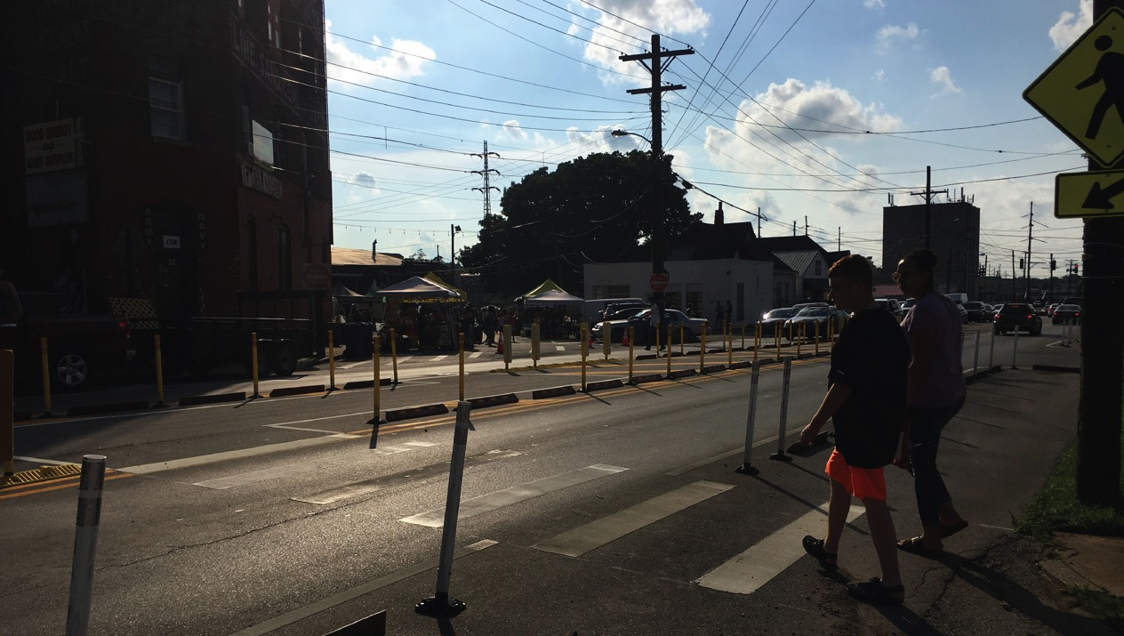
3. Make the most of the resources at your disposal and let the community lead the way to create slower, safer streets.
Lessons learned

Slide 13
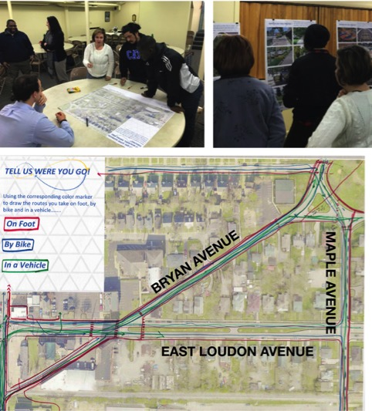
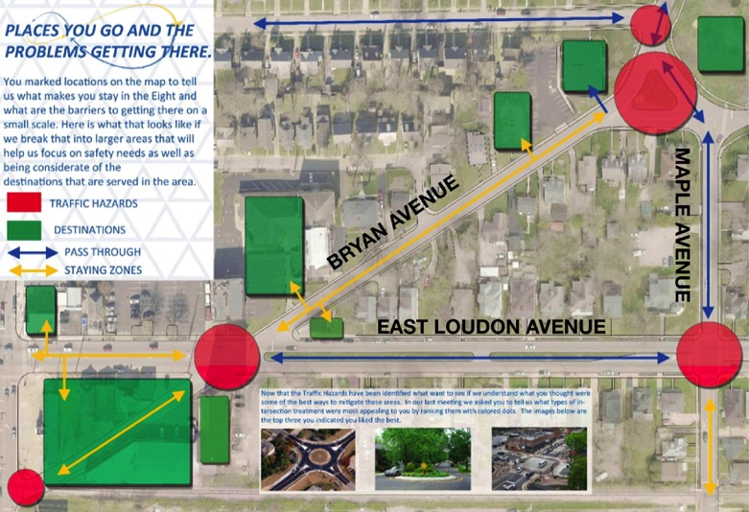
Lexington, KY Bryan Avenue intersections
Citizens Environmental Academy led door-to-door and peer-to-peer engagement
Let the community define safety and mobility problems and guide solutions

Slide 14
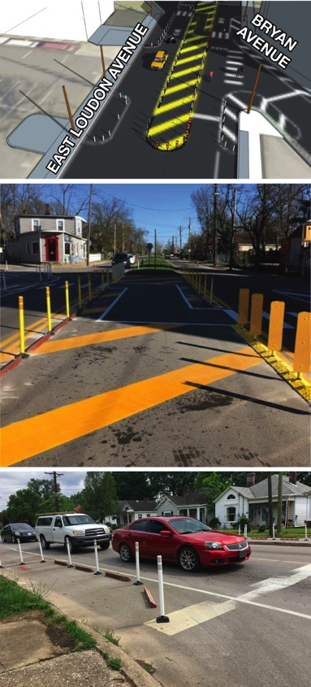
Lexington, KY Bryan Avenue intersections
Redesigned two confusing, dangerous intersections to make them safer and more predictable
Added a protected crosswalk, refuge median, and bump outs
“It does slow down traffic, and that’s the most frustrating part for people that just drive through the area. But I think the overall safety aspects of the project outweigh the little bit of delay that people might experience going through there.”
-Sandra Broadus, Citizens Environmental Academy

Slide 15
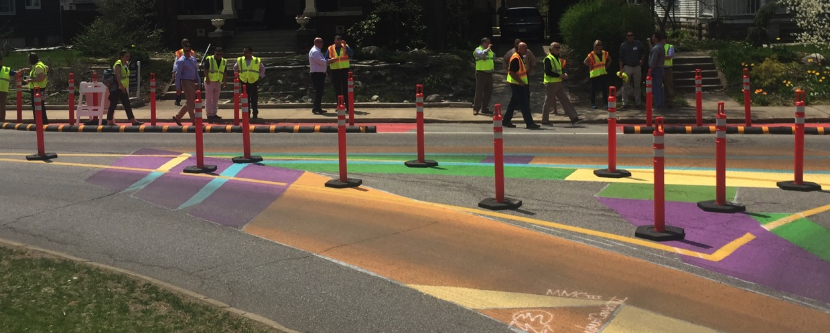
Thank you!
Emiko Atherton, eatherton@smartgrowthamerica.org

