Slide 1

Accelerate Change - Safe System Approach
Tom DiSalvi
Vice President, Safety and Loss Prevention
MARch 20, 2018

Slide 2
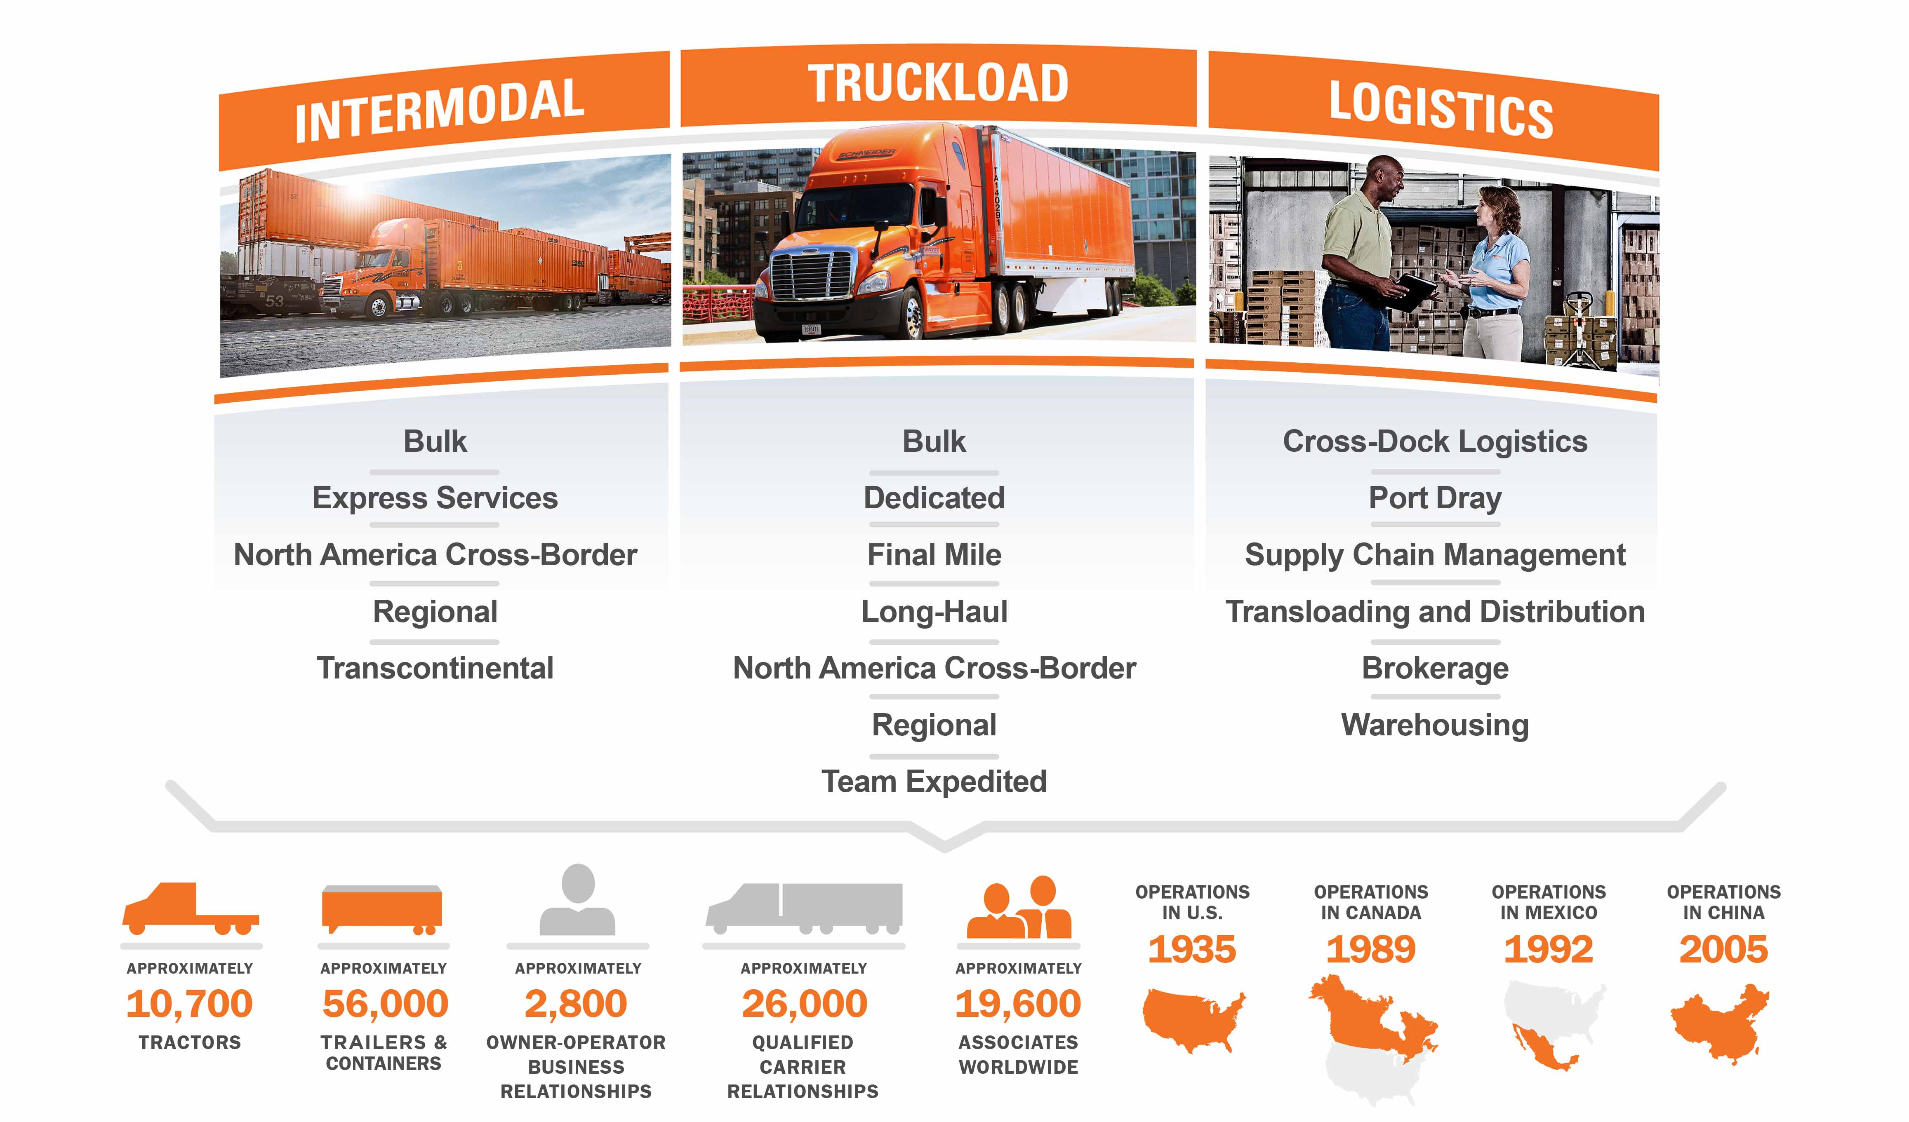

Schneider at a glance
Founded in 1935 by Al Schneider
Headquartered in Green Bay, WI

Slide 3
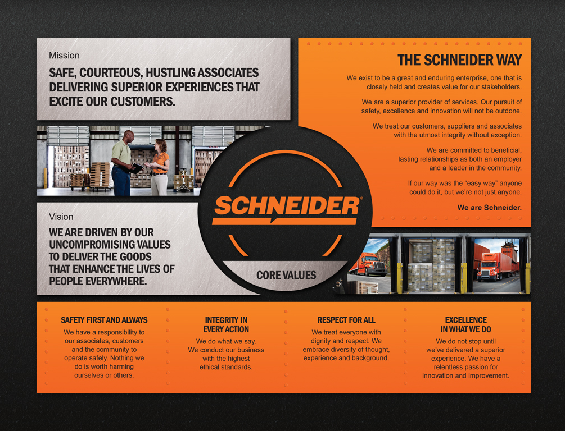
Key to success
Safety Culture
View Every Decision through a Safety Lens

Slide 4
Tenets of safety
Hire The Right Driver
Train Effectively
Management Safety Performance Actively
Leverage Technology
Hire The “Right” Drivers (and retain them)
Train Effectively:
Initial
Sustainment
Performance
Enhancement
Manage Safety Performance Actively
Leverage technology to enhance safety programs
1
2
3
4

Slide 5
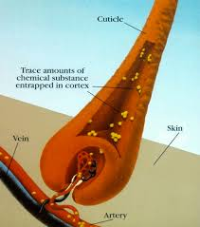
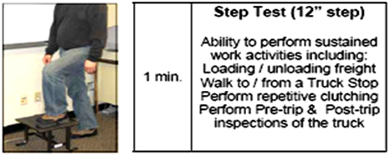
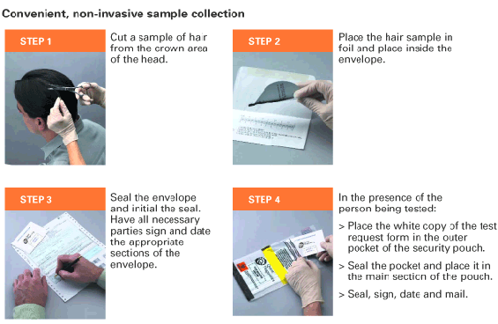
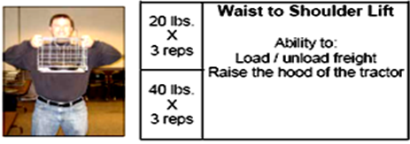
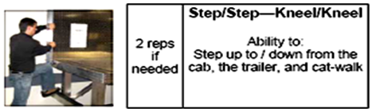
Hire the right driver: more than just “qualified”
Pre-Work Screening
  Reflects physical demands of work
  More than 10 different screening
  modules to reflect work-type
Hair Testing
  Over 100,000 Applicants
  Tested
  Over 4,000 Tested Positive
    Nearly 4% of all tests are positive
    Only 352 with DOT Positive Urine Test

Slide 6
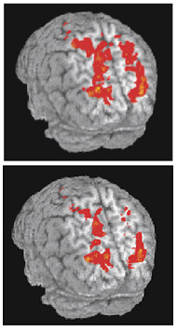


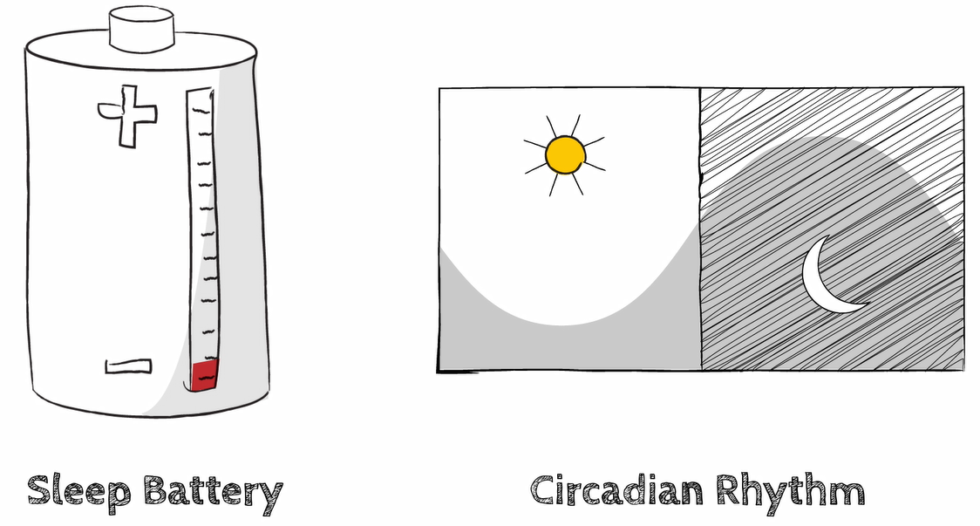
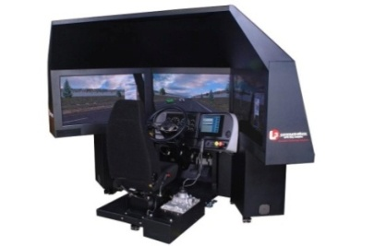
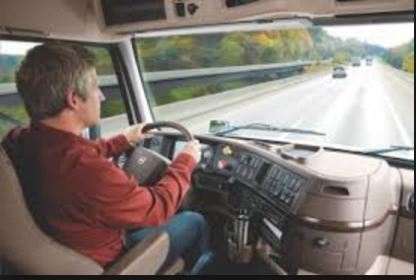
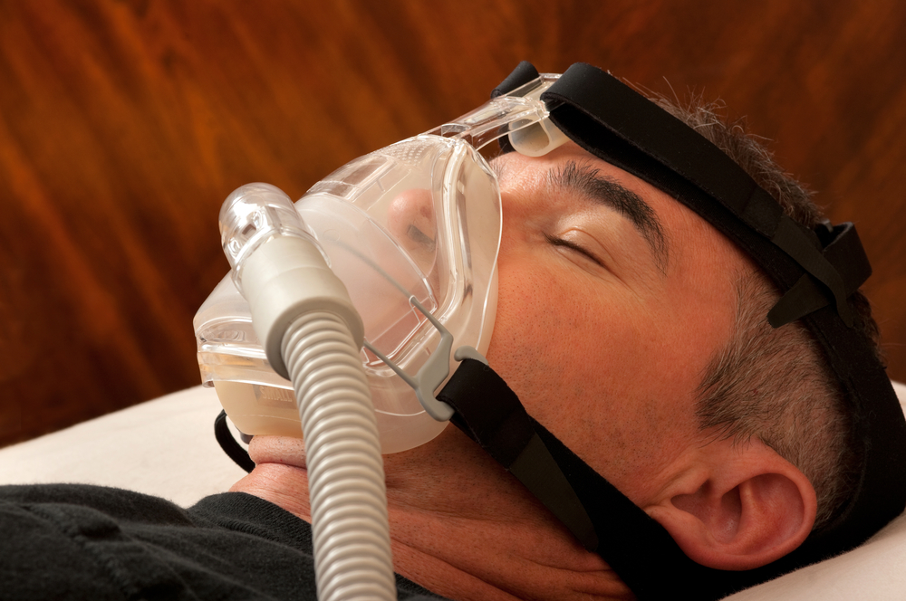
Train Effectively
Training throughout driving career
  Initial training
  Proactive training (quarterly)
  Skills refresher (annually)
Both behind-the-wheel and simulator training
Education and awareness
Distracted driving
  Cognitive distraction
  Looking but not seeing
Fatigue management
  Sleep dept
  Circadian rhythms
  Physiological need
  Sleep disorders

Slide 7
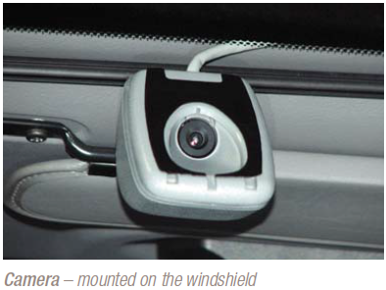
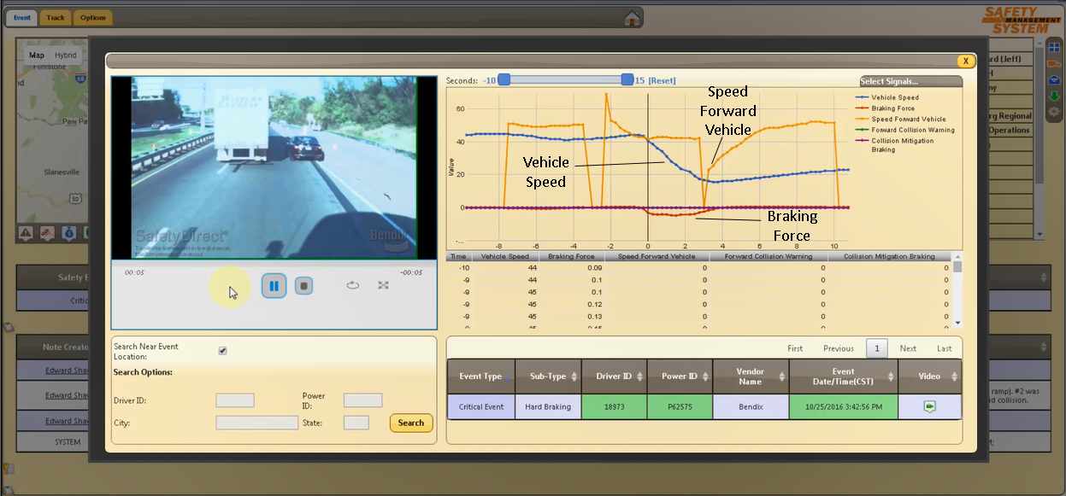
Manage Safety Performance Actively
Use of telematics and video technology
Recognize positive behavior as well as opportunities
Critical event recordings
- Hard Braking
- Stability Control

Slide 8
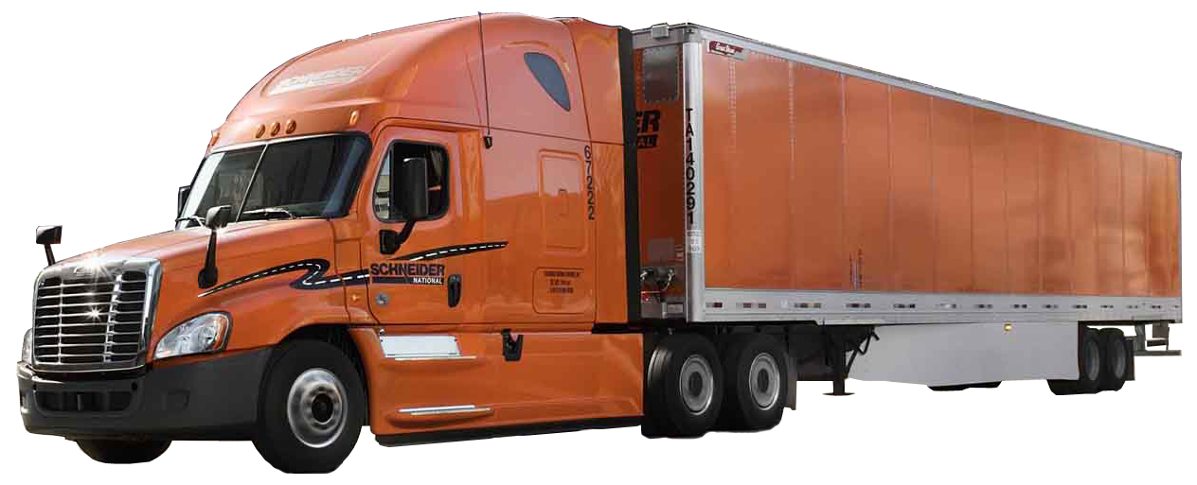
Leverage Safety technology
Active and passive systems
Forward-Facing Camera
w/ Lane Departure Warning
Climate Control
Cab Cooling (Southern Ops)
Cab Heaters (Entire Fleet)
High Visibility
Windshield
Emergency Egress
“Omaha Orange”
for Enhanced Visibility
Telematics Platform
Electronic Logging Device
Truck-Safe Navigation System
Text-to-Voice Communication
Critical Event Recording
Step & Grab Handle
for Trailer Entry
Collision
Mitigation System
Safer Rear Guard Bumper
LED Lights
Grab Handles for
Safe Entry
Big Brakes, ABS
Speed Limiter
Orange Seat Belt
Ratcheting Crank Handle
On Ground Access to Trailer
Electrical & Air Hoses
Ergonomic Driver
& Passenger Seats
Automated Transmission
Stability Control System

Slide 9
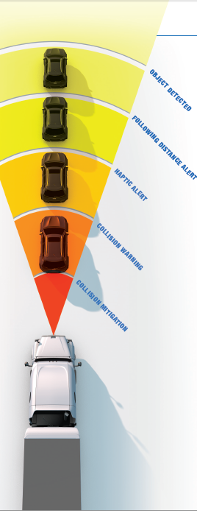
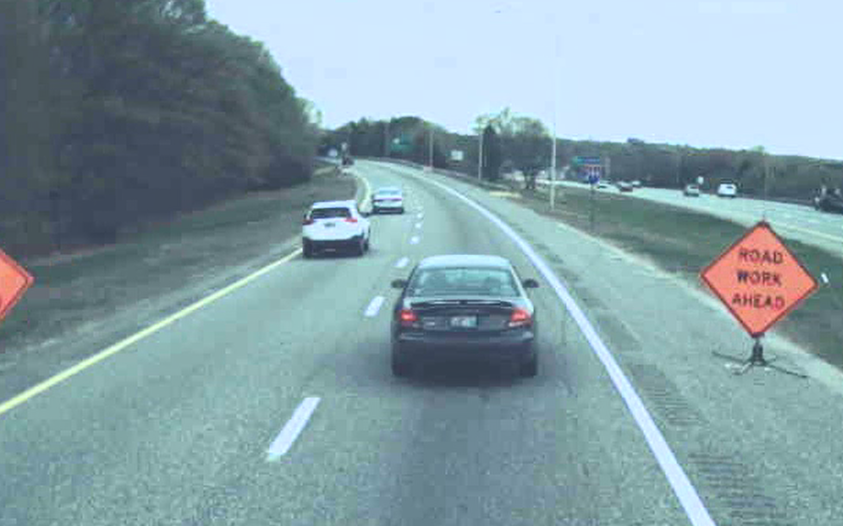
improved highway safety with active braking
SCHNEIDER RESULTS
FEWER
REAR END COLLISIONS
UP TO 68%
PROMOTES SAFE FOLLOWING DISTANCES
LOWER
REAR END CLAIM COSTS
UP TO 95%
REDUCES SEVERITY
OF REAR-END COLLISIONS
CO and OO Fleet w/ OnGuard

Slide 10
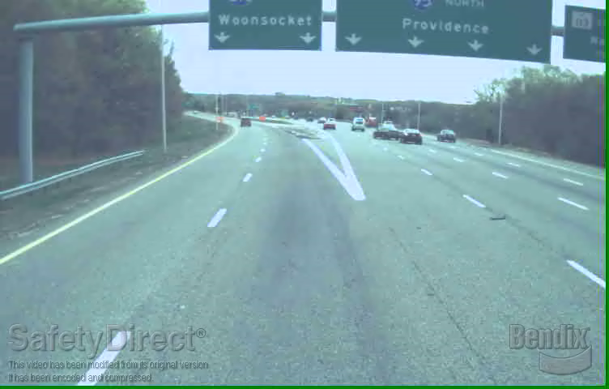

Slide 11
Thank you

