Slide 1


Road to Zero Coalition
Long-Term Vision Report Update
Debbie Hersman
Notes:
June 28, 2018

Slide 2
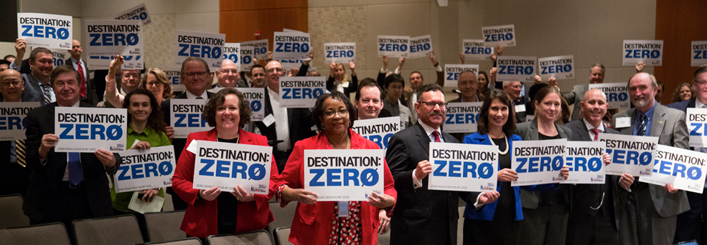
Notes:
If you joined us back in March, you will remember this photo! Please remember that you are part of this. Our gains are thanks to your efforts and participation, so thank you.

Slide 3

Notes:
Special thanks to the following organizations and individuals for their time and expertise on the Road to Zero Steering Group:
Adrian Lund, IIHS (retired)
Adrienne Gildea with CVSA (commercial vehicles and has been on membership committee)
Jonathan Adkins and Russ Martin with GHSA
John Bozzella with Global
Brian Roberts with NACE (National Association of County Engineers)
JT Griffin with MADD
And Debbie Weir with MADD who is now with Everytown for Gun Safety and Moms Demand Action for Gun Sense in America
I’m happy to say that they will all continue to serve as subject matter experts and participate in the Coalition, so don’t think you’re off the hook just yet!

Slide 4
2018 Road to Zero
Grant Recipients
Organization | Grant Name
America Walks with UNC-HSRC | Accelerating Adoption of Safer Systems for All Road Users
Bicycle Colorado | Bicycle-Friendly Driver and Confident Commuting Program
Center for Latino Progress | Cooperative Community Crash Reduction, Hartford CT
City of Boston | Boston's Safest Driver
Institute of Transportation Engineers/ Vision Zero Network | Moving from Conversation to Action: A Scalable Training Resource on Speed Management for Transportation Professionals and Community Stakeholders
Lorain County Public Health | Lorain Active Transportation Collaborative
National Complete Streets Coalition, Smart Growth America | Safe Street, Smart Cities Academy
NORC at University of Chicago | Underutilized Strategies in Traffic Safety
Texas A&M University / Houston Methodist Hospital | A systems approach to reduce drowsy driving among night-shift nurses
University of Alabama at Birmingham/ Safe Kids Worldwide | Improving Child Restraint Installation in Rural America through Interactive Virtual Presence
University of Michigan | Addressing Socioeconomic Disparities in Motor-Vehicle Fatalities
TOTAL AMOUNT | $ 1,500,000
Notes:
We didn’t have all the award winners selected last time we met, so this is our updated 2018 award recipient list.
One of the stand out things about the latest 2018 RTZ grant winners is just how much collaboration is happening among the different organizations.

Slide 5
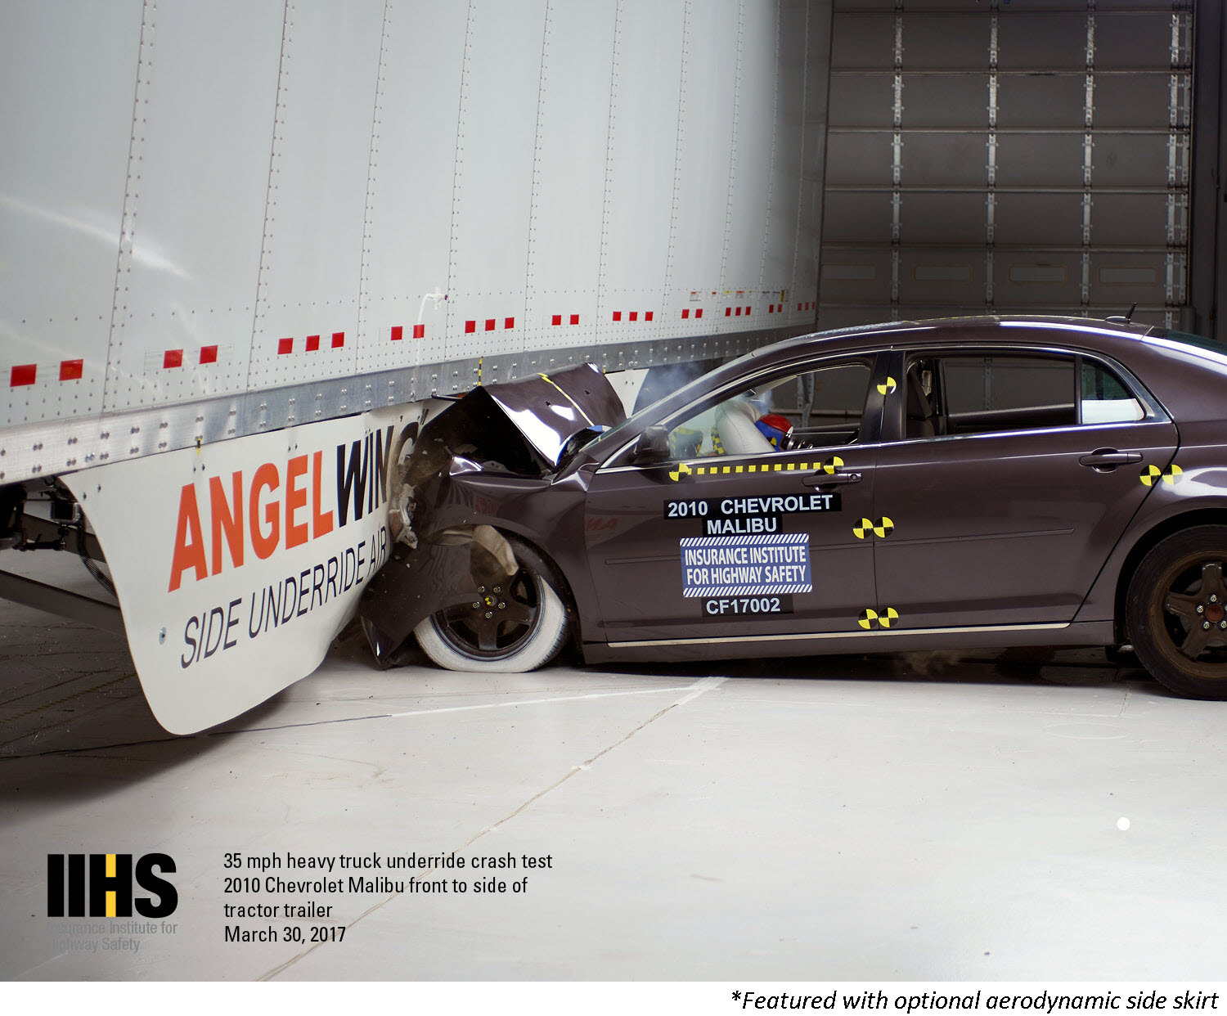
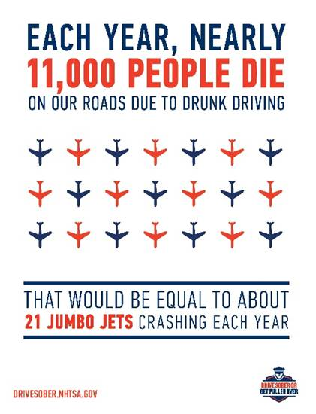
RTZ Priority Statements
Notes:
Part of our goal to end preventable deaths on U.S. roads, the Coalition has developed two Safety Priority statements that I want to make sure all members know about, and can support.
Truck Underride
Alcohol Impaired Driving
Truck underride crashes could be more survivable with effective underride guards, including rear and side guards. Comprehensive underride protection standards, including single-unit trucks, would create a safer environment for not only passenger vehicles, but for other vulnerable road users, such as pedestrians, cyclists, and motorcyclists.
On the impairment side, it is estimated that 7,000 lives per year could be saved if no drivers exceeded 0.08 BAC. It is time to double down on proven strategies and consider new approaches in order to significantly reduce and eventually put an end alcohol-impaired driving.
These statements and their accompanying strategy goals serve as a model for Coalition members as well as safety-minded advocates in the transportation space.

Slide 6

HOW DO WE SHIFT CULTURE?
Notes:
It all comes down to how do we shift safety culture?
Last time we were together, we talked about how we have been able to shift culture successfully in many areas of our lives, even other transportation modes.

Slide 7
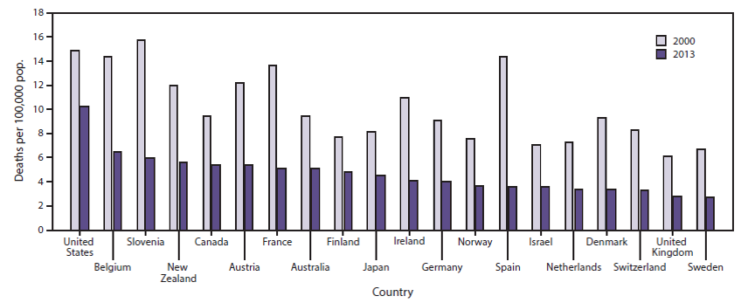
INTERNATIONAL COMPARISON
Sauber-Schatz, E. K. (2016). MMWR, 65.
Notes:
We talked about the global perspective in our panel earlier today. Just a reminder, we have a lot of catching up to do, as other nations are making much more progress on roadway fatalities than we have been able to do. We can do better.

Slide 8
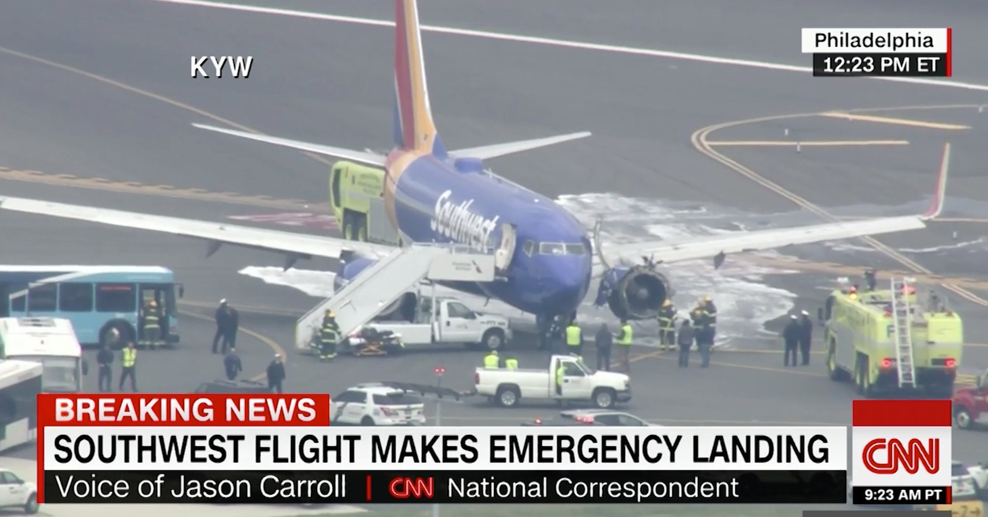
Notes:
How many of you remember the news about this crash?
The likelihood of a jet engine failure is less than one for every million flights worldwide.
But that doesn’t stop many from worrying about safety in the air.
We demand 100% safe operations in aviation, marine, pipeline, rail and transit, we should cultivate a corresponding societal demand for safe roads.
Safety is not yet our #1 priority on our roads, but that’s why all of you have joined the Road to Zero Coalition.

Slide 9
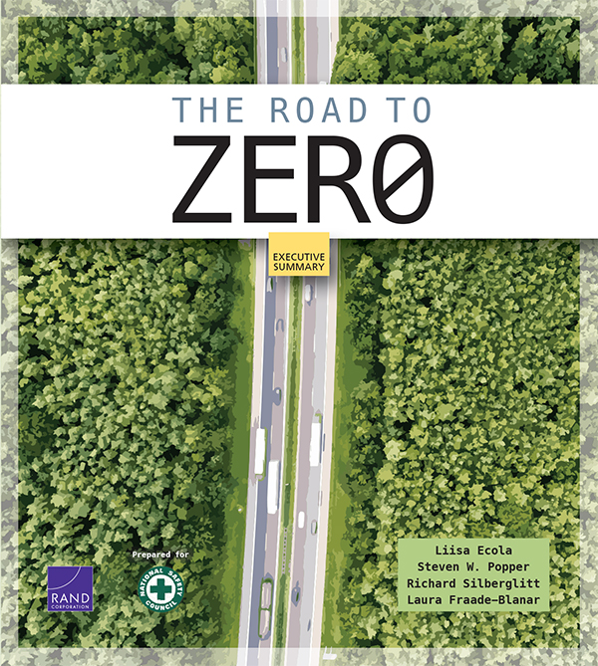
DOUBLE DOWN
on What Works
ACCELERATE Technology
PRIORITIZE
Safety
Notes:
We successfully released the RTZ report at Lifesavers back in April. Many thanks to the Lifesavers Committee for allowing the roll out of the report at the conference.
Copies of the report are available on the table where you checked in, so please make sure to pick up a copy.

Slide 10
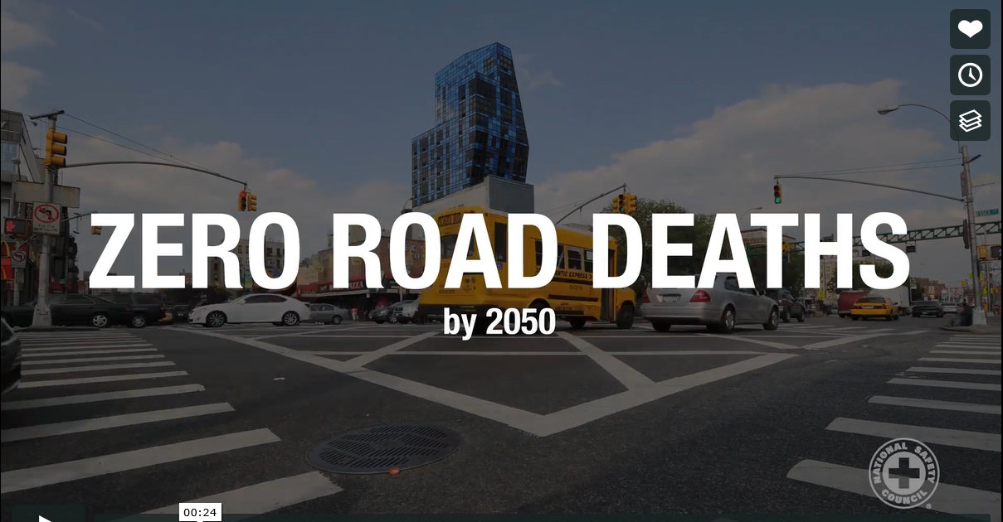
Notes:
RTZ Video – We unveiled this video at Lifesavers.

Slide 11
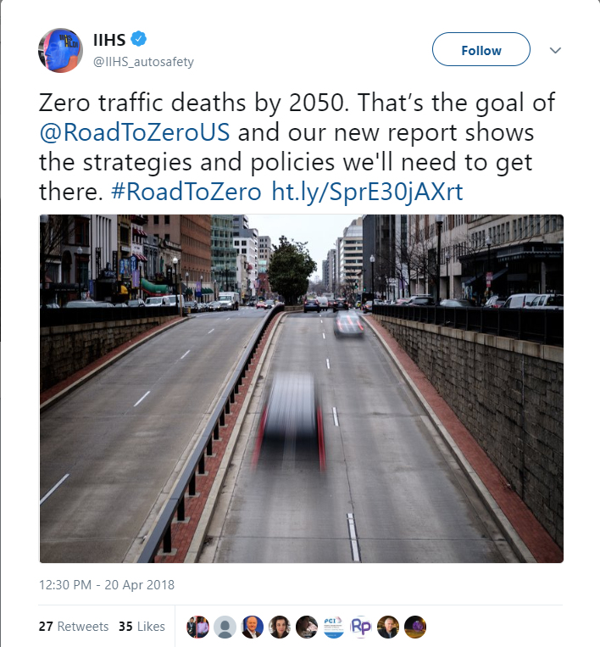
Notes:
The video you just saw, alongside a Communications Kit is available at NSC.org/RoadtoZero.
Who has used the Communications Kit? Thank you to all who shared the report on social media. Please continue to do so!
We had really great response to the report so far - garnered over 140 million media impressions.
I hope you continue talking about the report and getting more traction going forward.
Stay tuned for a Twitter Chat and Thunderclap coming up in August!

Slide 12
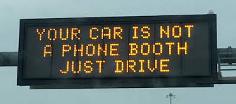
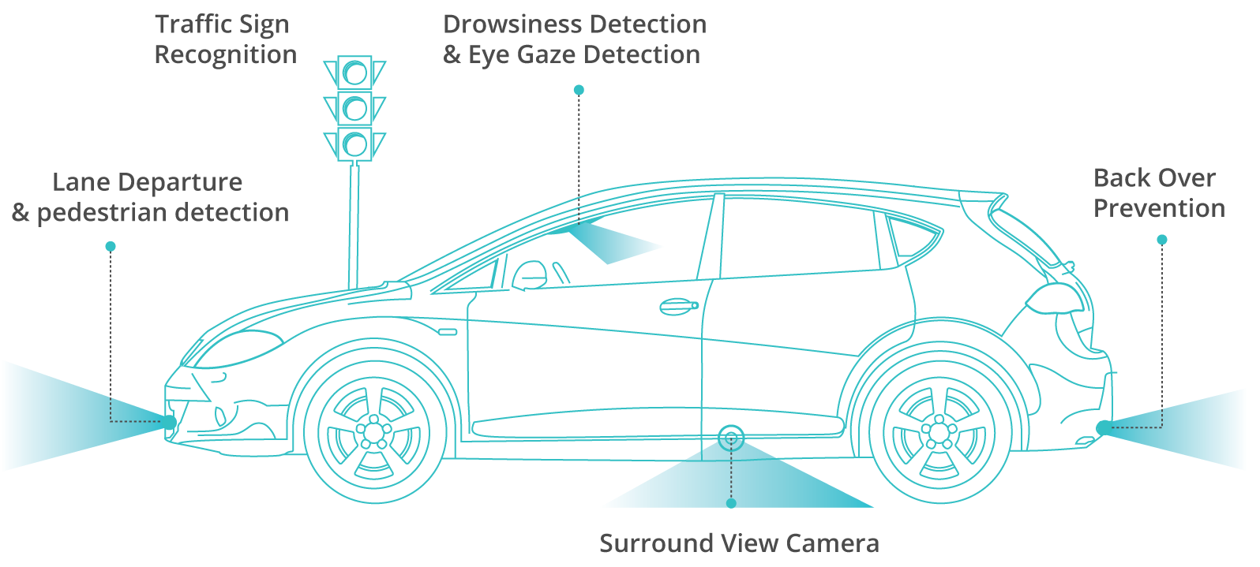
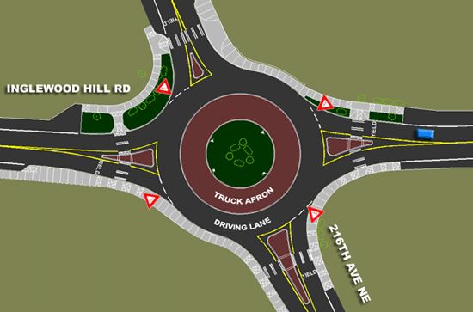
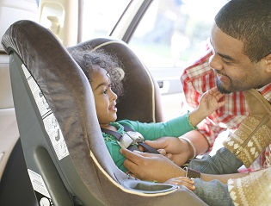
THE FUTURE OF ZERO
Notes:
We are working to change the culture by seeing all components in our transportation systems through a safety lens : Human, Machine, Environment, and Safety Culture.
The safety culture piece is really important.

Slide 13
Thursday, Sept 13, 2018
1 – 4pm ET
NEW LOCATION:
20F Street NW Conference Center
UPCOMING MEETING
Notes:
Will be available by webcast and the focus will be on the role of law enforcement.

