Slide 1
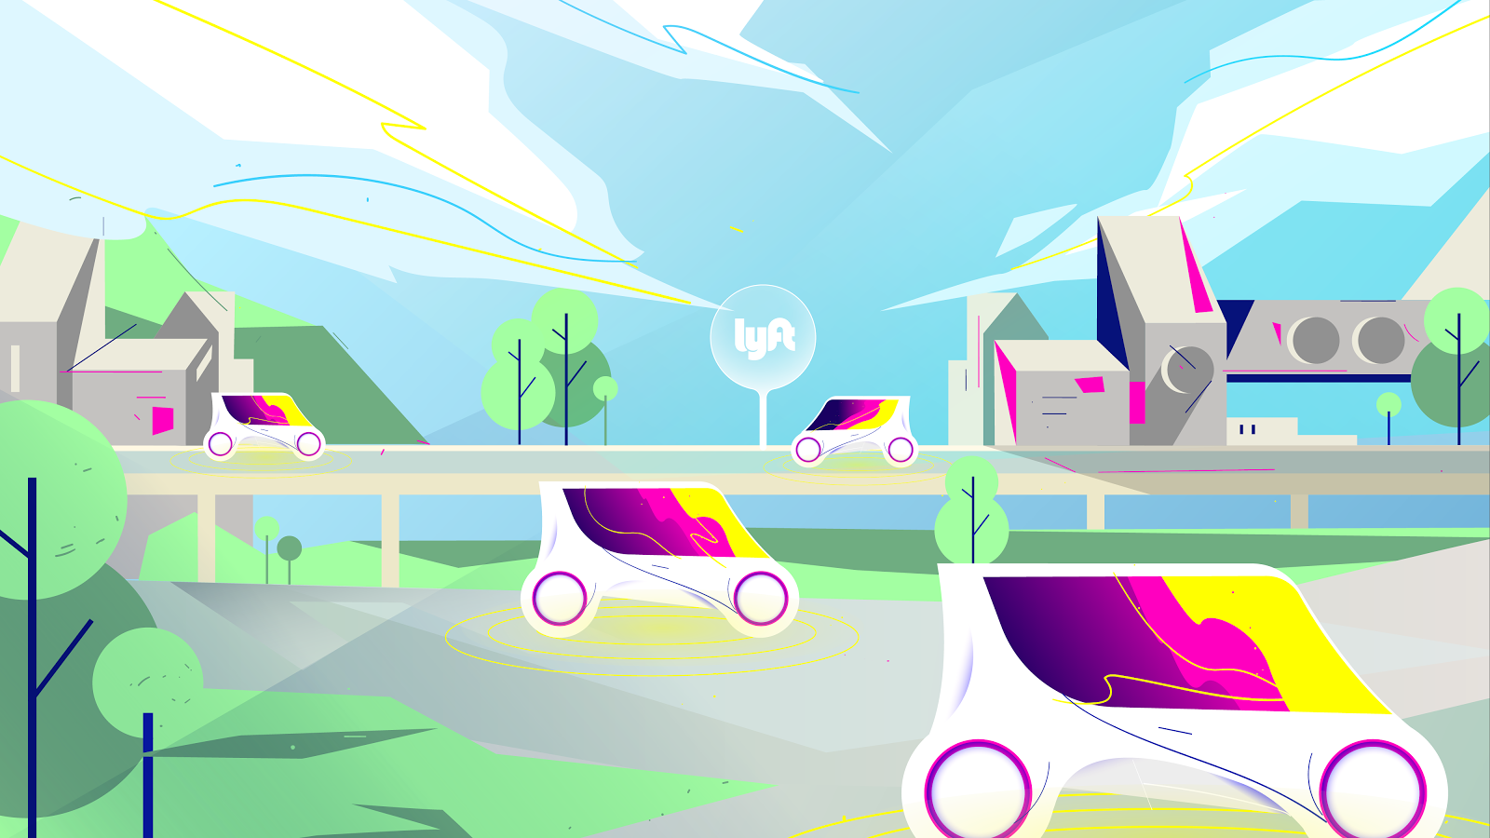

Notes:
End.

Slide 2
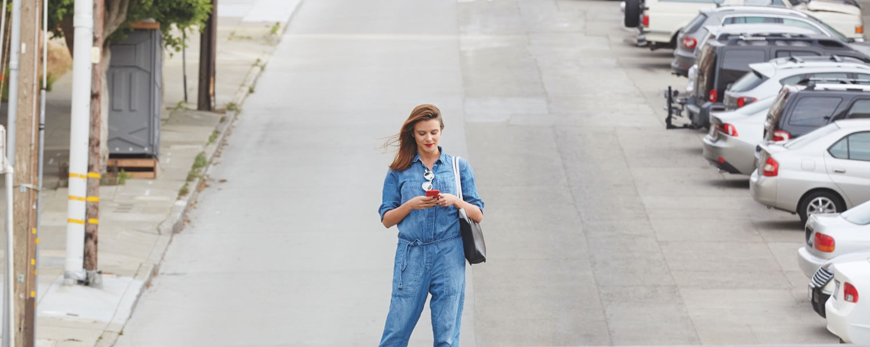
“Designing a dream
city is easy; rebuilding
a living one takes
imagination.
- Jane Jacobs
Notes:
Open with Jane Jacobs quote - today we have an exciting opportunity to reimagine the cities we’ve created

Slide 3
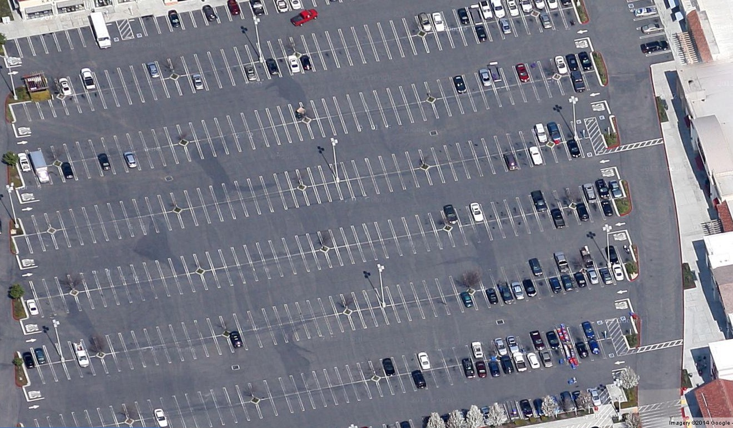
Image Credit: Stockton City Limits
Notes:
Today’s cities are marked by a familiar reality of parking spaces. We’ve built our cities around cars
In 2011, researchers estimated that there are at least 700 million parking spaces in the U.S. That means our country has more than 6,000 square miles of parking — bigger than the state of Connecticut.

Slide 4
The average vehicle is only used 4%
of the time.
Notes:
Yet we barely use them

Slide 5
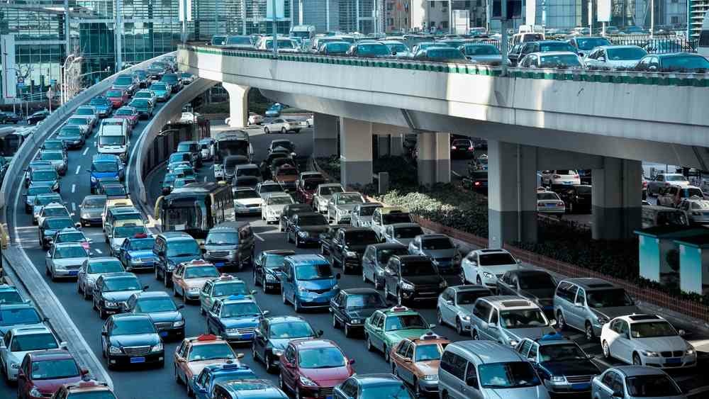
Notes:
And we do - we spend most of our time sitting in traffic

Slide 6
The Third
Transportation
Revolution
Notes:
This is all about to change with the Third Transportation Revolution

Slide 7
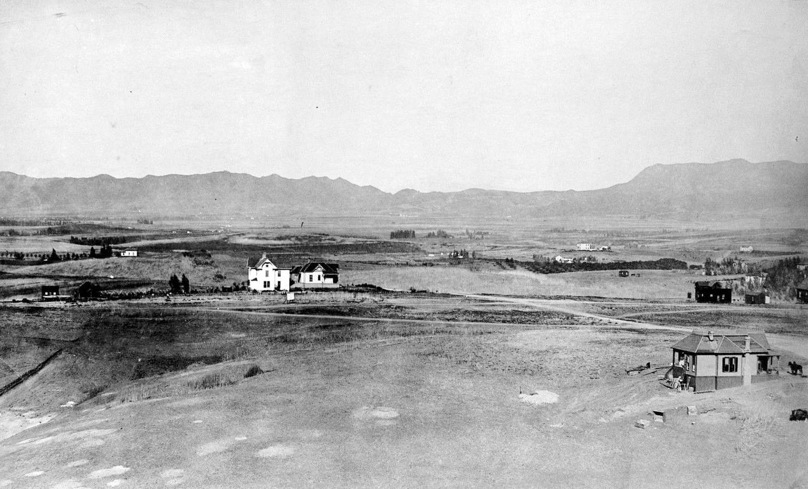
Image Credit: Water Power Associates
Notes:
First, we had agricultural communities loosely connected

Slide 8
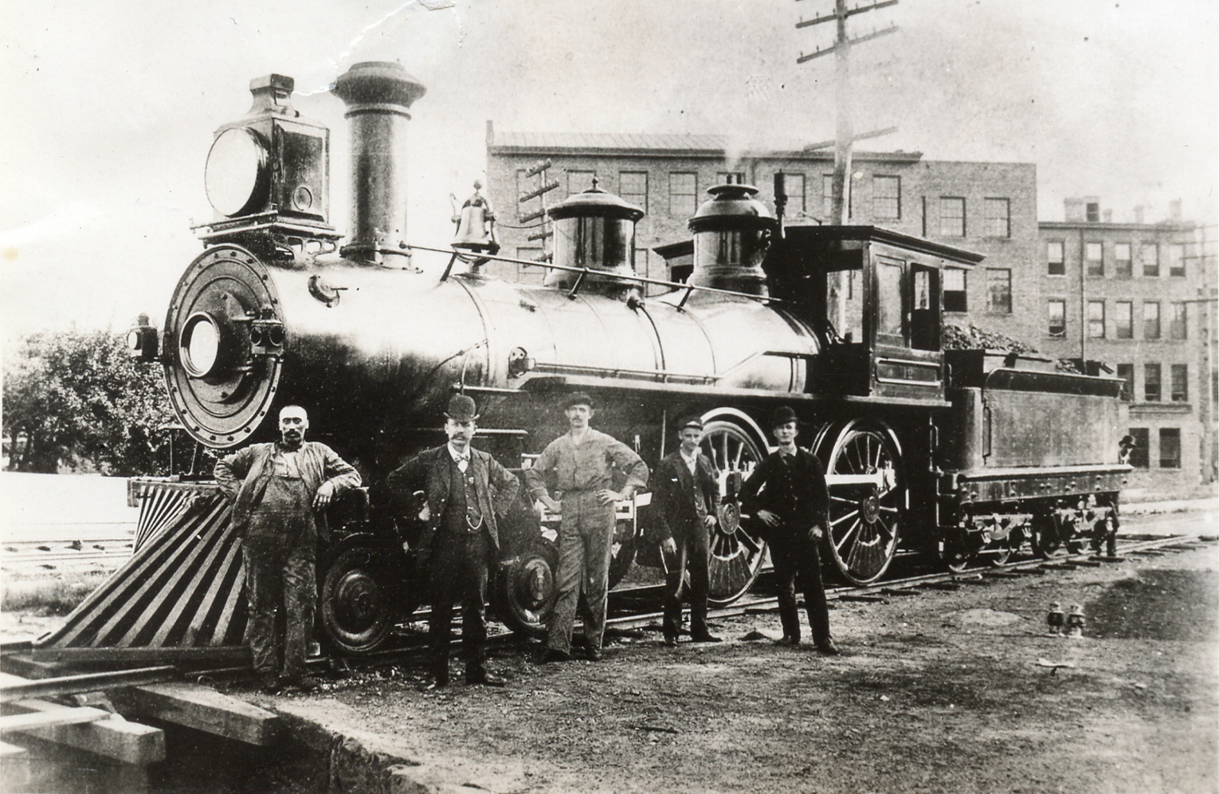
Image Credit: ThingLink
Notes:
With the industrial revolution, we got trains and canals

Slide 9
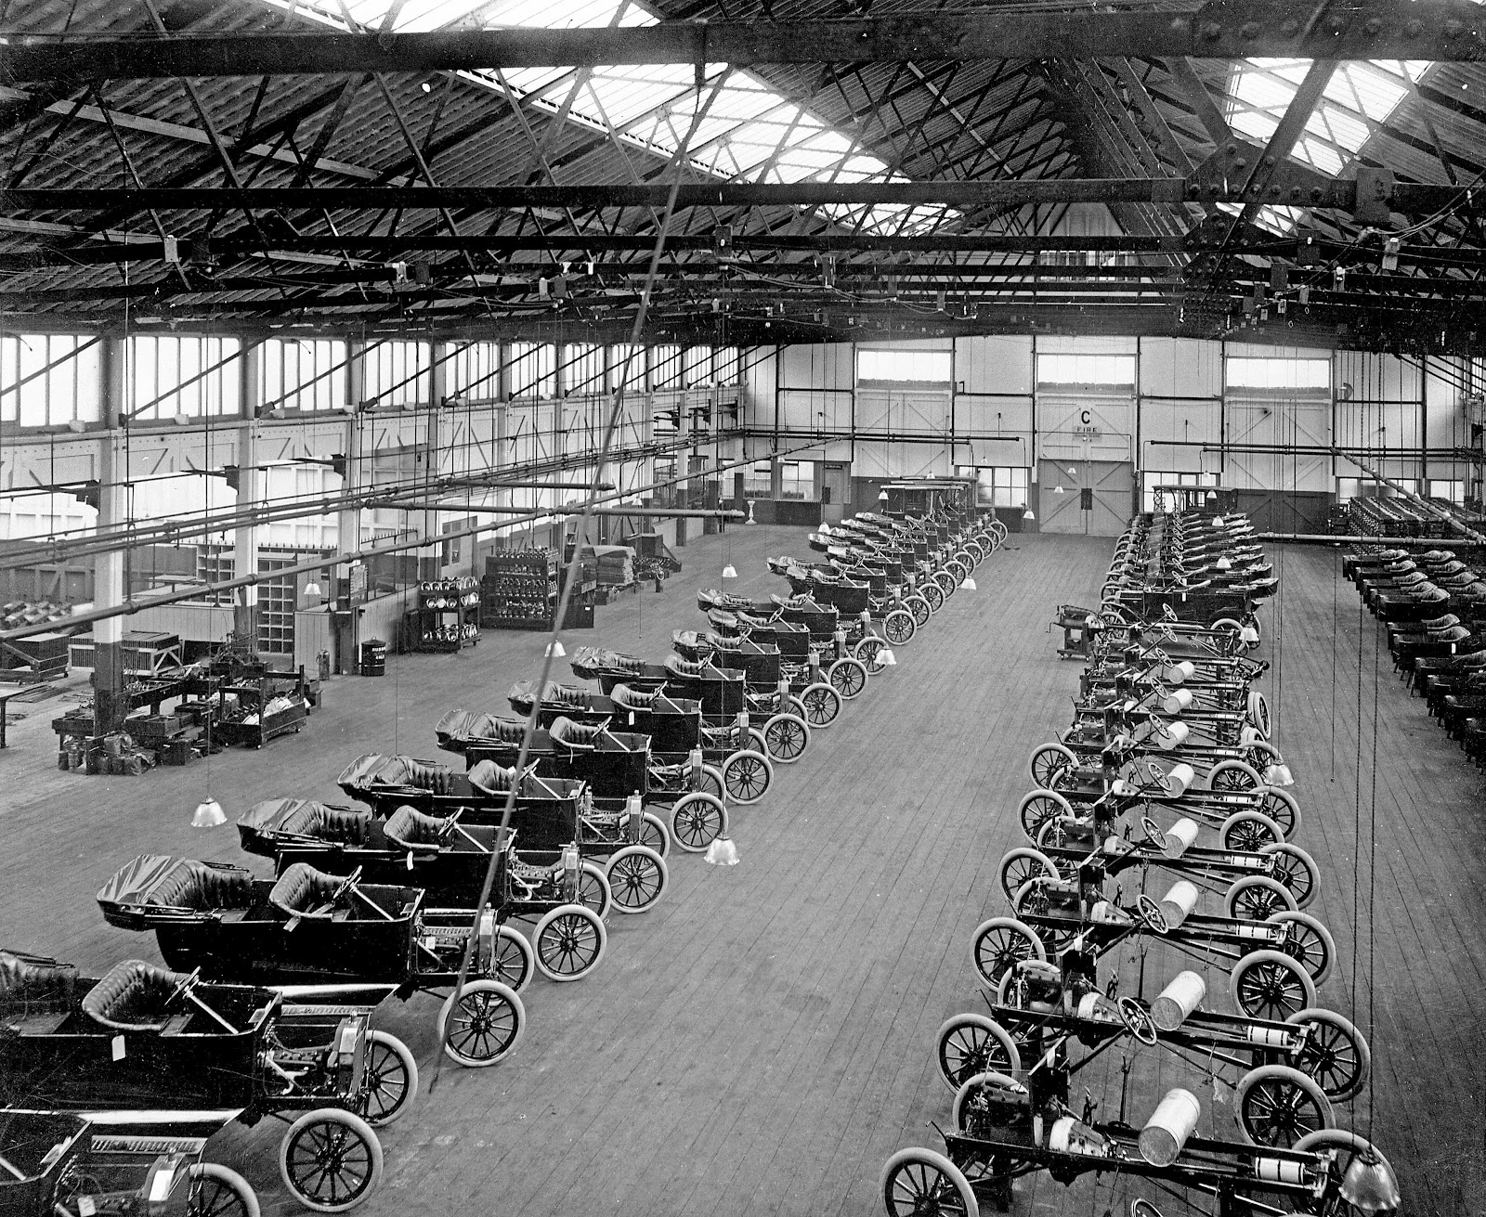
Image Credit: Ally on Cars
Notes:
Fast forward a century and the automobile was invented.

Slide 10
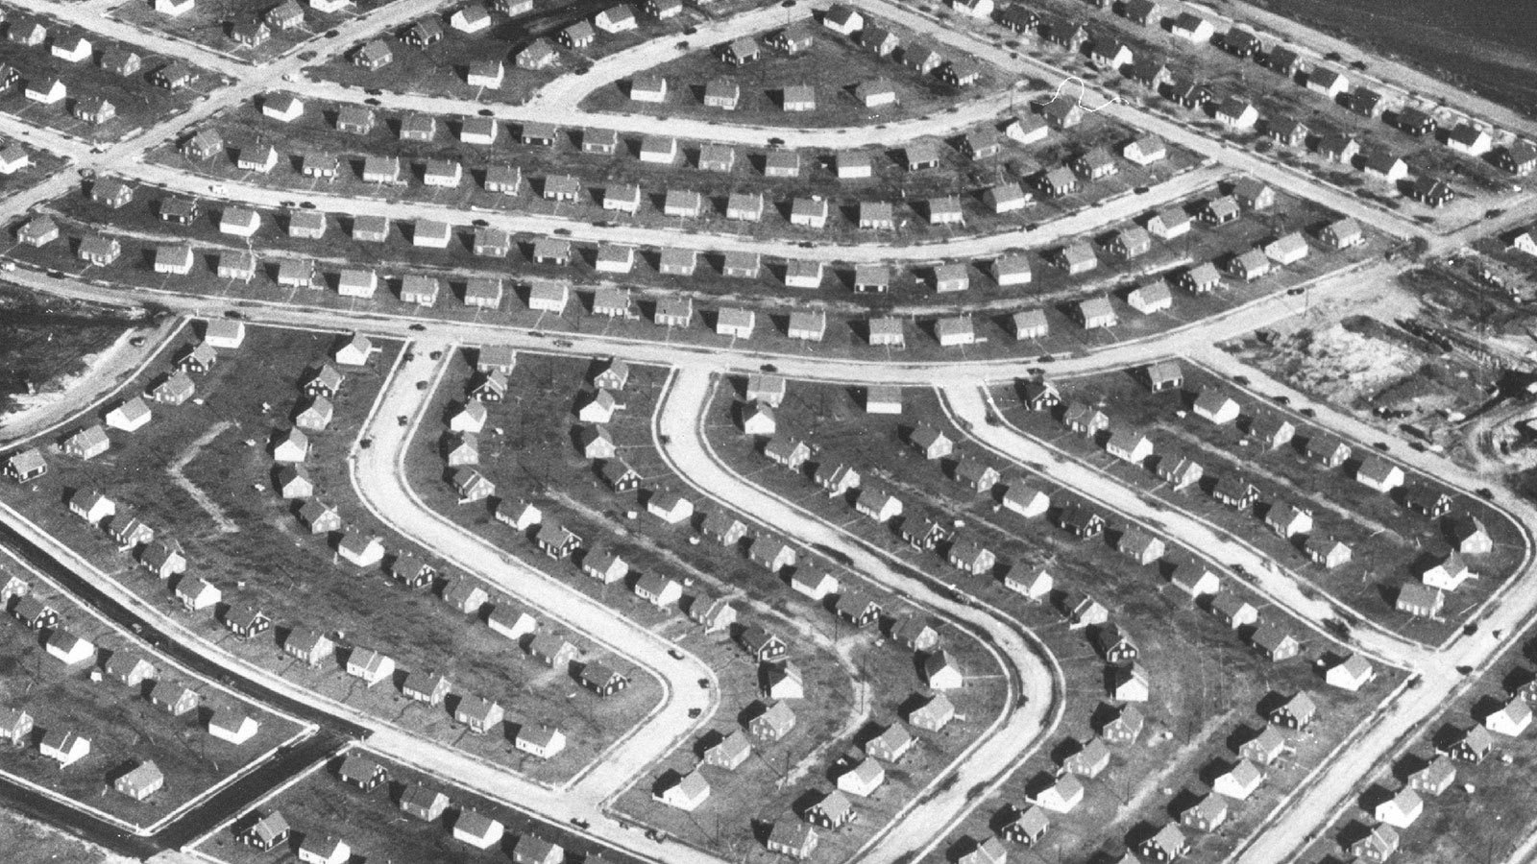
Image Credit: WTTW
Notes:
With the car, we could live outside of cities - so the suburbs were born
(photo of Levittown, NY)

Slide 11
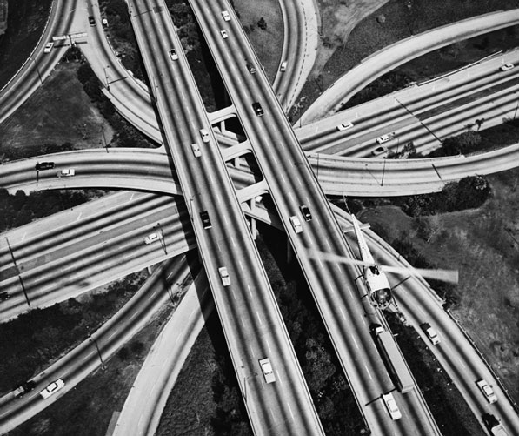
Image Credit: California Historical Society Collection, USC Libraries
Notes:
And to get there, the freeways

Slide 12

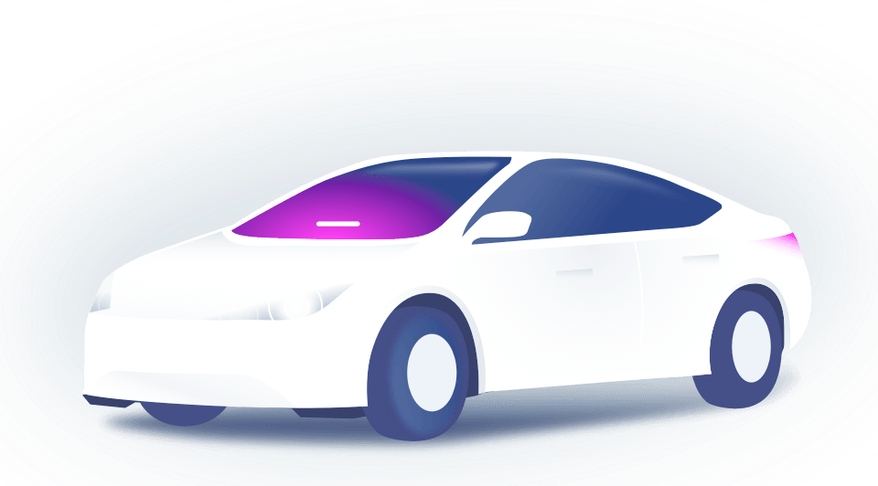
Autonomous vehicle fleets
Notes:
But now we’re approaching the third revolution: Autonomous Vehicles.

Slide 13
By 2025, private car
ownership will
all-but end in
major U.S. cities.

Slide 14
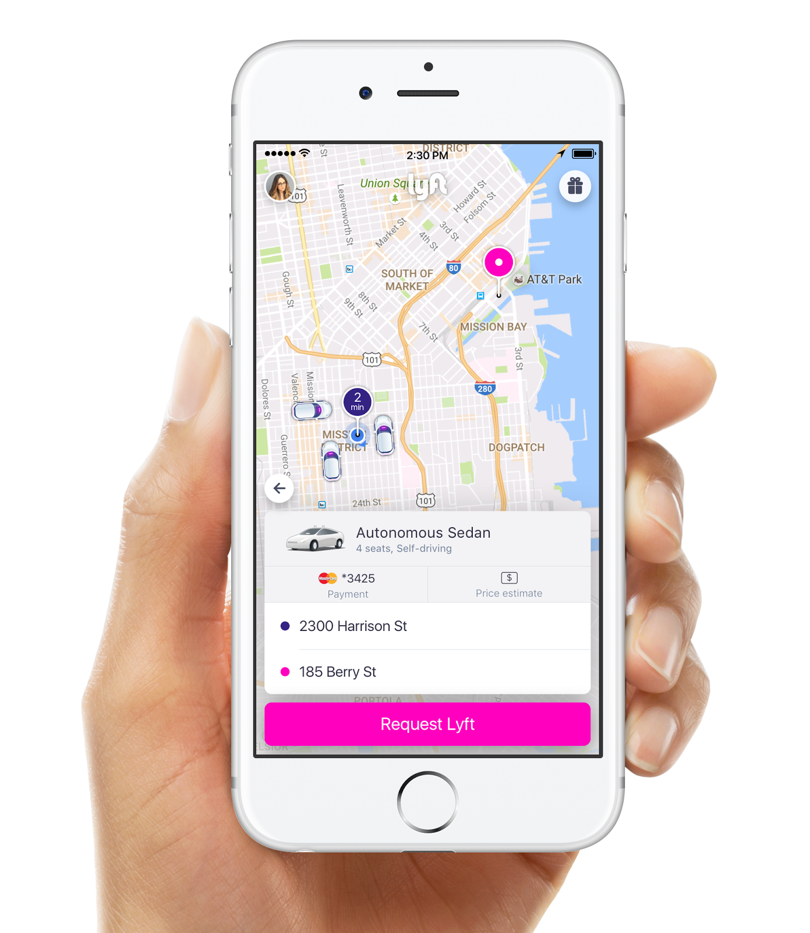
Within five years
a fully autonomous fleet
of cars will provide the
majority of Lyft rides
across the country

Slide 15
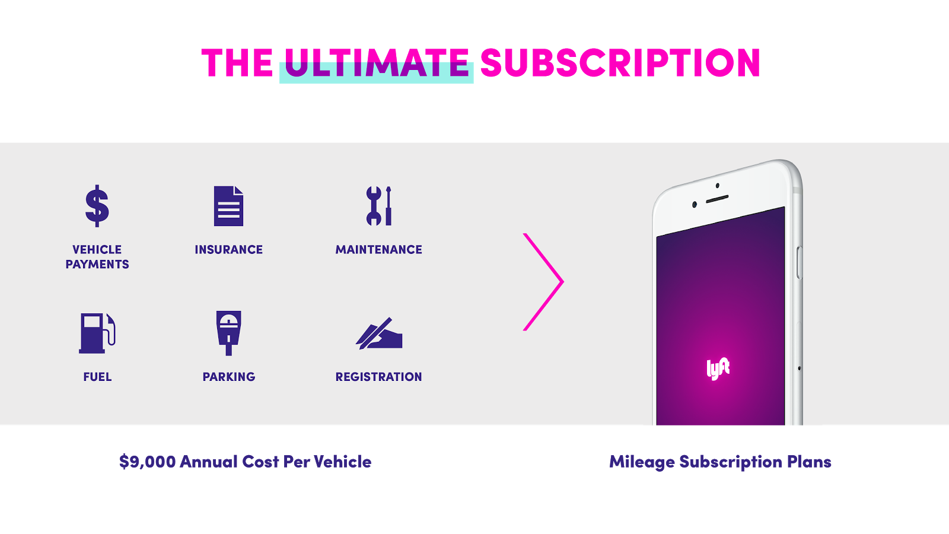
Notes:
How will it work?

Slide 16
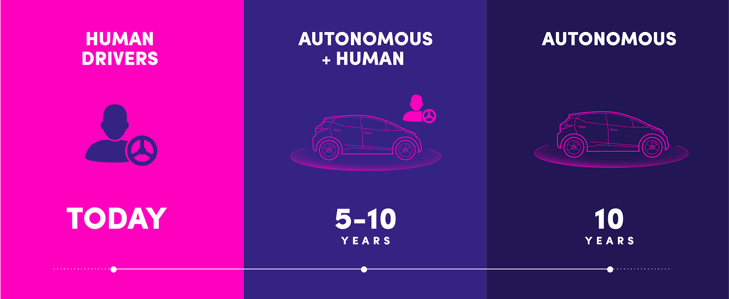
Notes:
At first, fully autonomous cars will have a long list of restrictions. They will only travel at low speeds, they will avoid certain weather conditions, and there will be specific intersections and roads that they will need to navigate around. As technology improves, these cars will be able to drive themselves in more and more situations.

Slide 17
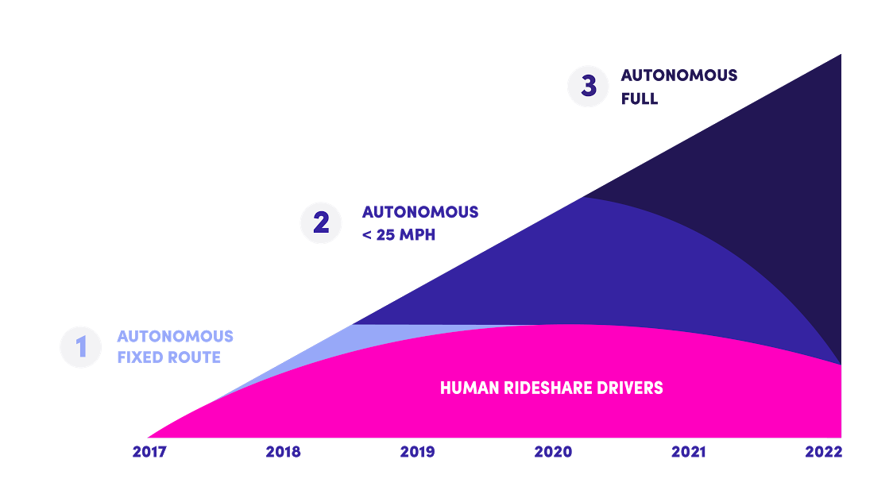
Notes:
Rides in autonomous vehicles will be less expensive than any options today and will lead to more people using Lyft for more and more of their transportation needs. As people rely on Lyft for more of their transportation, they are more likely to live car-free. And as more people trade their keys for Lyft, the overall market will grow dramatically. When autonomous cars can only solve a portion of those trips, more Lyft drivers will be needed to provide service to the growing market of former car owners.

Slide 18
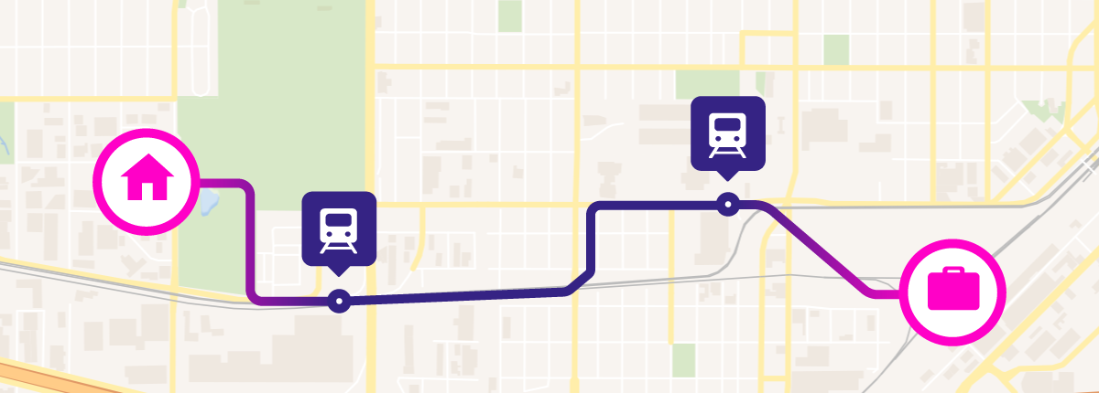
page title
subtitle
Solving the First and Last Mile Problem
Notes:
for example, you could take a self-driving car to the transit station.

Slide 19

+
Notes:
We’re already doing this with cities - and with self driving cars, it will bring down the cost of the trip even more. For example, in the Denver area, we’ve partnered with the City of Centennial, CO. The City is subsidizing Lyft rides to/from the light rail station. By working with transit agencies to help them stay current with changing consumer trends (real-time, mobile-based), we’re making it even easier to avoid owning a car.

Slide 20
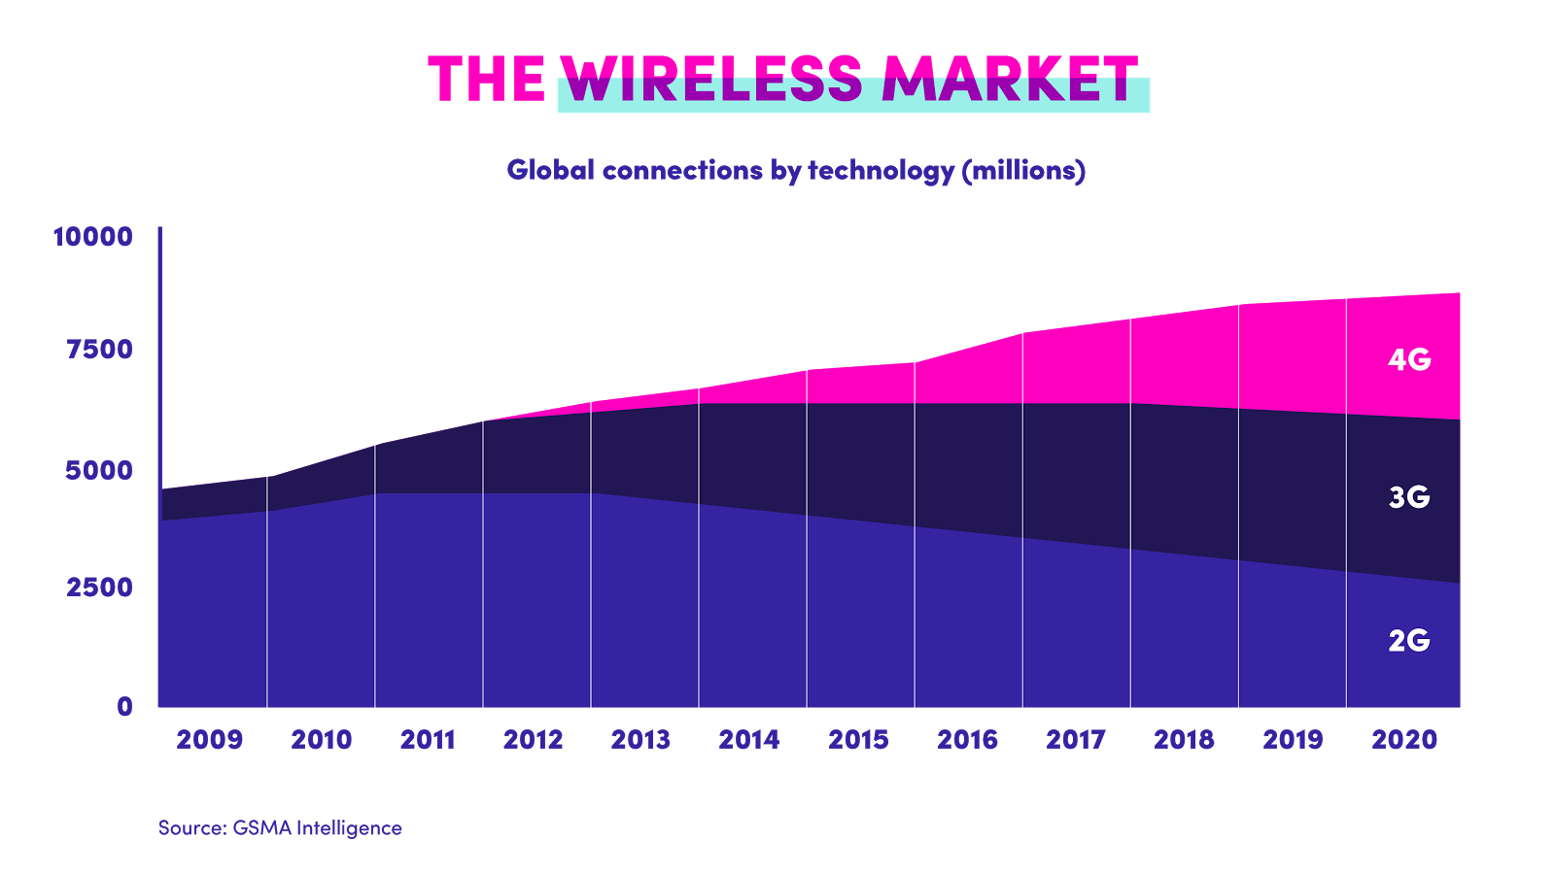
Notes:
Remember when cell phone coverage transitioned from 3G to 4G? The 4G networks were slowly rolled out, first covering only the largest cities and eventually growing to cover larger and larger portions of suburban areas. This ensures that people are always covered, one way or another. If you spend most of your time in a place that’s only covered by 3G or even 2G, you still have a network to rely on. But as soon as you step into a spot with 4G coverage, you automatically get to try it. Just wait for the upcoming launch of 5G. Future 5G networks won’t be introduced to the world by new companies, they will be rolled out on top of the largest existing networks around the world.

Slide 21
Cities re-designed
for people
Notes:
When it comes to autonomous vehicles, the most important question is not what they will be like on the inside. It’s what changes they will enable in the world around them. Since autonomous networks will be much more efficient than individual ownership, a large number of cars will come off the road — freeing up an enormous amount of space to devote to anything but cars.

Slide 22
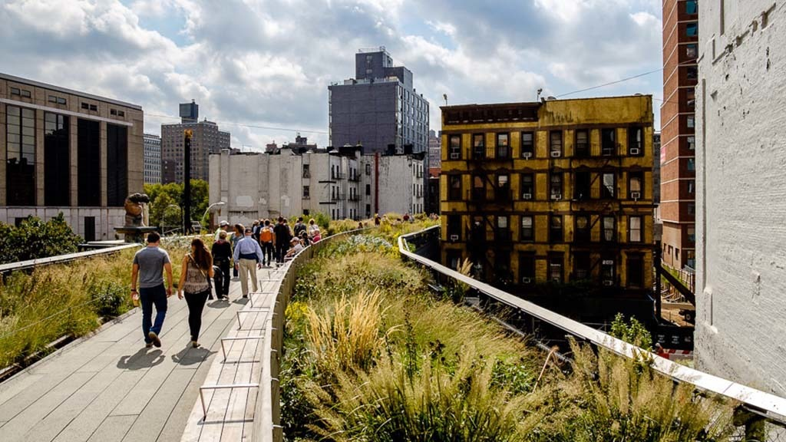
The High Line, NYC
Image Credit: Timeout
Notes:
we’re already seeing this - in NYC’s Chelsea District High Line

Slide 23
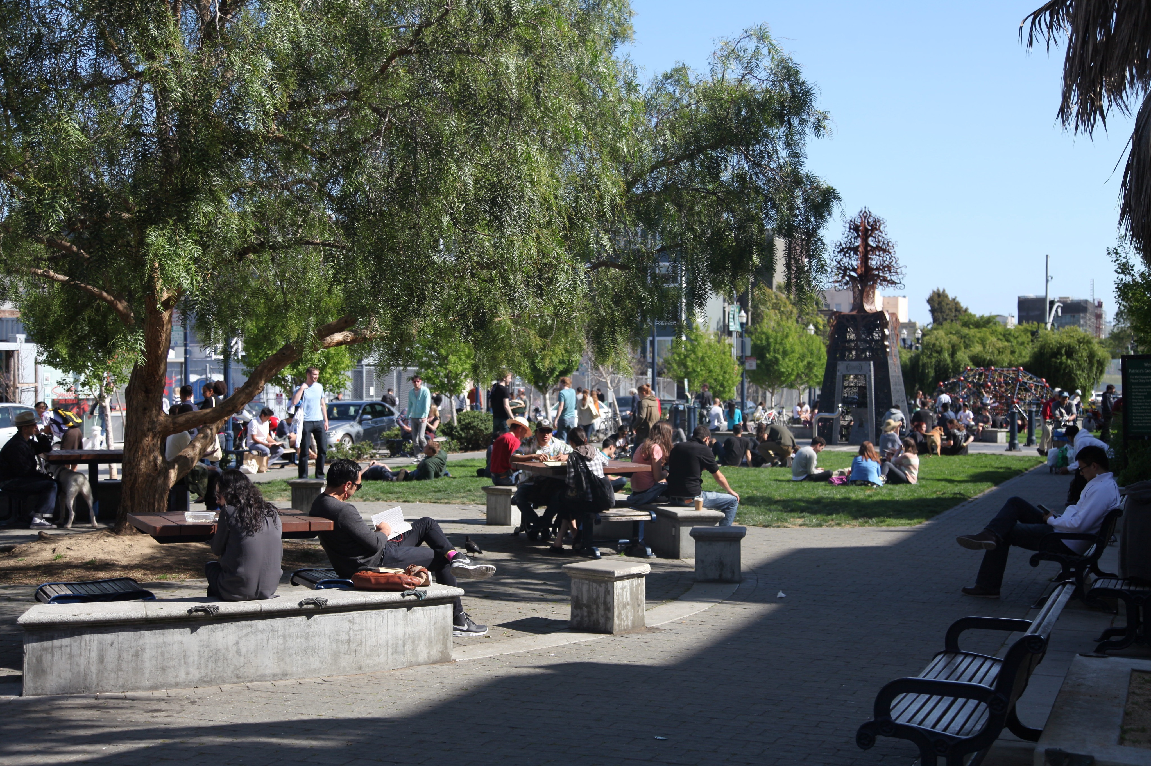
Octavia Street, SF
Image Credit: Reporting SF
Notes:
Or in Hayes Valley, when the Central Fwy was taken down and replaced by Patricia’s Green

Slide 24
Notes:
It’s a long and exciting road ahead.
End.

