Slide 1
City of the Future:
The Evolution of Cities in the Coming Decade

Slide 2
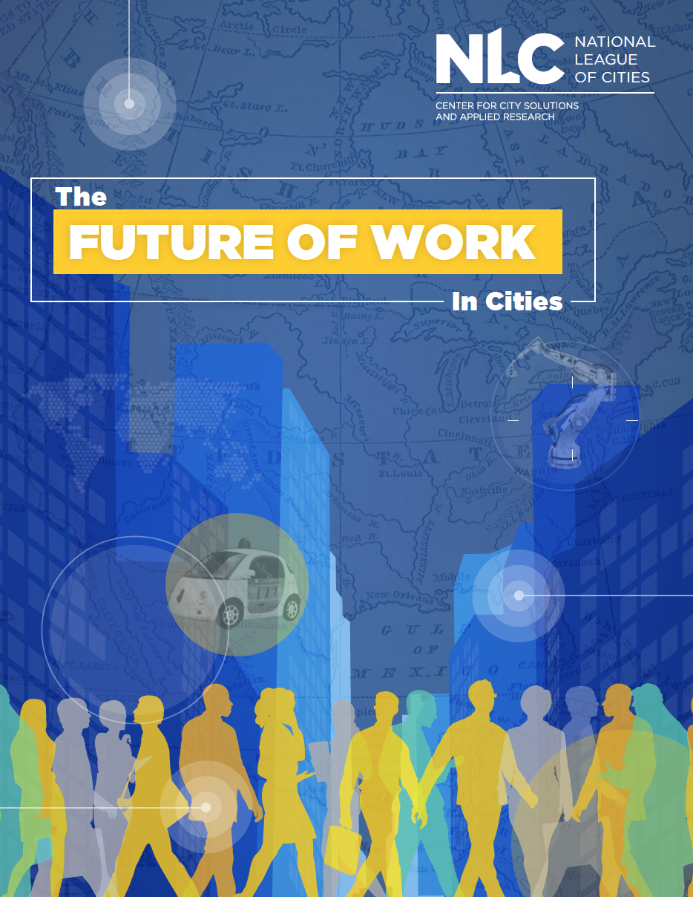
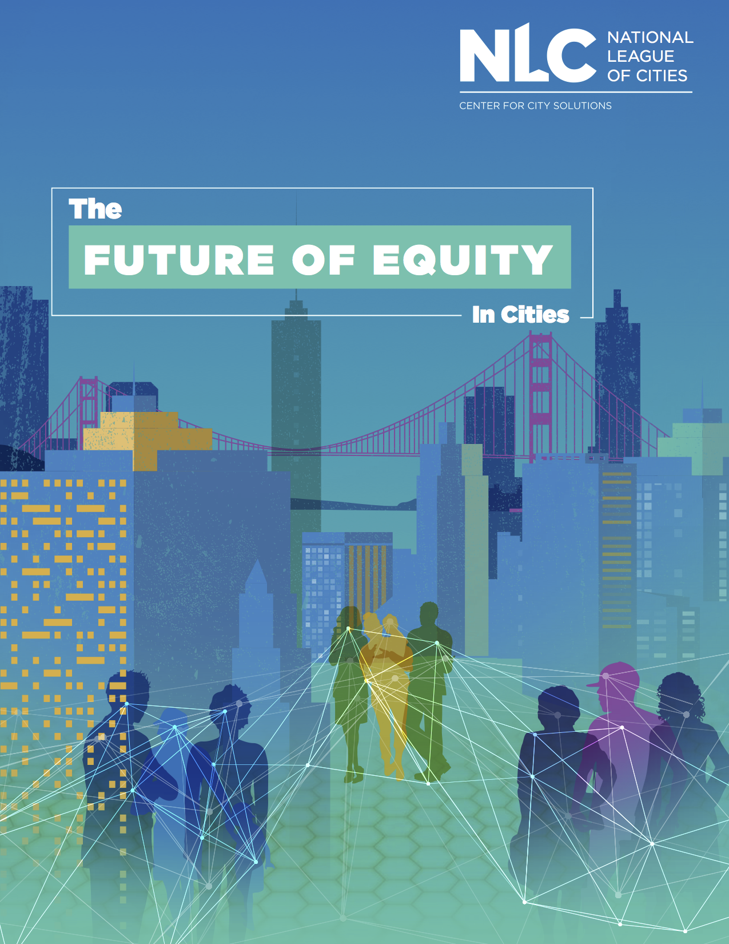
City of the Future Initiative
Technology & Mobility
Work
Equity

Slide 3


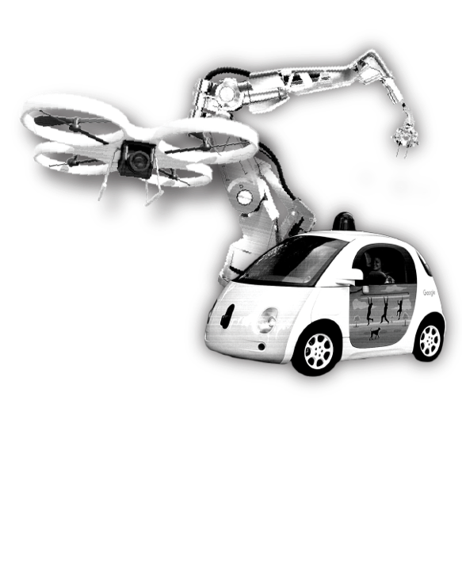



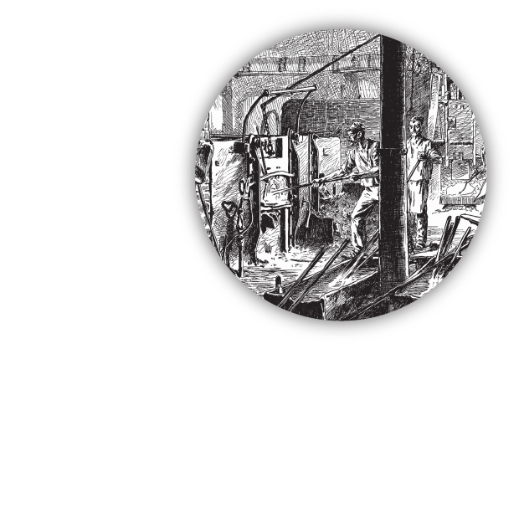

Slide 4

The Future of Mobility
Notes:
Mobility is central to individual prosperity, commerce and to the growth of communities.
Whether it is city streets, commuter highways, rail lines, or ports, the work of cities requires attention to both the existing transportation network, and the emerging trends that will shape the future.
New technology is promising a hyper-connected future for cities in which driverless cars and smart city applications have the potential to improve services, efficiency and quality of life.

Slide 5
Long Range Transportation Plans
38%
Consider driverless cars
30%
Address impact of TNCs
82%
Lay out explicit intentions of strategy around ITS
80%
Mention equity

Slide 6
Mobility & Infrastructure 2020
Accessibility & multi-modalism
Public-private mobility partnerships
AVs in all 50 states
Notes:
Info on how uber/lyft working together with cities on transit – first/last mile; seamlessness in switching modes

Slide 7
Mobility & Infrastructure 2030
Demographic & workforce shifts
Public & private mobility system growth
New modes of transportation
Notes:
By now, make case that with Avs
Autonomous is commonplace
Reducing road fatalities

Slide 8
Thank you!
Brooks Rainwater
Senior Executive & Director Center for City Solutions
National League of Cities
@BrooksRainwater

