Slide 1
UTMOST
Crash Countermeasure
Visualization Tool
Carol A.C. Flannagan,
Kathleen D. Klinich*,
Jared Karlow, Jingwen Hu

Slide 2
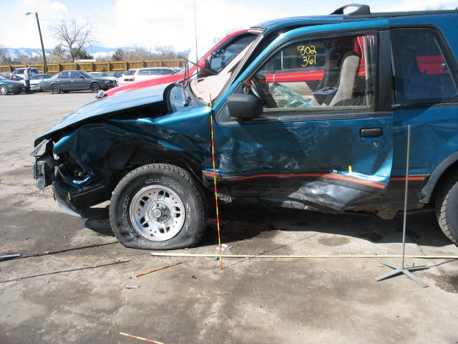
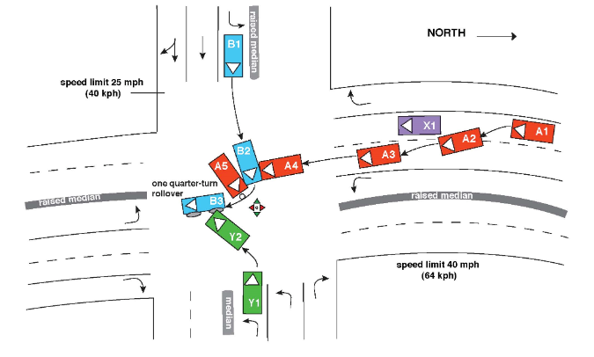
UTMOST
Unified Theory for Mapping Opportunities in Safety Technology
Allow visualization of the benefits of multiple safety countermeasures
Understand how combinations of those countermeasures might influence the crash population
UTMOST.UMTRI.UMICH.EDU

Slide 3
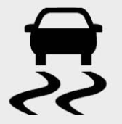

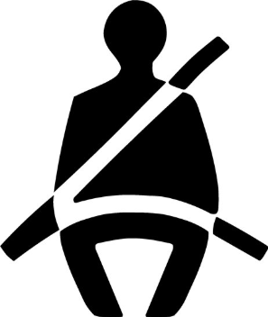

Using UTMOST
Start with current distributions of crashes and injuries; Road to Zero project added fatalities
Explore what could happen if
  Vehicles had advanced crash avoidance technologies
  Everyone wore their seatbelts
  All states had strong traffic safety laws
Evaluate tradeoffs between safety benefits and implementation costs

Slide 4
Datasets
Distribution of people in crashes generated from 2013-2015 National Automotive Sampling System—General Estimates System (NASS-GES)
Distribution of crashes by severity estimated for each combination of crash variables using NASS-GES
Injury risk curves modeled using the 2010-2015 National Automotive Sampling System—Crashworthiness Data System (NASS-CDS) dataset
Fatality risk and delta v distribution based NASS-CDS and corrected based on 2011-2016 FARS

Slide 5
Doing the math
Injury/fatality risk
Exposure: distribution of crashes by crash severity
Multiply together for injury distribution
Integrate for counts

Slide 6
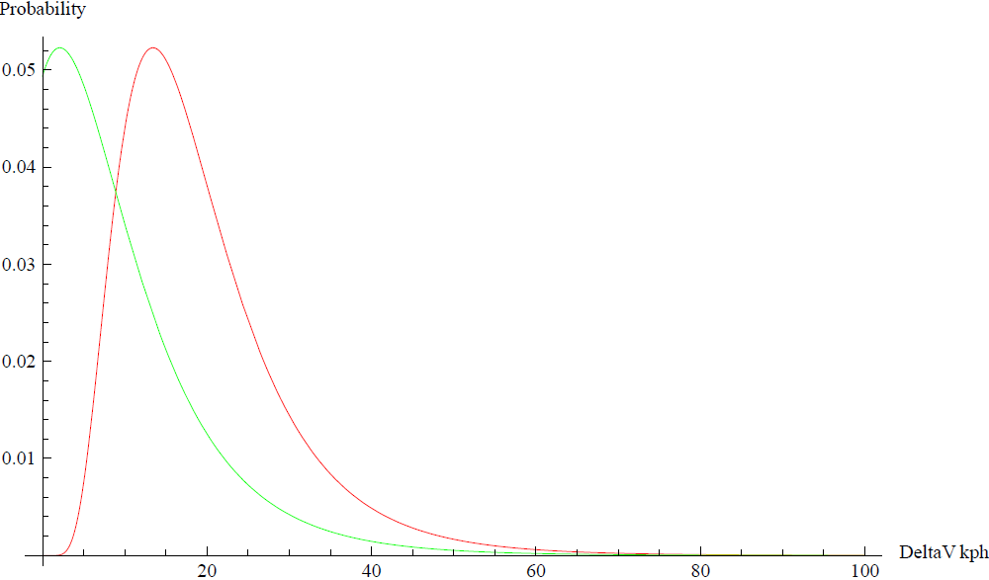
Effect of reducing crash severity

Slide 7
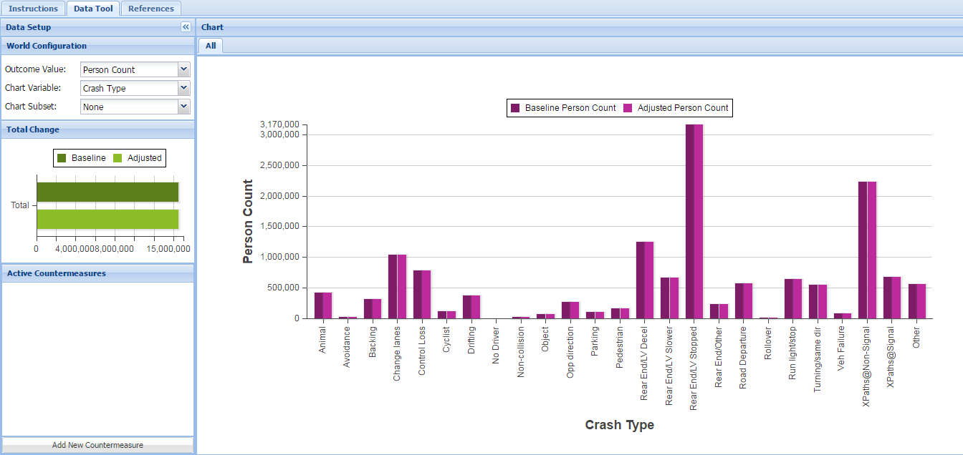
Opening screen

Slide 8
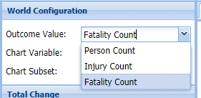
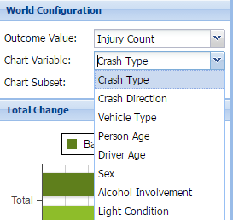
Configuring crash world
Outcomes
  People in crashes
  People injured in crashes
  People killed in crashes
Configured by
  crash type
  crash direction
  vehicle type
  person age
  driver age
  Sex
  alcohol involvement
  light condition

Slide 9
Crash type: Fatal vs. All

Slide 10
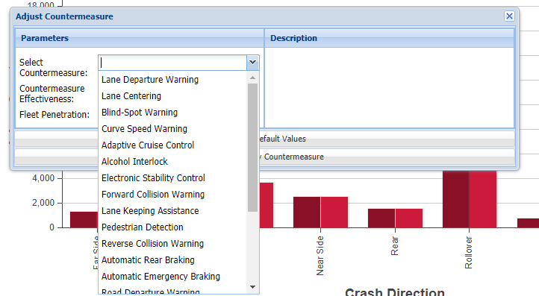
Applying countermeasures

Slide 11
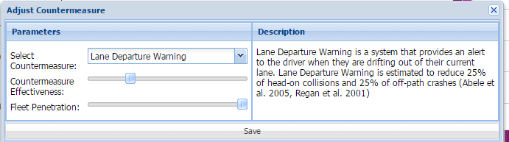
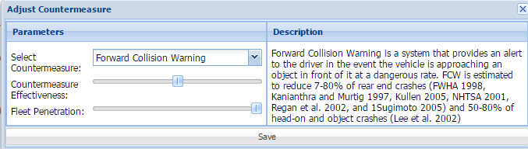
LDW & FCW

Slide 12
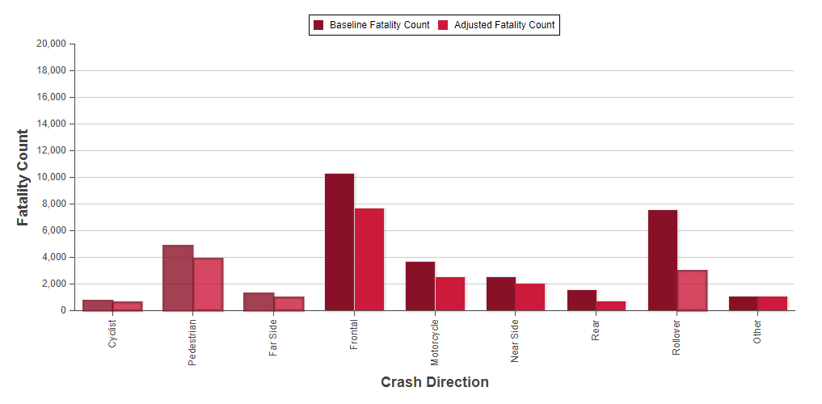
Fatal crashes: all current CA technologies in all vehicles
N: 33,292 ->22,232: 33% reduction
(Top 5: ESC, Lane Keeping Assistance,
Lane Centering, AEB, FCW)

Slide 13
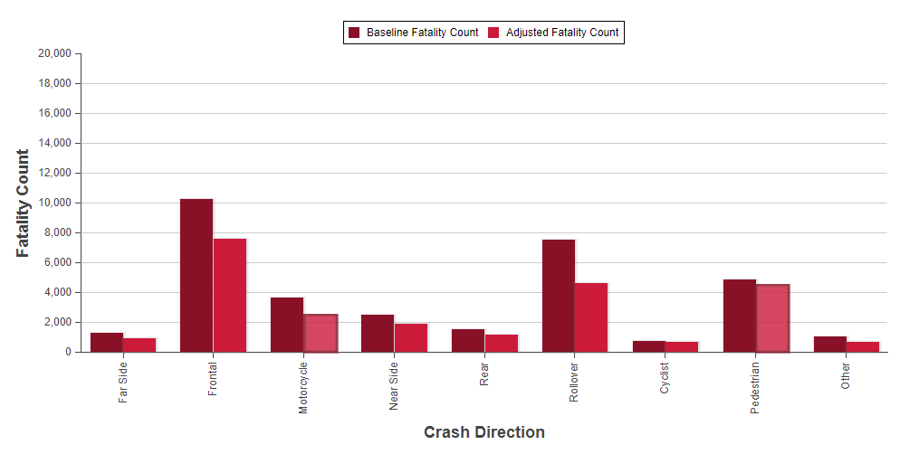
Fatal crashes: no alcohol crashes
N: 33,292 ->24,489: 26% reduction

Slide 14
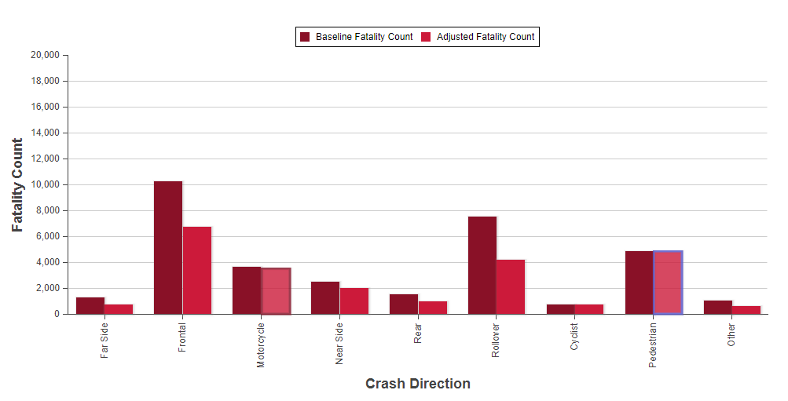
Fatal crashes: 100% Proper Restraint
N: 33,292 ->24,216: 27% reduction

Slide 15
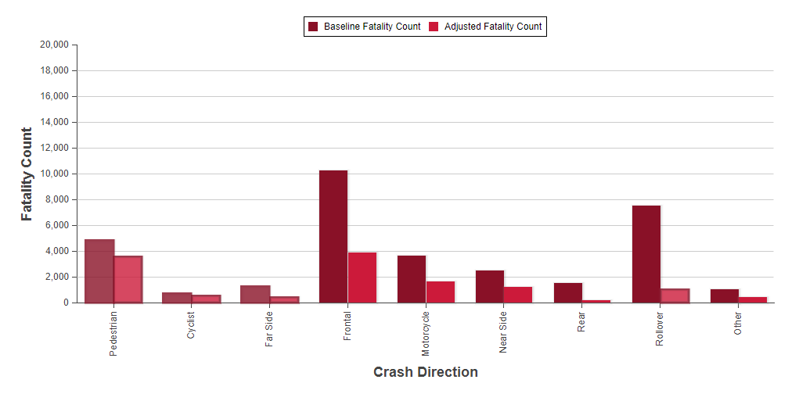
Fatal crashes: all three countermeasures
N=33,292 ->12,943: 61% reduction

Slide 16
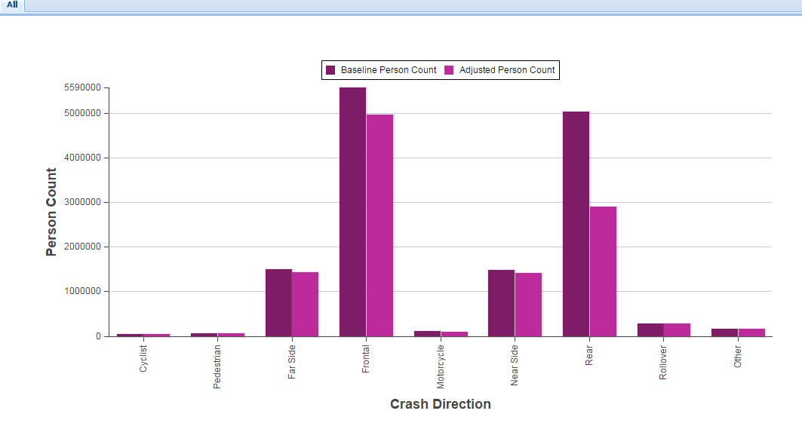
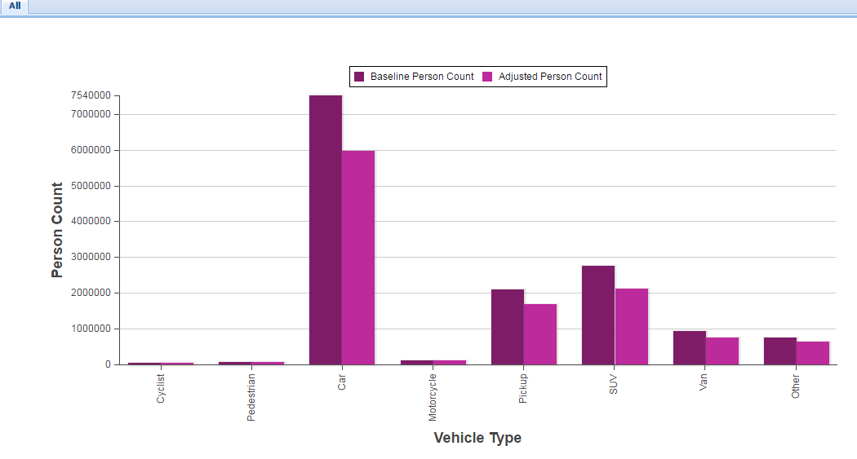
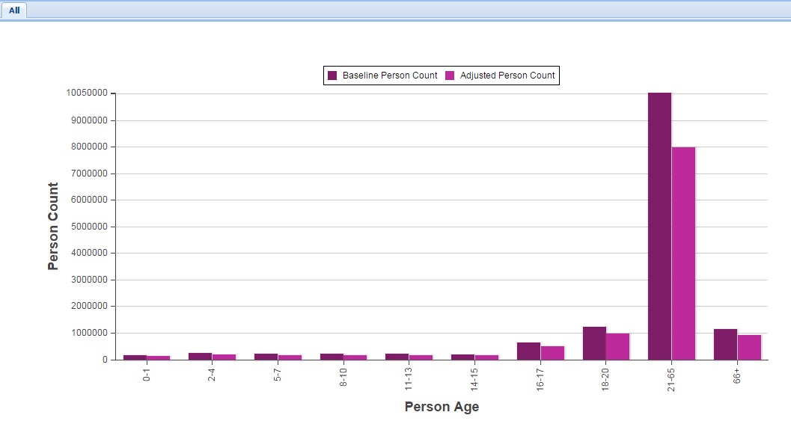
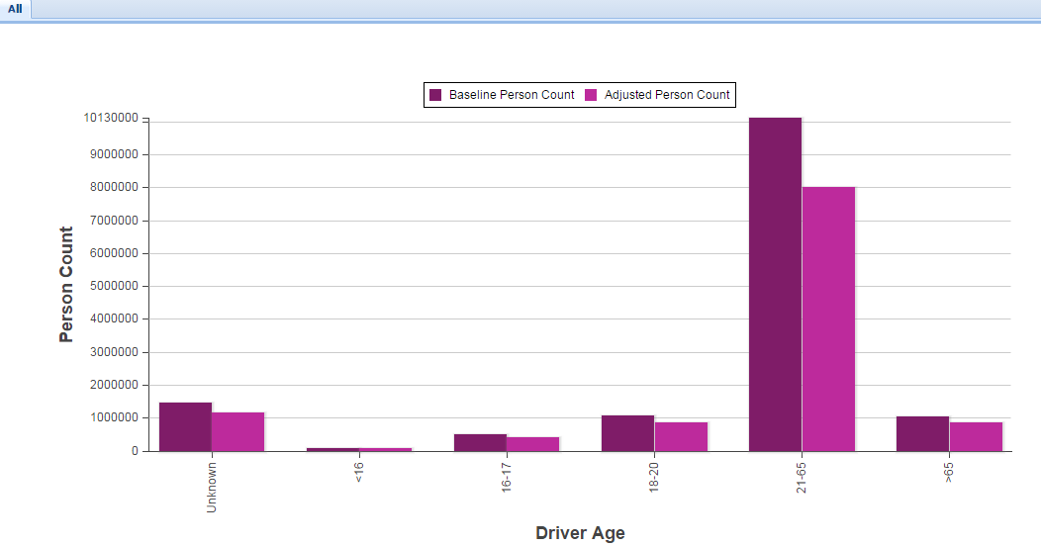
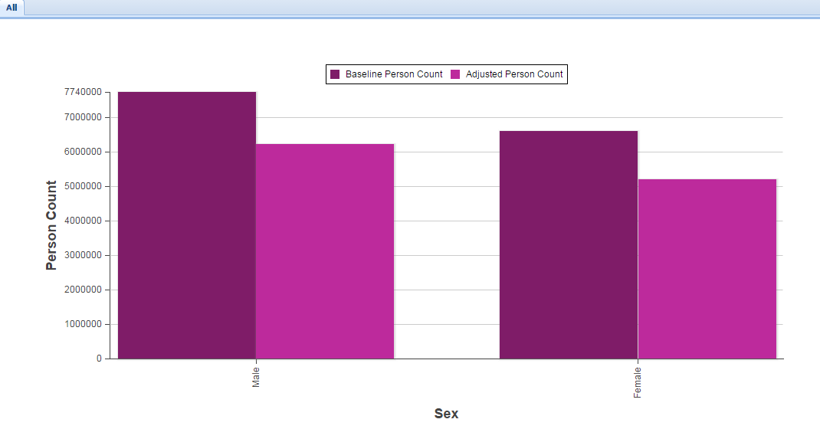
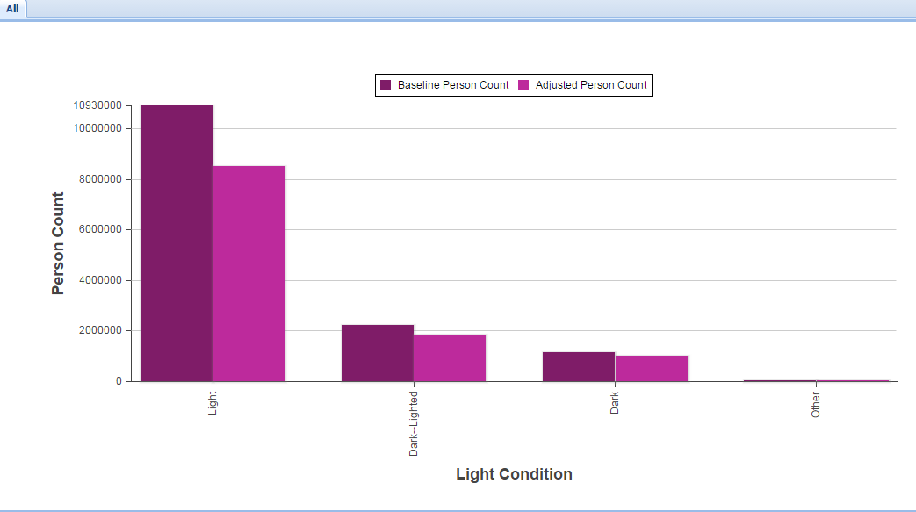
Choosing alternate chart variables

Slide 17
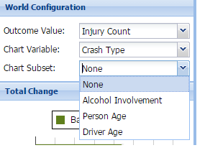
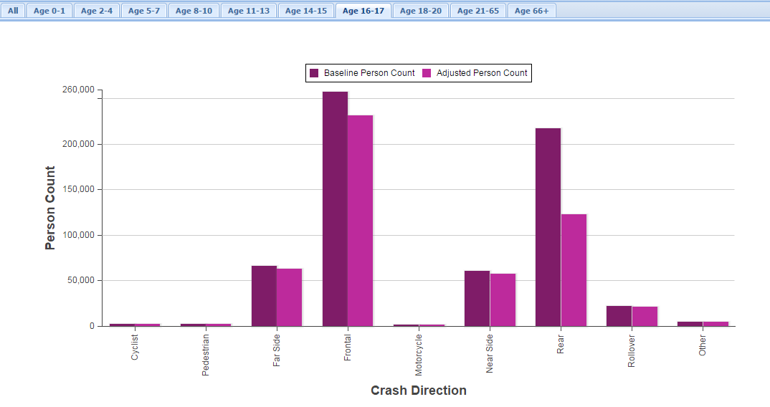
Chart subset

Slide 18
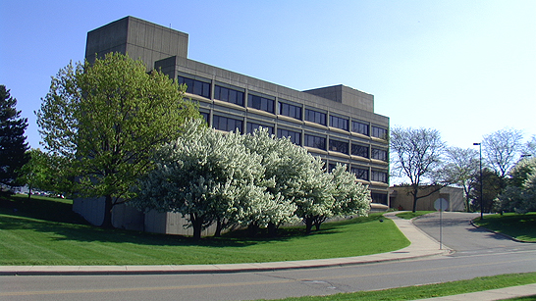
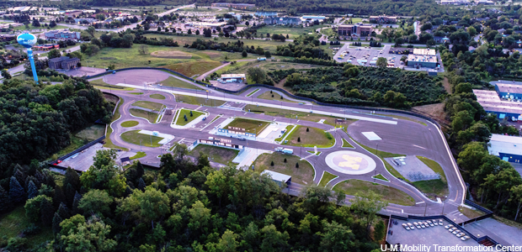
Overview
UTMOST.UMTRI.UMICH.EDU
Online tool to explore effects of countermeasures on motor-vehicle crashes, injuries, and fatalities
Continuing Road to Zero project will add options to view by race/ethnicity and income level

Slide 19
Thank you for your attention.
Contact: Carol Flannagan cacf@umich.edu
or Kathy Klinich kklinich@umich.edu

Slide 20
Crash variables
Overall crash direction (front, near-side, far-side, rear, rollover, pedestrian, pedalcyclist, motorcyclist, and other)
Crash type or mechanism (run-off-road, backing, etc.)
Occupant age group: (0-1,2-4,5-7,8-10,11-13,14-15,16-17,16-20,21-65,66+)
Occupant gender (Male, Female)
Driver age group (<16,16-17,18-20,21-25,25-65,66+)
Driver gender (Male, Female)
Driver alcohol involvement (Yes, No)
Light condition (light [includes dusk and dawn], dark, dark but lighted, other/unknown)
Pedestrian alcohol involvement (Yes, No for pedestrians only)
Vehicle type (Passenger car, SUV, Van, Pickup, Pedalcyclist, Motorcyclist, Pedestrian, Other)

Slide 21
Injury risk: restraint effect
Age 14+ in vehicles: effect of belt use estimated from NASS-CDS
Motorcyclists: helmet effectiveness estimated from NASS-GES
Children: restraint effectiveness estimates from NASS-GES for age groups 0-1, 2-4, 5-10, 11-13

Slide 22
Injury/fatality risk variables for planar crashes
Impact direction (frontal, nearside, farside, rear)
delta V (expressed as ln [delta V])
Occupant age and gender
Belt restraint (yes/no)
Vehicle type (passenger car vs. other)
Alcohol involvement

Slide 23
Injury/Fatality risk for other crashes
Rollover: occupant age and belt use
Pedestrian/cyclist:
  Pedestrian/cyclist age
  Light level
  Striking vehicle type
  Pedestrian/cyclist alcohol use
Motorcycle
  Age
  Light level
  Alcohol use

Slide 24
CA Technology and Relevant Crash Types
Crash Avoidance technology | Relevant Crash Types
Lane departure warning | Head-on (from lane drift); Run-off-road
Adaptive cruise control | Rear-end crashes
Alcohol interlock | Alcohol involved
Electronic Stability Control | Single-vehicle run-off-road crashes rollovers
Frontal collision warning | Rear-end crashes, object crashes
Intelligent lighting systems | Pedestrian/cyclist low-visibility crashes
Lane change warning | Drifting and lane change crashes
Lane keeping assistance | Head-on collisions from lane drift, sideswipe crashes, run-off-road crashes
Pedestrian detection system | Pedestrian crashes
Reverse collision warning system | Backing crashes
Road departure warning | Run-off-road crashes

