Slide 1


Getting to Zero Roadway Fatalities – What Will It Take?
Notes:
Lifesavers Conference – 2018
San Antonio

Slide 2
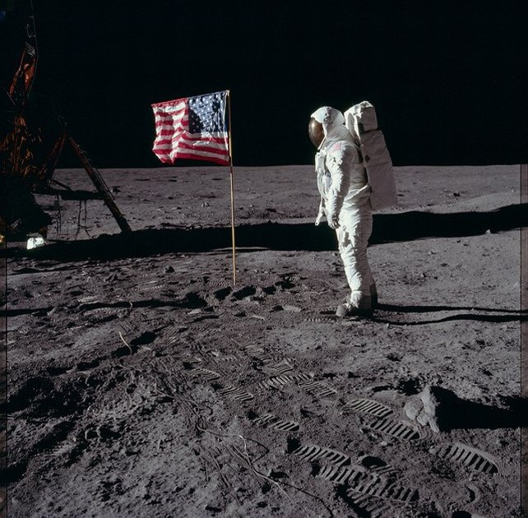
Notes:
National Safety Council eliminating preventable deaths in our lifetime is our moonshot. At work, in our homes and communities, and of course, on the road. Every 3 minutes we lose someone. To something preventable.
Data is a primary driver for our research and advocacy priorities, and so we go where the data tells us to go.

Slide 3
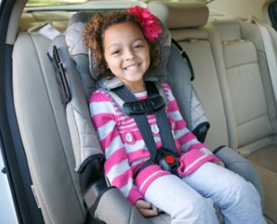
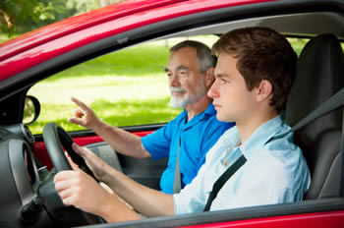
Motor Vehicle Crashes
#1 cause of death for ages 5-24
Notes:
This year, for the first time in U.S. history, preventable injuries became the 3rd leading cause of death.
As everyone gathered here today in San Antonio knows, motor vehicle crashes are still a huge contributor to that #3 cause.
Because crashes are the leading cause of death for people from age 5 -24, young people are impacted disproportionately.
This means car crashes impact the years of life lost – the number of years someone might have lived if they had not died of an illness or injury.

Slide 4

HOW DO WE SHIFT CULTURE?
Notes:
We know that motor vehicle deaths are moving in the wrong direction. For two years in a row we have topped 40,000 deaths/year.
In Texas, there has not be a single day without a roadway fatality since November 2000.
#EndTheStreakTX
Something must change.
How do we move people – where people believe the crashes are preventable. How do we shift culture?

Slide 5
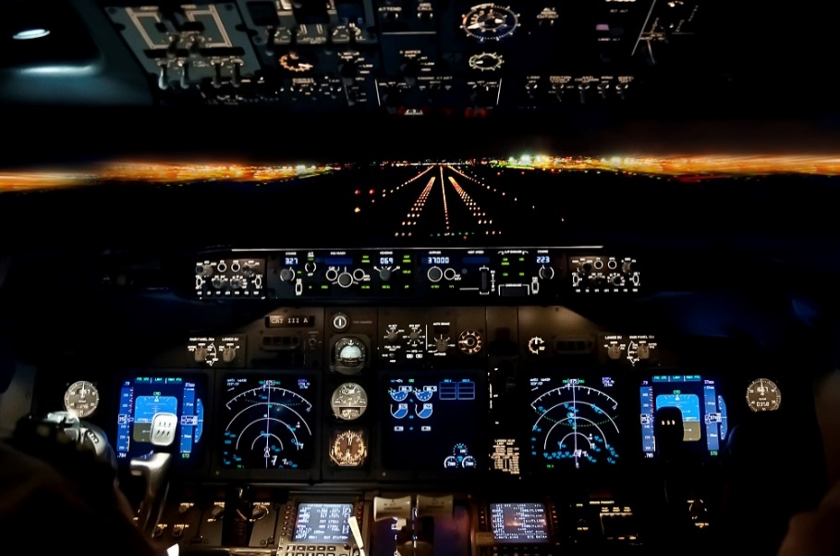
CAST Goal:
Reduce fatalities by 80%
in 10 years
Notes:
I know from working at NTSB for 10 years – aviation safety has improved significantly in our lifetime.
We go for years in commercial without a single fatality.
In the aviation industry, operators, labor unions, aviators – set a goal of reducing crashes by 80% and they’ve exceeded their goal, despite having a really complex system.

Slide 6
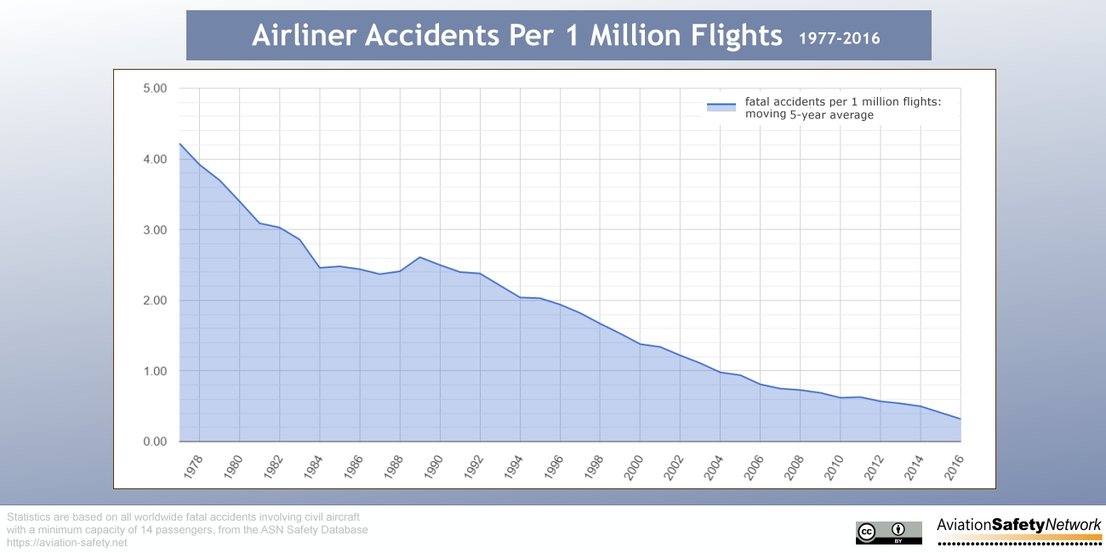
Outcome:
Notes:
It’s a system that’s expected to be safe and we rely on it.
The likelihood of a passenger dying in an airplane is 1 in 205,552.
Contrast that with the likelihood of dying in a motor vehicle crash is 1 in 102.
So why is it that we text our loved ones before liftoff, but not before getting behind the wheel?
The fact that a single fatality can capture international media attention says something about how far we’ve come with making even a single fatality after nine years something to talk about.

Slide 7
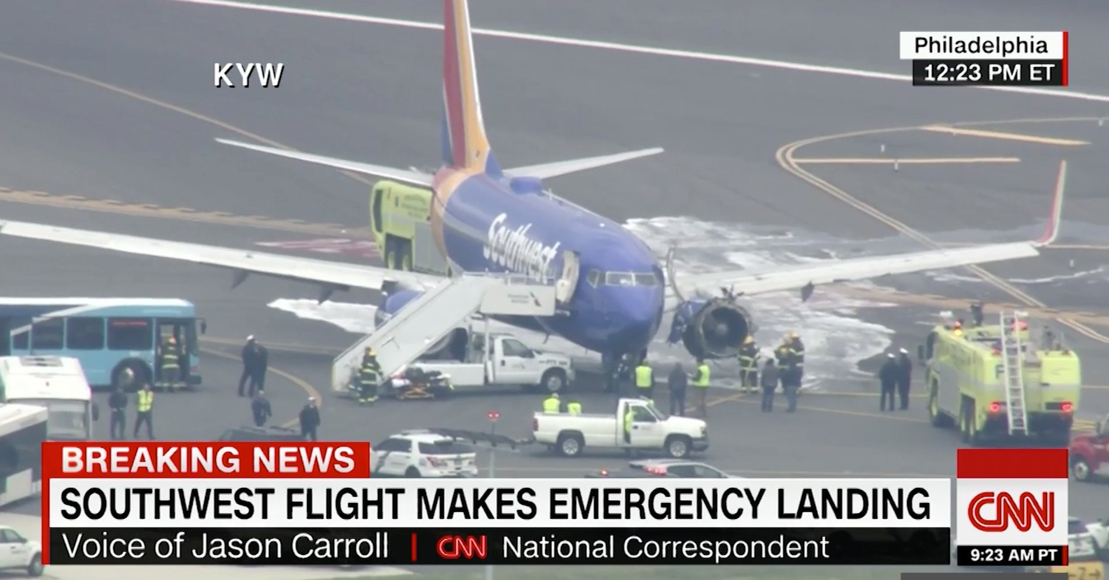
Notes:
How many of you have heard about this crash last week?
The likelihood of a jet engine failure is less than one for every million flights worldwide.
But that doesn’t stop many from worrying about safety in the air.

Slide 8
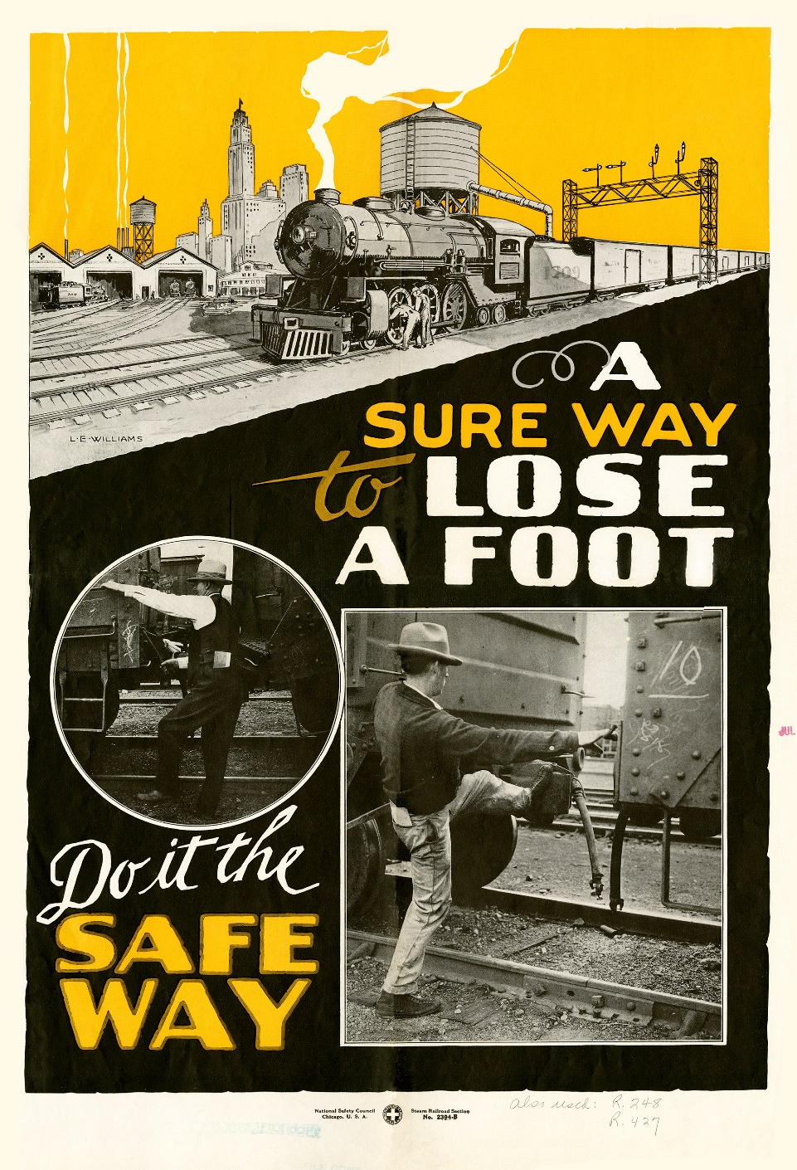
Notes:
Old workplace safety poster from NSC from the 1920’s
The most dangerous place to work was the railroad.
Took a concerted effort to change that.

Slide 9
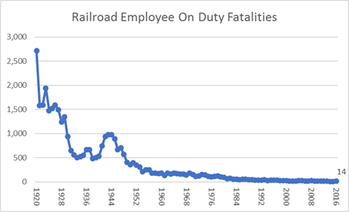
Railroad Employee on Duty Fatalities
Source: Association of American Railroads
Notes:
Dramatic reduction – changes in technology, equipment, training – primarily because they changed their culture.
We’ve gone from 2,500 plus per year to less than 15.
They’ve been able to lower deaths consistently.

Slide 10
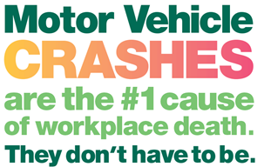
WHAT ABOUT ROADWAYS?
Notes:
Today, 40% of our workforce fatalities occur on the road.
Employers have an outsize role to play as most people have to drive to get to work, and workplace cellphone policies and other incentives can get workers to do the right thing behind the wheel.
We have many people here who are involved in the Our Driving Concern program for employers. Stop by their booth for some great resources and connections.

Slide 11
100+
CAN WE MAKE A DIFFERENCE?
WHAT IS THE RIGHT NUMBER?
Deaths
per day
in the U.S.
Notes:
When are we going to get as serious about the 100+ roadway fatalities we experience EVERY SINGLE DAY?
Making the shift to a culture where ZERO is the only appropriate answer isn’t easy. But we have put together a vision to get us there and I am going to share that vision with you today.

Slide 12
How Road to Zero is working
Coalition Work
Innovative Grants
Long Term Scenario
Coalition
Grants
Notes:
We built a road to zero coalition with over 675 unique organizations.
Our focus it to get to roadway fatalities by 2050

Slide 13
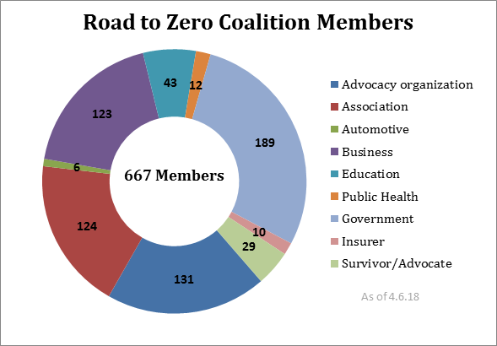
Notes:
In the short term, we have the incredibly committed and varied members of the Coalition coming together to share best practices and develop new ways of getting things done.
If you or your organization is represented on the Road to Zero steering group, please stand!
If you have been involved with Road to Zero in any way, please stand!
Let’s give everyone standing a round of applause.
We are breaking the silos of transportation to bring together groups that don’t normally get a lot of interaction. We are working alongside advocate and insurance groups and technology and automation experts all getting to find where their ideas intersect, and where the Coalition can have a stronger voice in getting the private and government agencies to see these possibilities in a new light.
Everyone in this room should be part of the Coalition, and if you haven’t joined yet, please stop by the Road to Zero booth and sign up.

Slide 14
2018 Road to Zero
Grant Recipients
Organization | Grant Name
America Walks with UNC-HSRC | Accelerating Adoption of Safer Systems for All Road Users
Bicycle Colorado | Bicycle-Friendly Driver and Confident Commuting Program
Center for Latino Progress | Cooperative Community Crash Reduction, Hartford CT
City of Boston | Boston's Safest Driver
Institute of Transportation Engineers/ Vision Zero Network | Moving from Conversation to Action: A Scalable Training Resource on Speed Management for Transportation Professionals and Community Stakeholders
Lorain County Public Health | Lorain Active Transportation Collaborative
National Complete Streets Coalition, Smart Growth America | Safe Street, Smart Cities Academy
NORC at University of Chicago | Underutilized Strategies in Traffic Safety
Texas A&M University / Houston Methodist Hospital | A systems approach to reduce drowsy driving among night-shift nurses
University of Alabama at Birmingham/ Safe Kids Worldwide | Improving Child Restraint Installation in Rural America through Interactive Virtual Presence
University of Michigan | Addressing Socioeconomic Disparities in Motor-Vehicle Fatalities
TOTAL AMOUNT | $ 1,500,000
Notes:
In the near term, we are providing grants to fuel innovative and proven traffic safety solutions.
We are in our 2nd year of grant funding, and these are our 2018 grant recipients of the Safe System Innovation Grants.
To qualify, for a Safe System Innovation Grant from Road to Zero, an organization needed to clearly explain how their innovative program will reduce roadway fatalities, set a timeframe for the reduction, outline how the program will be evaluated, detail how the organization intends to reach its target audience.
I’d like to highlight two grants in particular: Texas A&M University Department of Industrial and Systems Engineering in collaboration with Houston Methodist Hospital
University of Alabama at Birmingham (UAB Youth Safety Lab) in collaboration with Safe Kids Worldwide
One of the stand out things about the latest 2018 RTZ grant winners is just how much collaboration is happening among the different organizations.

Slide 15
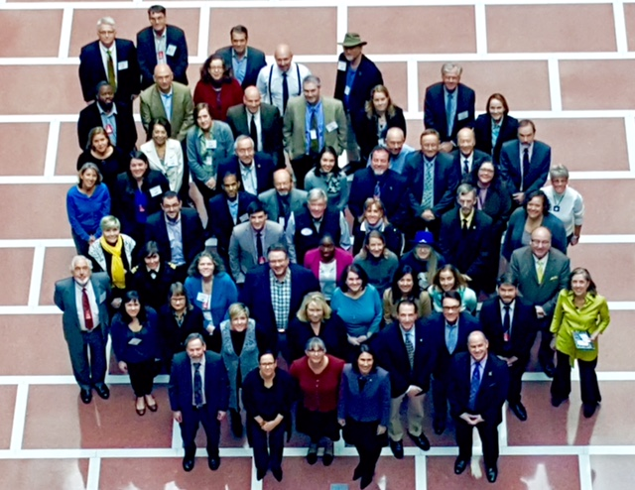

Slide 16


Slide 17
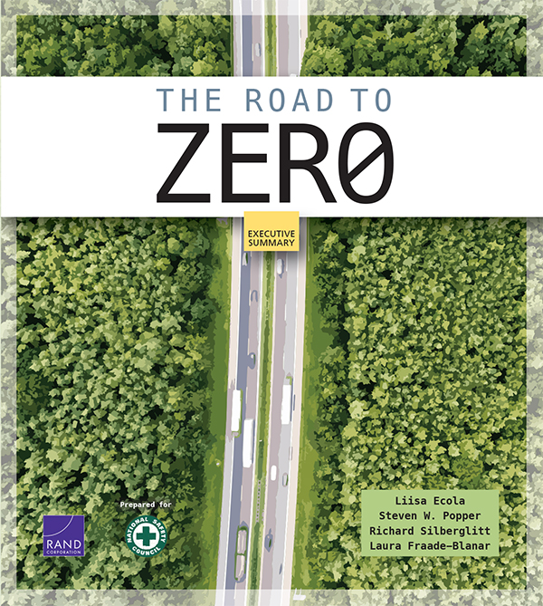
DOUBLE DOWN
on What Works
ACCELERATE Technology
PRIORITIZE
Safety
Notes:
For the long term, we developed a vision for ending roadway fatalities by 2050 with help from Coalition members and the RAND Corporation.
We just released the Road to Zero report and we hope it will help everyone working in traffic safety make the case for how we can get to zero.
The report breaks down how we can get to zero by focusing on three things:
Doubling down on what works
Accelerating technology
And implementing a Safe Systems Approach – Promoting Safety

Slide 18
DOUBLE
DOWN
ON
WHAT WORKS
ADVANCE
PROVEN COUNTER-MEASURES
Notes:
Step One is Double Down on What Works through proven countermeasures.
This is the area where most of you are making a difference.

Slide 19
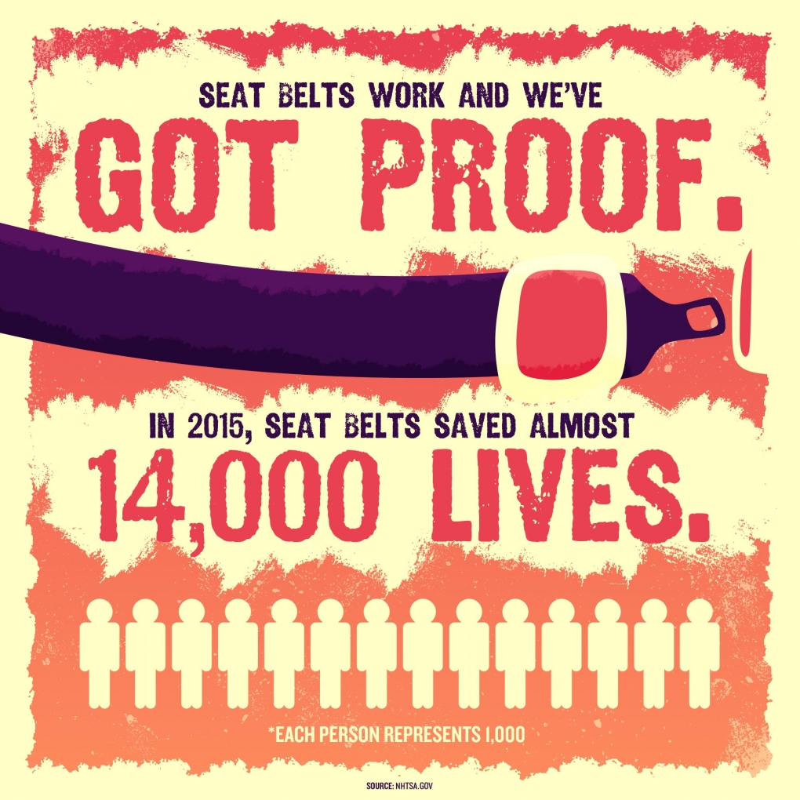
Notes:
Strong laws – like primary seat belt laws, have boosted seat belt use
Strong and visible enforcement campaigns, like Click It or Ticket have boosted seat belt use
Strong public education campaigns have also done their share in boosting seat belt use
These are all proven measures that work.

Slide 20
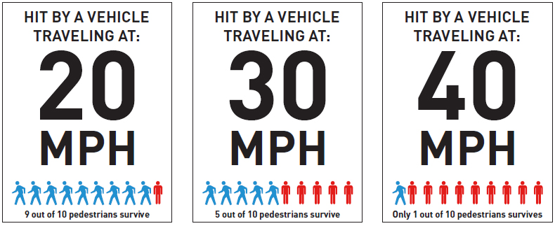
Fatality Risk Goes Up
Over 25 MPH
Image: Seattle Department of Transportation
Notes:
We know what’s causing the crashes, so we need to continue to focus on what’s killing us on the roads – speed, impairment, distraction.
San Antonio is a Vision Zero city, and every Vision Zero community is making these kinds of proactive measures a focus for bringing down fatalities.

Slide 21

Notes:
There are so many things that ordinary people can do to protect themselves on the road. Check to Protect encourages people to address open recalls. We worked with state agencies, with DMV’s, local automotive dealers to spread the word about an easy and free action that drivers can take to make sure their vehicle is safe to drive.

Slide 22
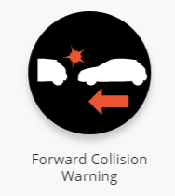
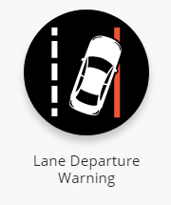
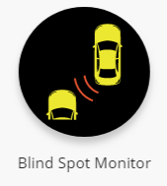
ACCELERATE TECHNOLOGY
3 Existing Technologies Can Save 10,000 Lives
Notes:
Accelerating existing and other promising automated technologies is the next step.
Carnegie Mellon found that forward collision warning, lane departure warning, and blind spot monitors alone can save 10,000 lives EACH YEAR.
These are technologies that are already out there.

Slide 23
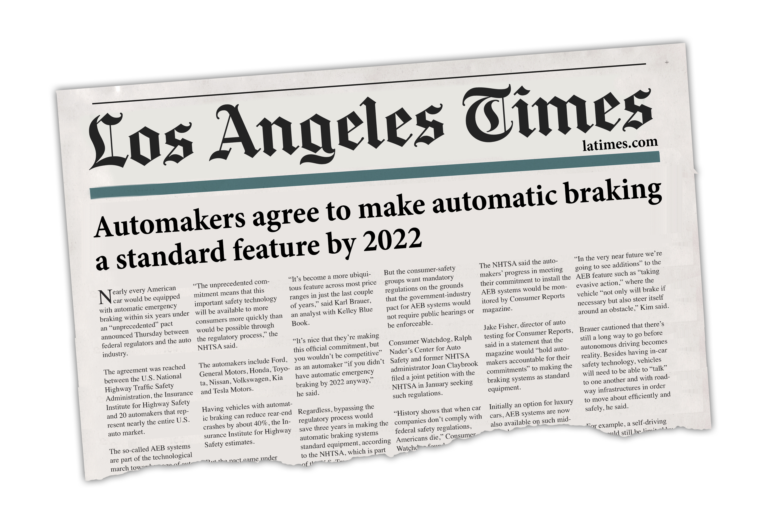
Notes:
We know automakers aren’t waiting for rulemaking or regulations to make life-saving features standard. And we can ensure that fleets out there take advantage of existing safety tech.
The promise of life-saving technology doesn’t end with the vehicle itself, it also applies to the environment and emergency response. Smart grid technologies, automated enforcement, real-time transmission of crash forces and vital health information for first responders can all reduce the death toll.

Slide 24
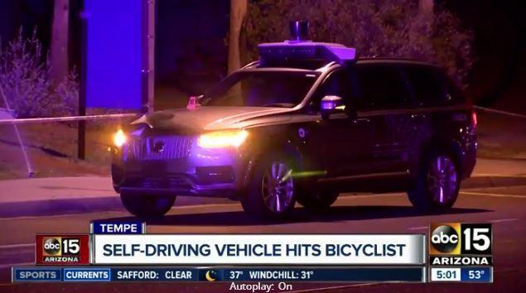
Notes:
I’m sure many of you heard about the recent Uber crash in Tempe, Arizona that struck and killed a woman who was crossing the street with her bike in poorly lit conditions. Cases like this remind us that we need more time to self-driving vehicles ready for primetime. But there are so many other ways we can enhance safety for driver-operated ones.

Slide 25
CREATE
A SAFE SYSTEMS APPROACH TO
SHIFT
CULTURE
PRIORITIZE
SAFETY
Notes:
The 3rd, and most important step is to ensure we put safety at the center of every transportation system.
We demand 100% safe operations in aviation, marine, pipeline, rail and transit, we should cultivate a corresponding societal demand for safe roads. The U.S. is trailing our international counterparts in addressing road safety. It’s because safety is not yet our #1 priority.
We know humans make mistakes, but we can design our systems in such a way that will make the likelihood of deadly mistakes near zero.

Slide 26
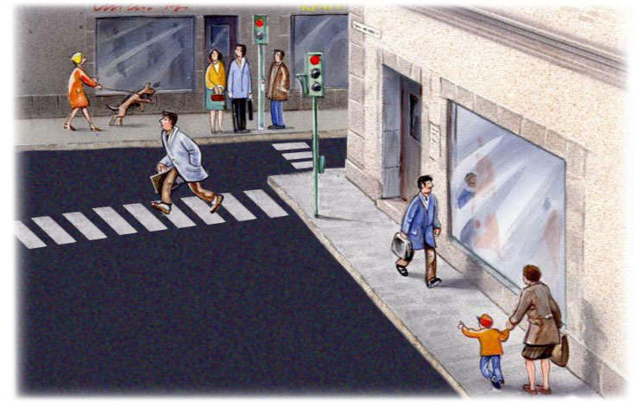
Source: Dr. Matts-Ake Belin, Swedish Transport Administration, Vision Zero Academy

Slide 27
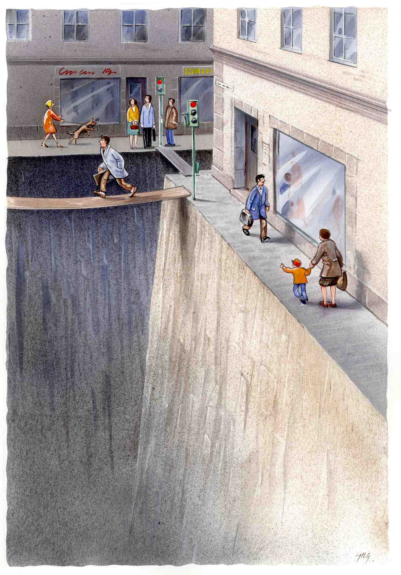
Source: Dr. Matts-Ake Belin, Swedish Transport Administration, Vision Zero Academy

Slide 28
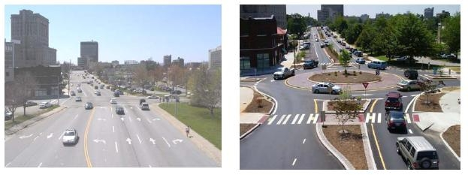
Asheville, North Carolina
Safe Infrastructure Project
7 lanes of traffic reduced to single lane roundabout:
              pedestrians cross just one lane at a time
              lower speeds
              shorter queues
              better use of space
Notes:
Vision Zero cities and others who have taken the safe systems approach have saved lives by redesigning dangerous corridors and crash-prone intersections.
Infrastructure improvements, automated enforcement, adjusting speed limits and traffic signal timing have created a safer road environments for the most vulnerable road users such as bicyclists and pedestrians.

Slide 29
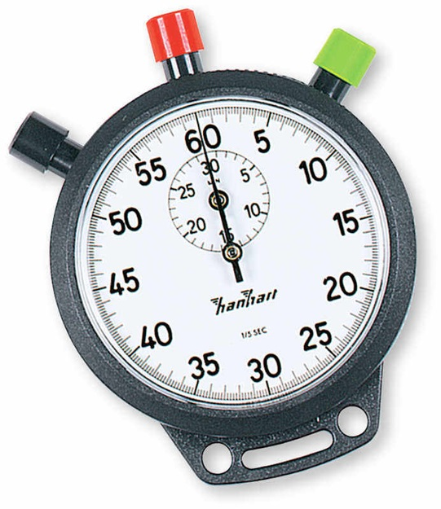
PRIORITIZE
SAFETY
EMERGENCY RESPONSE
THE GOLDEN HOUR
43% of fatal motor vehicle crash victims reach a hospital alive
NHTSA, 2016
Notes:
Another way to improve roadway fatalities is improving what happens to those hurt in a crash.
NHTSA estimates that nearly 43% of victims transported by EMS who ultimately died were still alive when they arrived at the hospital.

Slide 30
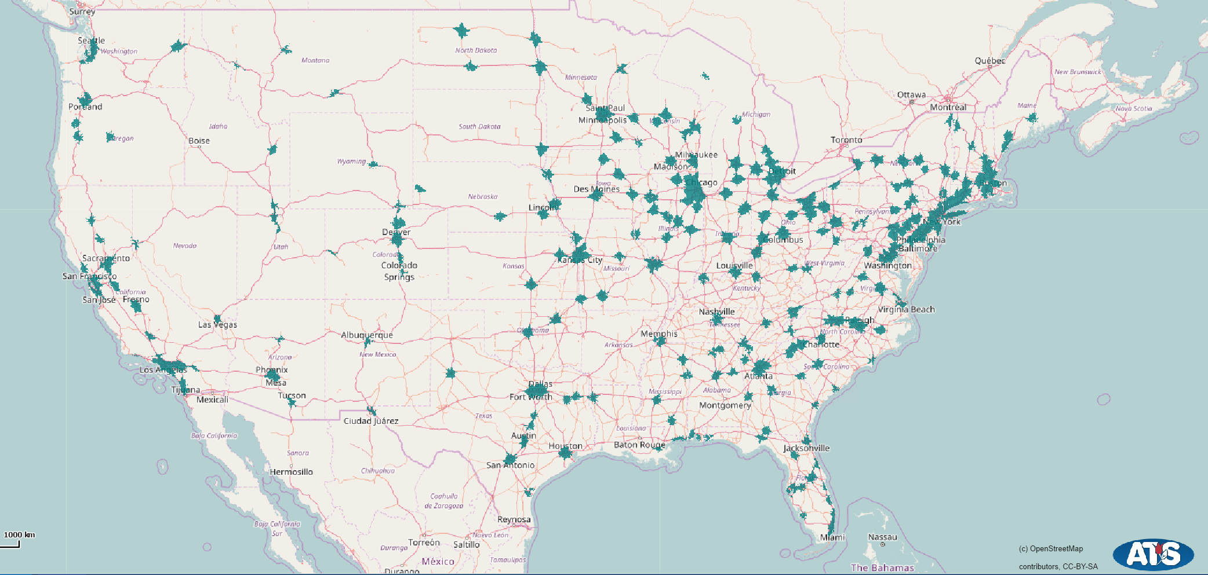
Trauma Access
Source: TraumaMaps.org
Notes:
Let’s get graphic. Here’s a heat map of sorts. The green areas are where you can crash, and assuming the ground ambulance is on scene immediately, they can get you to a level 1 or 2 trauma center within an hour.

Slide 31
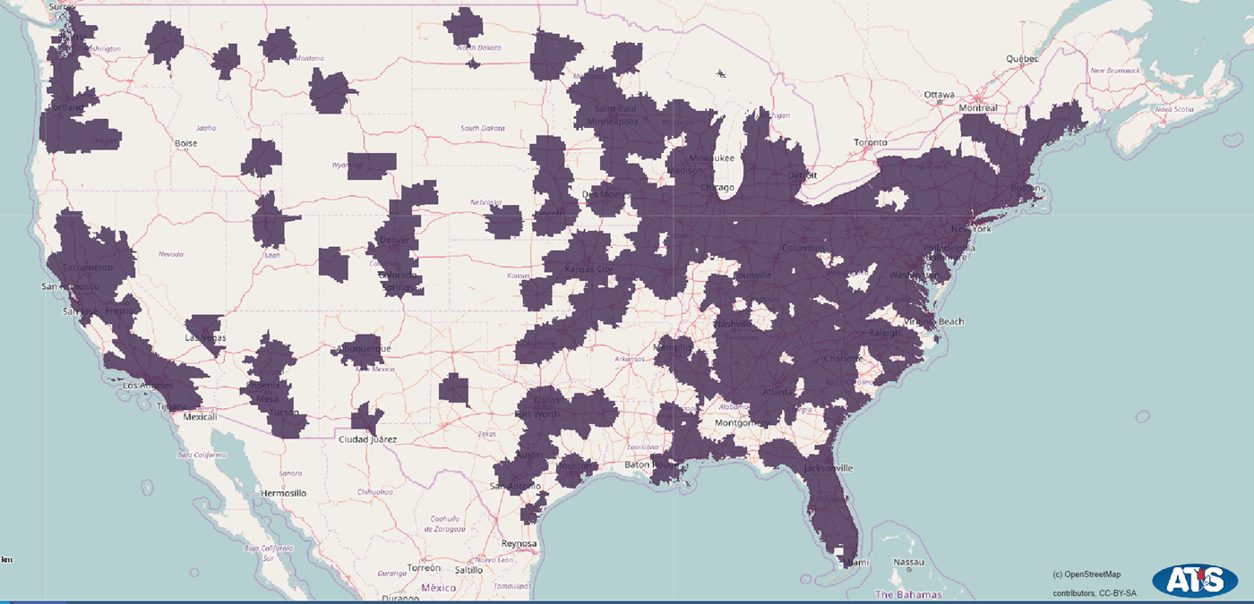
Trauma Access By Helicopter
Source: TraumaMaps.org
Notes:
Rural communities have just 19% of the population but 49% of roadway fatalities.
The purple areas are where you can crash and pray for a helicopter to be available because they should be able to get you to the trauma center within an hour.

Slide 32
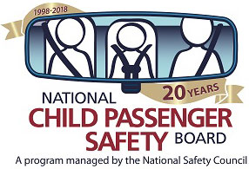
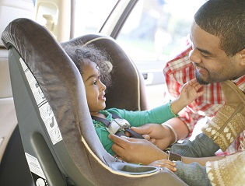
Notes:
The National Child Passenger Safety Board celebrated its 20th anniversary this year. We have made great strides with child passenger safety. Motor vehicle crashes used to be the #1 cause of death for kids ages 1-4 as well, but in 2011 and again in 2016, it actually dropped to #2.
Today, child restraint use is estimated to be 94%. (That’s better than our 90% seat belt use.)
Today it is common for hospitals to assist new parents with correct use of car seats before newborns are discharged. Progress is being made. Those restrains saved an estimated 11,300 lives since 1975.
But there is one area where we can do more. We still lose 500 kids under age 4 every year. 40 kids are lost to heatstroke after finding their way into, or being left in a hot car. We can do better. We have a Heatstroke report coming out in May to tackle this issue. We’re calling for lawmakers, parents, caregivers and the public to advocate for change and raise awareness. There is not a single reason why we should be losing our most precious cargo.

Slide 33
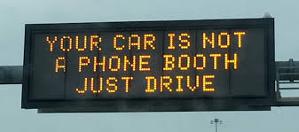
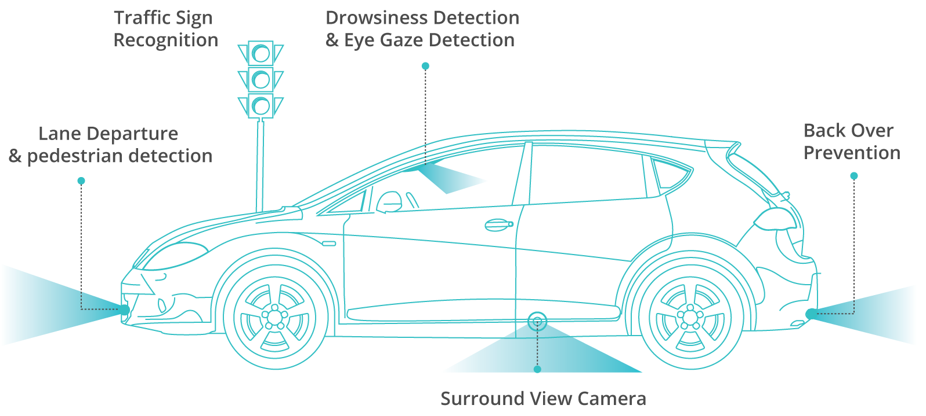
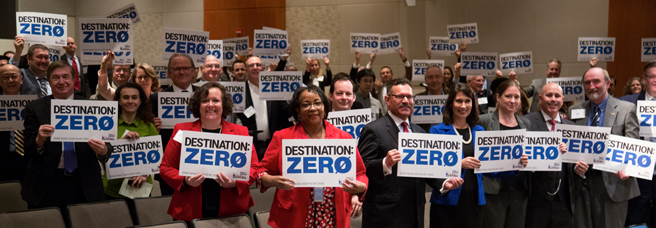
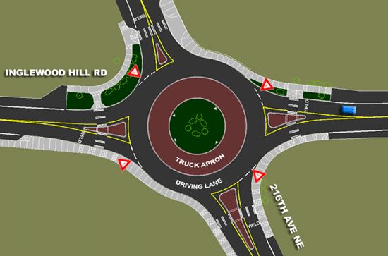
THE FUTURE OF ZERO
Notes:
We are working to change the culture by seeing all components in our transportation systems through a safety lens : Human, Machine, Environment, and Safety Culture.
The safety culture piece is really important. We’ve made great progress when it comes to child safety seats.

Slide 34

Notes:
NSC video

Slide 35
Notes:
Thank you!

