Slide 1

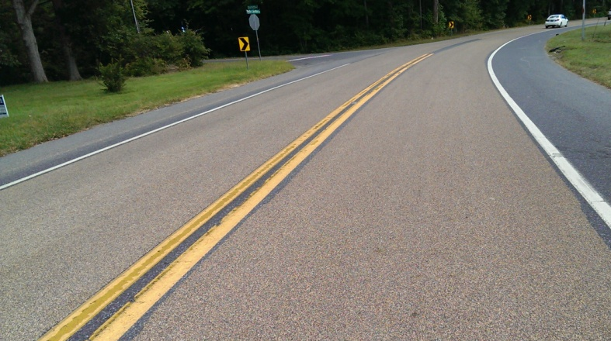
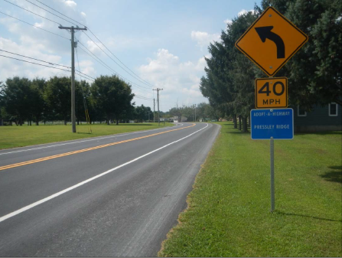

Effective Systemic Curve Improvements
Road to zero coalition
Infrastructure safety panel
December 12, 2017
Presented by:
Adam Weiser, P.E. PTOE
Safety Programs Manager
Delaware Department of Transportation

Slide 2
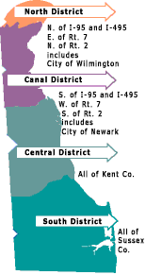
Delaware Roadway System
13, 731 total lane miles in Delaware
  DelDOT is responsible for 89% of the lane miles
    Maintenance responsibilities range from Interstates to subdivision streets
  25% of Delaware’s roads qualify for federal funds for rehabilitation and reconstruction projects
57 municipalities in Delaware
  12% of all crashes occurred on locally owned roadways (2009 – 2011)
  3% of all fatal crashes occurred on locally owned roadways
Wilmington, Newark and Dover maintain the majority of the local roadway mileage not maintained by DelDOT

Slide 3


Delaware Strategic Highway Safety Plan
Mission Statement: The Delaware Strategic Highway Safety Plan: Toward Zero Deaths aims to eliminate fatalities and serious injuries on Delaware’s roadways through a multi-agency approach that utilizes education, enforcement, engineering and
emergency services strategies.
Vision Statement: The goal of the Delaware Strategic Highway Safety Plan: Toward Zero Deaths is to achieve a reduction of at least 3 fatalities and 15 serious injuries annually and continue to reduce the total number of fatalities and serious injuries to achieve at least a 50 percent reduction by 2035.

Slide 4
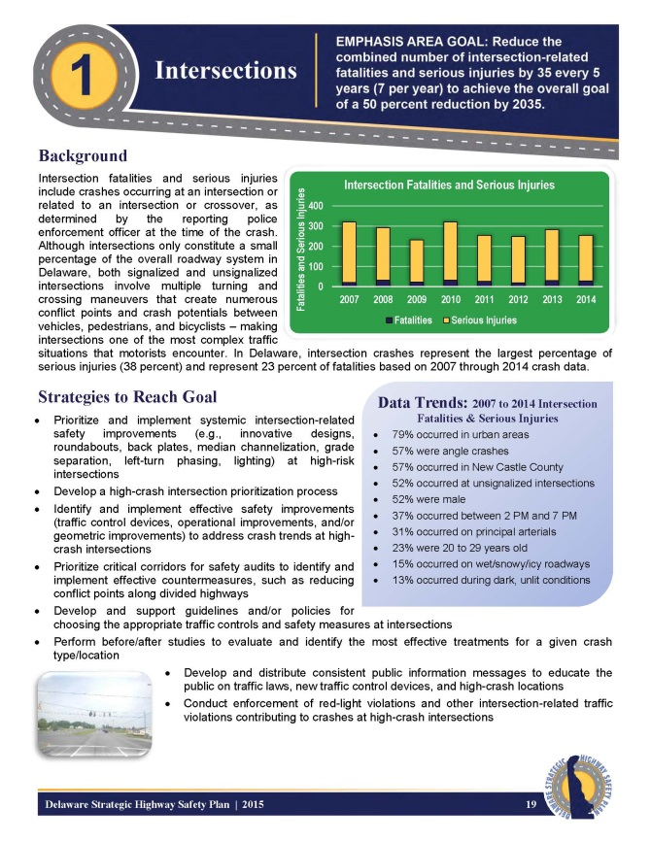
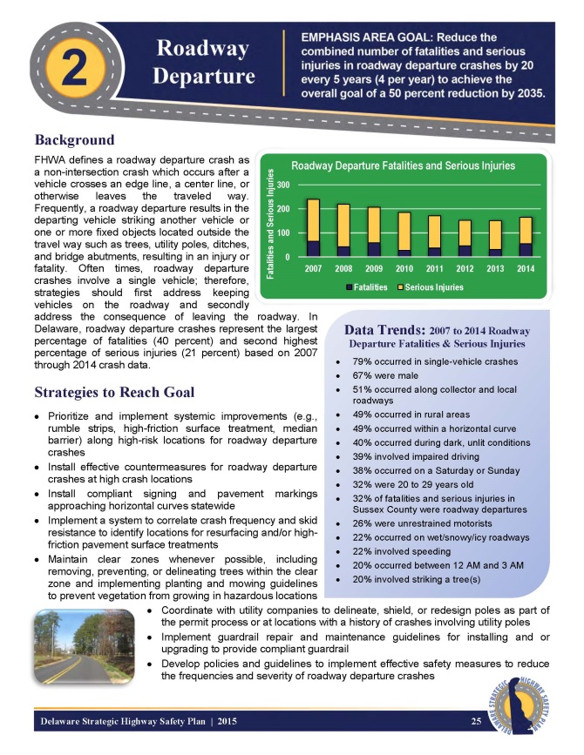
Delaware Strategic Highway Safety Plan
Emphasis Areas
  1 – Intersections
  2 – Roadway Departures
  3 – Impaired Driving
  4 – Unrestrained Motorists
  5 – Motorcycles
  6 – Speeding
  7 – Pedestrians
  8 – Traffic Records

Slide 5
Delaware Strategic Highway Safety Plan
Emphasis Area 2 – Roadway Departures
  Strategy 1 – Keep Vehicles on the Road
    Pavement Marking improvements
    Rumble strips
    High Friction Surface Treatment
    Horizontal Curvature Signage
  Strategy 2 – Minimize the Consequences of Leaving the Road
    Safety Edge
    Clear roadsides
    Breakaway/crashworthy infrastructure

Slide 6
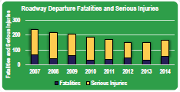
Delaware Strategic Highway Safety Plan
Emphasis Area 2 – Roadway Departures
  Crash Data Trends – fatalities and serious injuries
    79% occurred in single-vehicle crashes
    51% occurred along collector and local roadways
    39% involved impaired
    driving
    49% occurred in rural areas
    49% occurred within a
    horizontal curve
    32% of fatalities and serious
    injuries in Sussex County
    were roadway departures
    26% were unrestrained motorists
    22% occurred on wet/snowy/icy roadways

Slide 7
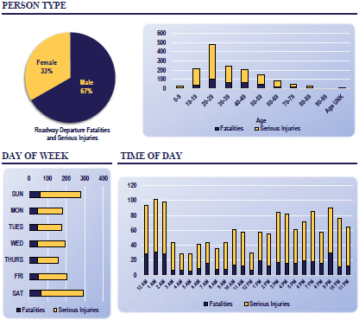
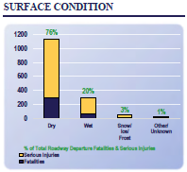
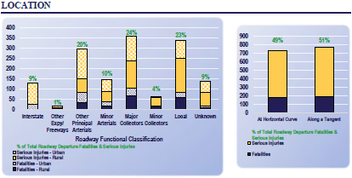
Delaware Strategic Highway Safety Plan

Slide 8
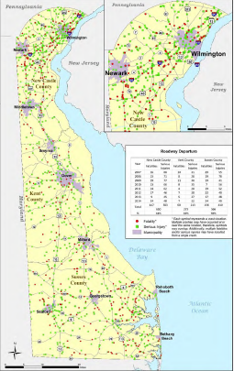
Delaware Strategic Highway Safety Plan

Slide 9
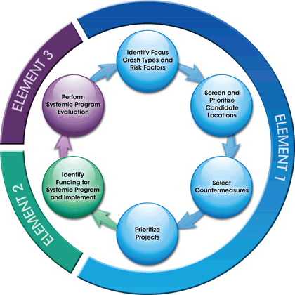
Systemic Safety Improvements
Change in how we think about safety improvements
  Identify problems based on system-wide data
    Use SHSP to identify problem areas
    Examples:
      Road departure crashes
      Pedestrian crashes
      Wet weather related crashes
    These types of crashes are spread
    across the road network, not clustered
    at specific locations
    Look at roadway characteristics that are
    frequently present in severe crashes
      Geometry
      Traffic volume
      Location

Slide 10
DelDOT’s Systemic Safety Program
High-Friction Surface Treatment
  Prioritize all roadways based on roadway departure crashes on wet pavements
  Focus on horizontal curves and high wet-weather crash locations
Horizontal Curve Signing Improvements
  Address MUTCD Compliance
  Address Roadway Departure Emphasis Area
Others
  Longitudinal rumble strips
  Freeway Median Barrier

Slide 11
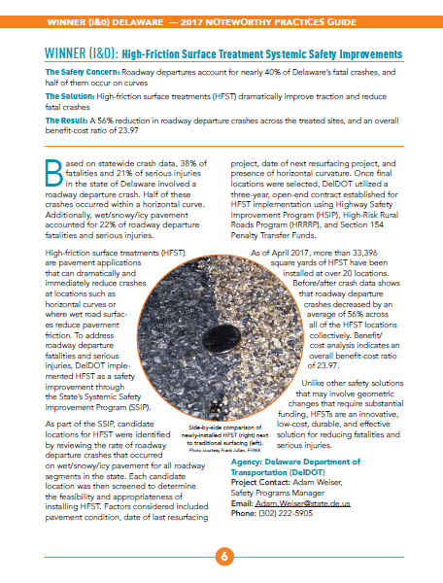
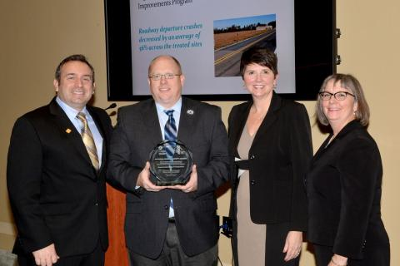
High friction surface treatment

Slide 12
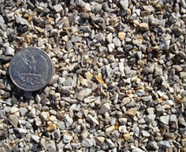
High-Friction Surface Treatment
Skid resistant surface treatment
  Ultra-thin pavement overlay
  Addresses friction demand issues:
    Reduction of friction in wet pavement conditions
    High friction demand due to vehicle speed and/or geometrics
Where to use
  Sharp horizontal curves
  Locations where vehicles brake excessively
  Surfaces where premature polishing has occurred
  High volume intersection approaches
  Interchange ramps
  Bridges

Slide 13
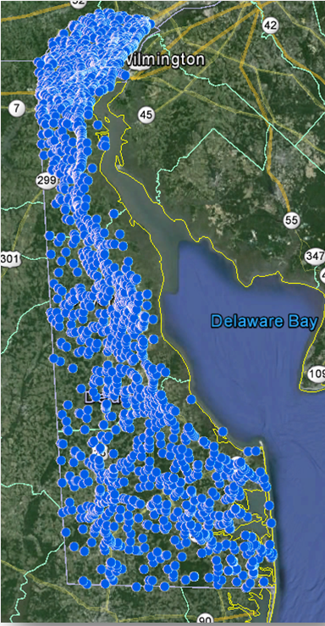
Wet Weather Crashes in Delaware
January 2010 – December 2012
  Initial data set for candidate selection
  3 years of data
  10,000 crashes
  43 fatalities
    20 fatalities involving DUI
  2,406 personal injuries
  22% involved careless or reckless driving

Slide 14
Location Selection
Systemic process
  Road Departure Crashes on wet roadways
  Focus on rural collectors and locals
  Horizontal curve locations
  Location not included in any paving program
    Pave & Rehab
    Microsurfacing
  Crash analysis
    Determine # wet weather crashes
    Calculate crash rate
    Rank by crash rate

Slide 15
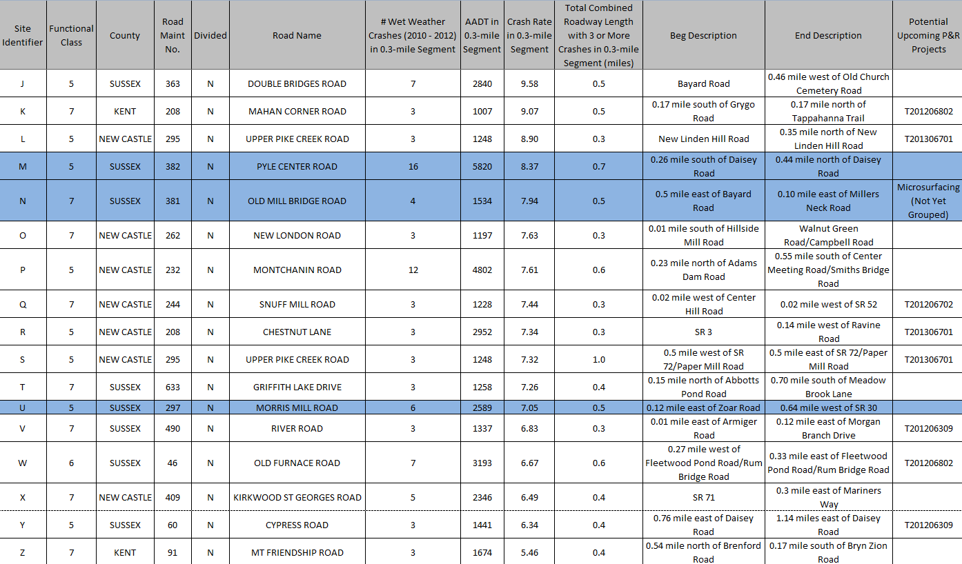
Location Selection

Slide 16
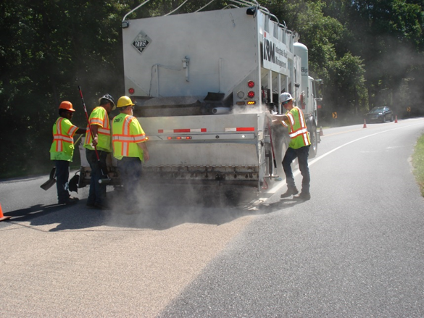
High-Friction Surface Treatment
Materials
  Polymer resin binder material
  High-quality aggregates
    Polish and abrasion resistant
    Reduce hydroplaning on wet
    surfaces
Application methods
  Hand/manual application
  Truck mounted/mechanical
  application
Costs
  $25 to $50 per square yard
  depending upon aggregate
  10-year life cycle

Slide 17

Delaware’s HFST Program
Test location
  Pyle Center Road – Sussex County
    Horizontal curve
    Intersection in middle of curve
    Before data – 8 wet weather crashes per year
    HFST installed September, 2013
      Joint effort between DelDOT and DBi Services
        Cost sharing
    75% reduction in wet weather crashes (two years of data)

Slide 18
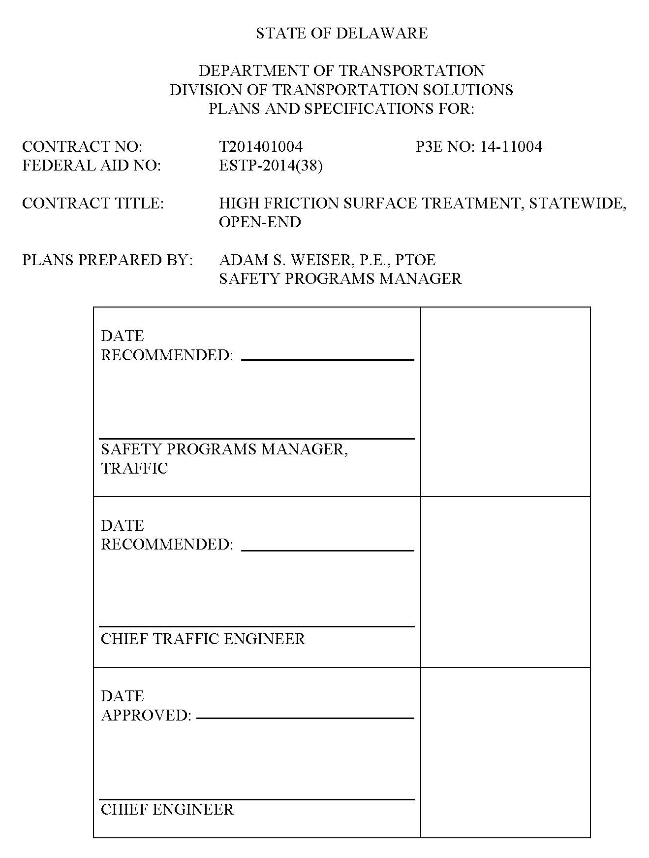
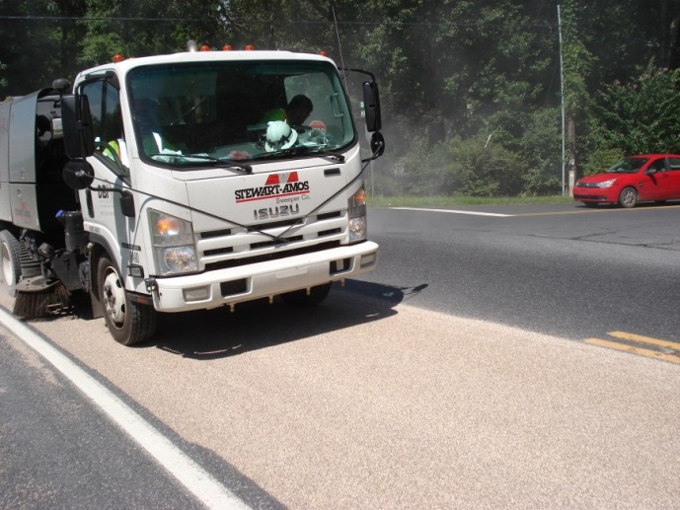
Delaware’s HFST Program
Contract development
  Three-year open-end location
    Statewide contract
  Identified 15 initial locations
    Included in contract documents
  Remaining locations identified throughout
  life of contract
  Award value = $1,178,645.32
    Funded with HSIP, HRRRP and
    Section 154 Penalty Transfer Funds
    Award Date: 5/6/2016
  Contractor: Poly-Carb, Inc.

Slide 19
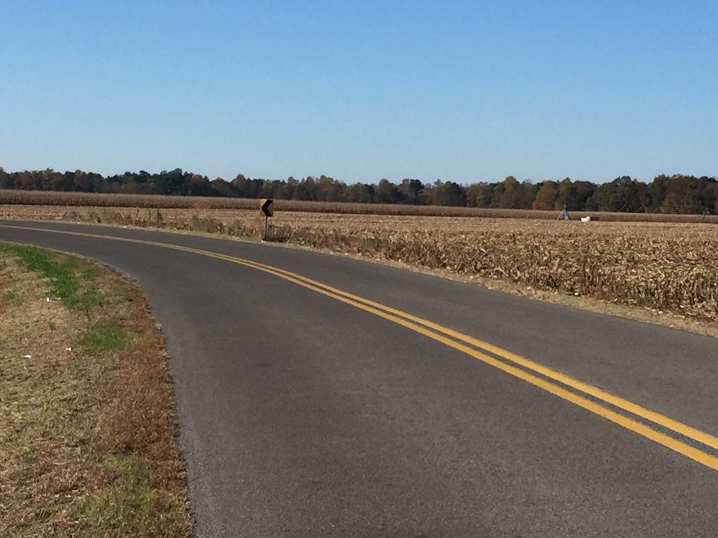
Delaware’s HFST Program
Current status
  Completed 30 locations
  Additional locations to be
  handed off by spring
  Updated site selection process
  complete
Future Plans
  Continue before/after studies
  New open-end contract
  Implementation on stop-controlled approaches at intersections

Slide 20
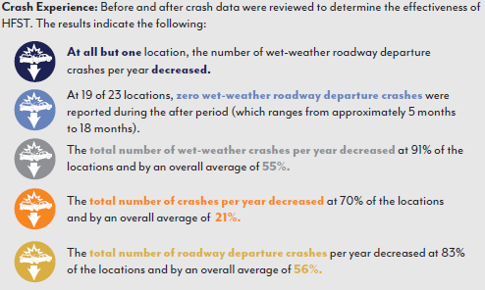
Delaware’s HFST Program

Slide 21
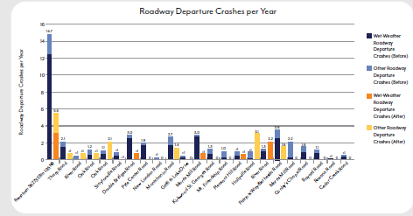

Slide 22
Delaware’s HFST Program
Current challenges
  How do we treat re-installation as part of other projects?
  Impacts of plowing
    Test location has experienced two winters and is holding up
  Aggregate types
    Calcined bauxite is most common but has to be shipped in from other locations
    NTPEP test bed of additional aggregates
      Waiting for additional results
      More local materials, lower costs (hopefully)
  Maintenance
    Potholes
    Cracking
    Poor adherence
Time will tell…

Slide 23
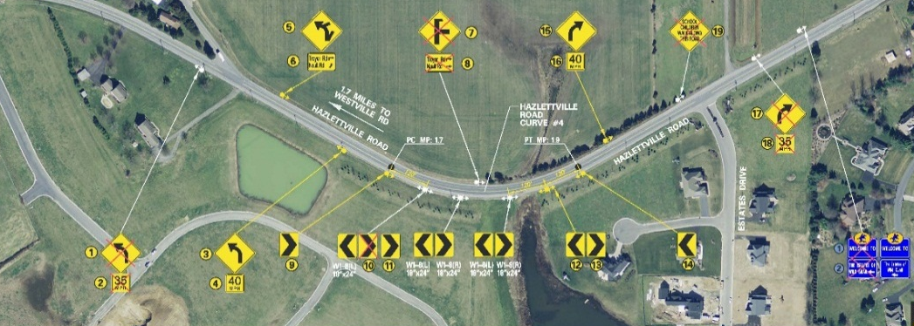
Horizontal curve signing program

Slide 24
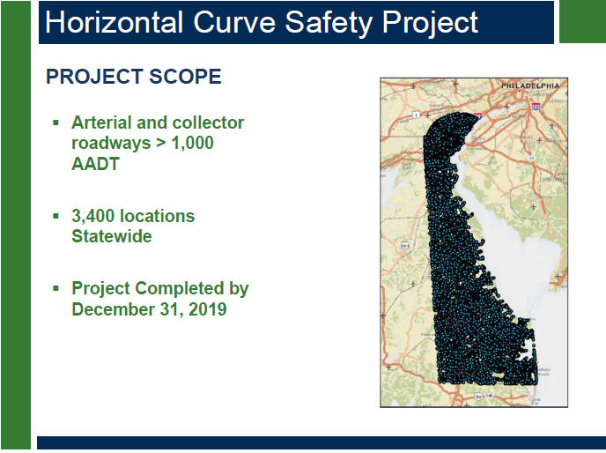

Slide 25
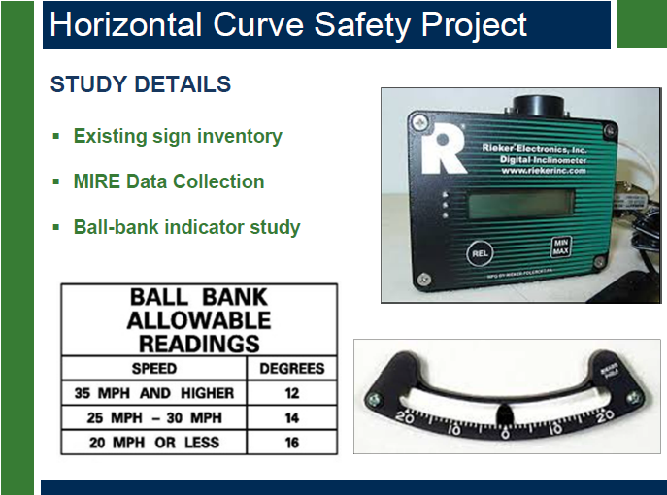

Slide 26
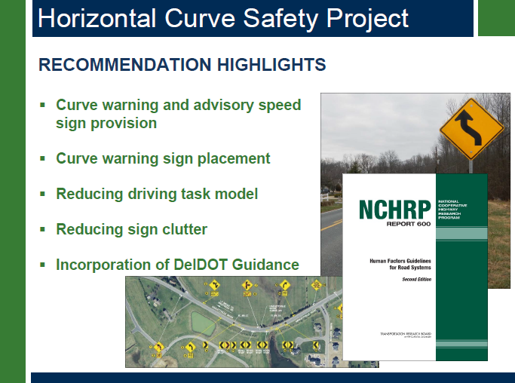

Slide 27
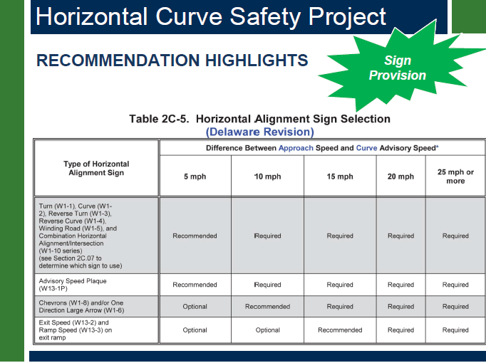

Slide 28
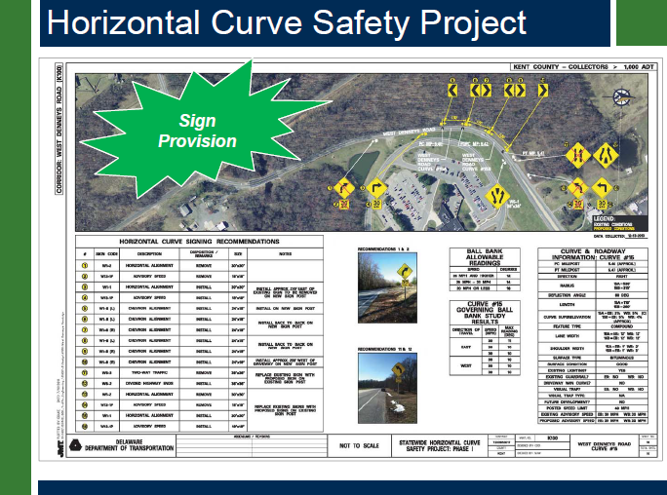

Slide 29
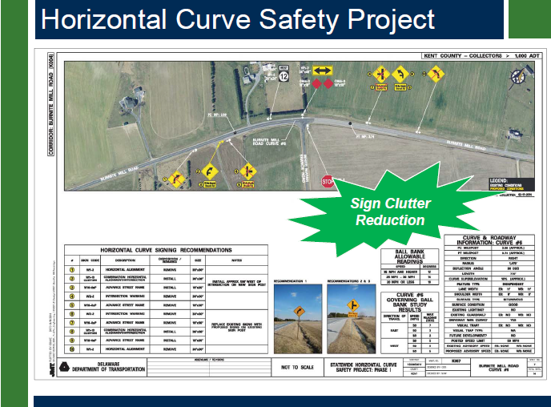

Slide 30
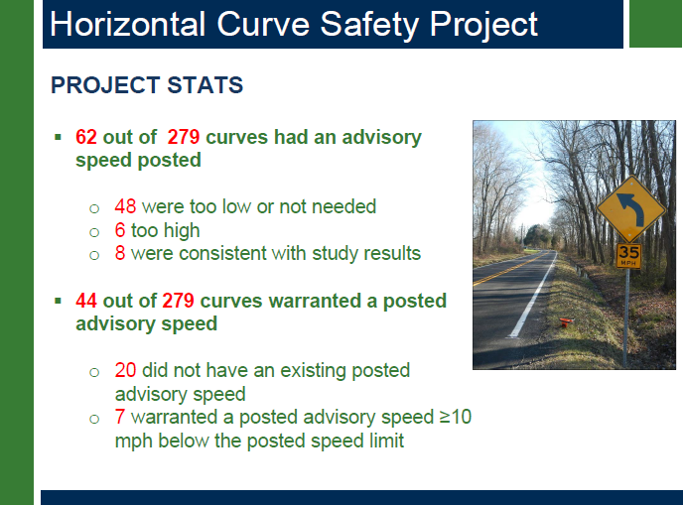

Slide 31
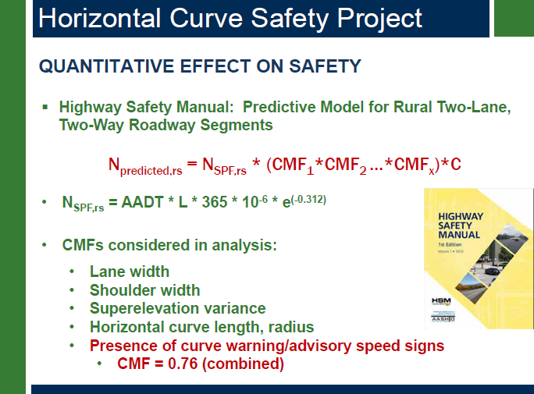

Slide 32
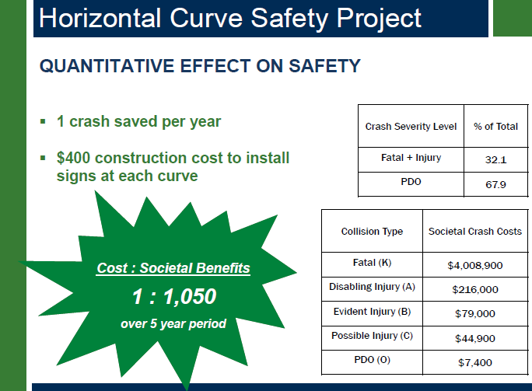

Slide 33
Thank you!
Contact Info:
Adam Weiser, P.E., PTOE
Safety Programs Manager
Delaware Department of Transportation
169 Brick Store Landing Road
Smyrna, DE 19977
P: (302) 659-4073
E: Adam.Weiser@state.de.us

