Slide 1

Advanced Safety Technologies
Reflections and Visions
Skip Yeakel, P.E.
Volvo Group North America
March 20, 2018
Panel Discussion at NTSB Headquarters
L’Enfant Plaza, Washington, D.C.

Slide 2
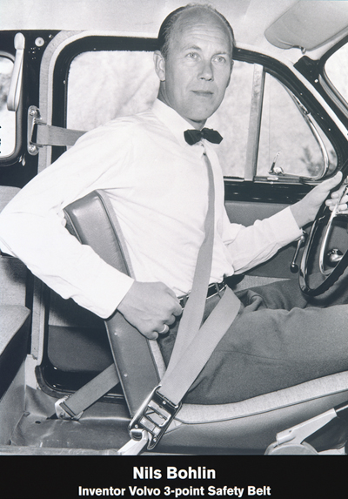

Wear Your Seat Belt
Many trucker deaths are still attributed to the simple lack of wearing the 3-point seat belt that all truck OEM’s provide (ref: FMCSA stats)
As an incentive to increase seat belt use and inspections, a wireless Trusted Truck® concept was demonstrated to reward “trusted” trucks
https://jalopnik.com/volvo-gave-away-their-most-important-invention-to-save-1069825878

Slide 3
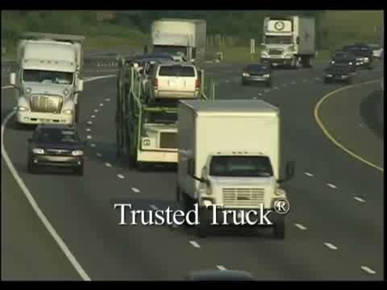

Slide 4
From 1959 to ~Y2K and IVI
Intelligent Vehicle Initiative (IVI) / US DOT JPO
4 OEM’s with 1 Goal: RD³ = R&D + Demo & DEPLOY!
CWS + ACC, Lane Keeping, Roll Stability
Deployment results precede regulations
Many CWS/ACC and LK systems sold
ESC Made Standard ~2006; finally a regulation

Slide 5
Current Safety Technologies
HMI ELD Regulation effective December 2017
Automatic Emergency Braking now standard
Camera and 360 Vision System options
Pre-crash video – proves 4-wheeler causation
Distracted Driver Mitigation – CWS and AEB
Crash AVOIDANCE is the universal CV goal

Slide 6
Near-Term Safety Apps
Platooning + Other DSRC App Deployment
Distracted Driver Mitigation – CWS and AEB
Emergency Responder Day – Penn State Demo with MASITE and PA ITS Chapters – lead to…
Self-Contained ER Community DSRC Prospects
Work Zone and Incident Infrastructure
SPaT Challenge + Smart Belt & Other Coalitions

Slide 7
Future Safety Technologies
Automated Truck and Bus Evolution Continues
Self-Contained vs. DSRC – Advanced Warning
DSRC vs. 5G; 5G vs. 6G, Satellite, Whatever
Fully Autonomous Applications in Demo Mode
Construction Equipment, Mines, etc. Apps
Widely Autonomous Trucks – After I’m Gone

Slide 8
Video References
Automatic Emergency Braking: https://www.youtube.com/watch?annotation_id=annotation_83258&feature=iv&src_vid=ridS396W2BY&v=WH4F7J7AAFE
Collision Avoidance in a Curve: https://www.youtube.com/watch?v=dqNtzncxxcI
Crash Zone and Emergency Responder: http://www.tsag-its.org/
Platooning: https://www.youtube.com/watch?v=iNTKqh7i5jQ
Work Zone Warning: CAMP Fowlerville, MI Demo Clip (upon request)

