Slide 1

Stop the Bleed
Campaign
Jon R. Krohmer, MD, FACEP
October 13, 2017

Slide 2
Stop the Bleed Campaign
Based on valuable lessons learned from military conflict medical care
Started out as the Hartford Consensus Conference – following the Sandy Hook School shooting
White House National Security Council Initiative
Parallel activities by National Association of EMTs (NAEMT) and the American College of Surgeons Committee on Trauma (ACSCOT) – programs combined
Department of Homeland Security Office of Health Affairs (OHA)

Slide 3
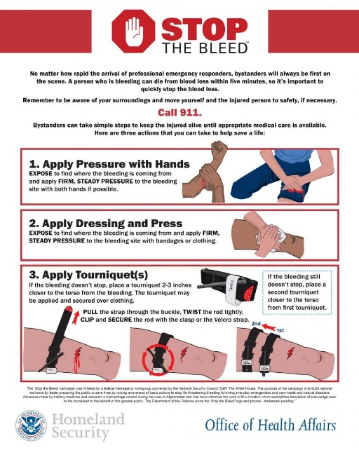
Hemorrhage Control
Recognize the Bleeding
Control the bleeding through a staged appraoch
  Direct Pressure
  Pressure dressing
    (Wound packing)
  Applying a tourniquet

Slide 4


Slide 5
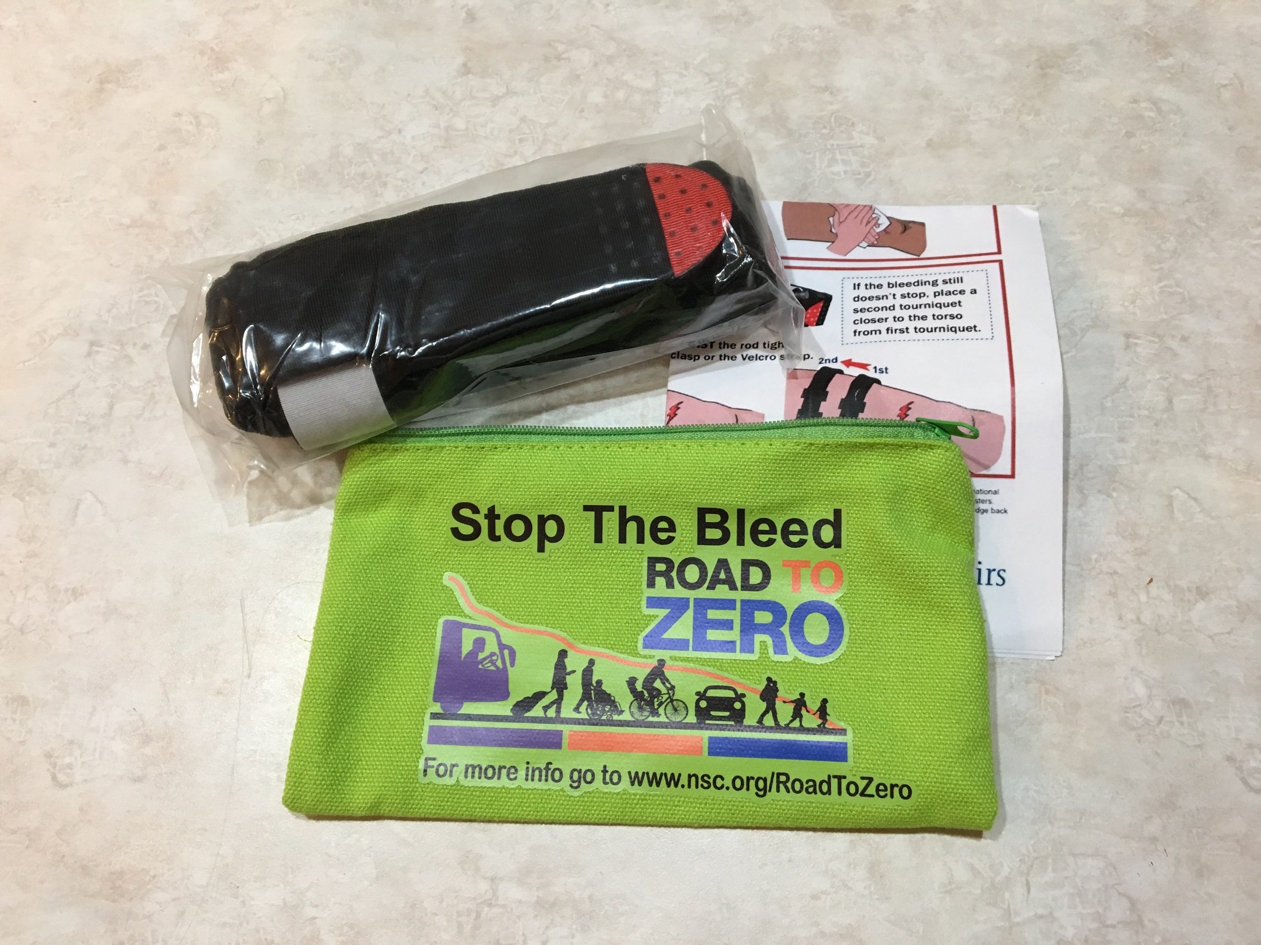

Slide 6


Slide 7

www.bleedingcontrol.org
www.dhs.gov/stopthebleed
jon.krohmer@dot.gov
Paul.Brooks@hq.dhs.gov

