Slide 1
Enhanced Emergency Medical Response
Dia Gainor, NASEMSO
Road to zero MARCH 2017

Slide 2
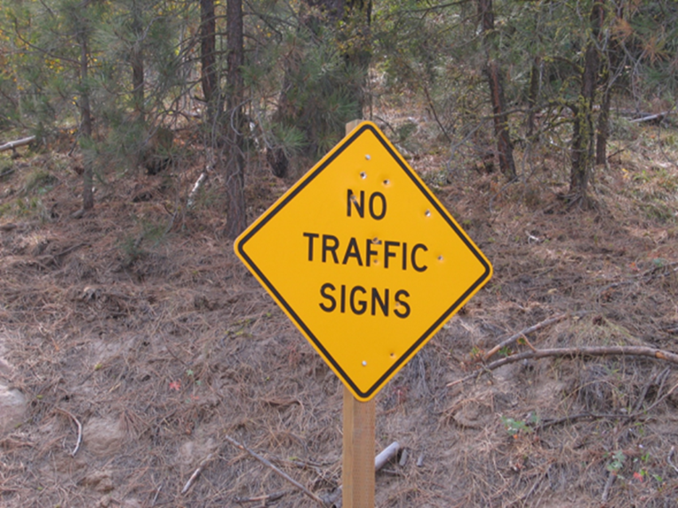
Notes:
This is a real sign on a county road about 45 miles north of where I live. Ignore the bullet holes--really pertinent to our work here—we have to go down this road, and not only do we not know what lies ahead, we’re forced to imagine it, predict it, and simply accept that the usual wayposts aren’t there. We have to imagine possibilities AND RISKS that could exist since the infrastructure and others’ behaviors and resources available to us may be completely different than usual. But we still have to go.

Slide 3
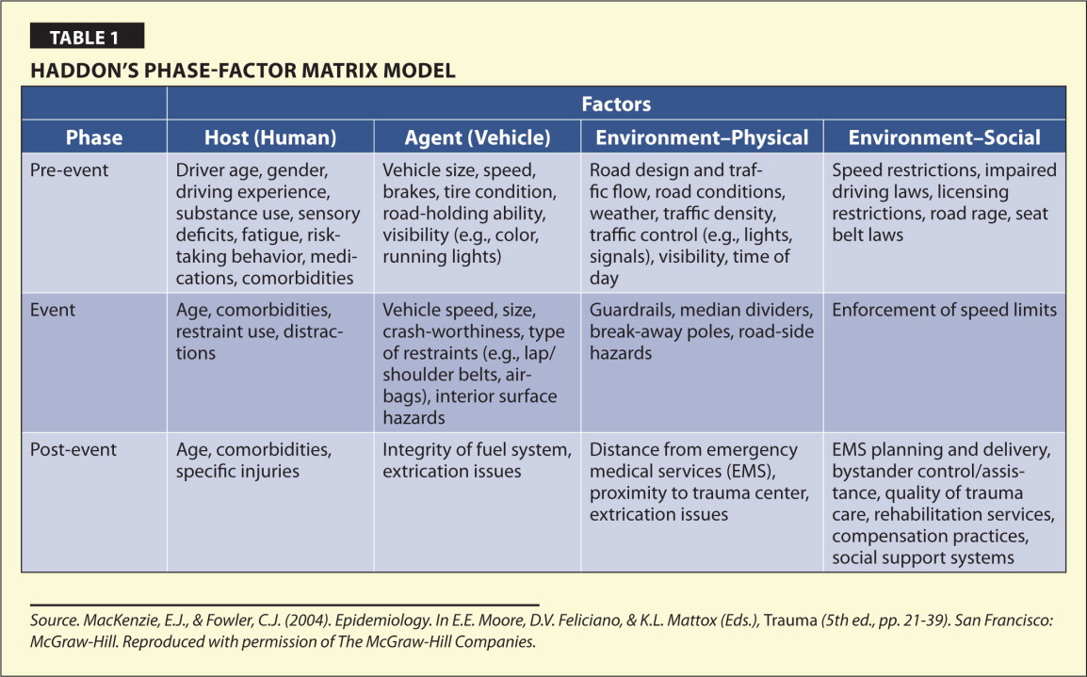
Notes:
While he asserted that prevention must come first, this last row, as a physician, he knew that it medical intervention was equally important. If all of the programs aimed to prevent, to educate, to make people safe fail and a crash still occurs, and injury occurs, then the post event phase is the last hope for the victim. The emergency care and trauma systems are the victims’ safety net—and they are YOUR program’s safety net.

Slide 4
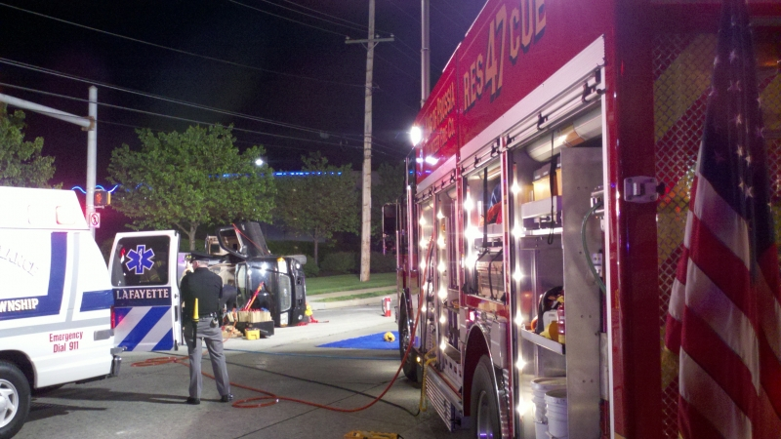
Notes:
We have relatively straightforward scenes to tend to like this single car rollover with one ambulance, one firetruck, and one police car dispatched…

Slide 5
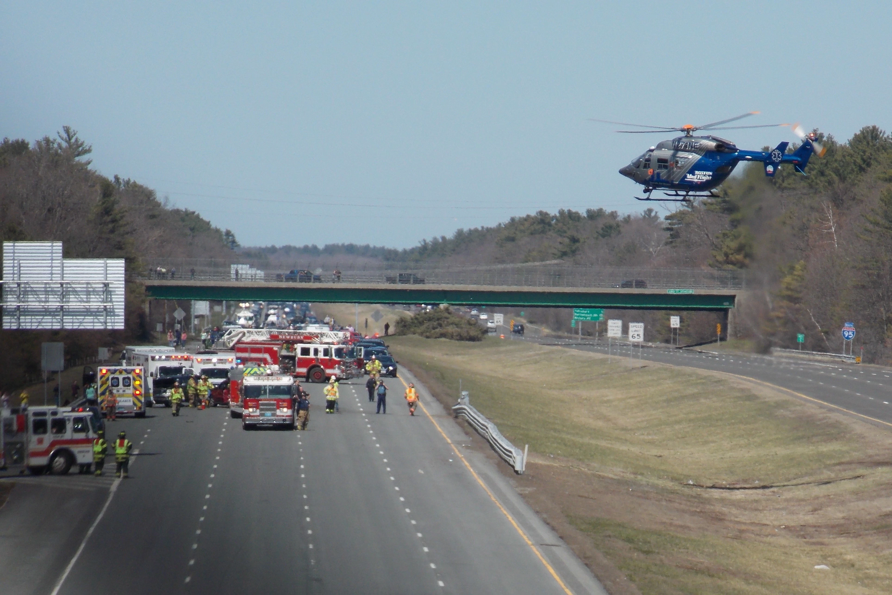
Notes:
…to the complex multivehicle, mass casualty scenarios involving several emergency response agencies, often from multiple jurisdictions, and we complicate things further by closing down the highway in order to use it as a helicopter landing zone. (We know the state transportation department loves it when we do that). BUT IT IS FROM THIS POINT FORWARD where EMS role and trajectory is completely different from law enforcement, fire and rescue, and towing, and hence why we single EMS out, and don’t dilute it by referring to it as “emergency response” when we’re referring to saving lives. Sure, on scene we share the common objective of safe quick clearance. EMS then has a whole other phase of work to do, critical medical interventions on scene, extrication (which is as much a medical as mechanical event) transporting away from the scene and to the appropriate hospital. Sounds simple, right?

Slide 6
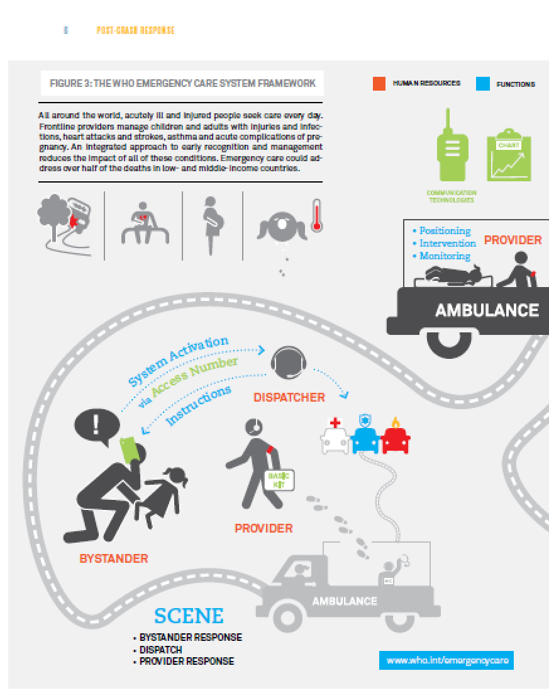
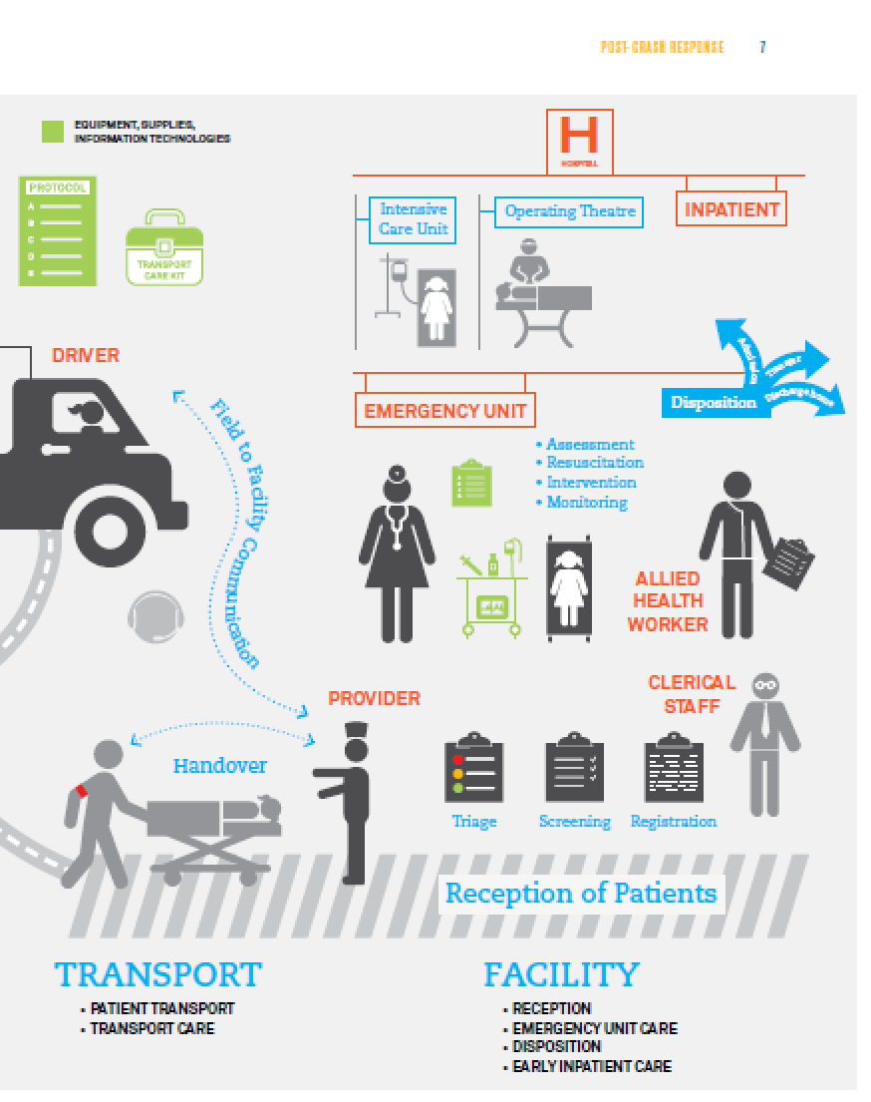
The WHO Emergency Care
System Framework
Notes:
Far from it. Love this diagram from WHO because of how it brings some order to the chaos of all of the people, vehicles, equipment, resources, facilities, and illustrates the number of handoffs and considerations that have to occur to give that victim their last chance to survive. Emergency care and trauma systems in the US are highly variable and inconsistent in the care of motor vehicle related trauma. Why does that matter?
“Although conceptually simple, the development of the appropriate infrastructure for trauma systems is extremely complex. State agencies must have appropriate legislation to ensure that they have authority to develop the system, there must be a process to review and designate trauma centers, and finally, there should be some form of prehospital medical direction and triage protocols.”

Slide 7
Until prevention is 100% successful:
Improve incident detection, 911 access, and Next Generation 911 system capabilities
On-scene medical care, trauma triage, and transport decisions (destination and mode)
Access to trauma centers.

Slide 8
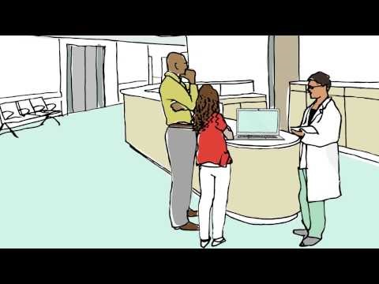
In the meantime, while there are still crashes…

Slide 9
Next Door to TRB @ NASEM
Notes:
Important theme and recent activities which reflect increased and sustained interaction between DoD and civilian medical communities to increase incorporation of lessons learned from both environments into the other environment.
• Additional work to translate science from military to civilian environments and vice versa
• Both have vested interests in improving care of trauma victims – although some of the trauma causes may vary in scope and specifics
• Increased support for Combat Casualty Care Research Center and development of strong civilian equivalent

Slide 10
NASEM RECOMMENDATION 1:
The White House should set a national aim of achieving zero preventable deaths after injury and minimizing trauma-related disability.
VISIT WWW.NATIONALACADEMIES.ORG/TRAUMACARE

Slide 11
NASEM RECOMMENDATION 4:
The Secretary of Health and Human Services (HHS) should designate and fully support a locus of responsibility and authority within HHS for leading a sustained effort to achieve the national aim of zero preventable deaths after injury and minimizing disability.
VISIT WWW.NATIONALACADEMIES.ORG/TRAUMACARE

Slide 12
NASEM
RECOMMENDATION 4 (con’t):
This leadership role should include coordination with governmental (federal, state, and local), academic, and private-sector partners and should address care from the point of injury to rehabilitation and post-acute care.
VISIT WWW.NATIONALACADEMIES.ORG/TRAUMACARE

Slide 13
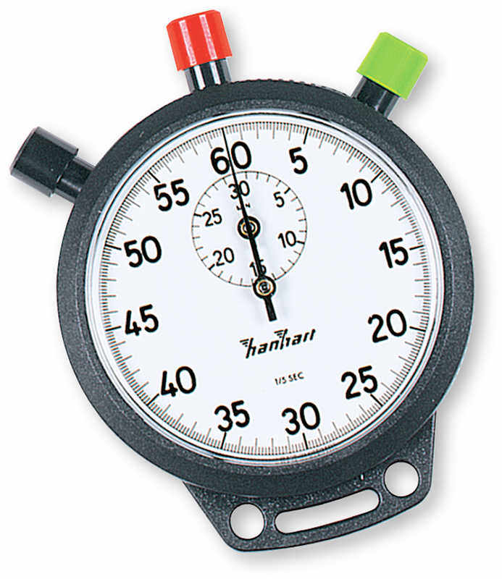
The Golden Hour in the USA
43% of fatal motor vehicle crash victims reach a hospital alive
NHTSA, 2016
Notes:
It matters because not everybody is killed instantly. NHTSA estimates that nearly 43% of victims transported by EMS who ultimately died were still alive when they arrived at the hospital. Admittedly there are some victims with unsurvivable injuries who may live for a brief period of time, and unless their crash happens at the front door of a Level 1 trauma center with an open operating room, their death is not preventable—but still, this leaves us with a large population whose death WAS preventable in the post crash phase. Trauma is a disease whose primary cure is surgery, making the clock the biggest enemy of the seriously injured patient.
The 42.7% figure is a 5-year moving average (mean) for: “the number of people in FARS who died from their injuries who were alive when transported to the hospital by EMS.” That is, they were not pronounced dead at the scene and were not recorded to have died “en route.”
“The “Golden Hour” was first described by R Adams Cowley, MD, at the University of Maryland Medical Center in Baltimore. From his personal experiences and observations in post-World War II Europe, and then in Baltimore in the 1960s, Dr. Cowley recognized that the sooner trauma patients reached definitive care—particularly if they arrived within 60 minutes of being injured—the better their chance of survival. Over the years, we’ve debated whether the Golden Hour is actually 60 minutes, but Dr. Cowley’s concept remains true.” (Eisele in JEMS, August 31, 2008)

Slide 14
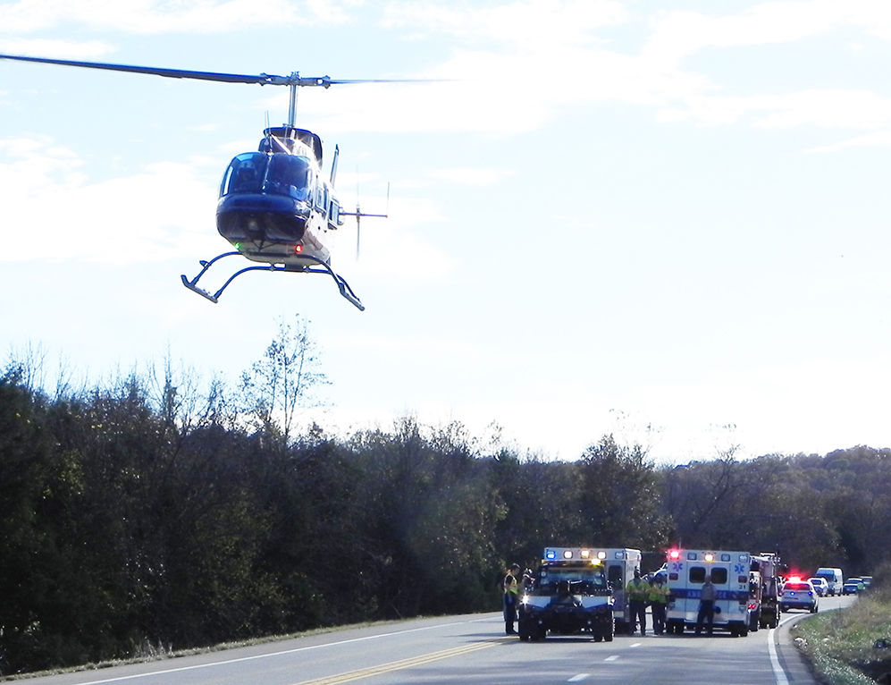
Notes:
Research tells us that severely injured patients transported by helicopter have better outcomes than those transported by ground. Remember: time, time, time…

Slide 15
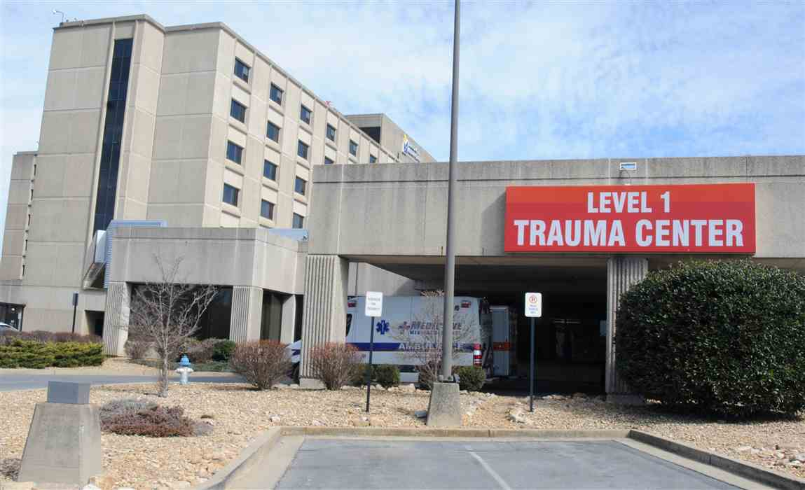
Notes:
Research tells us that patients treated at a trauma center have higher survival rates than those who are taken to the closest random hospital, and interestingly, the further that a fatal crash occurs from a Level 1 or 2 trauma center, the more likely it is that the victim will be listed as "died at scene.'' time time time

Slide 16
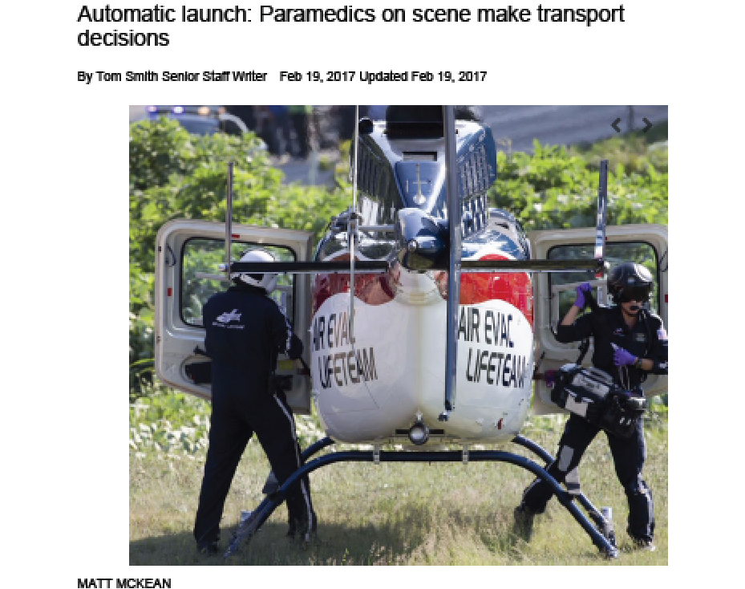

Slide 17
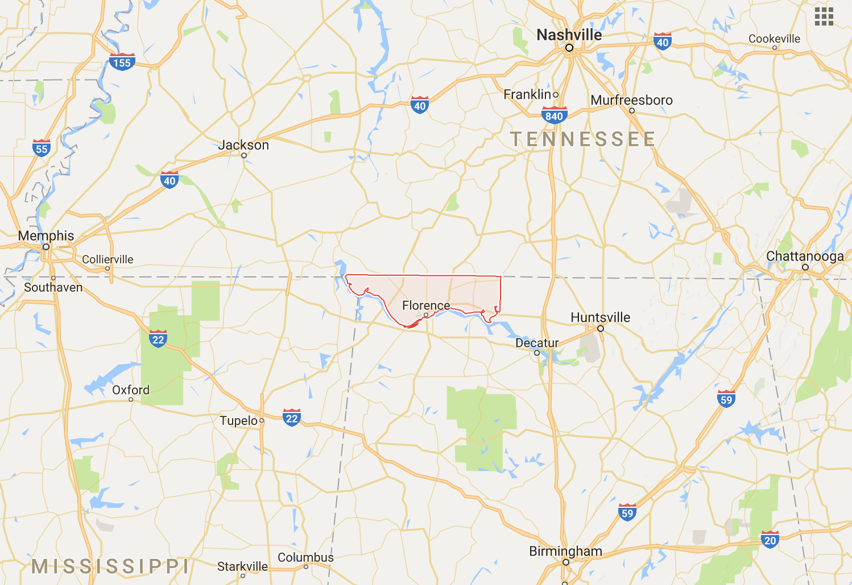

Level I adult and pediatric
Level 2 adult center
Level 1 adult center
Burn Center
Level 1 pediatric center

Slide 18
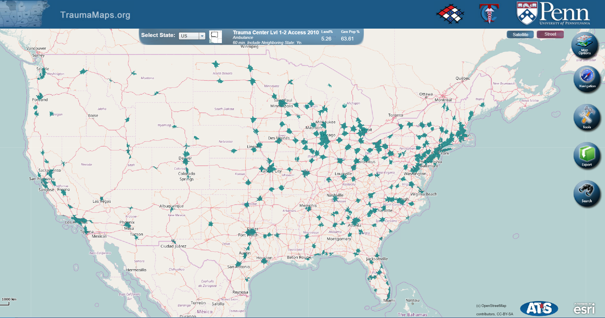
Notes:
Let’s get graphic. Here’s a heat map of sorts. The green areas are where you can crash, and assuming the ground ambulance is on scene immediately, they can get you to a level 1 or 2 trauma center within an hour.

Slide 19
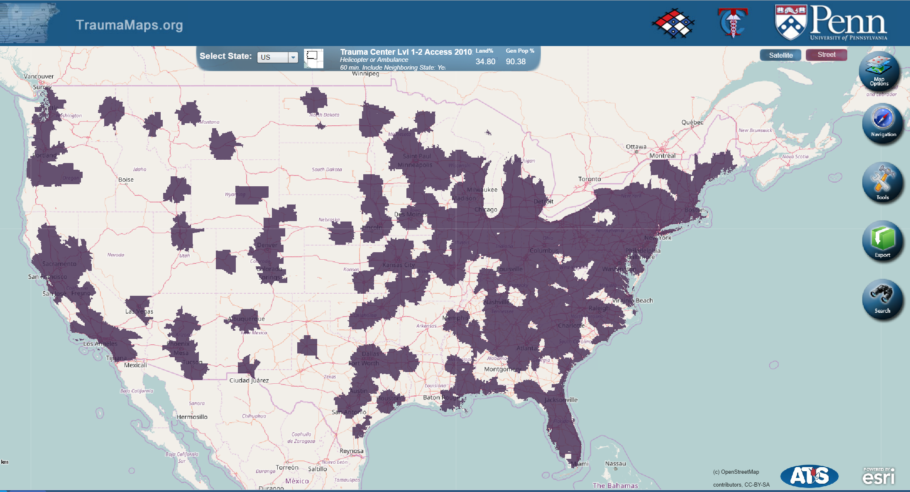
Notes:
Okay, let’s be fair and add helicopter availability. The purple areas are where you can crash and pray for a helicopter to be available because they should be able to get you to the trauma center within an hour.

Slide 20
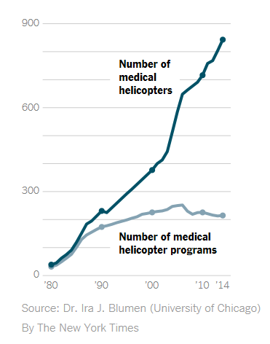
Notes:
Some of my colleagues in the transportation safety world ruminate about the reduced death rates we enjoyed in the US from 1990 to the early teens—well in the EMS camp, we have one theory. Look at the sheer increase in the number of medical helicopters from less than 250 in 1990 to 850 in 2014. Haven’t been able to do even more conclusive research on this, but we think we’re on to something.

Slide 21
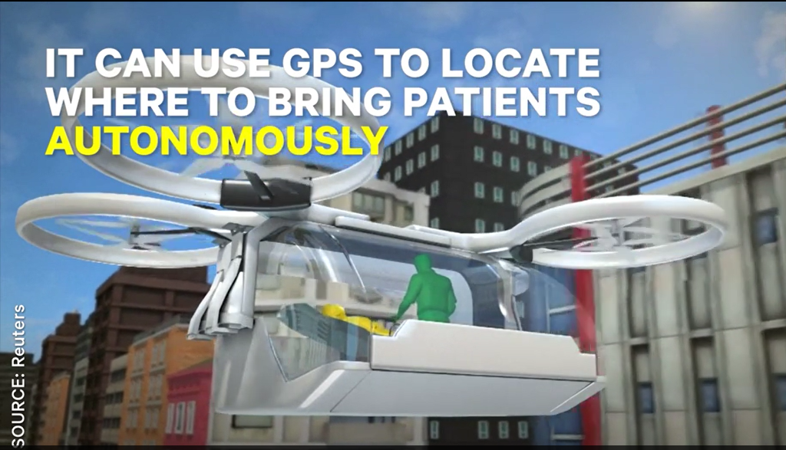
But in the future…
Notes:
But can we say we should put a helicopter at every interchange on rural highway segments? No. But if we start thinking the year 2050, all kinds of possibilities emerge. Forget what is proven today, this initiative is about exploiting the future, directing the future before it happens!!!
Capabilities of UAV (drone) to provide rapid additional response of equipment and supplies to scene to assist bystanders (unencumbered by road and traffic constraints) while ground emergency resources are responding
Hands-off assessment tools
Hemorrhage control blankets
Civilian use airway control devices
Self-use / auto-use (by civilians) IO devices
Oxygen carrying capacity high concentration fluids
Mobile applications would provide civilians with additional instructions / training based on information obtained on-scene
UAV ambulances - with or without medical crew – with ability to respond to the scene and transport victims to hospital
Strategic multiple vehicle placement throughout trauma regions to allow for more rapid response to rural and frontier locations (facilitated by remote control capabilities or self-guided flying capabilities)
Placement based on data analysis identifying areas of risk and need

Slide 22
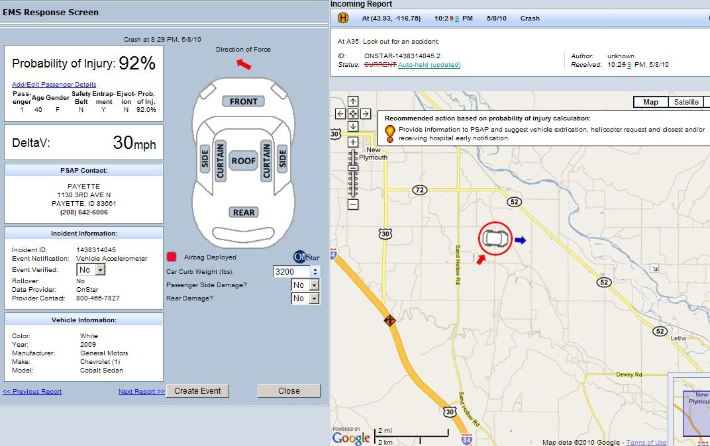
But in the future…
Notes:
AACN – expansion of information collected and automatically transmitted from vehicles; similar sensors identifying information from motorcyclists, bicyclists and pedestrians
Information is simultaneously transmitted to 911 center, EMS agencies and closest level I or II trauma center (based on GIS information of crash location)
Immediate communications link from scene (vehicle or bystander) with telecommunications devices (iPhone, etc) to allow tele-link assessment of scene to responding resources
FirstNet development and NG911 capabilities will allow for faster sharing of information among all responders
Ability to provide just in time training for additional medical care techniques to bystanders from EMS communications center
Increased capabilities to transmit real time information to trauma center to allow for faster mobilization of needed resources.

Slide 23
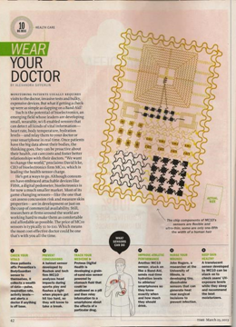
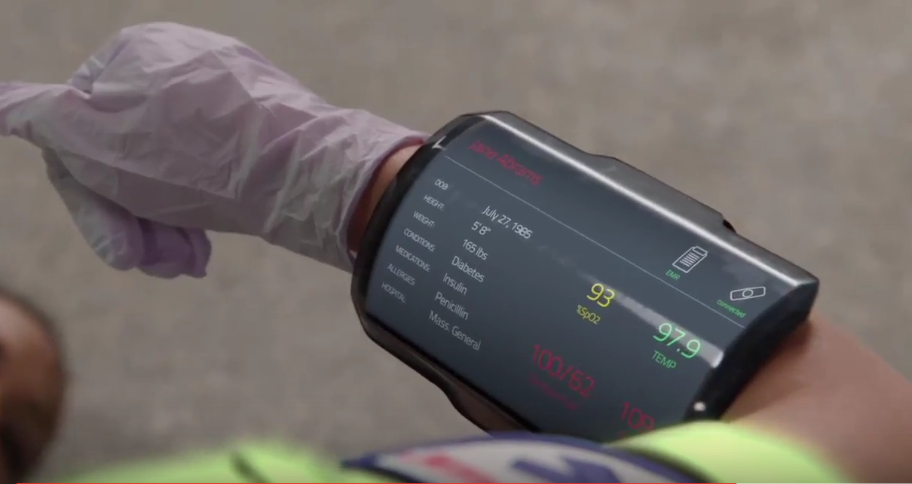
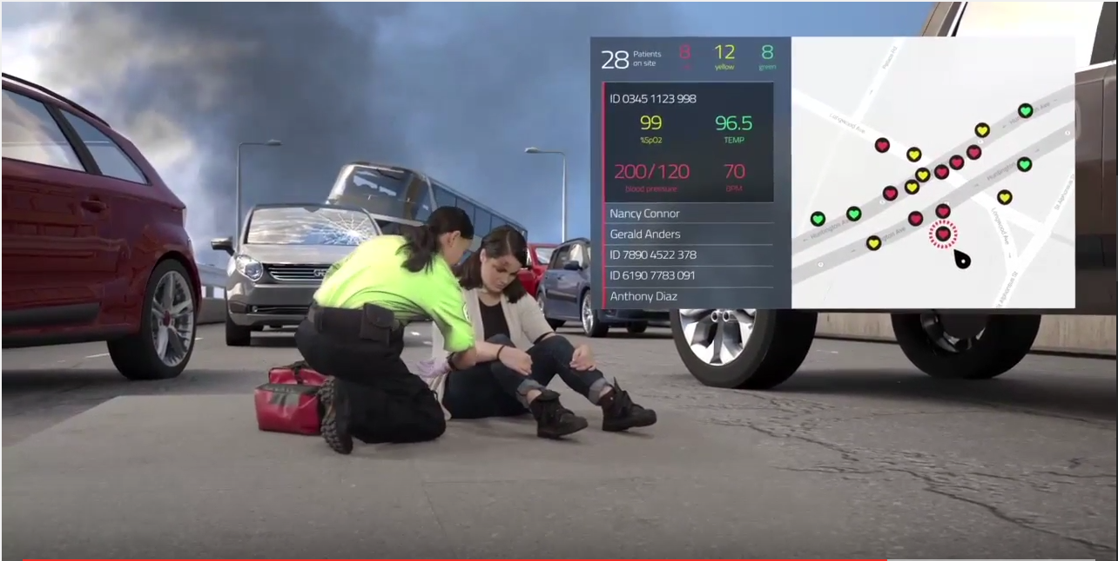
But in the future…
Notes:
You bet, 30 years from now “wear you doctor”--More sophisticated field equipment allows for greater diagnostic and therapeutic capabilities
Portable 3D ultrasound devices will allow for identification of location of internal bleeding with focused ability to laser coagulate the bleeding sites
For large scale traumatic events, specialty response vehicles respond to location with much more sophisticated equipment and personnel – trauma equivalent to Heartmobile/ Stroke ambulance

Slide 24


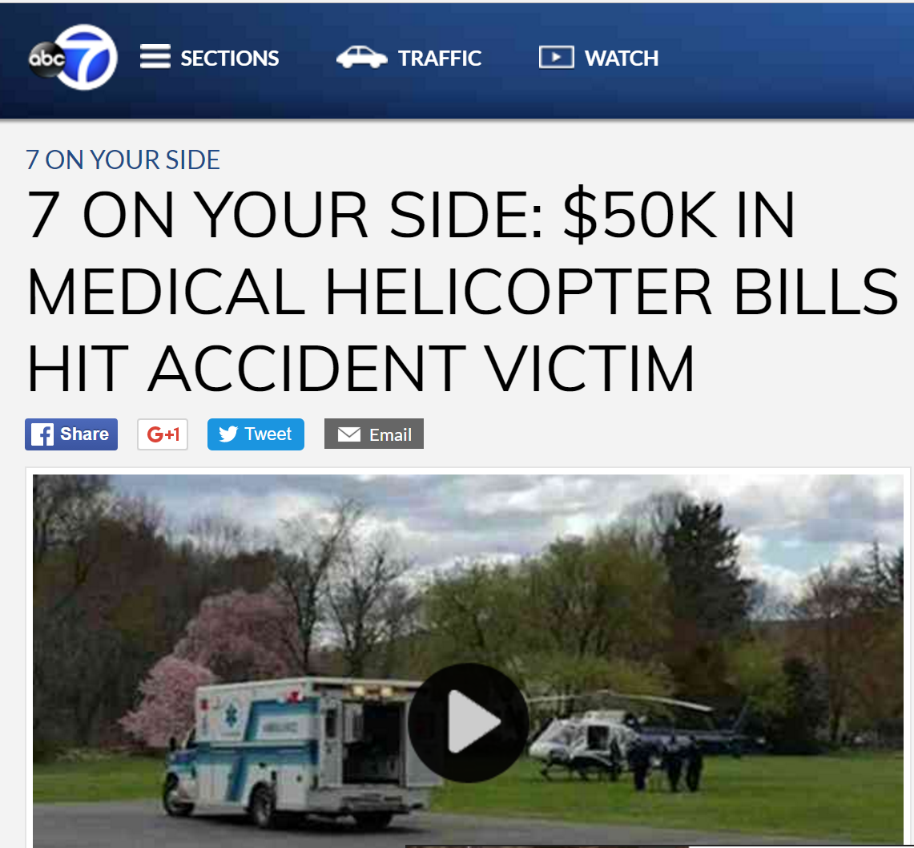
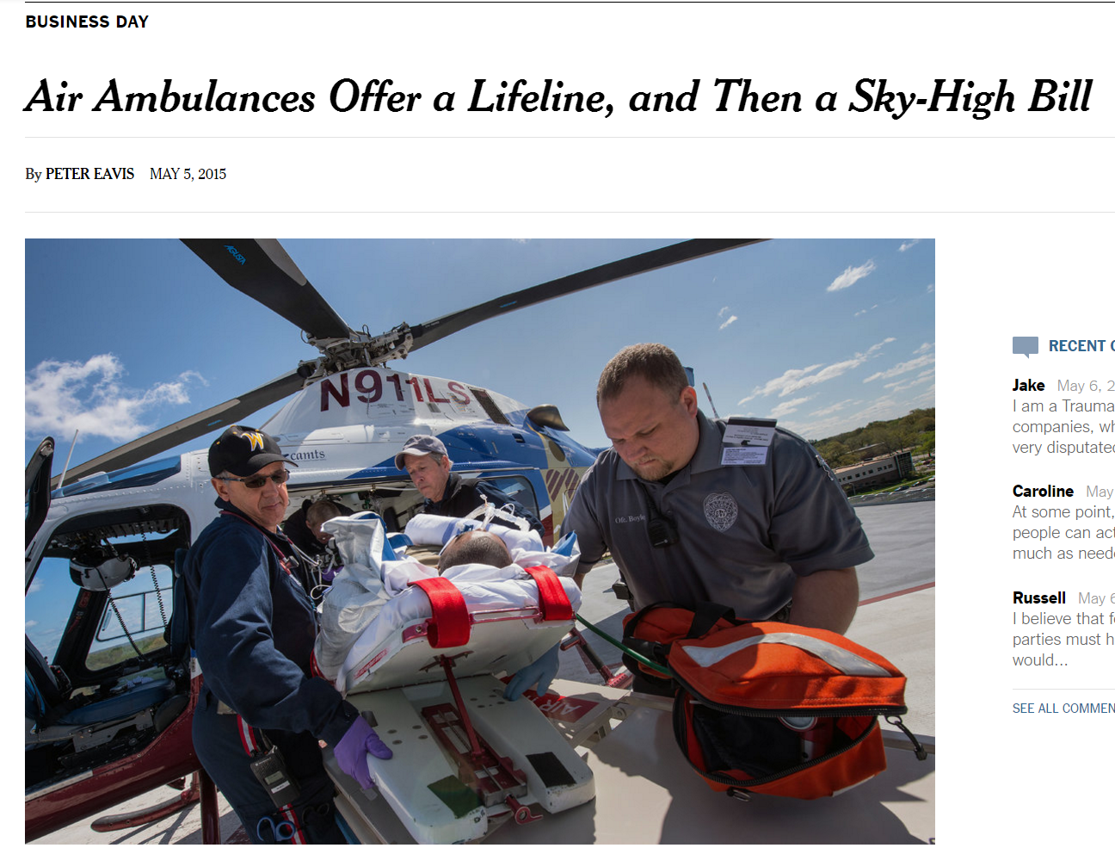

Slide 25
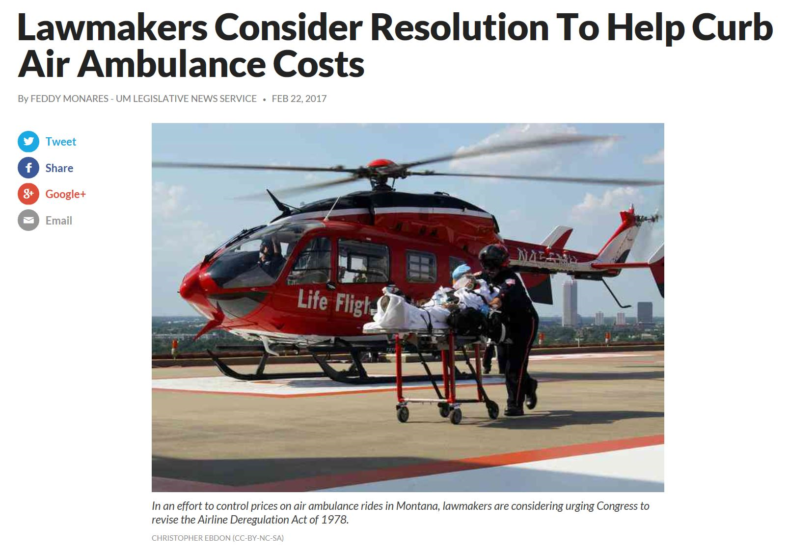

Slide 26
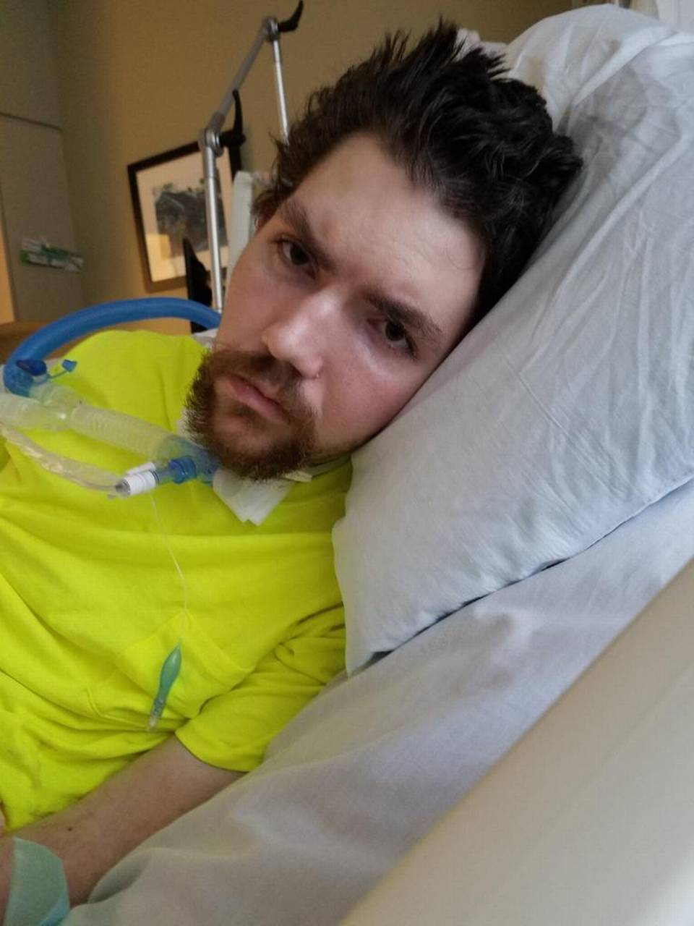
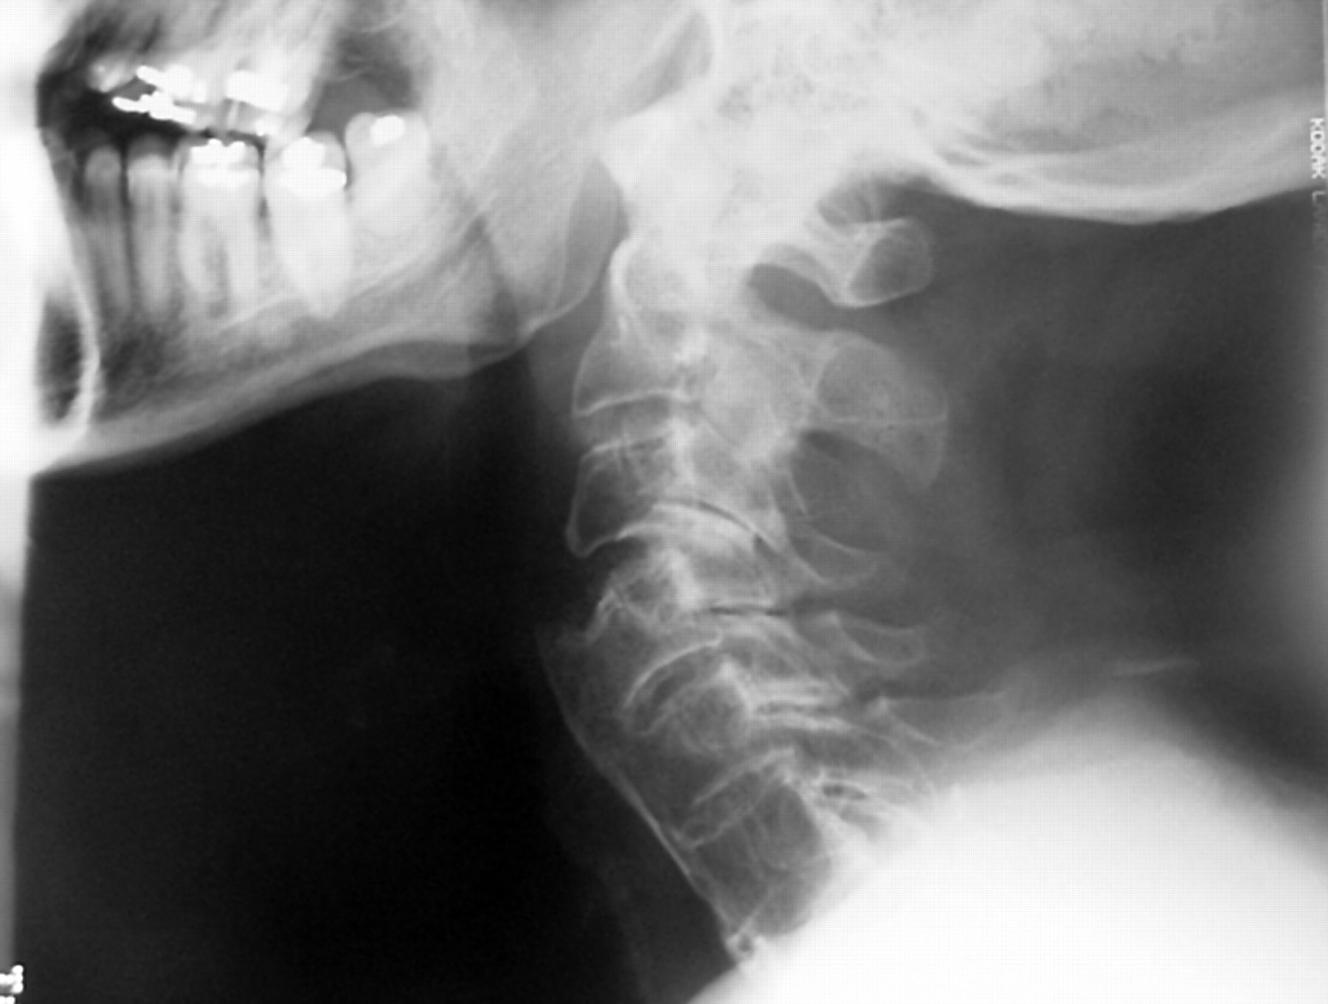
Robert

Slide 27
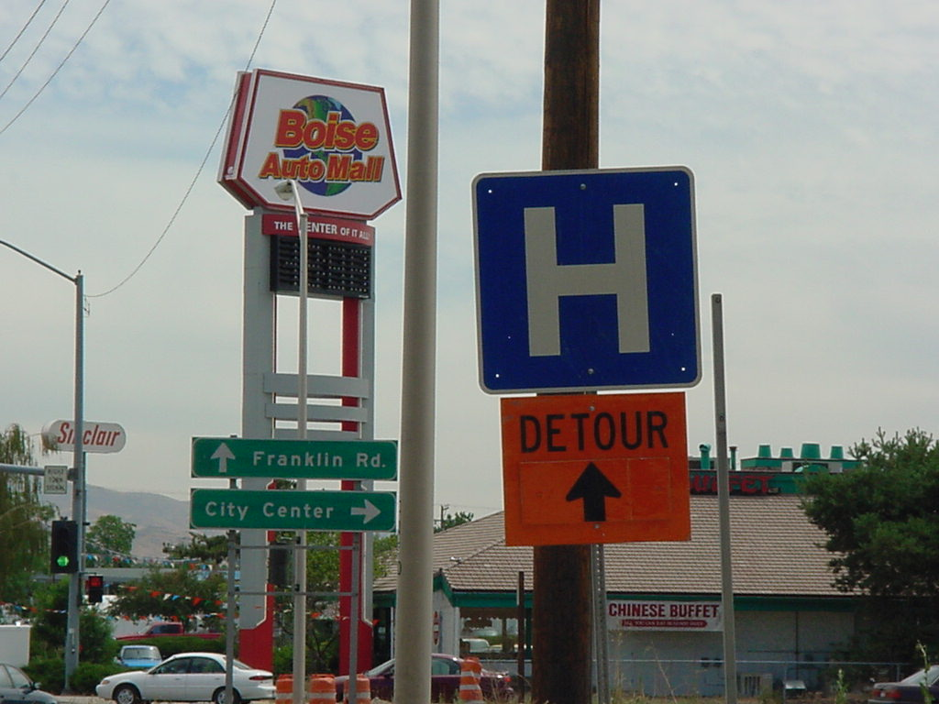
Notes:
We have to choose a route—but part of what we will do with RAND is calculate the consequences, which is essential.

Slide 28
In the future…???
Tecnology. Technology. Then more technology.
Every middle school grad knows what (and what not) to do
“Don’t Die” kit in every vehicle, motorcycle and bicycle
Multisource deterministic contemporaneous records linkage
NTSB focus always includes the post-crash phase & research in post crash care is balanced
Notes:
100% medical examination autopsies from traumatic injury deaths with 100% reporting to national database – which complements and feeds into FARS. A true registry would include it all: crash records, prehospital care reports, ED, HDD, TR, hello, DL history, DDACTS, the whole nine yards. Machine and artificial intelligence would continuously analyze and produce outputs detecting new trends and emerging threats.

Slide 29
In closing
The future scenario(s) that we are developing here is really important
Prevent the crash, sure.
  But let’s address preventable deaths post crash.
The benefits of better trauma care are real and measurable.
Notes:
1. (based on our EMS Agenda experience)
2. To be convincing and effective
3. I’ve outlined the areas where lives could be saved. As we move forward with the scenario I would be happy to help with more specific estimates of the potential.

Slide 30
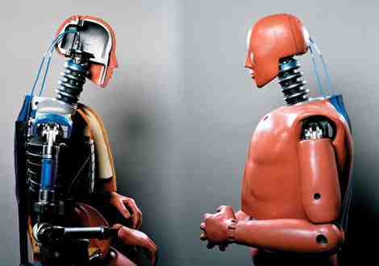

Dia Gainor
Dia@NASEMSO.org
www.nasemso.org
208-861-4841

