Slide 1

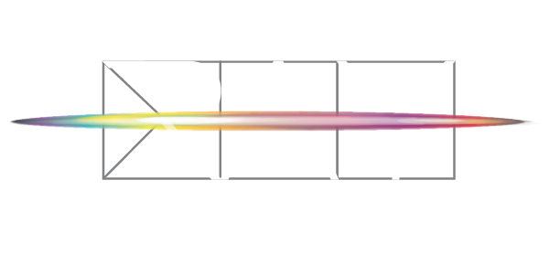
Notes:
Thank you for having us, what a great opportunity to share our story

Slide 2


The Ray:
A Publicly-Accessible Living Laboratory
A Proving Ground for the Transportation Infrastructure of the Future
Wildlife Conservation
Changing
Attitudes
Life Safety
Pollution
Remediation
Resource
Efficiency
@TheRayHighway

Slide 3

Ray C. Anderson (1934-2011)
Interface, Inc.
Pioneered business case for corporate sustainability
Brought industrial ecology to the mainstream
“America’s Green Industrialist”
@TheRayHighway

Slide 4
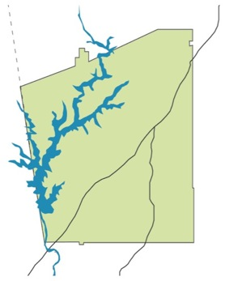
“The Ray” Goals, Mission
Better outcomes for communities,
the economy & the environment.
Zero deaths
Zero carbon
Zero waste
Liabilities → Assets
Leverage more value
.
I-85
Exit 18
Exit 2
@TheRayHighway

Slide 5



WheelRight tire safety station
Measures tread depth & tire pressure within seconds - automatic, drive-through
In U.S., under-inflated tires waste 2B gal. fuel/yr. & increase tail pipe emissions
WheelRight (UK) pilot on The Ray 1st in U.S. – only tread depth monitoring in the world
@TheRayHighway

Slide 6
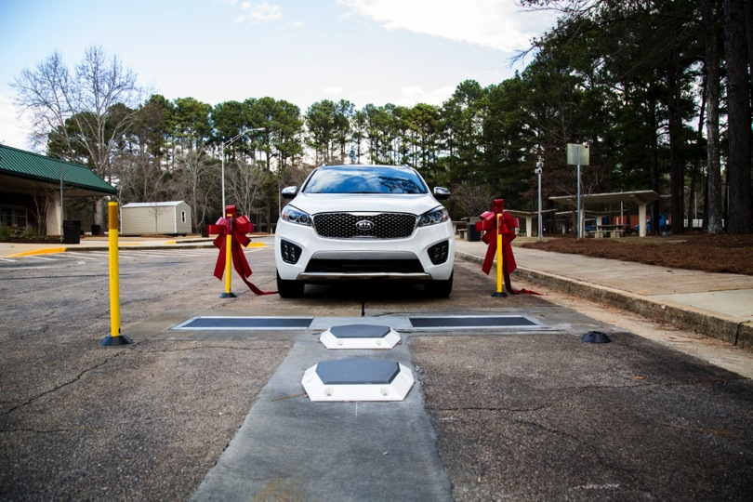
Notes:
While not a leading cause of highway accidents and fatalities, NHTSA estimates that 41 vehicular-related deaths occur annually because of blowouts alone from underinflated tires.
About 1 in 4 automobiles and 1 in 3 light trucks on U.S. roads have at least one tire underinflated 8 pounds per square inch or more below the recommended level. - NHTSA
“Tire underinflation is the “single most common” factor in tire failure. – International Tire & Rubber Assoc.
According to Edmonds.com, underinflated tires increase tire wear, which could burn through a set of $400 tires a year early.

Slide 7
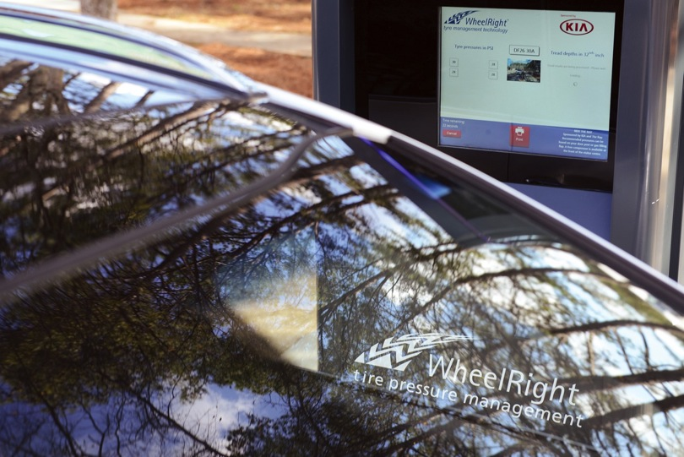

Slide 8
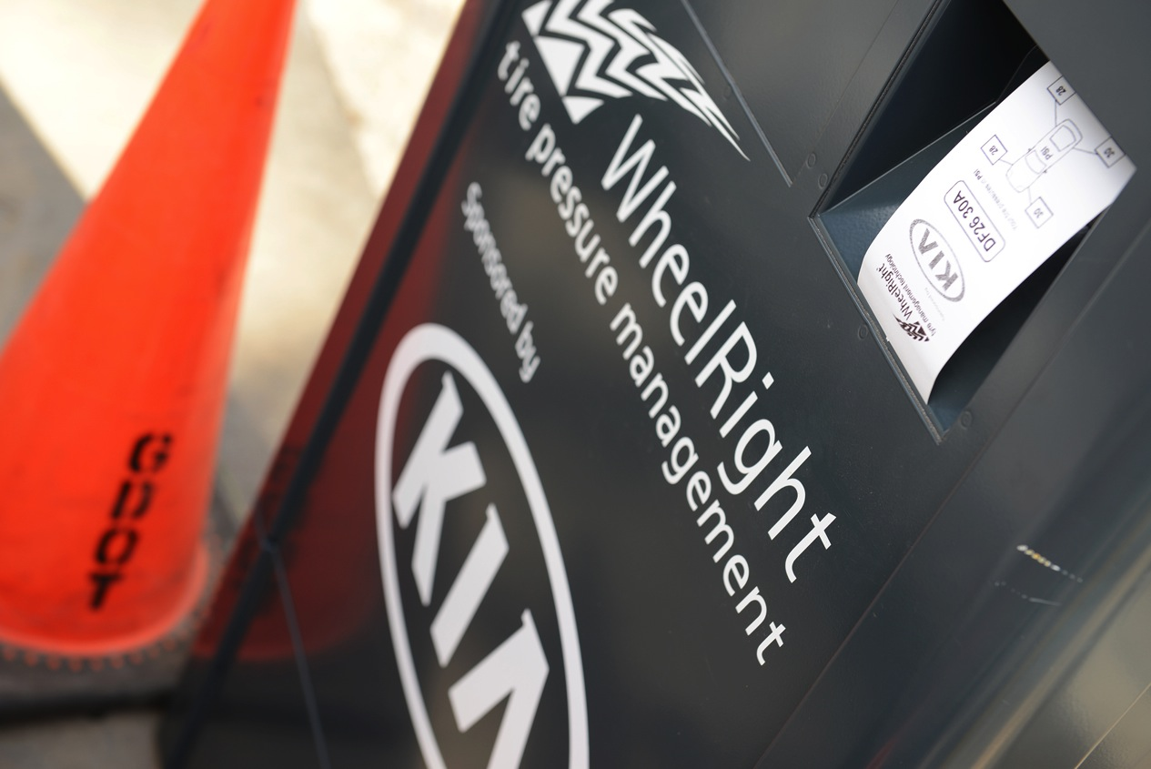
Notes:
Low tire pressure wastes 5 million gallons of fuel every day in the U.S. -- 2 billion gallons each year
Vehicles with underinflated tires waste approximately 1.2 billion gallons of fuel per year due to the increased resistance of the tires – 2006 TRB

Slide 9



The Smart Ray – CV & AV Ready
Race for 1st – public, high-speed CV & AV route
Connected Vehicle project partners:
  Tech firm + GDOT + GDecD + freight + research
  + The Ray
Autonomous Vehicle project partners:
  Tech firm + Georgia DOT + The Ray
Notes:
Cadillac 2018, GM will announce other model expansion this summer
2019 – VW and Ford
2020 - Toyota

Slide 10
Notes:
V2X Data Ecosystem Opportunities
• Harnessing and Owning the Newest, Richest Data Source in Transportation.
• Together, we will deliver a statewide V2X Data Ecosystem that will support the deployment of V2X infrastructure on all GA roadways.
Advancing GDOT from worst to first - early mover, national model, driver standards for interoperability across the nation
Bringing Auto Manufacturers to GA - attract automotive OEM’s testing and innovation to test and validate V2X applications, continuing GA position as an early adopter for autonomous vehicles.
• Preparing for AV’s - V2X technology is essential to preparing for the arrival of autonomous vehicles by providing a safe and coordinated communication environment for automation and empowering DOTs to optimize its benefits.

Slide 11

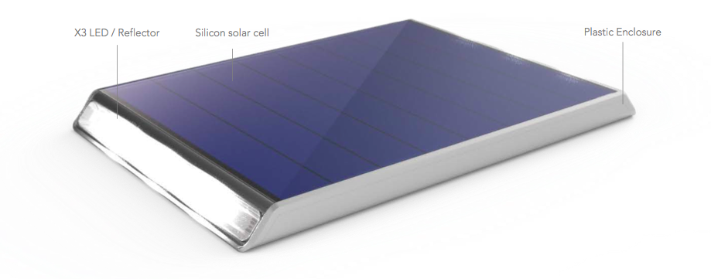

2018 World Changing Ideas Award Finalist

Slide 14

Concepts for Future Consideration
Expansion of Wattway on The Ray
Highway wind energy project
Drone monitoring
Smart lighting & under-bridge lighting
Graphene battery storage
Dynamic + wireless EV charging, in-lane
Solar road dot deployment

Slide 15

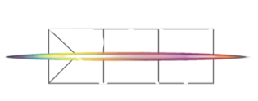


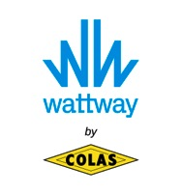











Research Partners
Technology Partners
Contact:
Harriet Langford, Founder
harriet@theray.org
Allie Kelly
allie@theray.org
Facebook / Twitter / Insta / LIn: @TheRayHighway
#RideTheRay
#DriveTheFuture
Project Partners

