Slide 1


Roadway Fatalities and Causes
PROGRESS & OPPORTUNITIES
Grant Baldwin, PhD, MPH
Director, Division of Unintentional Injury Prevention
National Center for Injury Prevention and Control
Centers for Disease Control and Prevention
Road to Zero Coalition Meeting
December 15th 2016

Slide 2


Motor Vehicle Related Deaths Decreased Significantly in Last 25 Years
TRENDING UP
AGAIN
Motor Vehicle Deaths Decreased
31%
1980-2015
Our Goal
IIHS 2015.

Slide 3


Leading Causes of Injury Death by Age Group
Highlighting Top 3 Causes
Rank | <1 | 1-4 | 5-9 | 10-14 | 15-24 | 25-34 | 35-44 | 45-54 | 55-64 | 65+ | Total
1 | Unintentional Suffocation 991 | Unintentional Drowning 368 | Unintentional MV Traffic 345 | Unintentional MV Traffic 384 | Unintentional MV Traffic 6,531 | Unintentional Poisoning 9,334 | Unintentional Poisoning 9,116 | Unintentional Poisoning 11,009 | Unintentional Poisoning 7,013 | Unintentional Fall 27,044 | Unintentional Poisoning 42,032
2 | Homicide Unspecified 119 | Unintentional MV Traffic 293 | Unintentional Drowning 125 | Suicide Suffocation 225 | Homicide Firearm 3,587 | Unintentional MV Traffic 5,856 | Unintentional MV Traffic 4,308 | Unintentional MV Traffic 5,024 | Unintentional MV Traffic 4,554 | Unintentional MV Traffic 6,373 | Unintentional MV Traffic 33,736
3 | Homicide Other Spec., Classifiable 83 | Homicide Unspecified 149 | Unintentional Fire / Burn 15 | Suicide Firearm 174 | Unintentional Poisoning 3,492 | Homicide Firearm 3,260 | Suicide Firearm 2,830 | Suicide Firearm 3,953 | Suicide Firearm 3,910 | Suicide Firearm 5,367 | Unintentional Fall 31,959
4 | Unintentional MV Traffic 61 | Unintentional Suffocation 120 | Homicide Firearm 58 | Homicide Firearm 115 | Suicide Firearm 2,270 | Suicide Firearm 2,829 | Suicide Suffocation 2,057 | Suicide Suffocation 2,321 | Unintentional Fall 2,558 | Unintentional Unspecified 4,590 | Suicide Firearm 21,334
5 | Undetermined Suffocation 40 | Unintentional Fire / Burn 117 | Unintentional Other Land Transport 36 | Unintentional Drowning 105 | Suicide Suffocation 2,010 | Suicide Suffocation 2,402 | Homicide Firearm 1,835 | Suicide Poisoning 1,795 | Suicide Poisoning 1,529 | Unintentional Suffocation 3,692 | Suicide Suffocation 11,407
6 | Unintentional Drowning 29 | Unintentional Pedestrian 107 | Unintentional Suffocation 34 | Unintentional Fire / Burn 49 | Unintentional Drowning 507 | Suicide Poisoning 800 | Suicide Poisoning 1,274 | Unintentional Fall 1,340 | Suicide Suffocation 1,509 | Unintentional Poisoning 1,993 | Homicide Firearm 10,945
7 | Homicide Suffocation 26 | Homicide Other Spec., Classifiable 73 | Unintentional Natural / Environment 22 | Unintentional Other Land Transport 49 | Suicide Poisoning 363 | Undetermined Poisoning 575 | Undetermined Poisoning 637 | Homicide Firearm 1,132 | Unintentional Suffocation 698 | Unintentional Injury 48,295 | Suicide Poisoning 6,808
8 | Unintentional Natural / Environment 17 | Homicide Firearm 47 | Unintentional Pedestrian 18 | Unintentional Suffocation 33 | Homicide Cut/Pierce 314 | Homicide Cut/Pierce 430 | Unintentional Fall 504 | Chronic Low. Respiratory Disease 4,402 | Undetermined Poisoning 539 | Unintentional Fire / Burn 1,161 | Unintentional Suffocation 6,580
9 | Undetermined Unspecified 16 | Unintentional Struck by or Against 38 | Unintentional Struck by or Against 16 | Unintentional Poisoning 22 | Undetermined Poisoning 229 | Unintentional Drowning 399 | Unintentional Drowning 363 | Unintentional Suffocation 452 | Homicide Firearm 538 | Suicide Poisoning 1,028 | Unintentional Unspecified 5,848
10 | Unintentional Fire / Burn 15 | Unintentional Natural / Environment 36 | Unintentional Firearm 14 | Homicide Cut/Pierce 19 | Unintentional Other Land Transport 177 | Unintentional Fall 285 | Homicide Cut/Pierce 313 | Unintentional Drowning 442 | Unintentional Unspecified 530 | Suicide Suffocation 880 | Unintentional Drowning 3,406
2014

Slide 4


Safer Roads
Safer Road Users
Improved Post Crash Response
Safer
Vehicles
Safe System Approach
Road Safety Management

Slide 5
TIMELINE
Motor Vehicle Safety Policies
1960s
1970s
1980s
1990s
2000s
2010s
1966
Motor Vehicle Safety Act
1974
Universal Motorcycle Helmet Law in 45 States
1975
55 MPH Maximum Speed Limit
1982
Alcohol Traffic Safety Incentive Program
1984
National Minimum Legal Drinking Age
1986
Child Restraint Laws in all 50 States
1992
BAC 0.1 in all 50 states
1995
Primary or secondary seat belt law in 49 states
1999
State incentive grant program encourages adoption of safety measures
2005
Graduated Driver Licensing Laws set in 45 States
2006
BAC lowered to 0.08 in all 50 states
2008
In person renewal of license for older drivers in 18 states
2015
Talking on handheld cellphones banned in 14 states
Texting is banned for all drivers in 46 states
Peer
Review
Motor vehicle-related fatality rate decreased by almost 50% since 1960
ADAPTED: Dellinger et al., 2007; Bandi et al. 2015; and IIHS 2015.

Slide 6

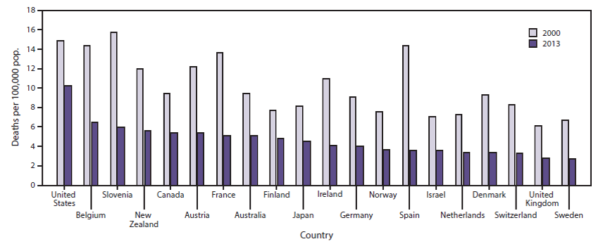
Country Comparison
Death rates declined in the United States
between 2000-2013
But other High Income Countries saw sharper declines
Sauber-Schatz, E. K. (2016). MMWR, 65.

Slide 7

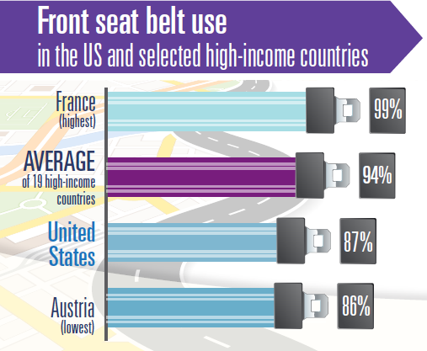
A total of 87% of U.S. drivers were restrained in 2013
12,584
Lives saved
by restraints in U.S.
2,800
More lives that could have been saved if ALL restrained in U.S.
Sauber-Schatz, E. K. (2016). MMWR, 65.
NHTSA Traffic Safety Facts. DOT HS 812 153

Slide 8

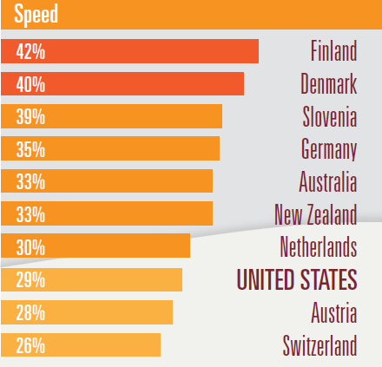
Speeding was involved in 29% of U.S. motor vehicle crash deaths in 2013
SPEED - Percent of Fatalities Where Involved
9,696
Deaths in United States
Sauber-Schatz, E. K. (2016). MMWR, 65.

Slide 9

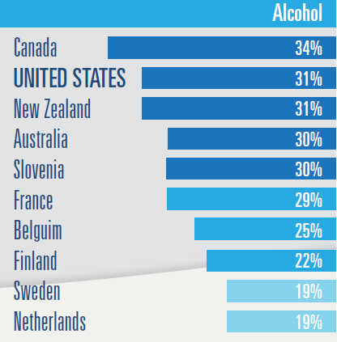
Alcohol was involved in 31% of U.S. motor vehicle crash deaths in 2013
ALCOHOL - Percent of Fatalities Where Involved
10,197
Deaths in United States
Sauber-Schatz, E. K. (2016). MMWR, 65.

Slide 10
.
.
.
.
.
35,092 FATALITIES
2,443,000 INJURIES
32,166
Fatal Crashes
Crash
Pyramid
1,715,000
2015
Injury Crashes
4,548,000
Property Damage Only
6,296,000
Police-Reported
Crashes
~13,000,000
Crashes
$242 Billion in Economic Cost
$836 Billion in Societal Harm
NHTSA DOT HS 812 349 – Sept 2016

Slide 11
2014
Significant variation in fatality
rates by state
POPULATION
VMT
5.3 Fold Variation
2.9 Fold Variation
U.S. Average
U.S. Average
STATE
Fatality Rate Per
NHTSA DOT HS 812 293

Slide 12
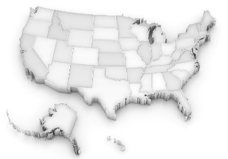
Percent decline in fatality rates varied
per state in the last decade
Fatality Rate by 100 Million VMT
2014
Percent Change
2005 to 2014
US. Average
State
NHTSA DOT HS 812 293

Slide 13
Deaths to pedestrians, bicyclists, and motorcyclists increased in the last decade
2006
2015
PERCENT
LG TRUCK, BUSES and OTHER – Increased 1%
MOTORCYCLISTS – Increased 3%
PED, BIKE and OTHER – Increased 5%
LIGHT TRUCKS – Decreased 2%
PASSENGER CARS – Decreased 6%
NUMBER OF DEATHS
42,708
NUMBER OF DEATHS
35,092
NHTSA HS 812 349 – Sept 2016

Slide 14
American Indians / Alaska Natives continue to be disproportionally impacted
AGE ADJUSTED RATE PER 100,000
1.45 Fold Greater
YEAR

Slide 15



Just imagine if the United States had the same motor vehicle crash death rate in 2013 as:
LIVES SAVED
DIRECT MEDICAL COSTS AVERTED
Second Highest Death Rate
12,000 $140 Million
BELGIUM
AVERAGE OF 19 COMPARISON COUNTRIES
18,000 $210 Million
Best Performing Country
24,000 $281 Million
SWEDEN
WISQARS

Slide 16
Keys to Public Health Success
Adapted from Thomas Frieden
Use Science for Action
Address the biggest, modifiable risk factors
Support Implementation
Create a technical package
Leverage Context
Make the default choices “safe and healthy”
Use effective, evidence-based, and scalable interventions
Demonstrate impact with data
Enable, learn from, and celebrate small, local wins
Leverage partners and the intersection with practice
Act when the timing is right or pressing

Slide 17
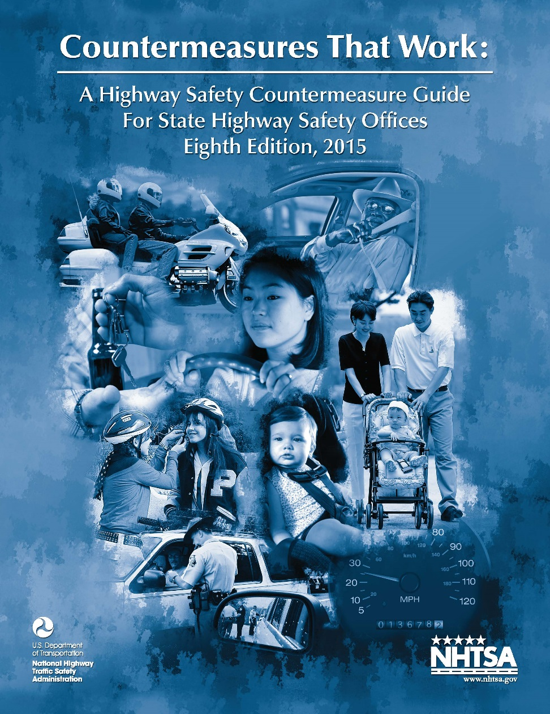

Leverage Proven, Evidence-Based Interventions
Sobriety Checkpoints
0.08 BAC Laws
Ignition Interlocks
Minimum Legal Drinking Age
Universal Helmet Laws
Seat Belts Laws
Child Safety Seats

Slide 18


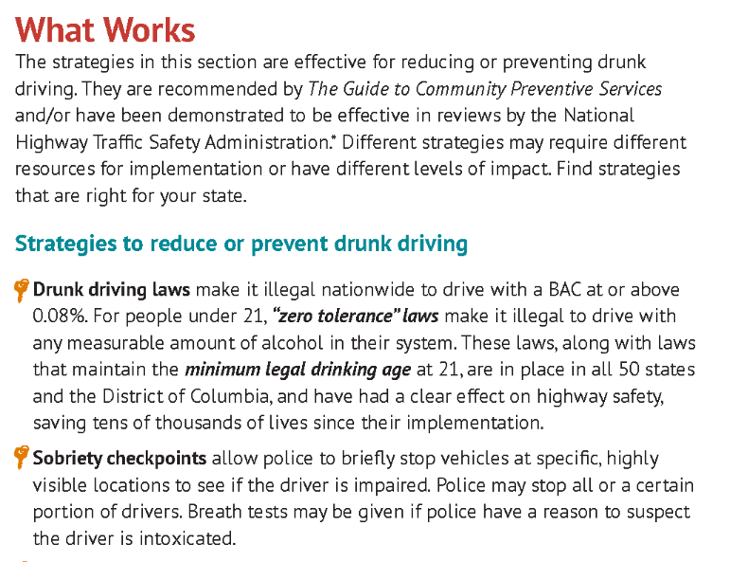

Focus on what works and your best buys for lives saved and cost in every state
State-Based Fact Sheets
Cost Calculator
Motor Vehicle Prioritizing Interventions and Cost Calculator for States
http://www.cdc.gov/motorvehiclesafety/

Slide 19


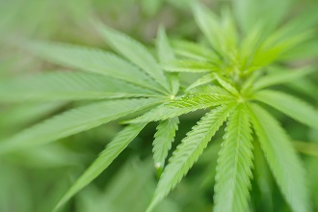
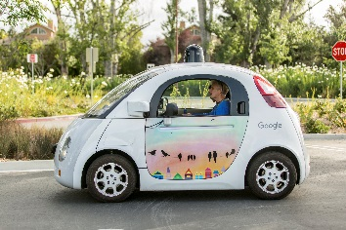


Distraction
Drugged Driving
Emerging
Issues
Vehicle Automation
Older Drivers
Data Linkage

Slide 20
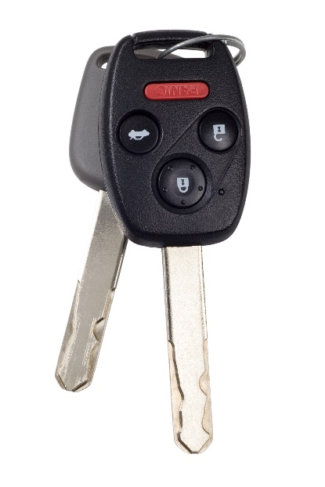
Five Things We Can Do Now
Learn from other high income countries and replicate when possible
Couple strong laws with high visibility enforcement
Create a safety culture
Address racial and ethnic disparities and vulnerable road users
Leverage new technologies when possible but double down on existing countermeasures
1
Pay for
patient counseling, coordination of care, and checking PDMP
2
3
Peer
Review
4
Peer
Review
5

Slide 21
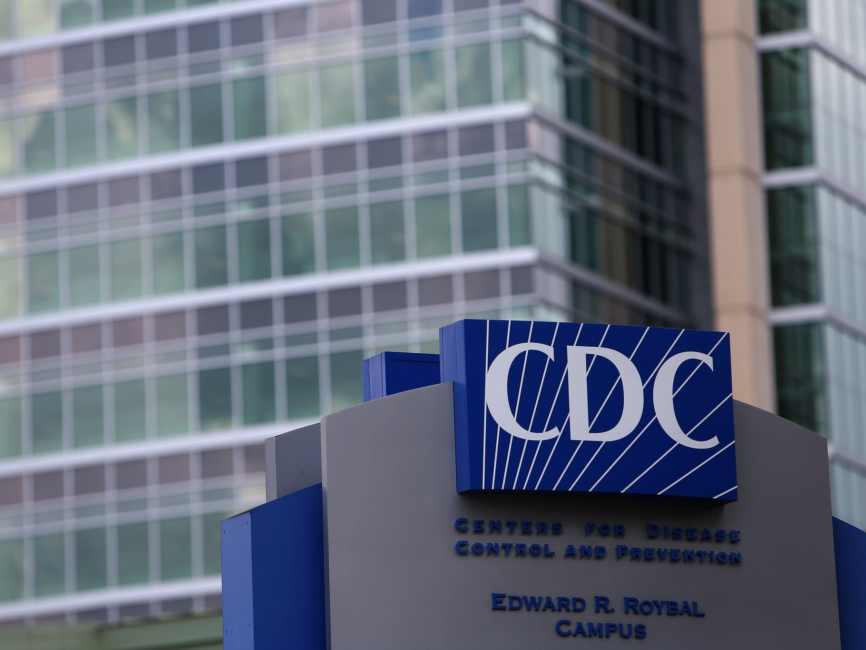
For more information please contact Centers for Disease Control and Prevention
1600 Clifton Road NE, Atlanta, GA 30333
Telephone: 1-800-CDC-INFO (232-4636)/TTY: 1-888-232-6348
E-mail: cdcinfo@cdc.gov Web: www.cdc.gov
The findings and conclusions in this report are those of the authors and do not necessarily represent the official position of the Centers for Disease Control and Prevention.
Special thanks to Erin Sauber-Schatz, Ann Dellinger, and Kory Trott for their assistance with this presentation
PHOTO: Ben Gray - 2016

