Slide 1
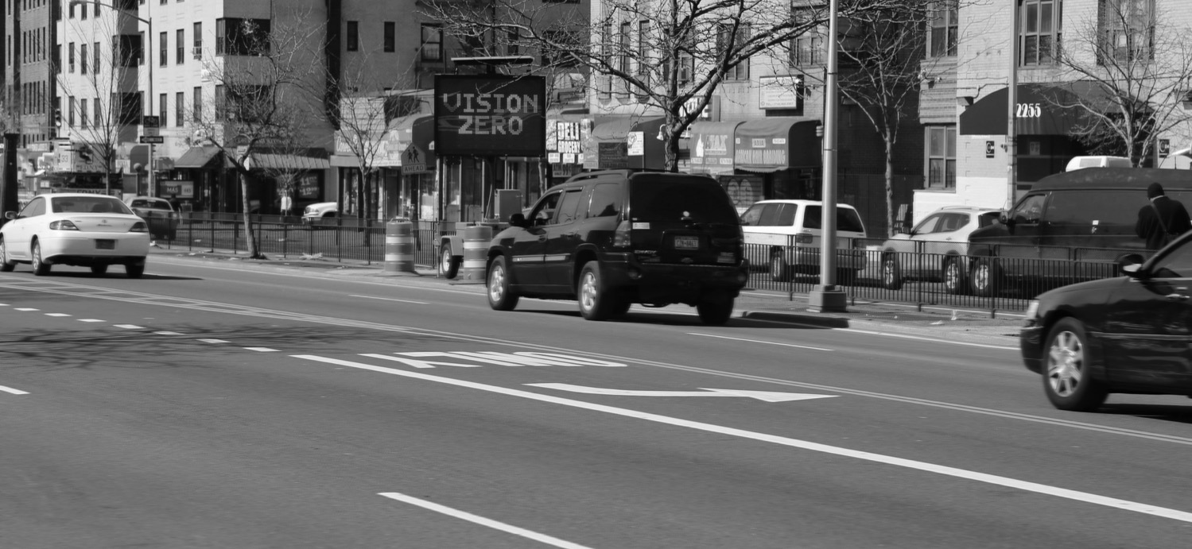


NYC Vision Zero
How Do You Create Positive Change and Overcome Obstacles?
Kim Wiley-Schwartz
Assistant Commissioner, Education and Outreach

Slide 2
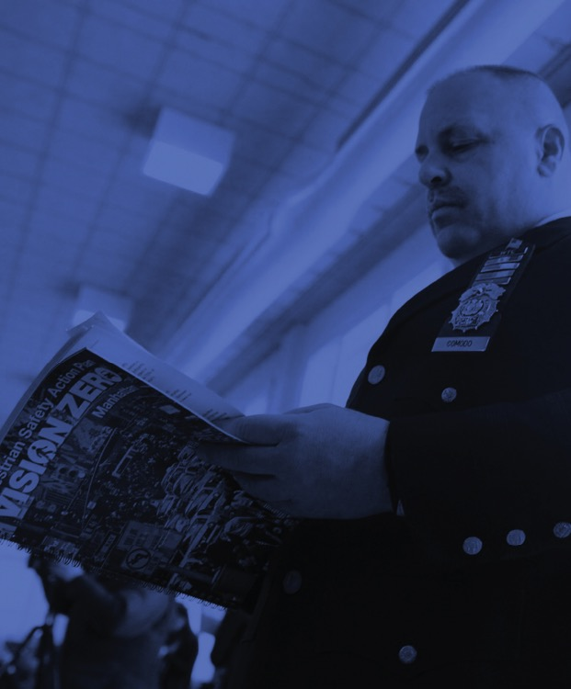
In this presentation
1 | Vision Zero NYC Style
2 | Focus on Dangerous Driving Behaviors: Three Years of Results
3 | Using Data to Target Intervention
4 | Promising Results
nyc.gov/dot

Slide 3
1
Vision Zero NYC Style

Slide 4
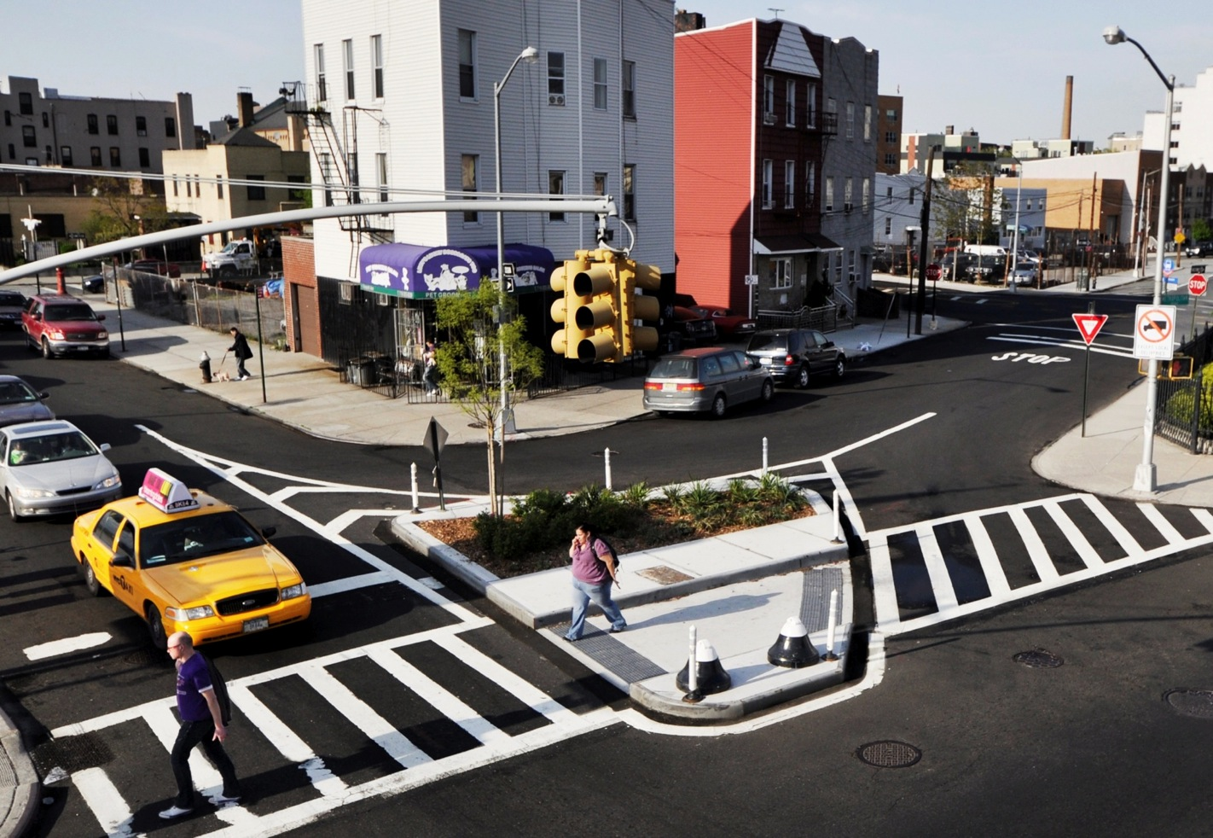
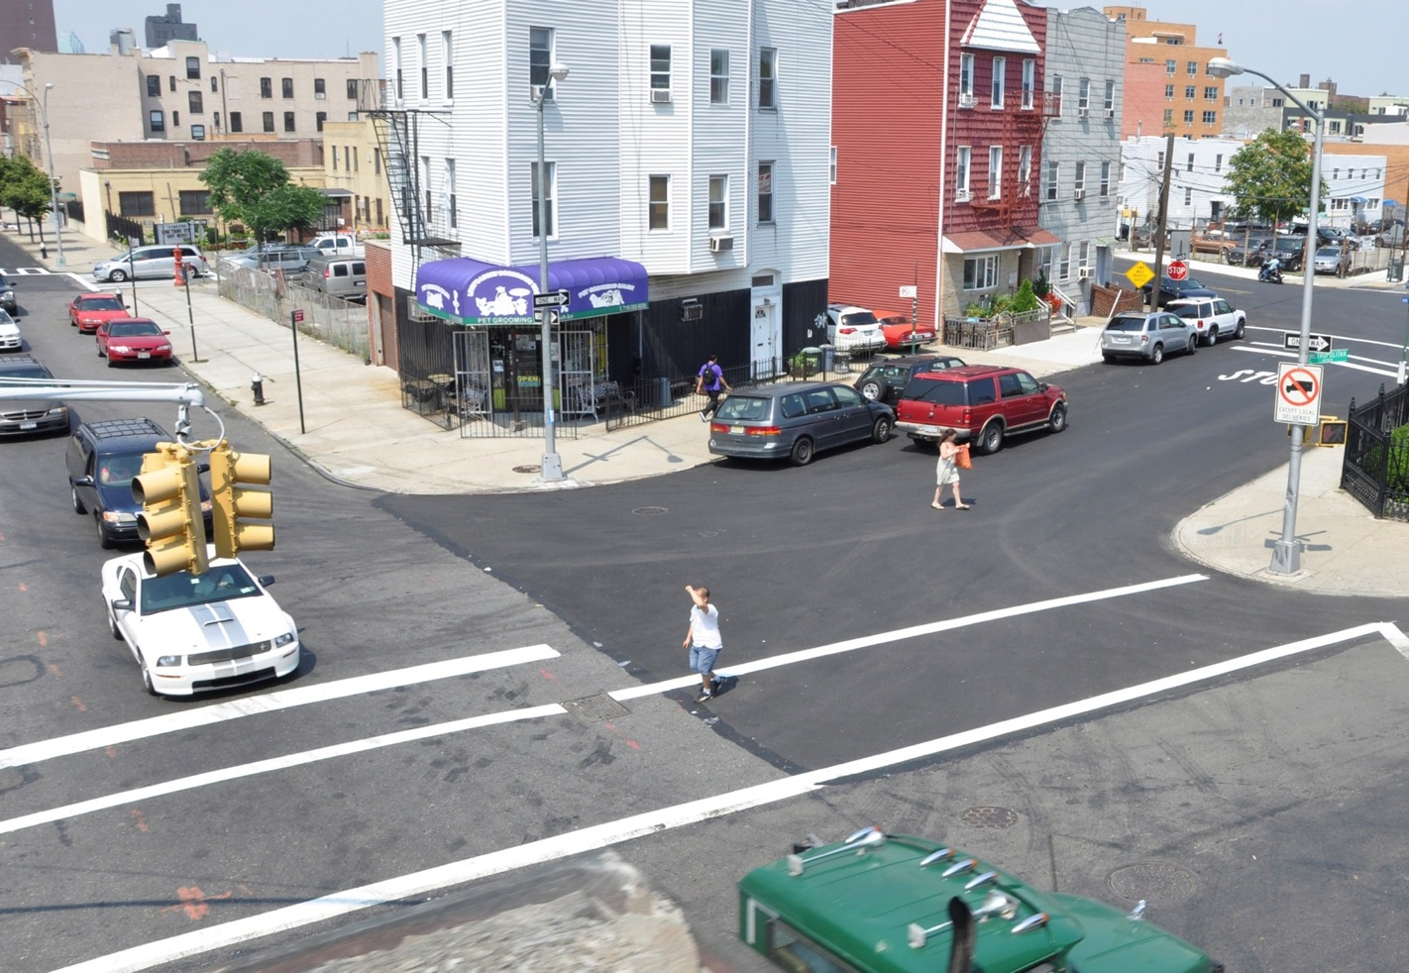

Slide 5
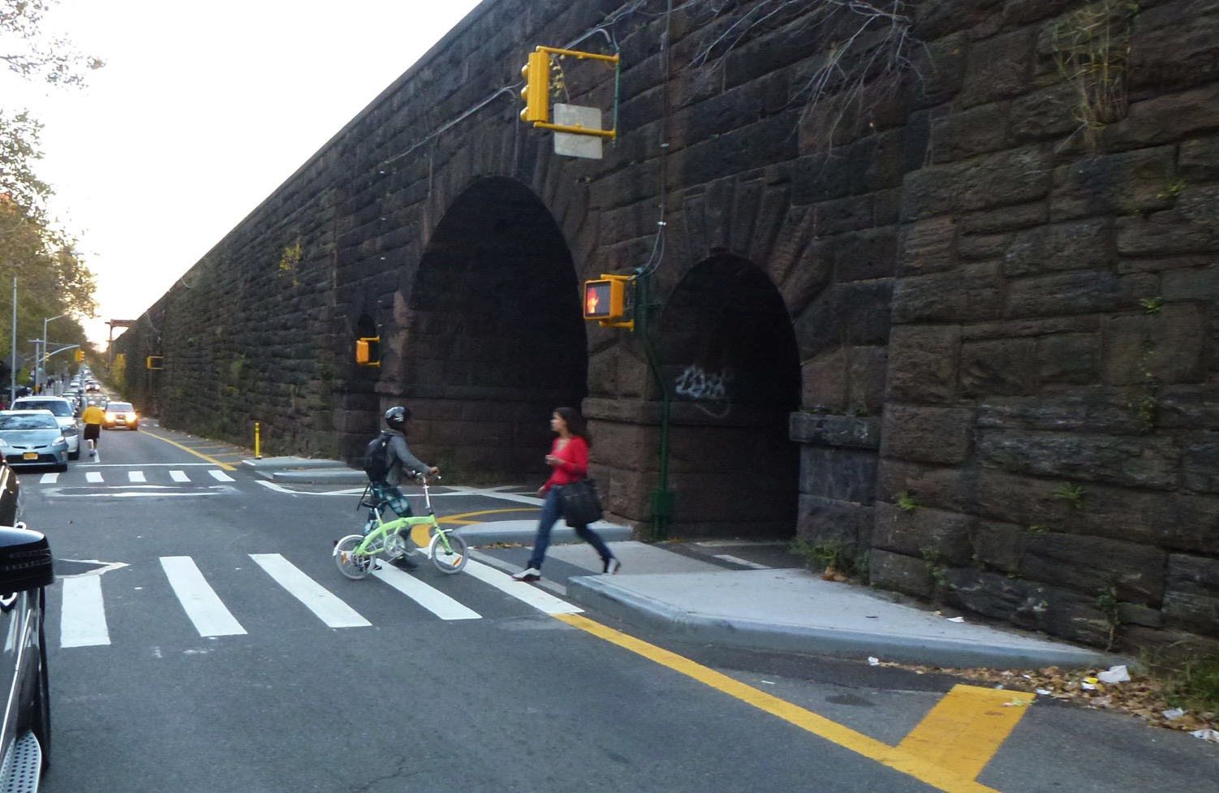
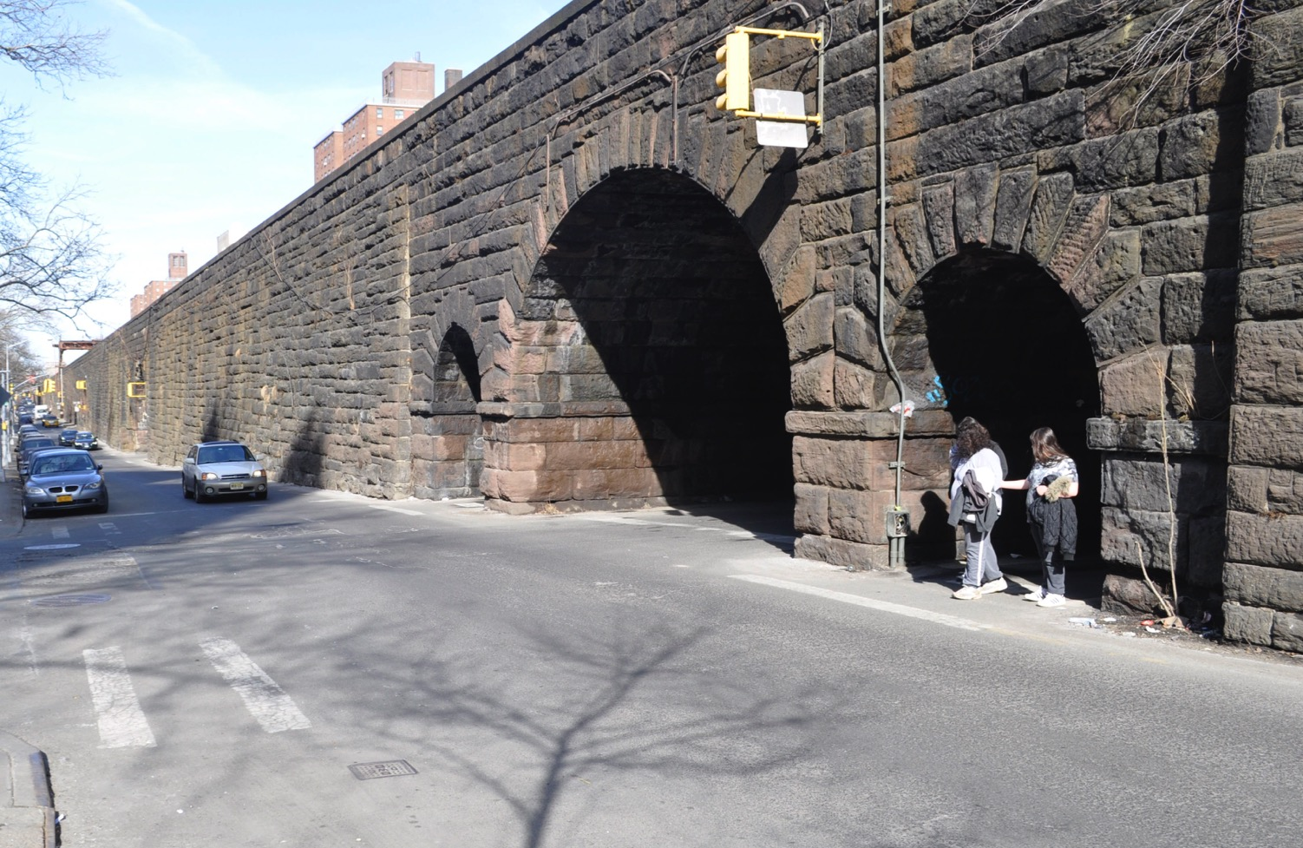

Slide 6
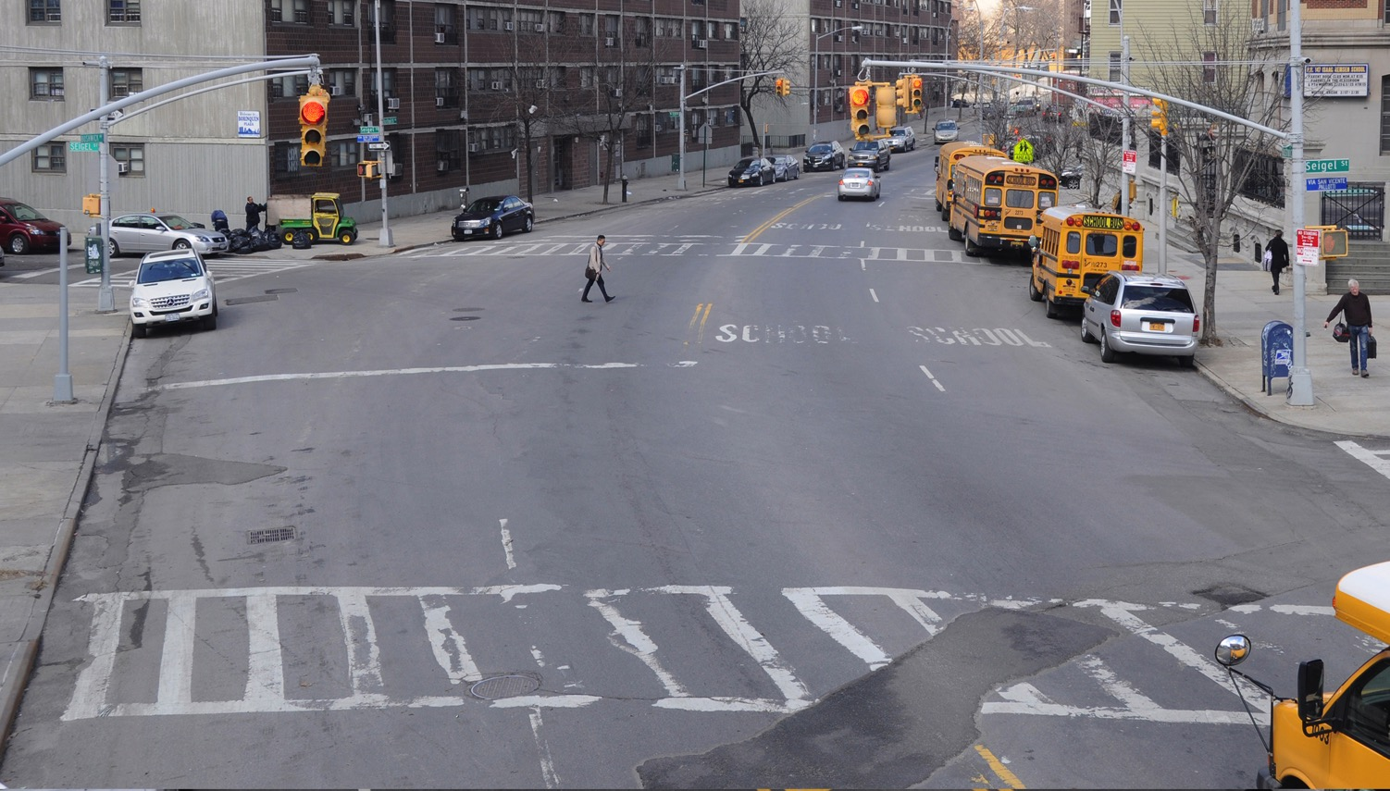
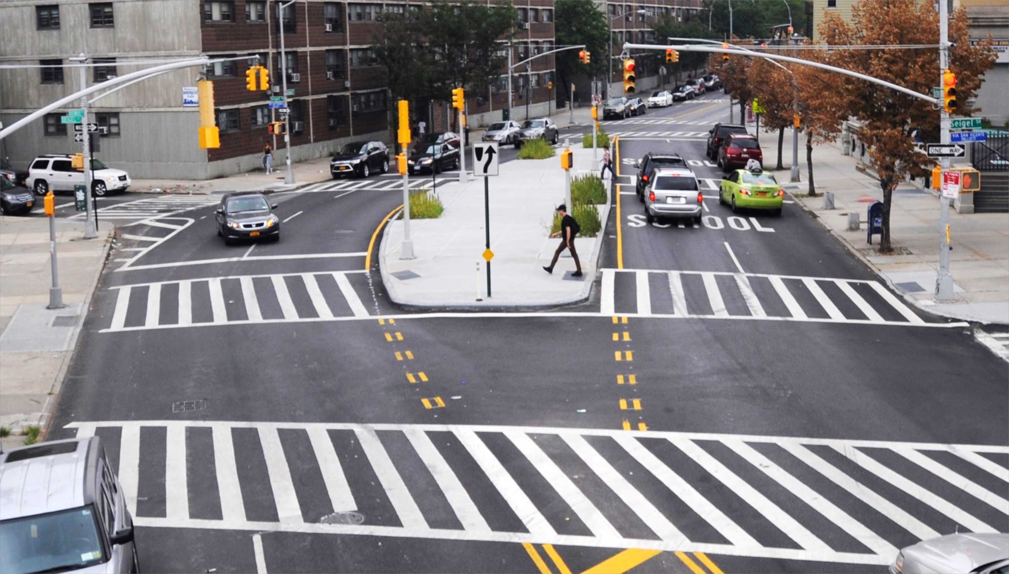

Slide 7
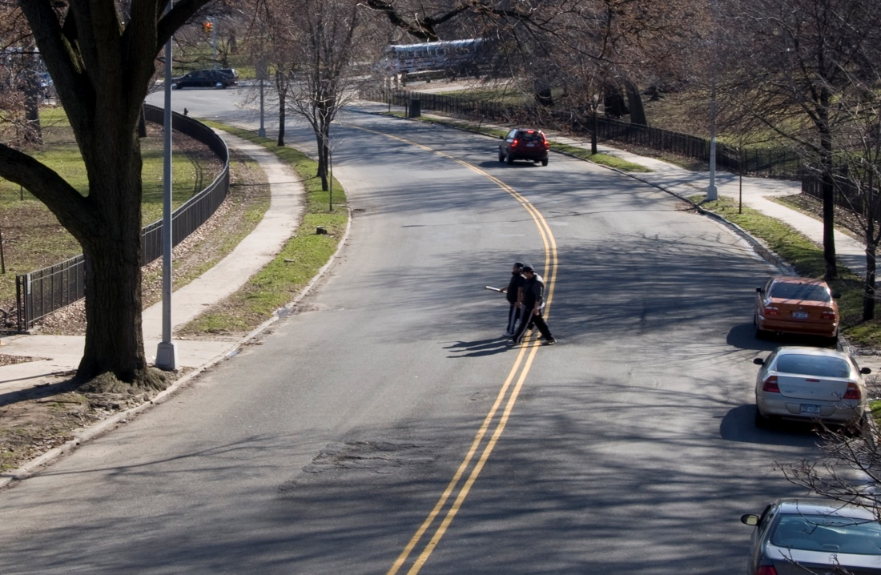
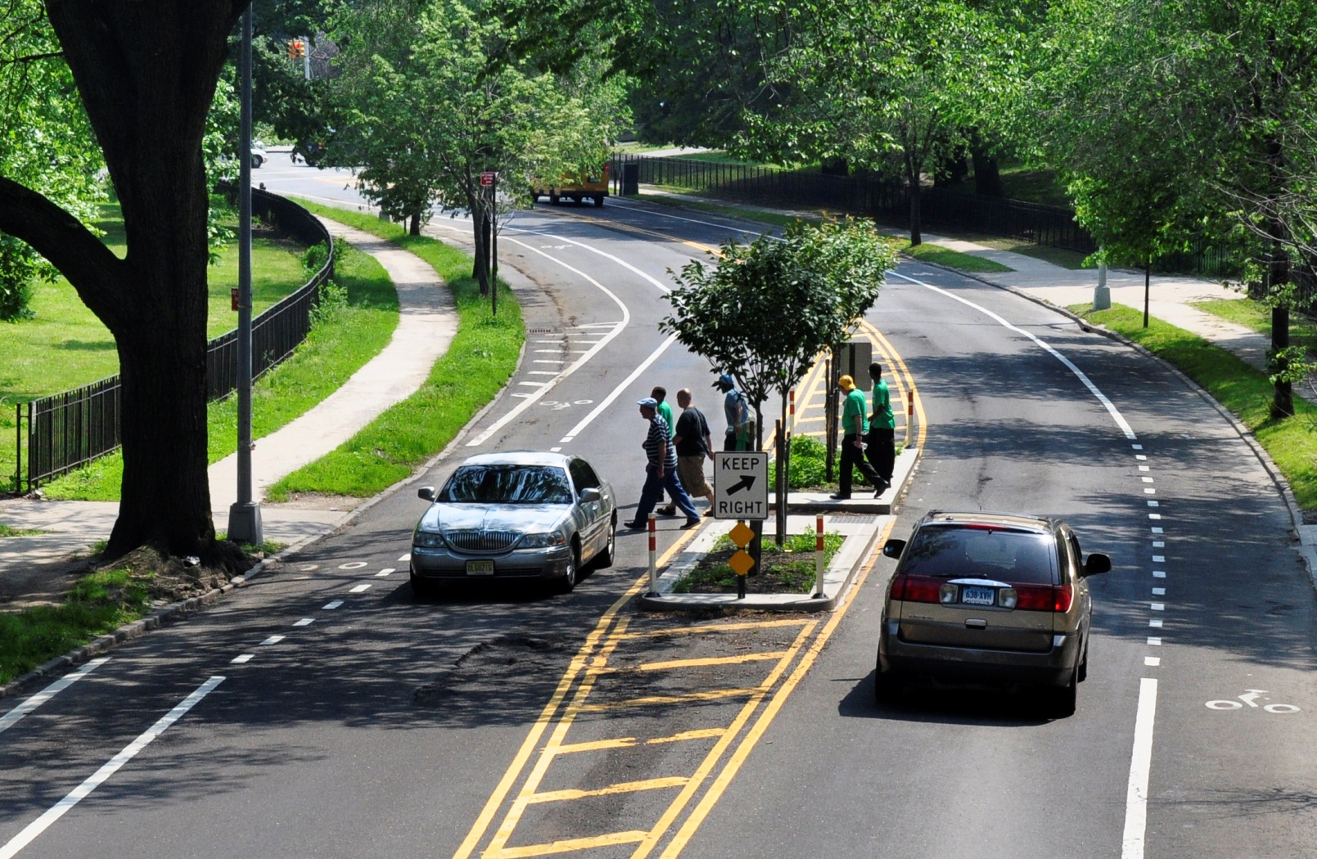

Slide 8
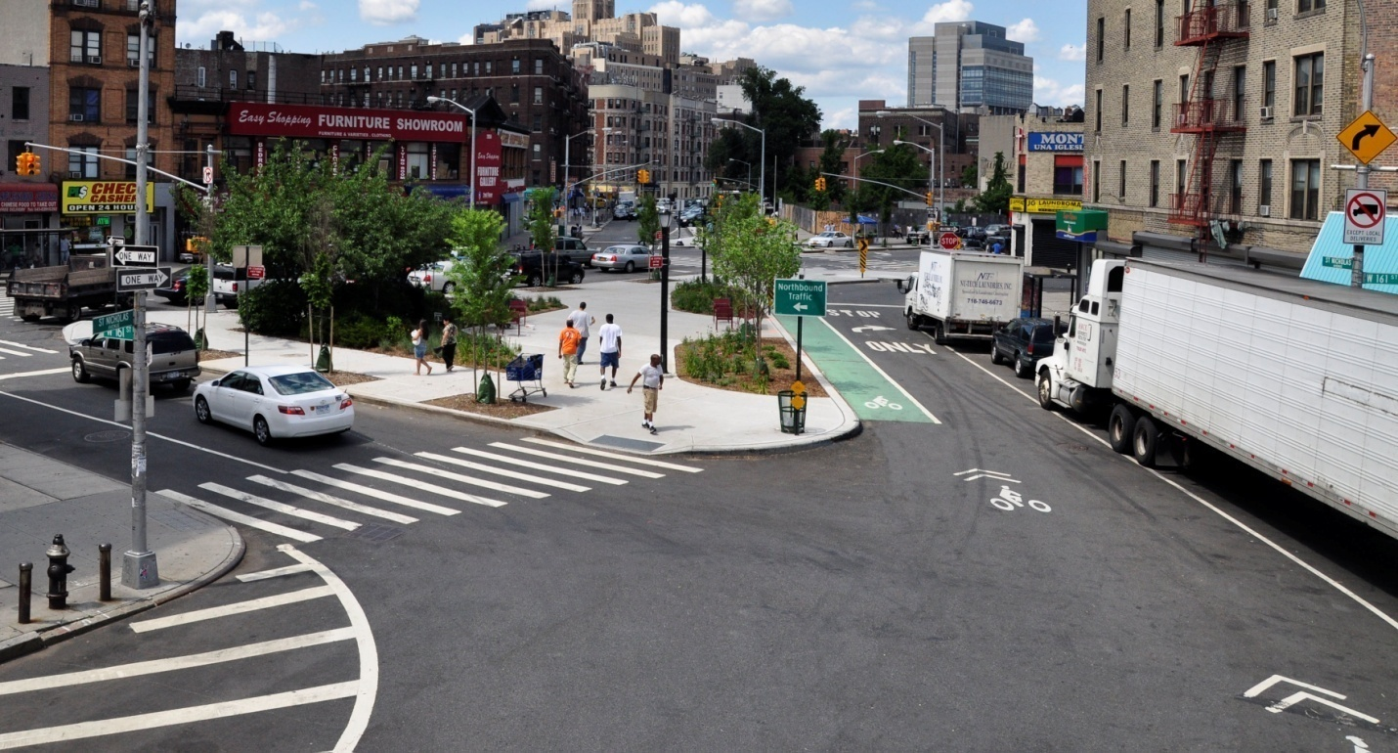
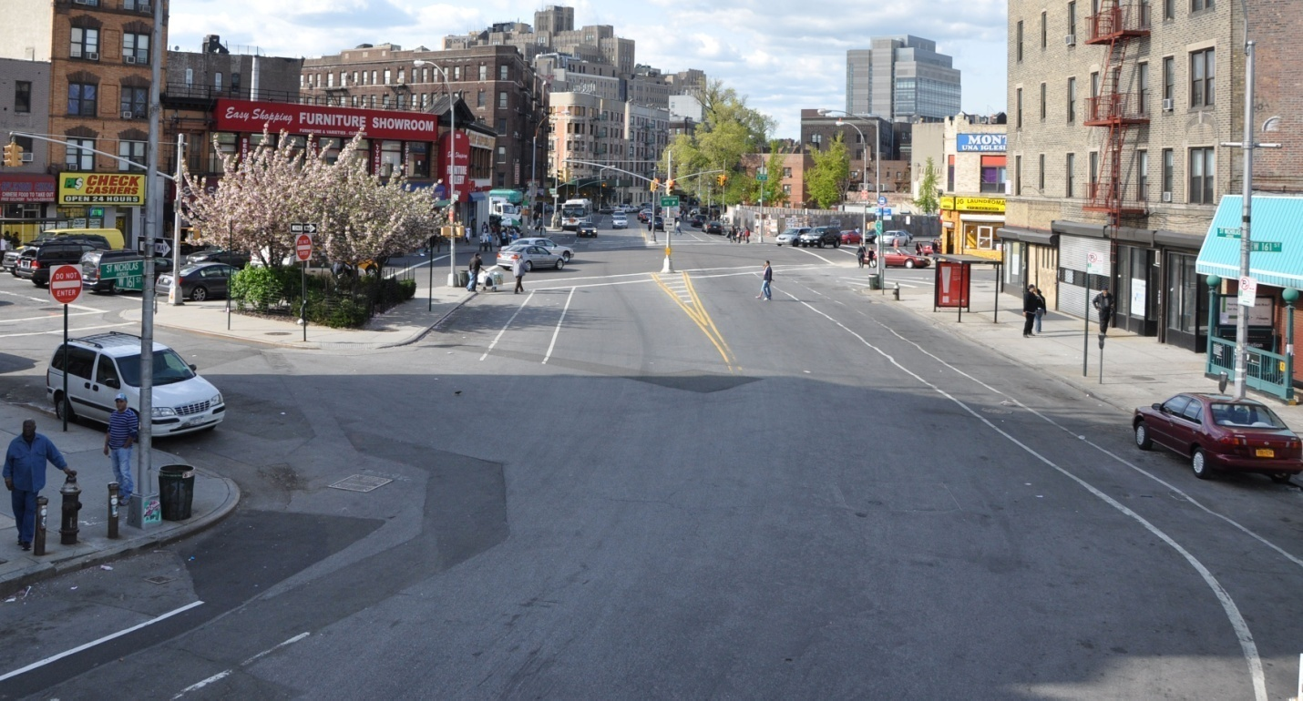

Slide 9
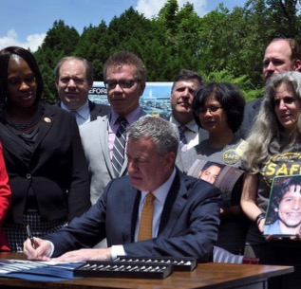
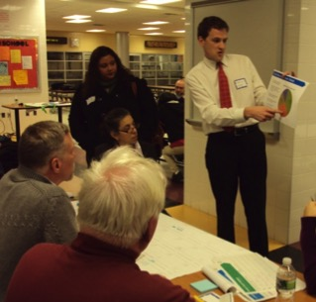
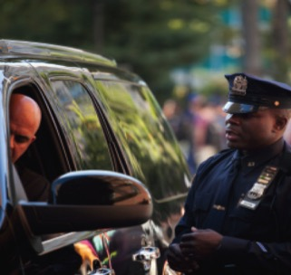
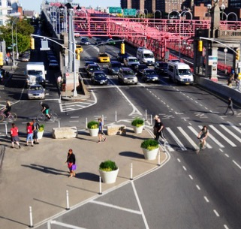
Vision zero NYC
Public Policy + Mindset Change
LEGISLATION
EDUCATION
ENFORCEMENT
ENGINEERING
Multi-Agency Involvement led by City Hall

Slide 10
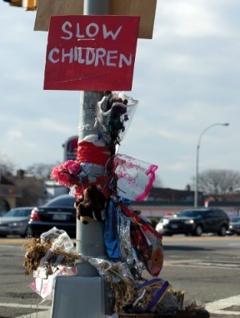
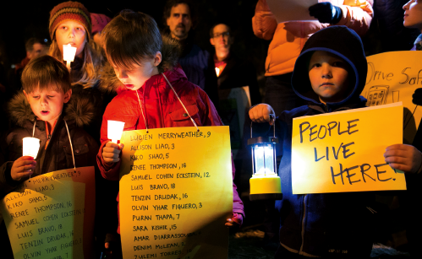

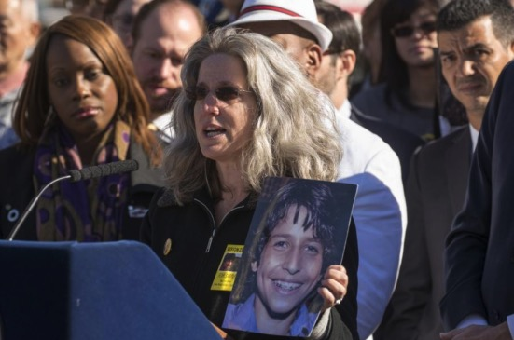
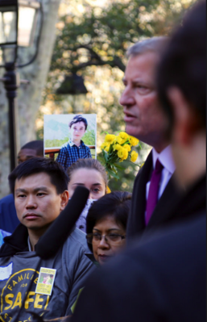
Death and injury on city streets is not acceptable, and we will no longer regard serious crashes as inevitable.
Mayor de Blasio

Slide 11
2
Focus on Dangerous Driving Behaviors:
Three Years of Results

Slide 12
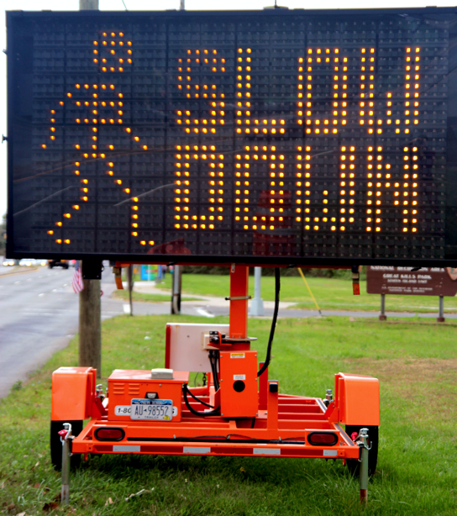
Driving Down Speeding
1 in 4 traffic fatalities in NYC involved unsafe speeds.

Slide 13
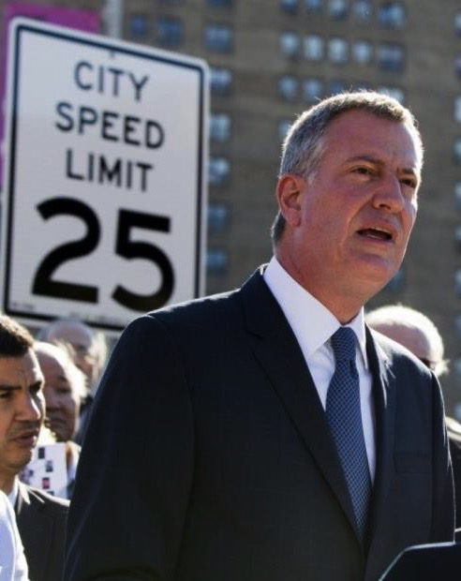

Changes to Speed Limit
In Effect November 7, 2014
25 MPH default speed limit on all NYC streets unless otherwise posted.
LEGISLATION
New York Times, October 1, 1964, p. 25

Slide 14
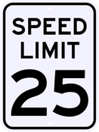

Speeding
Total Summons Given by NYPD
5 year average
prior to Vision Zero:
77,828
2016 versus
prior to Vision Zero:
+76%
ENFORCEMENT

Slide 15
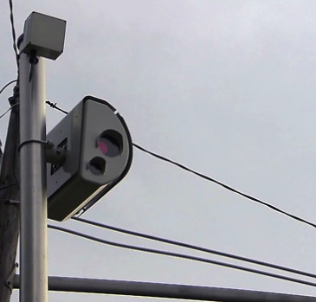
Safety Speed Cameras
Limitations
of NYC Program:
55 percent of fatal and serious injury crashes occur outside of school zones.
NYC Speed Camera Program
20 authorized in 2013
Grew to 140 locations in 2014
$50 fine, no points, must travel 10 mph over limit
Must be located ¼ mile from school and used during school hours
ENFORCEMENT

Slide 16
Safety Speed camera violations
Total Summons (Automated) Given
5 year average
prior to Vision Zero:
0
ENFORCEMENT

Slide 17
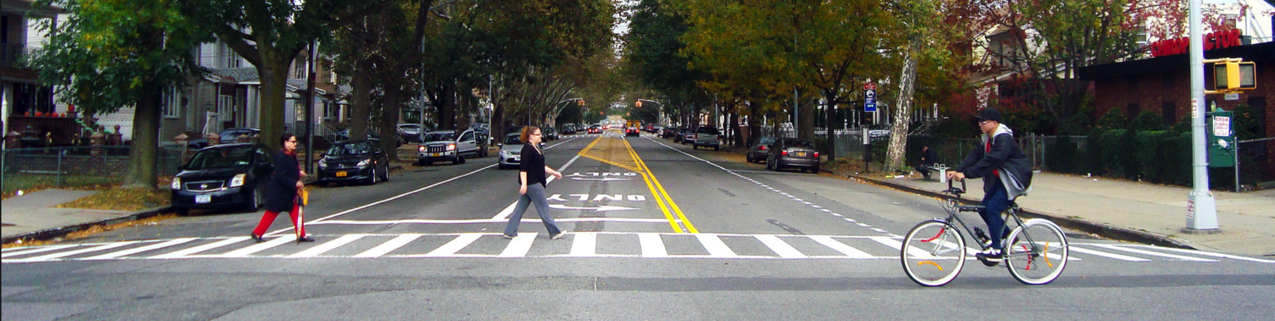
Face down Failure to Yield
78% of serious injuries and fatalities occur in the crosswalk.

Slide 18
Leading pedestrian intervals
Installation Before and After Vision Zero
5 year average
prior to Vision Zero:
16
2016 versus
prior to Vision Zero:
+4,750%
ENGINEERING

Slide 19

Failure to yield
Total Summons Given
5 year average
prior to Vision Zero:
10,808
2016 versus
prior to Vision Zero:
+292%
ENFORCEMENT

Slide 20
3
Using Data to Target Intervention

Slide 21
Where are crashes occurring?

Slide 22
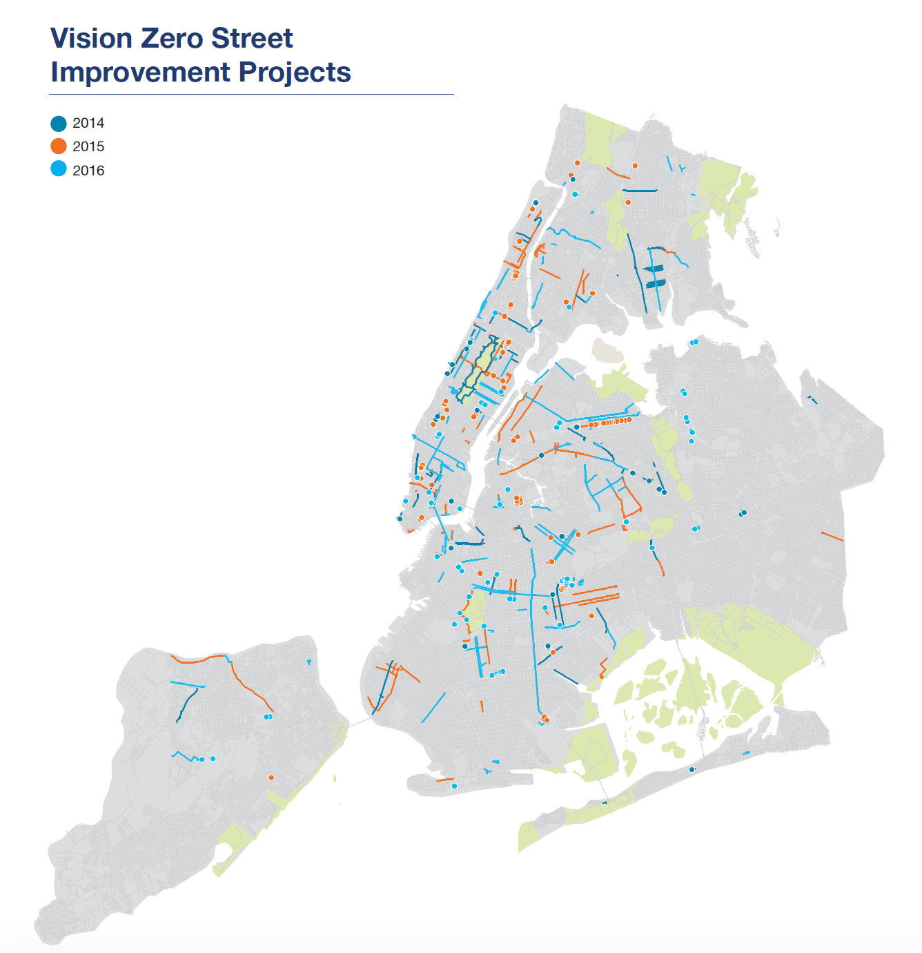
citywide
2016 Safety Improvement Projects
76 corridor and intersection safety projects at Vision Zero priority locations
105 projects completed overall
ENGINEERING

Slide 23
Total safety projects
Before and After Vision Zero
5 year average
prior to Vision Zero:
47
2016 versus
prior to Vision Zero:
+162%
ENGINEERING

Slide 24
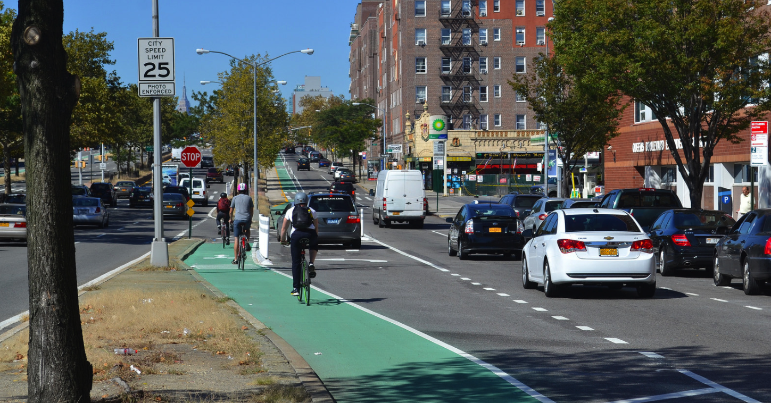

Slide 25
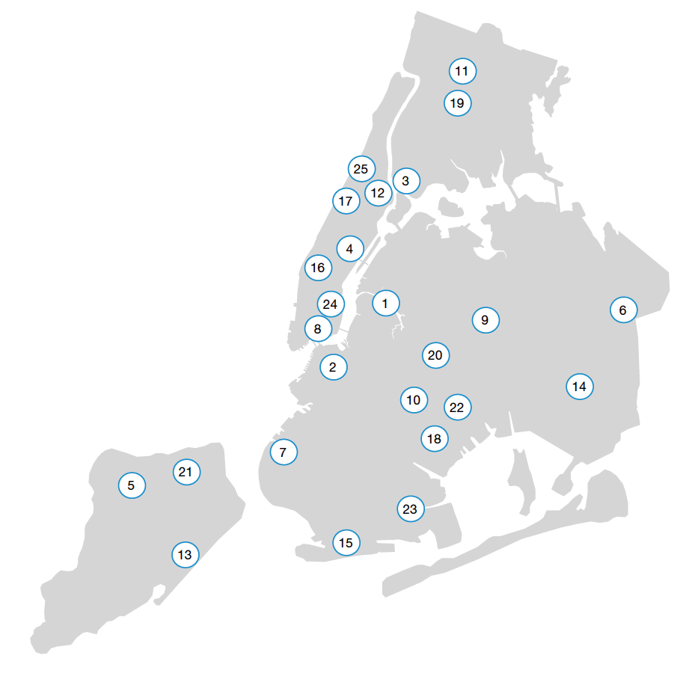
Vision zero street teams
2016
NYPD/DOT Street Team work in 25 high crash neighborhoods
Interact with 870,000 drivers and pedestrians

Slide 26
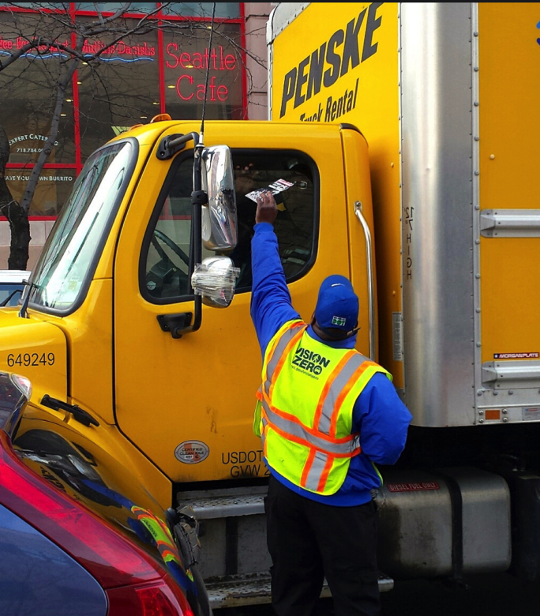
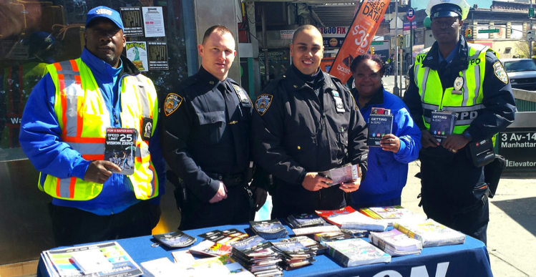
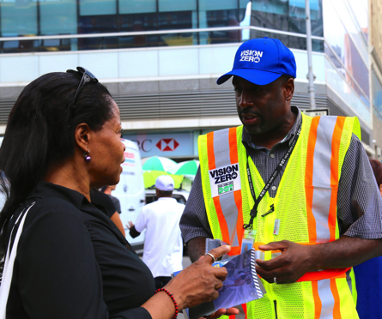
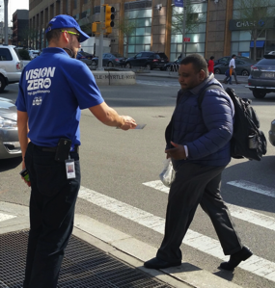

Slide 27
What is causing crashes?

Slide 28
Danger in the crosswalk
Left Hand Turns
Right Turn
Pedestrians and bicyclists are killed or severely injured (KSI) by a left-turning vehicle at over three times the rate (19%) of pedestrian and bicyclist KSI by a right-turning vehicle (6%).
Left Turn
KSI by Turning Vehicle

Slide 29
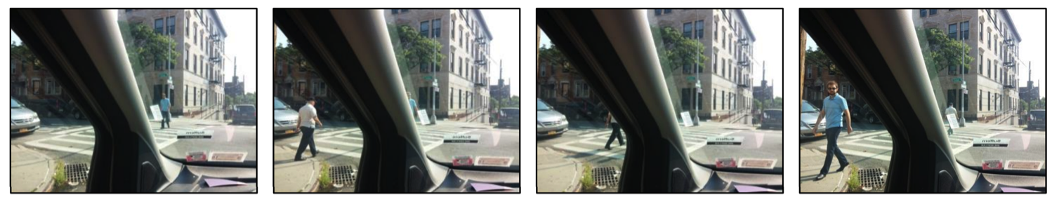
Pedestrians aren’t visible
Vision is blocked by vehicle’s A-pillar

Slide 30



Intra-Agency Collaboration
Data
Engineering
Communication

Slide 31
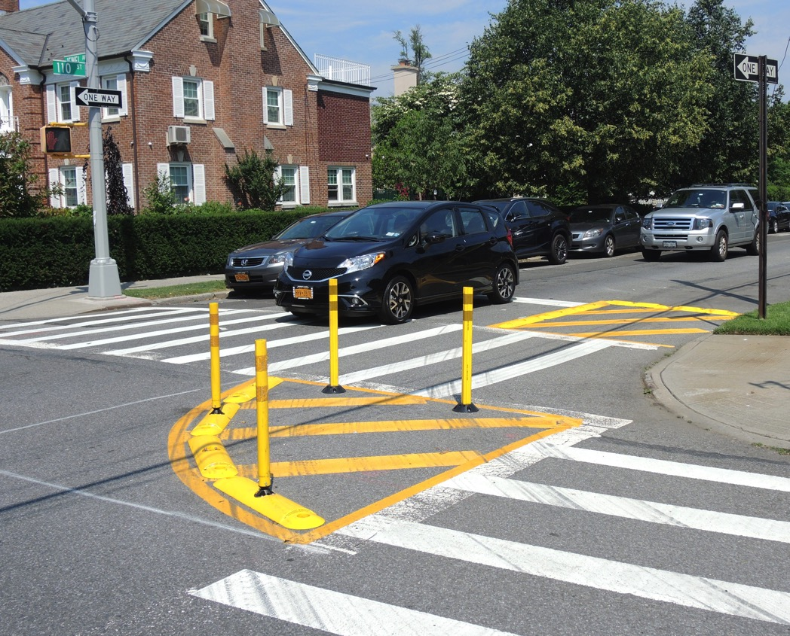
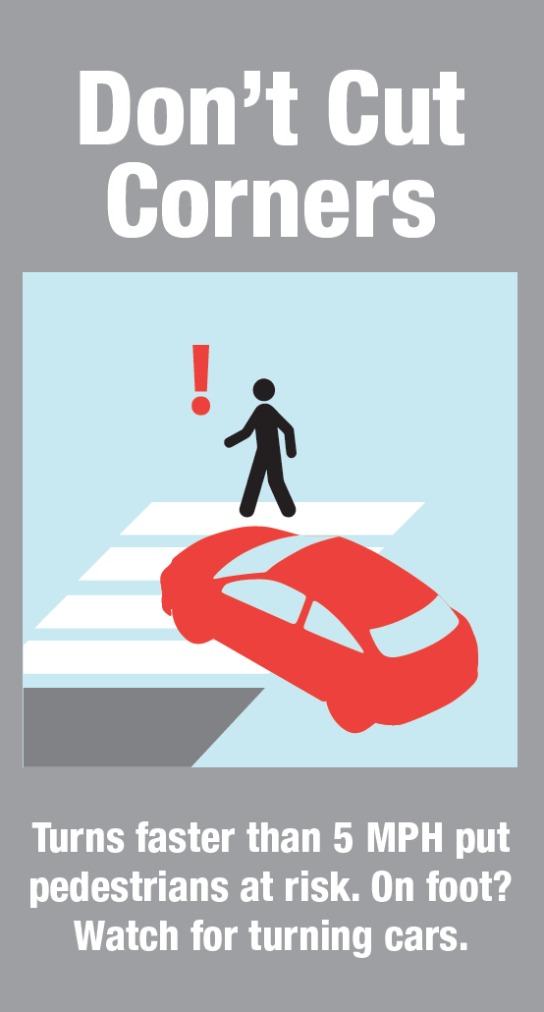

Slide 32
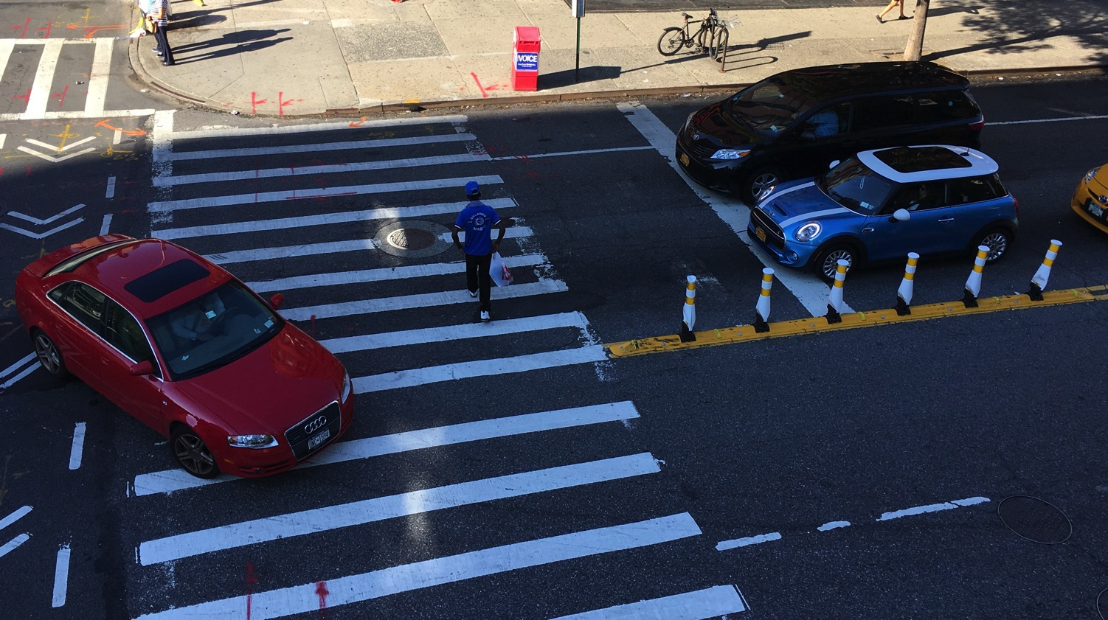

Slide 33
4
Promising Results

Slide 34

Danger after dark
In 2015:
Oct, Nov, Dec
8 pedestrians were killed the week after we ended Daylight Saving Time.
Jan, Feb, Mar, Apr, May, Jun, Jul, Aug, Sept
40% of pedestrian fatalities occurred in October, November and December.

Slide 35



Inter-agency collaboration

Slide 36
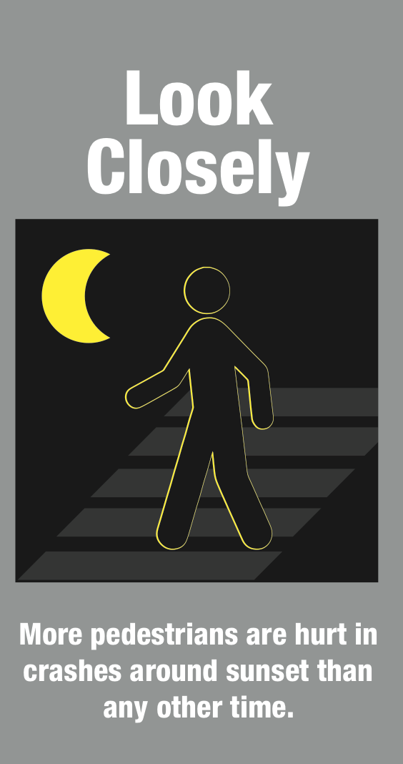
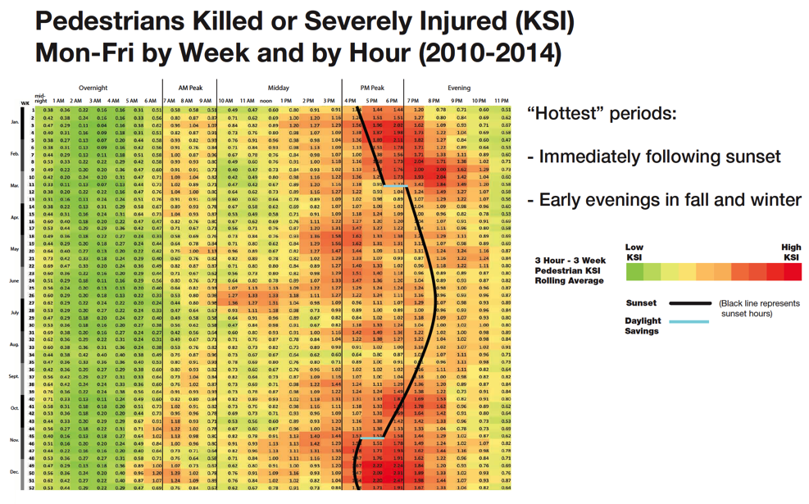

Slide 37
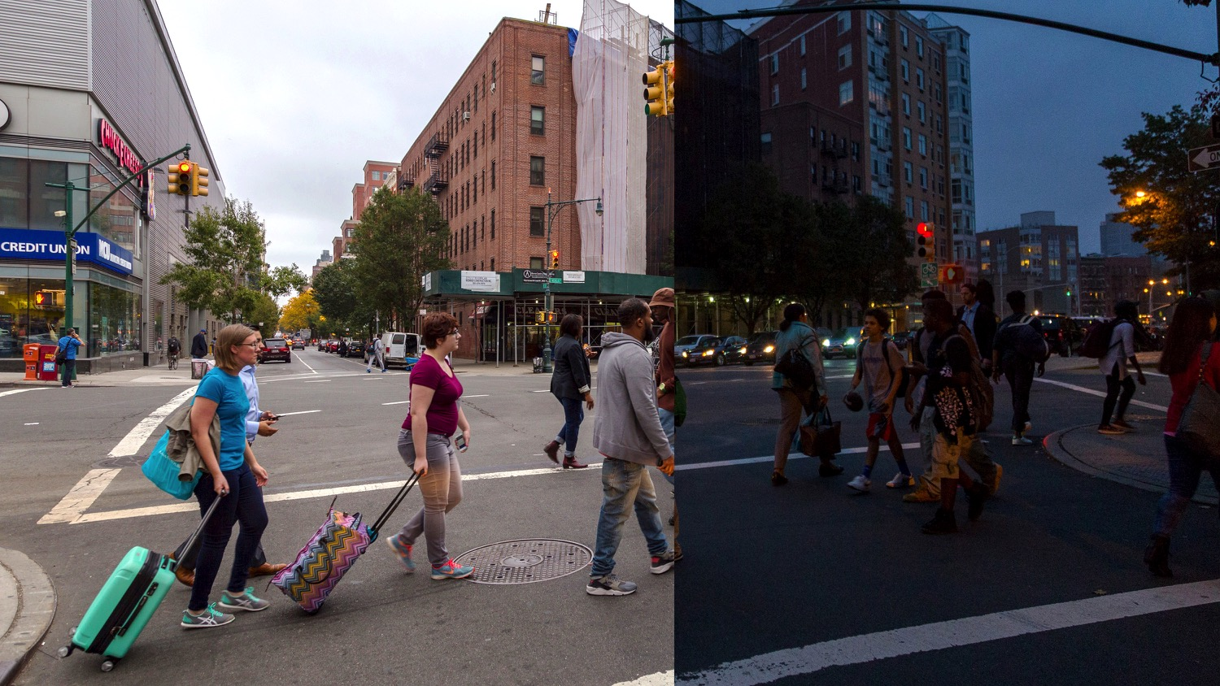

Slide 38
Results of the effort
PEDESTRIAN FATALITIES:
October 27-November 28
That’s a
46%
drop from last year
28
November 16-February 17
26%
decline overall
15
2015
2016

Slide 39
All traffic fatalities
Before and After Vision Zero
303
312
Trendline/forecast based on 2009-2013 fatalities
295
Prior to Vision Zero
5 year average:
271 fatalities
Average increase:
8.1 fatalities/year

Slide 40
pedestrian traffic fatalities
Before and After Vision Zero
177
182
172
Trendline/forecast based on 2009-2013 fatalities
Prior to Vision Zero
5 year average:
157 fatalities
Average increase:
4.9 fatalities/year

Slide 41
2017 Promising Trend
PEDESTRIAN FATALITIES:
Through September 30
That’s a
24%
drop from last year
105
80
All modes fatalities
6%
decline overall
2016
2017

Slide 42




Keys to success
Vision and commitment
at Mayoral level
Partnership with Enforcement
Scalable and effective interventions
Plan and act where
the problems are
Safer Streets
for NYC

Slide 43
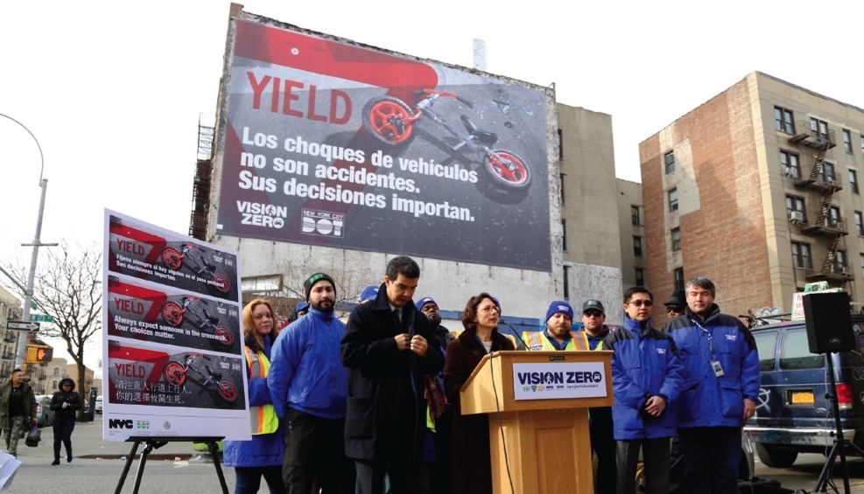


Thank you!
Questions?

